Slide 1
VX2TEXT: End-to-End Learning of Video-Based
Text Generation From Multimodal Inputs
Minjun Song
May 29, 2026
INFONET Journal Club Presentation

Slide 2
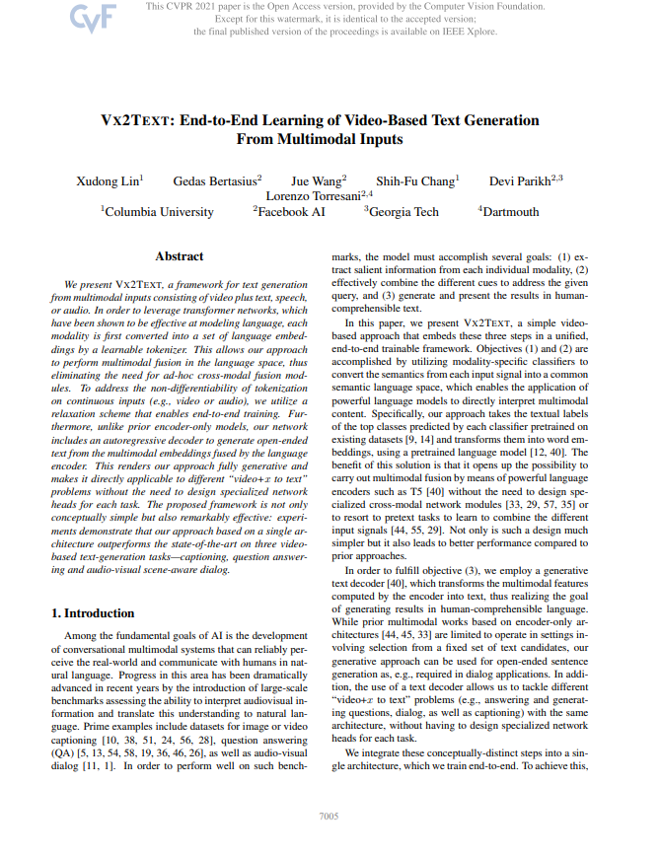
Paper Details
Title: “VX2TEXT: End-to-End Learning of Video-
Based Text Generation From Multimodal Inputs”
Authors: Xudong Lin and 5 others
Affiliation: Columbia University, Facebook AI
Publication: CVPR 2021
Link: https://openaccess.thecvf.com/content/
CVPR2021/papers/Lin_Vx2Text_End-to-End_Learning_of_Video-Based_Text_Generation_From_Multimodal_Inputs_CVPR_2021_paper.pdf
Notes:
Title:
VX2TEXT: End-to-End Learning of Video-Based Text Generation From Multimodal Inputs
Authors:
Columbia University, Facebook AI
Core Contribution:
A framework that converts multimodal inputs (video, audio, speech) into a unified language space for open-ended text generation using a standard transformer architecture

Slide 3
Motivation and Problem Statement
The Goal:
  Develop conversational AI that perceives the real world (multimodal) and communicates naturally
Existing Challenges:
  Prior methods rely on complex, ad-hoc cross-modal fusion modules
  Many SOTA models require costly pretext training on millions of samples to learn multimodal representations
  Discriminative models are often limited to selecting answers from a fixed set

Slide 4
Proposed Framework
Multimodal fusion entirely in
language space
Continuous signals mapped via
differentiable tokenization
Encoder-decoder
for
unified handling
Notes:
Concept:
- Perform multimodal fusion entirely in the language space
Architecture:
- A generative encoder-decoder (based on T5)
Workflow:
- Extract semantics using modality-specific classifiers
- Convert these semantics into language embeddings via Differentiable Tokenization
- Fuse embeddings in a language encoder and generate text with an autoregressive decoder

Slide 5
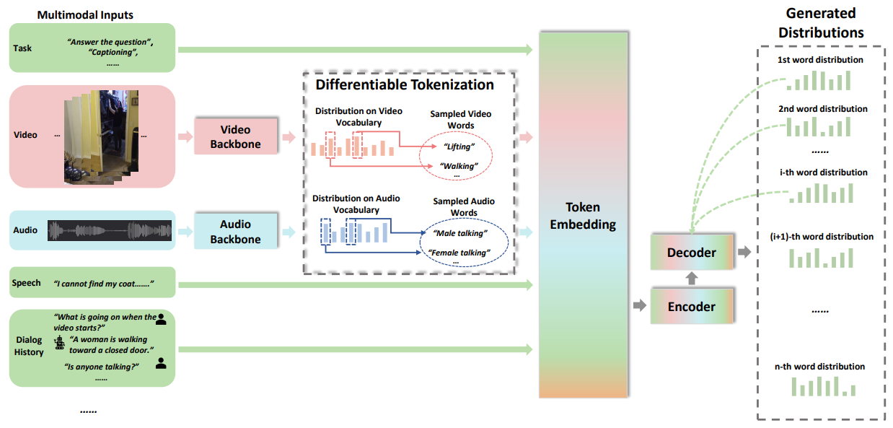
Proposed Framework
Notes:
Concept:
- Perform multimodal fusion entirely in the language space
Architecture:
- A generative encoder-decoder (based on T5)
Workflow:
- Extract semantics using modality-specific classifiers
- Convert these semantics into language embeddings via Differentiable Tokenization
- Fuse embeddings in a language encoder and generate text with an autoregressive decoder

Slide 6

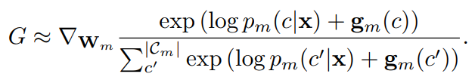
Differentiable Tokenization
The Mechanism:
  Uses pretrained modality-specific classifiers to predict category labels:
Solving Non-Differentiability:
  Uses a relaxation scheme involving Gumbel-Softmax trick and Straight-Through Estimator:
Benefit:
  Enables the entire system—including the video and audio backbones—to be trained end-to-end for the final text generation objective
Notes:
To process continuous signals like video and audio, the framework uses a Differentiable Tokenization scheme
W_{m} = learned embedding weights
c_{m}^{k} = one-hot vector of k-th sampled category from modality m
g_{m} = -log(-log(u)) where u ~ Uniform(0,1)
p_{m} = probability distribution ∈ R^{1*Cm}
G= gradient for each category c during back propagation

Slide 7
Unified Handling
Generative Tasks:
  Handles video captioning and dialog by generating coherent sentences using Beam Search or Greedy Decoding
Discriminative Tasks:
  Handles multiple-choice QA (e.g., TVQA) by treating it as a generative task—it evaluates the probability of each candidate answer and selects the highest
Advantage:
  No need for specialized network heads for different tasks; one architecture fits all
Notes:
As an encoder-decoder model, VX2TEXT achieves Unified Task Handling, meaning it can perform diverse "video+x to text" tasks using a single, unchanging network

Slide 8
Experimental Setup
Benchmarks:
  AVSD: Audio-visual scene-aware dialog (short answer)
  TVQA: Video question answering (multiple choice)
  TVC: Video captioning (caption)
Implementation Details:
  R(2+1)D-34 as video backbone, pretrained on Kinetics (400 action categories)
  CNN14 as audio backbone, pretrained on AudioSet (527 audio categories)
  T5-base as text transformer
Notes:
Audio-visual scene-aware dialog:
- Task is to provide as much information as possible about the content of the video.
Video question-answering:
- Task is to answer a multiple-choice question about the clip.
Video captioning:
- Task is to create a descriptive caption about the clip.
R(2+1)D-34:
- 34-layer 3D CNN designed for video action recognition and spatiotemporal feature extraction.
- Factorizes standard 3D convolutions into separate 2D spatial and 1D temporal operations to improve performance and computational efficiency.
CNN14:
- 14-layer CNN designed for audio pattern recognition (input as 2D log-Mel spectrogram).
- Consists of 5 blocks of convolutional filters, coupled with batch normalization and ReLU activations.
T5-base:
- 220M version of the Text-to-Text Transfer Transformer (T5) model developed by Google AI
- uses standard encoder-decoder Transformer architecture, converting all NLP tasks into unified "text-to-text" format

Slide 9
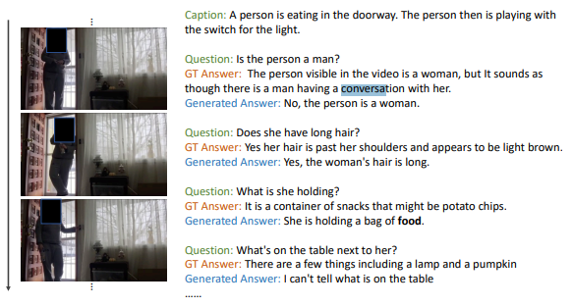
Task Example (AVSD)
Notes:
AVSD (Audio-visual scene-aware dialog)
- It is very encouraging that although our model takes some text inputs, e.g., dialog histories or speech transcripts, the generated text does include information from other modalities.

Slide 10
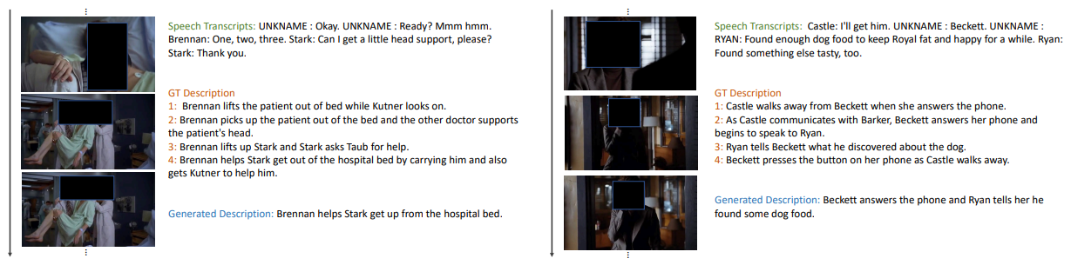
Task Example (TVC)
Notes:
TVC (Video captioning)
- It is very encouraging that although our model takes some text inputs, e.g., dialog histories or speech transcripts, the generated text does include information from other modalities.

Slide 11
Experiment Results – Ablation
Multimodal fusion entirely in
language space
Continuous signals mapped via
differentiable tokenization
Encoder-decoder
for
unified handling
Notes:
Concept:
- Perform multimodal fusion entirely in the language space
Architecture:
- A generative encoder-decoder (based on T5)
Workflow:
- Extract semantics using modality-specific classifiers
- Convert these semantics into language embeddings via Differentiable Tokenization
- Fuse embeddings in a language encoder and generate text with an autoregressive decoder

Slide 12
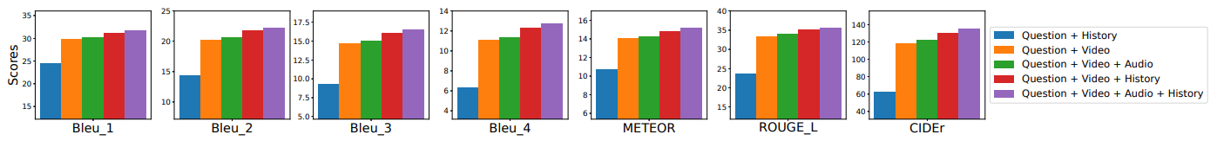
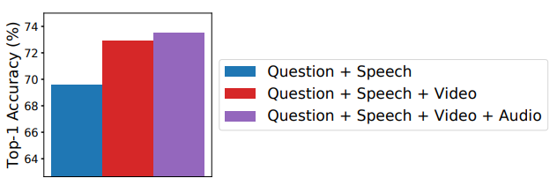
Experiment Results – Ablation (Multi-Modality)
AVSD
TVQA
Notes:
Modality Importance:
- Experiments show that adding video and audio consistently improves performance over text-only (speech/history) baselines
Differentiable vs. Frozen:
- Differentiable Tokenization significantly outperforms "Frozen Tokenization" and "Multimodal Feature Embedding"
Generative Advantage:
- The generative model is vastly superior to discriminative versions, particularly when training data is limited (e.g., a 29.9% accuracy gap when using only 10% of training data)

Slide 13
Experiment Results – Ablation (Differentiable Tokenization)
Method | Input Type | Backbone Status
Multimodal Feature Embedding | Continuous predictions (via fully-connected layer) | Trained end-to-end
Frozen Tokenization | Textual labels/names (top predictions) | Frozen (Not trained)
Differentiable Tokenization | Textual labels/names (sampled categories) | Trained end-to-end
Notes:
Modality Importance:
- Experiments show that adding video and audio consistently improves performance over text-only (speech/history) baselines
Differentiable vs. Frozen:
- Differentiable Tokenization significantly outperforms "Frozen Tokenization" and "Multimodal Feature Embedding"
Generative Advantage:
- The generative model is vastly superior to discriminative versions, particularly when training data is limited (e.g., a 29.9% accuracy gap when using only 10% of training data)

Slide 14
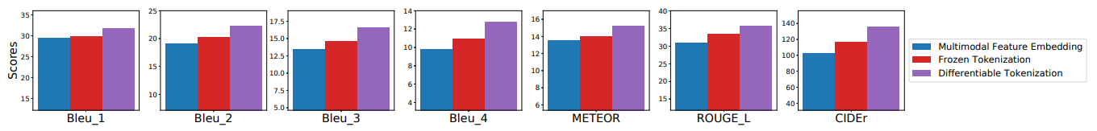
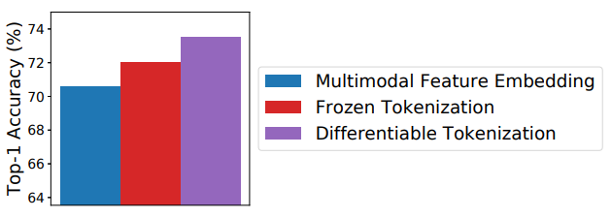
Experiment Results – Ablation (Differentiable Tokenization)
AVSD
TVQA
Notes:
Modality Importance:
- Experiments show that adding video and audio consistently improves performance over text-only (speech/history) baselines
Differentiable vs. Frozen:
- Differentiable Tokenization significantly outperforms "Frozen Tokenization" and "Multimodal Feature Embedding"
Generative Advantage:
- The generative model is vastly superior to discriminative versions, particularly when training data is limited (e.g., a 29.9% accuracy gap when using only 10% of training data)

Slide 15
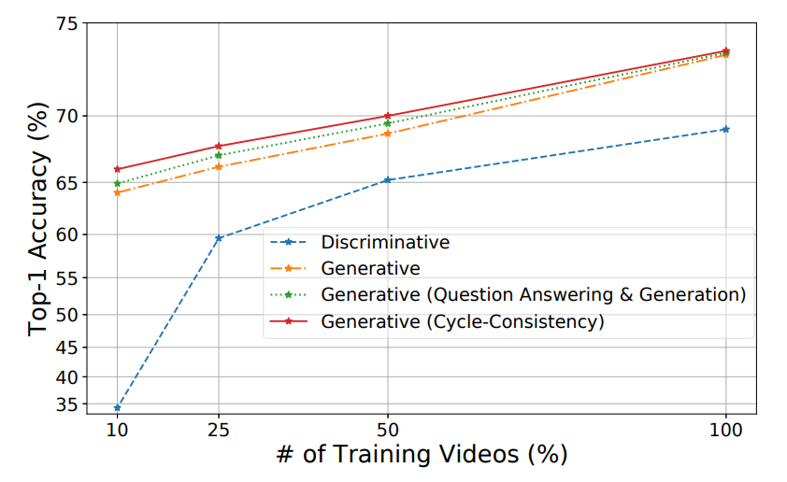
Experiment Results – Ablation (Unified Model)
Notes:
Modality Importance:
- Experiments show that adding video and audio consistently improves performance over text-only (speech/history) baselines
Differentiable vs. Frozen:
- Differentiable Tokenization significantly outperforms "Frozen Tokenization" and "Multimodal Feature Embedding"
Generative Advantage:
- The generative model is vastly superior to discriminative versions, particularly when training data is limited (e.g., a 29.9% accuracy gap when using only 10% of training data)

Slide 16
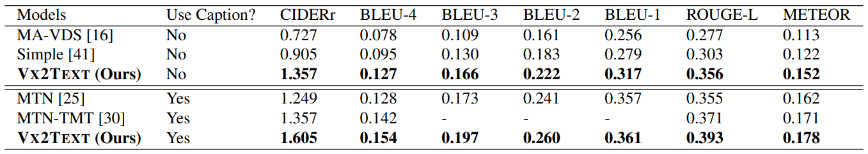
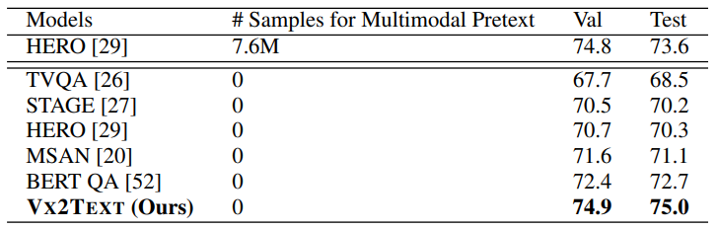
Experiment Results (SOTA Comparison)
AVSD
TVQA
Notes:
Performance:
VX2TEXT outperforms SOTA on all three tasks
Efficiency:
It beats models like HERO even when HERO uses expensive pretraining on 7.6 million samples (which takes 3 weeks), while VX2TEXT requires no multimodal pretext pretraining
Dialog Results:
On the AVSD test set, VX2TEXT achieved the best results with and without captions

Slide 17
Summary
VX2TEXT provides a conceptually simple yet effective way to handle multimodal inputs by leveraging the power of pretrained LMs through differentiable tokenization

