Slide 1
Reasoning with Language Model Is Planning
with World Model (RAP)
Youngu Lee
August 14, 2026
INFONET Journal Club Presentation
Notes:
Today I will talk about the paper “Reasoning with Language Model Is Planning with World Model.” It was published at EMNLP 2023. The paper presents RAP, which means Reasoning via Planning. The main question is simple. A normal language model often makes one long line of thought. What if it could instead predict the next state, compare several paths, and choose a better path?

Slide 2
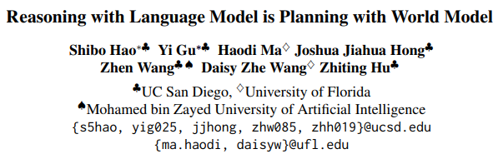
Paper
Authors: Shibo Hao, Yi Gu, Haodi Ma, Joshua Jiahua Hong, Zhen Wang, Daisy Zhe Wang, Zhiting Hu
Field: LLM Reasoning / Planning / World Models
Published in: Proceedings of EMNLP 2023, pp. 8154-8173
Year: 2023 | ACL Anthology: 2023.emnlp-main.507
Notes:
This paper was written by Shibo Hao, Yi Gu, and five other researchers. They are from UC San Diego, the University of Florida, and Mohamed bin Zayed University of Artificial Intelligence. The paper was presented at EMNLP 2023. The authors did not train a new model from the beginning. They used a language model that was already trained and changed how it solved a problem. The same model has two jobs. First, it suggests the next reasoning step. Second, it acts as a world model and predicts what will happen after that step. A search method then compares the possible paths. So the key idea is a new way to use a model while it is answering, not a new model structure. In other words, RAP changes the work around the model instead of changing the model itself.

Slide 3
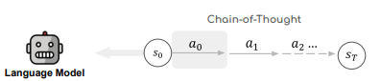
Why linear reasoning breaks on long horizons
LLMs generate reasoning traces autoregressively.
Key limitations:
  No explicit world state after each action
  No reward to evaluate intermediate steps
  Early mistakes propagate through a single chain
As tasks get longer:
  The search space grows rapidly
  Self-consistency samples complete paths blindly
  Models cannot strategically backtrack or revise
Notes:
The paper starts with a problem in normal Chain-of-Thought reasoning. Chain-of-Thought asks a model to solve a task one step at a time. The model writes the first step, then the next step, and keeps going until it gives an answer. This works well for many tasks, but it has three clear problems. First, the current state of the problem is often not shown in a clear form. We can read the text, but it may be hard to know exactly what changed after each step. Second, the model does not give a clear score to a partly finished path. It cannot easily tell if the first few steps are good or bad. Third, an early mistake can hurt every later step. A small wrong choice at the start may look harmless, but it can make the final answer completely wrong. The model usually keeps moving forward and does not go back. Self-Consistency tries several full answers and uses a vote. This can help, but it still does not choose which half-finished path should get more time. RAP tries to fix this by treating reasoning like a planning task with states, actions, scores, and search.

Slide 4
Design Goals of RAP
1. Explicit State Transitions
Represent reasoning as interleaved states and actions.
2. Look-Ahead with a World Model
Reuse the same LLM to predict each next state.
3. Reward-Guided Search
Score feasibility, confidence, usefulness, and progress.
4. Deliberate Planning with MCTS
Balance exploration and exploitation over reasoning traces.
Can inference-time planning make a frozen LLM reason more reliably?
Notes:
RAP has four main parts. First, it writes the reasoning process as clear states and actions. A state shows where the problem is now, and an action is the next step the model may take. Second, the language model also works as a world model. It predicts the next state after an action. Third, RAP gives each step a reward, or score. The score shows whether the action makes sense and whether it moves closer to the goal. Fourth, RAP uses a planning method to search through more than one reasoning path. The base language model is frozen, which means it is not trained again. The search process, not new training, is meant to be the main source of improvement. The paper asks whether a better search process can make the same model reason more reliably.

Slide 5
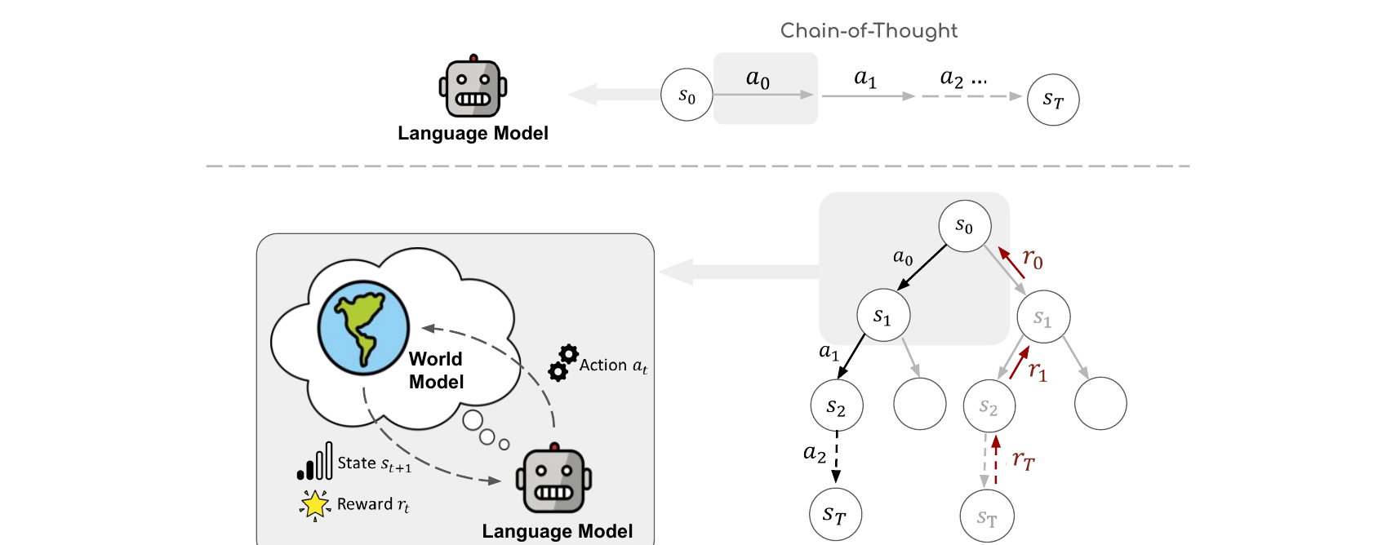
RAP turns linear reasoning into reward-guided planning
Chain-of-Thought follows one path. RAP predicts the next state and gives each path a score.
By comparing many paths, RAP can go back and choose a better one.
Notes:
This picture shows the main idea. The top part is normal Chain-of-Thought. The model starts at the first state and chooses action a-zero, then a-one, and then a-two. It follows one line until it reaches the final state. It does not clearly compare other actions. The bottom part is RAP. Here, the reasoning process becomes a tree. At each state, the language model suggests several next actions. The same model then acts as a world model and predicts the next state for each action. RAP gives every move a reward. The search grows paths with better scores, but it can also check a less-used path. The gray branches show choices that the search can compare before it spends more time on one path. If one path looks bad, it can return to an earlier state and try another path. So RAP does not have to trust the first full answer. It keeps asking which unfinished path should be checked next. One model is used for both jobs, but a search method controls the whole process. This is the main change: reasoning becomes a set of choices instead of one fixed line of text.

Slide 6
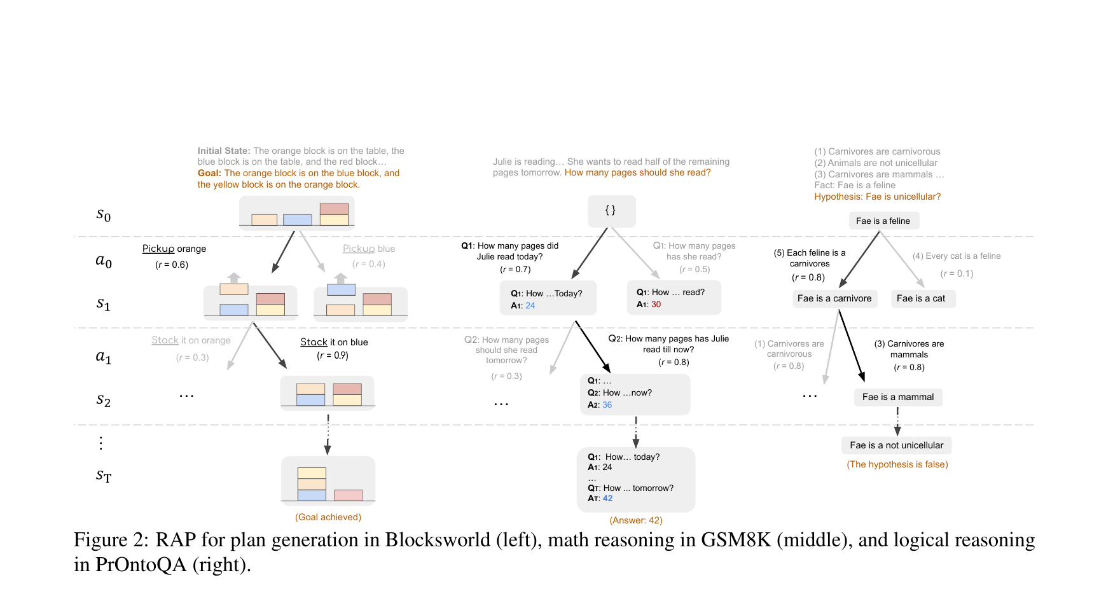
One state-action framework spans three reasoning domains
Blocksworld: configurations and valid block moves
GSM8K: intermediate values and sub-questions
PrOntoQA: current facts and inference rules
Notes:
The meaning of state and action changes for each task. In Blocksworld, the state is the current place of every block. An action is a move such as pick up, put down, stack, or unstack. The world model predicts where the blocks will be after the move. In GSM8K, the state contains the numbers and math results found so far. An action is the next small question or the next math step. In PrOntoQA, the state is the set of facts we are using. An action uses a logic rule to make a new fact. These tasks look very different, but RAP uses the same simple form for all of them: current state, next action, predicted state, and reward. This common form lets the authors use one search method even though the three tasks need very different steps. However, a person still has to decide what a good state and action look like for each new task.

Slide 7
Rewards turn partial traces into searchable signals
Action Likelihood
Uses the LLM's next-action probability as a prior.
State Confidence
Samples next-state predictions and measures agreement.
Self-Evaluation
Asks the LLM whether the reasoning step is correct.
Task-Specific Heuristics
Rewards progress toward a domain goal.
Reward Combinations
Weighted rewards vary by task and reasoning stage.
No Training Loss
RAP guides inference; the base LLM remains frozen.
Likelihood + Confidence + Self-evaluation + Task progress
Notes:
RAP needs a score before it reaches the final answer. The paper uses four kinds of scores. The first is action likelihood. This asks whether the language model thinks the action is a natural next step. The second is state confidence. The world model predicts the next state more than once. If the answers are similar, RAP has more trust in that state. The third is self-checking. The model looks at its own step and judges if the step is correct and useful. The last score is a task rule. For example, in Blocksworld, RAP can count how many parts of the goal are already true. A path may use likely actions but still move away from the goal, so RAP needs more than one score. These scores do not train the model. They only guide the search while the model is solving the task. This is useful because RAP can compare unfinished paths. But it also creates more work. A good set of scores for one task may not work well for another task.

Slide 8
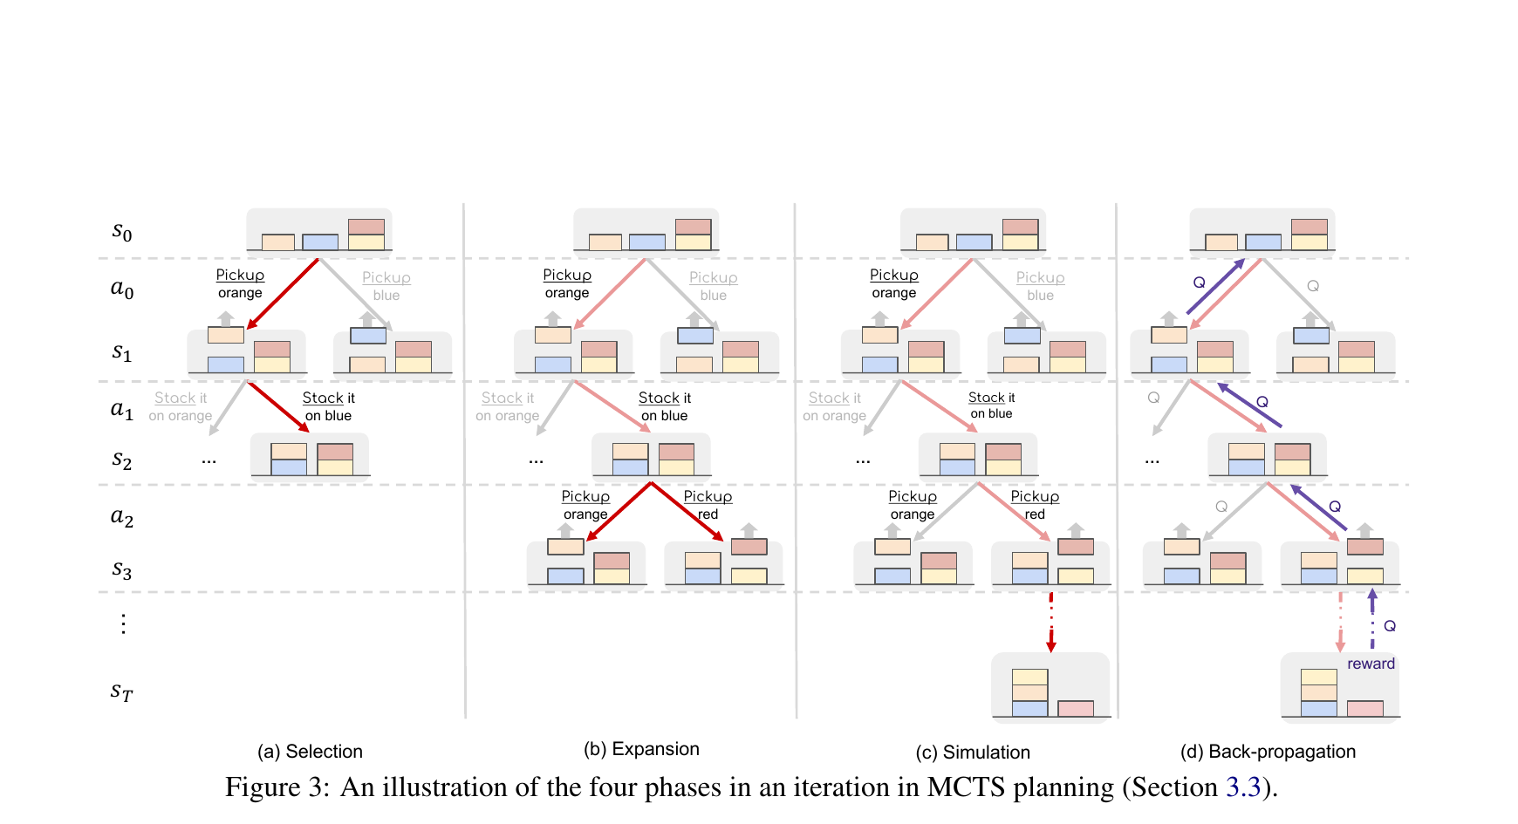
MCTS explores alternatives before committing to a trace
Selection: use UCT to balance value and uncertainty
Expansion and simulation: predict actions, states, and rewards
Back-propagation: update Q(s,a) along the visited path
Notes:
RAP uses Monte Carlo Tree Search, or MCTS, to choose which path to check. Each node in the tree is a reasoning state. Each line between nodes is an action. MCTS repeats four steps. The first step is selection. It starts at the root and chooses a path in the tree. It tries to balance two goals. One goal is to use paths that already have good scores. The other goal is to test paths that have not been used much. The second step is expansion. At the chosen end node, the model suggests new actions. The world model predicts a new state for each action, and new child nodes are added. The third step is simulation. The model takes a few more steps from a new node to get an idea of how good that path may become. The fourth step is back-propagation. This means the new score is sent back through the nodes on the chosen path. Their scores and visit counts are updated. The visit count is important because it keeps the search from checking only the first path that receives a high score. RAP repeats these four steps for a fixed number of rounds. More time goes to good paths, but other paths still get a chance. At the end, RAP chooses the path with the best support. For GSM8K, the authors also use RAP-Aggregation. It collects answers from several searched paths and uses them together, much like voting.

Slide 9
Experimental Setup
1. Shared Inference Setup
LLaMA-33B, temperature 0.8, frozen model
RAP uses task-specific states, actions, and rewards
2. Planning and Math
Blocksworld: 2-/4-/6-step plan success
GSM8K: final-answer accuracy; RAP-Aggregation
3. Logical Inference
PrOntoQA: 500 examples, 3-5 reasoning hops
Prediction accuracy and complete-proof accuracy
Baselines: CoT, Self-Consistency, Least-to-Most
Notes:
The authors test RAP on three kinds of reasoning. Blocksworld is a planning task. The model must move blocks from a starting layout to a goal layout by using valid actions. GSM8K is a set of math word problems with several steps. The final answer must be correct. PrOntoQA is a logic task. For this task, the paper checks both the final answer and the full proof. This is important because a model can guess the right final answer even when its reasoning is wrong. Together, these tests show both final-answer quality and the quality of the steps used to reach it. The main model is LLaMA 33B, used with a temperature of zero point eight. It is not trained again for these tests. The paper compares RAP with Chain-of-Thought, Self-Consistency, Least-to-Most, and other prompt methods.

Slide 10
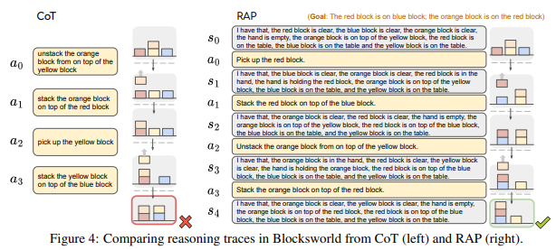
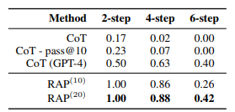
RAP recovers from early mistakes in Blocksworld
RAP(20): 100%, 88%, and 42% on 2-/4-/6-step tasks
CoT: 17%, 2%, and 0%; GPT-4+CoT: 50%, 63%, and 40%
LLaMA-33B+RAP averaged 64%; 33% relative gain over GPT-4+CoT
Notes:
The biggest gain appears in Blocksworld. The example on the left shows a common problem with one straight Chain-of-Thought plan. The model may reach one small goal, such as putting the orange block on the red block. But that move may make the next goal harder. The model has already chosen one order, so it can keep following a bad plan. RAP is shown on the right. It writes down the new block state after every move. If one path gets a low score, RAP can go back and try another order. A clear and correct state is useful because the search can see when one move blocks a later goal. The table shows a large gap. With twenty search rounds, RAP with LLaMA 33B solves one hundred percent of the two-step tasks, eighty-eight percent of the four-step tasks, and forty-two percent of the six-step tasks. Normal Chain-of-Thought with the same model gets only seventeen percent, two percent, and zero percent. On average, LLaMA 33B with RAP is thirty-three percent better than GPT-4 with normal Chain-of-Thought in this test. This does not mean LLaMA 33B is better than GPT-4 in general. It shows that clear state tracking and search are very important for a planning problem.

Slide 11
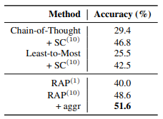
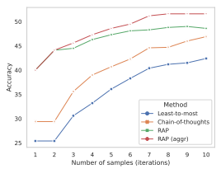
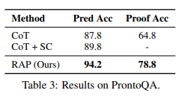
RAP improves both answers and complete proofs
GSM8K: RAP(10) 48.6%; RAP-Aggregation 51.6%
CoT+SC: 46.8%; Least-to-Most+SC: 42.5%
PrOntoQA prediction accuracy: 94.2% vs 87.8% CoT
PrOntoQA proof accuracy: 78.8% vs 64.8% CoT
Reward-guided search helps with small iteration budgets
Notes:
RAP also helps with math and logic, but the gains are smaller. On GSM8K, normal Chain-of-Thought gets twenty-nine point four percent. Self-Consistency raises this to forty-six point eight percent because it tries several full answers. RAP with ten search rounds gets forty-eight point six percent. RAP-Aggregation gets the best result, fifty-one point six percent. On PrOntoQA, final answer accuracy rises from eighty-seven point eight percent with Chain-of-Thought to ninety-four point two percent with RAP. Proof accuracy rises even more, from sixty-four point eight percent to seventy-eight point eight percent. This fourteen-point gain is important. It means RAP often gives a better full reasoning path, not only a better final guess. Looking at proof accuracy helps us separate real step-by-step reasoning from a lucky final answer. More search rounds usually help RAP find good paths. Still, the GSM8K result is only about fifty-two percent. Search does not remove every math mistake or every misunderstanding of the question.

Slide 12
Limitations
1. Frozen-Model Ceiling
World-model and agent quality remain bounded by pre-training.
2. Inference-Time Cost
MCTS requires repeated generation, simulation, and evaluation calls.
3. Task-Dependent Rewards
A reward helpful in planning can hurt mathematical reasoning.
4. Long-Horizon Failures Remain
Hard 12-step Blocksworld reaches only 9% with RAP(10).
5. Limited Failure Analysis
No systematic error taxonomy or cost-quality analysis.
Notes:
RAP also has clear limits. First, the reasoning agent and the world model are the same language model. If the model is sure about a wrong state, both parts can share the same mistake. Second, MCTS needs many model calls. Each round may ask for new actions, new states, a short trial, and a score. This makes RAP slower and more costly than one Chain-of-Thought answer. Third, the reward rules must fit the task. A useful rule for Blocksworld may not help with math or open questions. Fourth, long plans are still hard. In a harder twelve-step Blocksworld test with LLaMA 2 70B, RAP with ten rounds succeeds only nine percent of the time. These limits become more serious when the task has many steps or when each model call is expensive. The paper also gives only a small amount of detail about cost and common failure cases.

Slide 13
Summary
Problem
Linear CoT cannot simulate states or revise branches.
Key Idea
One frozen LLM serves as both agent and world model.
Planning Engine
Rewards and MCTS search alternative reasoning traces.
RAP improves all three tasks; LLaMA-33B beats GPT-4+CoT in planning.
Trade-off
More inference calls increase cost.
Reward design is task-dependent and can transfer poorly.
Notes:
To sum up, normal Chain-of-Thought follows one line and can have trouble after an early mistake. RAP changes reasoning into a planning problem. It uses one frozen language model as both a reasoning agent and a world model. The model suggests actions, predicts next states, checks each move, and searches several paths with MCTS. This method improves the results on planning, math, and logic tasks. The biggest gain is in Blocksworld, where clear states and valid actions are easy to define. My main lesson is that the way we use a model can be as important as the size of the model. We do not always need to train a new model. Sometimes we can get better reasoning by giving the model a clear state, asking it to look ahead, and letting it compare different choices. This point is useful for future systems that can spend more time only when a problem is hard. The cost is more time, more model calls, and more task design. RAP is therefore a good fit when the steps can be shown clearly, a partly finished solution can be scored, and a correct answer is worth the extra work. More broadly, this paper shows that language-model reasoning can be viewed as planning, not only as writing one long answer from left to right.

Slide 14
Thank you so much!
Notes:
That is the end of my presentation. Thank you for listening.

