Slide 1
A Midsummer Meme’s Dream: Investigating Market Manipulations in the Meme Coin Ecosystem
Gangryun Kwon
2026.06.22
INFONET Journal Club Presentation
Notes:
Hello everyone, let’s begin today’s Blockchain Journal Club.
Today, I will present the paper A Midsummer Meme’s Dream: Investigating Market Manipulations in the Meme Coin Ecosystem.

Slide 2
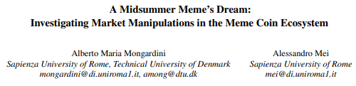
Paper
Accepted at
▪ USENIX Security Symposium, 2026
Authors
▪ Alberto Maria Mongardini and Alessandro Mei
Notes:
This paper was accepted at the USENIX Security Symposium 2026.
It was written by Alberto Maria Mongardini and Alessandro Mei.
The paper studies how meme coin markets can be manipulated across several blockchains.

Slide 3
Introduction
Background
Meme coins derive most of their value from community attention and perceived popularity rather than utility.
Problem
In low-liquidity markets, price, trading volume, and market capitalization can be artificially inflated.
Research Objective
This study investigates whether artificial growth strategies are used to attract investors and enable later profit extraction.
Notes:
Meme coins are different from utility-based crypto assets.
Their value mainly comes from community attention and perceived popularity.
Because of this, indicators such as price, trading volume, and market capitalization can be artificially inflated, especially in low-liquidity markets.
So, the main goal of this paper is to investigate whether artificial growth is used to attract investors and later extract profit.

Slide 4
Main contributions
Large-Scale Cross-Chain Dataset
The study analyzes 34,988 meme coins across Ethereum, BNB Smart Chain, Solana, and Base.
New Manipulation Strategy
The paper introduces Liquidity Pool-Based Price Inflation (LPI), which inflates prices through small trades in low-liquidity pools.
Sequential Manipulation Analysis
It shows how artificial growth strategies such as wash trading and LPI can lead to pump-and-dump schemes and rug pulls.
Notes:
The paper has three main contributions.
First, it builds a large cross-chain dataset of 34,988 meme coins.
Second, it introduces a new manipulation strategy called Liquidity Pool-Based Price Inflation, or LPI.
Third, it shows that manipulations often happen sequentially: artificial growth comes first, and then pump-and-dump schemes or rug pulls follow.

Slide 5
Research scope and dataset
Cross-Chain Coverage
The study examines meme coins on Ethereum, BNB Smart Chain, Solana, and Base.
Large-Scale Dataset
A total of 34,988 meme coins were collected from major market trackers and DEX aggregators.
Three-Month Price Analysis
The researchers tracked price changes and selected 707 tokens with returns above 100% for detailed analysis.
Notes:
The study covers four major blockchains: Ethereum, BNB Smart Chain, Solana, and Base.
The researchers collected meme coins from market trackers and DEX aggregators.
Then, they tracked price changes over three months and selected 707 tokens whose returns were higher than 100 percent for deeper analysis.

Slide 6
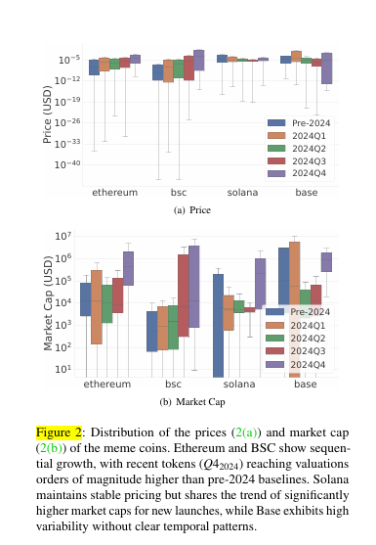
Vulnerability of meme coins
Low Liquidity
Small trades can cause large price movements.
Concentrated Ownership
A few wallets may control most of the token supply.
Inflated Market Indicators
Price, trading volume, and market capitalization
may not reflect real demand.
Easy Token Creation
Low-cost platforms allow new meme coins to be created
with minimal technical knowledge.
Notes:
Meme coins are highly vulnerable for several reasons.
First, low liquidity means that even small trades can move the price significantly.
Second, ownership is often concentrated in only a few wallets.
Third, market indicators may look strong even when real demand is weak.
Finally, meme coins are easy to create, so many low-quality or risky tokens can appear very quickly.

Slide 7
Ownership Concentration
Concentrated Holdings
385 high-return tokens showed severe ownership concentration.
Top 10 Holders
In concentrated tokens, the top 10 wallets controlled an average of 77.85% of the supply.
Critical Threshold
359 tokens had more than 30% of their total supply controlled by top holders.
Hidden Concentration
Bundle buys, fresh wallets, and strategic airdrops can make centralized ownership appear decentralized.
Market Risk
A small group of holders can coordinate trades, manipulate prices, or trigger sudden sell-offs.
Notes:
Ownership concentration is one of the first warning signs.
Among high-return tokens, 385 showed severe ownership concentration.
In these tokens, the top 10 holders controlled, on average, 77.85 percent of the supply.
This is risky because a small group of holders can coordinate trades, manipulate the market, or suddenly sell large amounts.

Slide 8
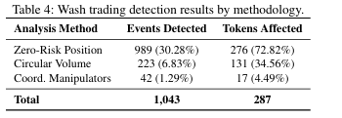
Wash Trading
Artificial Trading Activity
The same entities repeatedly buy and sell the token.
Trading Volume Inflation
The token appears more active and popular than it really is.
Investor Attraction
High volume improves visibility on tracking platforms and attracts new investors.
Key Findings
287 tokens showed strong evidence of wash trading.
1,043 wash trading events were detected.
Median trading volume increased 1,772%.
Notes:
Next, the paper analyzes wash trading.
Wash trading means that the same entities repeatedly buy and sell the same token.
This creates artificial trading volume and makes the token look more active and popular than it really is.
The paper found 287 tokens with strong evidence of wash trading and 1,043 wash trading events.
During these events, median trading volume increased by 1,772 percent.

Slide 9
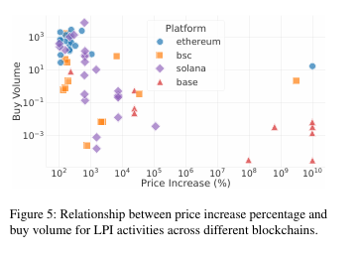
Liquidity Pool-Based Price Inflation (LPI)
Low-Liquidity Pool
A small liquidity pool makes the token price highly sensitive to trades.
Small Strategic Purchase
A manipulator buys a limited amount of the token.
Sharp Price Increase
The pool ratio changes significantly, causing the displayed price to rise.
Inflated Market Capitalization
The new price is multiplied by the circulating supply, creating an exaggerated market value.
Illustrative Example
0.01 ETH purchase → 300% price increase
Notes:
The paper also introduces Liquidity Pool-Based Price Inflation, or LPI.
In a low-liquidity pool, a small purchase can strongly change the token ratio inside the pool.
As a result, the displayed token price rises sharply.
Then, this inflated price is multiplied by the circulating supply, creating an exaggerated market capitalization.
For example, the paper shows that a 0.01 ETH purchase could cause a 300 percent price increase.

Slide 10
Overall Findings
High-Return Tokens Analyzed
707 meme coins achieved returns above 100%.
Suspicious Activity Detected
586 tokens showed at least one sign of artificial growth or market anomaly.
Manipulation Rate
82.89% of high-performing meme coins showed suspicious indicators.
Only 121 Tokens
No major manipulation signal was detected in only 121 tokens.
Notes:
Overall, the findings are quite strong.
Out of 707 high-return meme coins, 586 showed at least one suspicious signal.
That means 82.89 percent of high-performing meme coins had indicators of artificial growth or market anomalies.
Only 121 tokens showed no major manipulation signal.

Slide 11
Profit Extraction Strategies
Artificial Growth First
Wash trading and LPI create the appearance of popularity and rapid growth.
Investor Entry
Higher visibility attracts new investors and additional liquidity.
Pump and Dump
Early holders sell after the price has been inflated.
Rug Pull
Developers remove liquidity or abandon the project, leaving investors with heavy losses.
Notes:
The paper argues that manipulation often follows a sequence.
First, wash trading or LPI creates the appearance of popularity and rapid growth.
Then, new investors enter the market because the token looks promising.
After that, early holders may sell inflated tokens in a pump-and-dump scheme, or developers may remove liquidity in a rug pull.

Slide 12
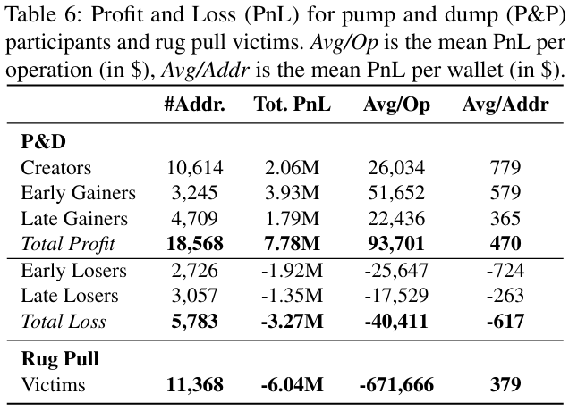
Economic Impact
Victim Addresses
More than 17,000 addresses suffered realized losses.
Pump-and-Dump Losses
Approximately $3.27 million in realized losses.
Rug Pull Losses
Approximately $6.04 million in realized losses.
Total Confirmed Losses
More than $9.3 million.
The actual damage may be higher because unrealized losses were not fully included.
Notes:
The economic impact is also significant.
The paper identifies more than 17,000 victim addresses with realized losses.
Pump-and-dump schemes caused about 3.27 million dollars in realized losses.
Rug pulls caused about 6.04 million dollars in losses.
In total, confirmed losses exceeded 9.3 million dollars, and the real damage may be even higher because unrealized losses were not fully counted.

Slide 13
Implications for Investor Protection
Market Indicators Can Be Misleading
High price, trading volume, and market capitalization do not always reflect genuine demand.
Need for Continuous Monitoring
Platforms should monitor suspicious trading patterns even after a token is listed.
Clear Risk Warnings
Ownership concentration, abnormal volume, and low liquidity should be presented as visible warnings.
Early Detection
Wash trading and LPI can serve as warning signs before pump-and-dump schemes or rug pulls occur.
Transparency of Transactions ≠ Fairness of the Market
Notes:
These findings have important implications for investor protection.
High price, high volume, or high market capitalization do not always mean real demand.
Platforms should continuously monitor suspicious trading patterns, even after a token is listed.
Also, risk indicators such as ownership concentration, abnormal volume, and low liquidity should be clearly shown to users.
The key message is that transaction transparency does not automatically mean market fairness.

Slide 14
Limitations of the Study
Detection Does Not Prove Illegality
Suspicious activity does not automatically mean criminal market manipulation.
Wallet Identity Is Uncertain
Multiple addresses may belong to one person, but this cannot always be proven.
Classification Errors Are Possible
Some meme coins may have been incorrectly included or excluded.
Limited Observation Period
Price movements were tracked over a three-month period.
Conservative Thresholds
Strict detection rules reduce false positives but may miss some manipulation cases.
Notes:
There are also limitations.
First, detecting suspicious behavior does not automatically prove illegal manipulation.
Second, wallet identity is uncertain because one person may control many addresses.
Third, some tokens may have been wrongly included or excluded.
Also, the observation period was limited to three months.
Finally, conservative thresholds reduce false positives, but they may miss some manipulation cases.

Slide 15
Conclusion
Artificial Growth Is Widespread
82.89% of high-return meme coins showed signs of artificial growth or market anomalies.
Manipulations Are Sequential
Wash trading and LPI often create misleading popularity before pump-and-dump schemes or rug pulls.
Transparency Is Not Enough
Blockchain records are public, but public transactions do not guarantee genuine market demand.
Investor Protection Is Necessary
Platforms need stronger monitoring systems and clearer warnings for suspicious activity.
Notes:
To conclude, artificial growth is widespread among high-return meme coins.
The paper shows that wash trading and LPI often create misleading popularity before pump-and-dump schemes or rug pulls.
Even though blockchain transactions are public, that does not guarantee genuine market demand.
Therefore, stronger monitoring systems and clearer investor warnings are necessary.

Slide 16
Thanks
Notes:
That concludes my presentation.
Thank you for listening.
I’m happy to take any questions.

Slide 17
Appendix
Appendix A. Ownership Concentration Criteria
Top holders controlled more than 30% of supply
Bundle buys exceeded 30% of supply
Fresh wallets held more than 30%
Airdrops distributed more than 30%
External signals from GoPlus, De.Fi, and Soul Scanner

Slide 18
Appendix B. Wash Trading Detection
Initial screening
Volume increase > 500%
Absolute price change < 5%
Transaction-level verification
Buy-sell difference ≤ 2%
Circular volume ≥ 99%
Same wallets repeatedly involved

Slide 19
Appendix C. LPI Detection
Initial screening
Price increase > 100% within 24 hours
Volume increase ≤ 20%, or total volume < $1,000
Transaction-level verification
Buy volume ≥ 90% of daily volume
Unique actors ≤ 10

Slide 20
Appendix D. Pump-and-Dump Detection
Peak identification
RSI > 80
Pump phase
Price increase > 50%
Volume increase > 500%
Within 24 hours
Dump phase
Price decrease > 30%
Post-dump volume < 50% of pump volume

Slide 21
Appendix E. Rug Pull Detection and Loss Estimation
Detection
Price decrease > 99% within one day
Volume decrease > 99% and remained inactive
Loss estimation
Addresses bought before the rug pull
Addresses did not sell before liquidity disappeared
Invested amount treated as loss

Slide 22
Appendix F. Economic Loss Estimation
Pump and dump
Wallet-level buy and sell flows
Only realized losses included
Unrealized losses excluded
Rug pull
Capital invested by addresses unable to exit
Remaining token value treated as approximately zero

