Slide 1
Toward Transparent and Incentive-Compatible Collaboration in Decentralized LLM Multi-Agent Systems: A Blockchain-Driven Approach
Youngu Lee
2026.06.05
INFONET Journal Club Presentation
Notes:
Hello everyone, let’s begin today’s Blockchain Journal Club

Slide 2
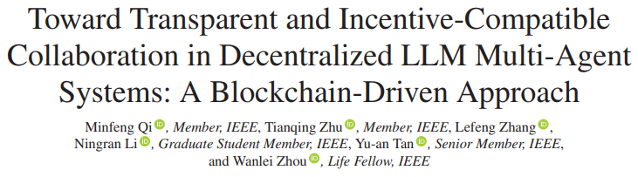
Paper
Published in
  IEEE Transactions on Network Science and Engineering, 2026
Authors
  Minfeng Qi, Tianqing Zhu, Lefeng Zhang, Ningran Li, Yu-an Tan, and Wanlei Zhou

Slide 3
Why I chose this paper
Research connection: My research interest is trustworthy decentralized AI agents
using blockchain.
Core problem: This paper studies how LLM agents can collaborate without a trusted
central controller.
Key idea: It combines incentive mechanisms, reputation updates, capability adaptation,
and smart contracts.
Future direction: This work can be extended to agent task verification and more
reliable reward design.

Slide 4
Motivation
LLM-based agents can reason, plan, communicate, and collaborate.
However, decentralized collaboration is difficult because there is no trusted central controller.
In open environments, agents may have different goals, capabilities, and reliability levels.
Therefore, the system needs a mechanism that can make agent behavior transparent, verifiable, and incentive-compatible.

Slide 5
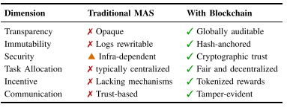
Problem: No central manager
Key limitations:
1. Opaque collaboration
Task assignment and communication are hard to audit.
2. Missing incentive structures
Agents may not honestly report their capabilities or complete tasks carefully.
3. Limited scalability
Centralized controllers and fixed protocols become bottlenecks as the system grows.
Notes:
기존 탈 중앙화된 MAS구조는 세가지 문제점을 가집니다. 첫 번째는 opaque collaboration입니다. 누가 task를 배정했고, 누가 수행했고, 중간에 어떤 일이 있었는지 확인하기 어렵습니다. 두 번째는 missing incentive structures입니다.

Slide 6
Background: What Is an LLM-Based Agent?
An agent is a system that can see, decide, and act.
An LLM-based agent uses an LLM as its brain.
It can understand natural language tasks.
It can make a plan, talk with other agents, and use tools.
Basic loop:
Perception
Thinking
Action
Feedback

Slide 7
Background: Why Use Blockchain?
Blockchain is used to make agent work easy to check.
It can record important actions.
It can show who joined the system, who got the task, how reputation changed.
So blockchain is not used for all work.
It is used for important records and trust.

Slide 8
Core Idea: Behavior-Shaping Incentive Mechanism
This paper does not only record agent actions.
It tries to guide agent behavior.
The system gives more chances to good agents.
It gives fewer chances to agents with weak skills or high workload.
Main factors:
  Skill match: CapMatch(Cj, wi)
  Reputation: ρi
  Workload: li

Slide 9
Utility Function:
The system checks if a task is good for an agent.
Utility = Expected reward - Penalty for high workload - Penalty for skill mismatch
  Higher reward → higher utility
  High workload → lower utility
  Poor skill match → lower utility
  So agents are pushed to choose tasks that match their real skills.
Notes:
이 논문에서는 agent가 어떤 task를 맡는 것이 좋은지를 utility function으로 계산합니다.

Slide 10

Reputation Update
Each agent has a reputation score.
Good task result → reputation goes up
Bad task result → reputation goes down
  ρi: reputation of agent i
  Si: task performance score
  λ: smoothing factor
  Agents with higher reputation get more task chances in the future.
Notes:
다음은 reputation update입니다.

Slide 11

Capability Adaptation: Agents Become Better Matched Over Time
Each agent has skill scores.
If an agent does well in one skill area, that skill score goes up.
If an agent does poorly, that skill score can go down.
  wi,k: skill score of agent i for skill k
  si,k: performance score for skill k
  μ: smoothing factor
  Over time, agents are more likely to get tasks that match their strong skills.
Notes:
이번에는 capability adaptation입니다.

Slide 12
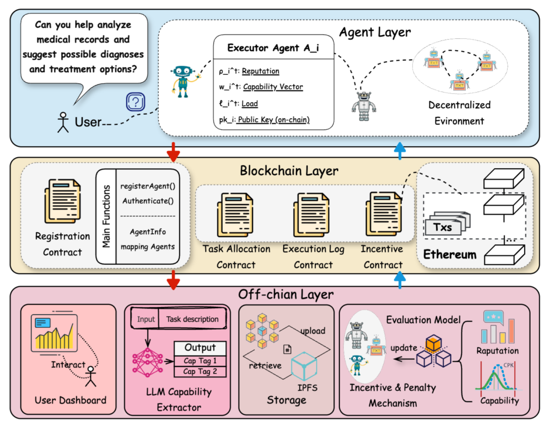
System Architecture: Off-chain LLM + On-chain Enforcement
Agent Layer
Agents do tasks with their skills, reputation, workload, and public keys.
Blockchain Layer
Smart contracts record key actions and update reputation.
Off-chain Layer
LLMs understand tasks, extract skills, and evaluate results.
Notes:
이렇게 하면 blockchain의 투명성은 활용하면서도, 모든 계산을 blockchain에 올리는 부담은 줄일 수 있습니다.

Slide 13
Experiment Setup: 20 Agents, 100 Tasks, 50 Rounds
The authors tested the system in a simulation.
  Agents: 20 LLM-based agents
  Tasks: 100 tasks
  Rounds: 50 rounds
Each round:
  5 new tasks are added.
  Agents bid for tasks.
  The system assigns tasks.
  Agents finish tasks.
  Reputation and skill scores are updated.
Notes:
이 실험은 시간이 지나면서 incentive mechanism이 agent behavior를 개선하는지 확인하기 위한 실험입니다.

Slide 14
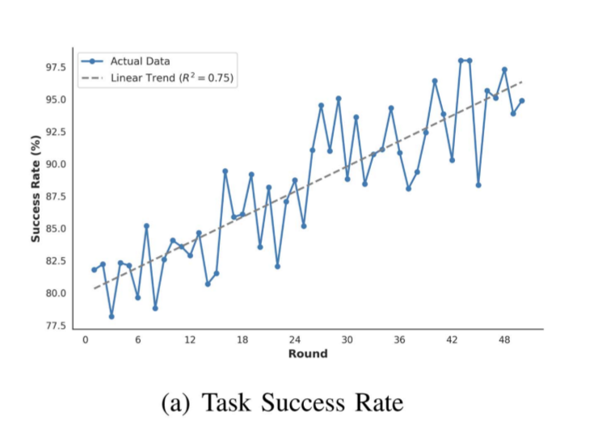
Result 1: Task Success and Quality Improve
Task success rate increased.
  Early rounds: 80.15%
  Later rounds: 94.49%
  Average success rate: 86.77%
Task quality also improved.
  Initial quality: 0.75
  Final quality: 0.89
Key point
  Better agent-task matching led to better results.

Slide 15
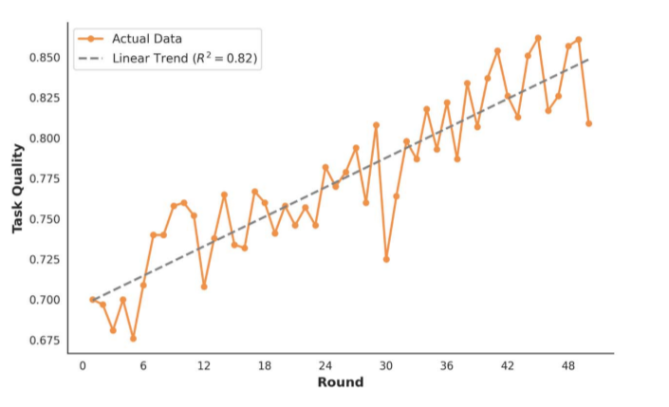
Result 2: Utility Improves and Bidding Becomes More Selective
At first, agents bid for almost all tasks.
  Round 1 bid rate: 92%
  Later, agents became more careful.
  Round 40 bid rate: 55%
Mean utility also increased.
  Round 1 utility: 3.34
  Round 46 utility: 7.0
Key point
  Agents learned to avoid tasks with weak skill match or high workload.

Slide 16
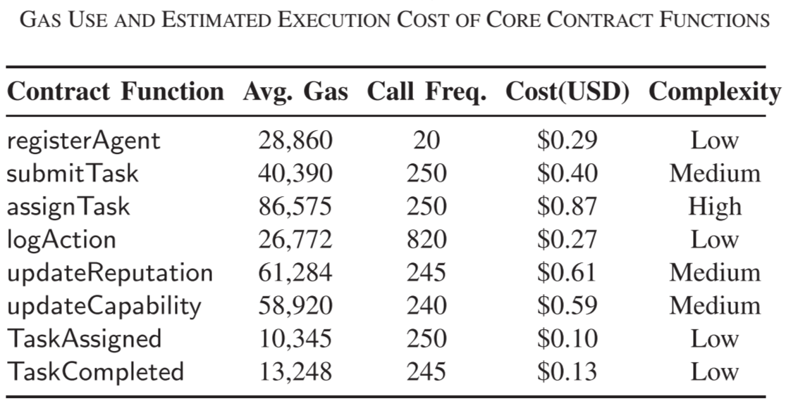
Result 3: Blockchain Provides Verifiable Logs, But With Cost
Blockchain made the process easy to check.
It recorded task events, bids, assignments, logs, and reputation updates.
  Average transactions per round: 67.32
  Average confirmation time: 2.18 seconds
  Average failed transactions per round: 0.86
But blockchain also has cost.
  Average gas per transaction: 147,865
Key point
  Blockchain gives transparency, but it also adds cost and delay.
Notes:
이 점 때문에 모든 작업을 on-chain에 올리는 것이 아니라, 중요한 기록만 on-chain에 남기는 설계가 필요합니다.

Slide 17
Limitations and Critical Discussion
1. Blockchain cost
  Blockchain gives trust, but it also needs gas fees.
  If there are many agents and tasks, the cost can become too high.
2. Limited scale
  The experiment used 20 agents and 100 tasks.
  A larger real-world system may have more delay and higher cost.
3. Task result verification
  Blockchain can record what happened.
  But it cannot fully prove that the agent's answer is truly correct.
Notes:
Blockchain은 누가 task를 했고 어떤 기록이 남았는지는 보여줄 수 있지만, agent가 제출한 결과가 정말 correct한지는 완전히 증명하지 못합니다. 그래서 blockchain은 transparency를 도와주지만 모든 trust problem을 해결하지는 못합니다.

Slide 18
Takeaways and Discussion
This paper is useful because it connects three ideas.
  1. LLM agents
    Agents can understand tasks and work together.
  2. Incentive design
    Good agents get more chances.
    Weak or overloaded agents get fewer chances.
  3. Blockchain
    Important actions are recorded and can be checked.
  Future Direction
    The next step is task result verification.
    Blockchain can show who did the task.
    But we still need a way to check whether the result is really correct.

Slide 19
Thanks

