Slide 1
Fine-Grained Spatially Varying Material Selection in Images
Yongtae Lee
2025. 05. 21
INFONET Journal Club Presentation

Slide 2
Overview
Purpose of the Presentation
Key Research Achievements
Research Process and Findings Leading to the Achievements
Notes:
searching a subject and found

Slide 3
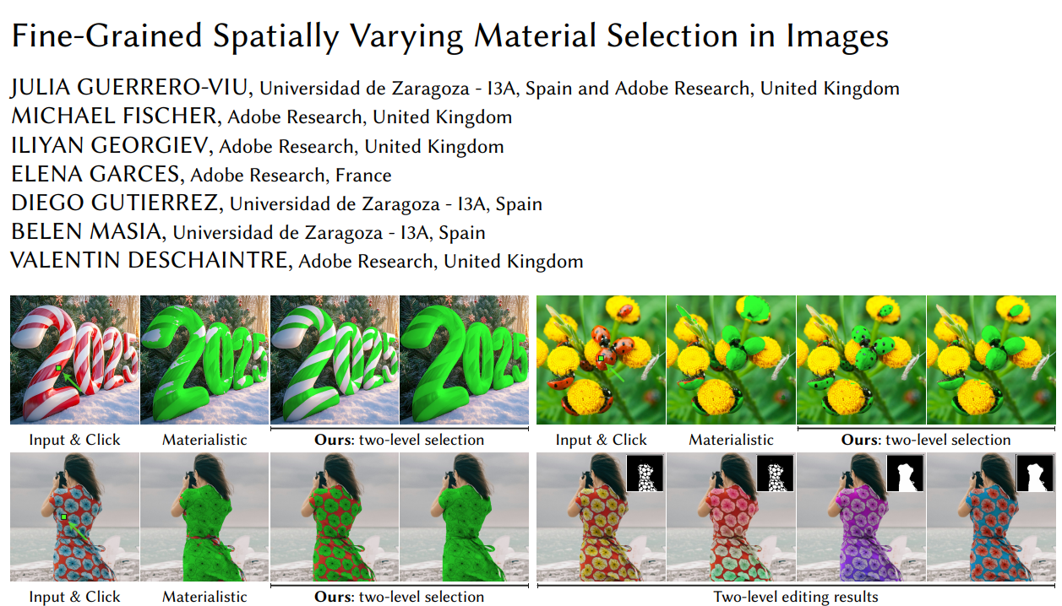
Paper
Published in
  ACM Transactions on Graphics (SIGGRAPH ASIA 2025)
Date of Publication
  Dec 2025.
Link
  https://dl.acm.org/doi/10.1145/3763332
Notes:
Why I chose this topic:
I found this paper while searching information for computer vision class.

Slide 4
Introduction
Main topic of paper: Material-aware selection
  Goal of the task: Select regions sharing the same material as a clicked pixel
  Applications:
    Image editing
    Appearance manipulation
    Material-aware recoloring
  Examples:
    Selecting all wooden surfaces in the image
    Editing wallpaper patterns
    Modifying specific decorative motifs

Slide 5
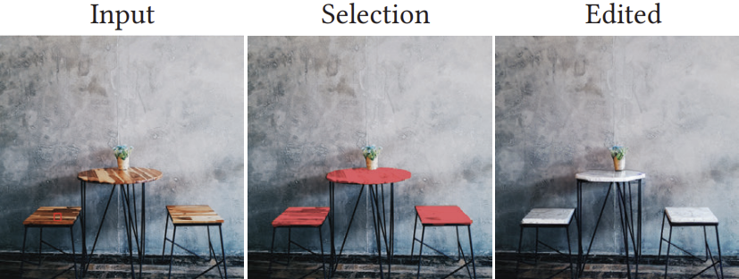
Related Work
Difference from Object Segmentation
  Object Segmentation: groups pixels by semantic identity
  Material Selection:
    Groups pixels by material similarity
    One object may contain multiple materials
Challenges of Material Selection
  The same material can appear differently due to shadows/highlights/perspective distortion
  Different materials may have visually similar appearance
  → Simple color similarity or object segmentation is insufficient
https://arxiv.org/pdf/2305.13291

Slide 6
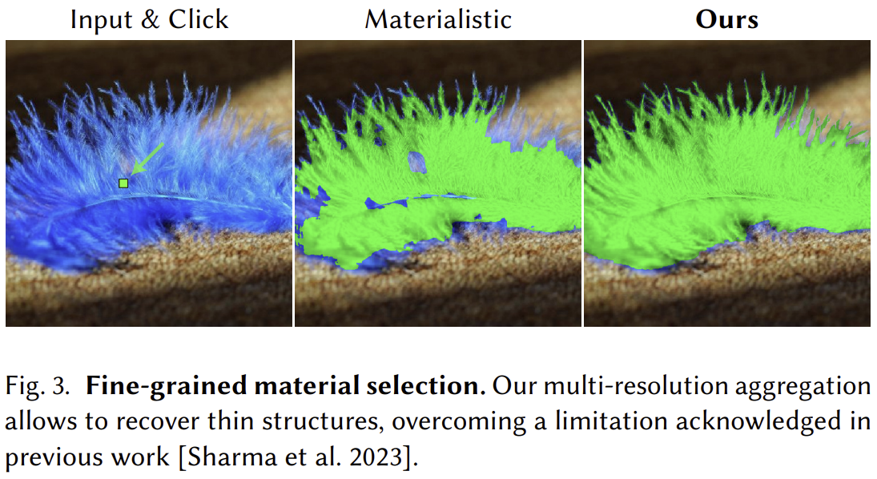
Related Work
Previous Work: Materialistic (2023)
  ViT-based material selection
  Limited spatial precision: Blurry edges, Failure on thin structures, Loss of fine details
  Texture-level representation only: Cannot isolate internal texture components

Slide 7
Core contributions
Multi-resolution Processing
  Combines full-image and high-resolution tile features
  Captures both global context and local details
Two-level Material Selection
  Texture level
  Subtexture level
DuMaS Dataset
  800K+ synthetic images
  Texture/subtexture annotations

Slide 8
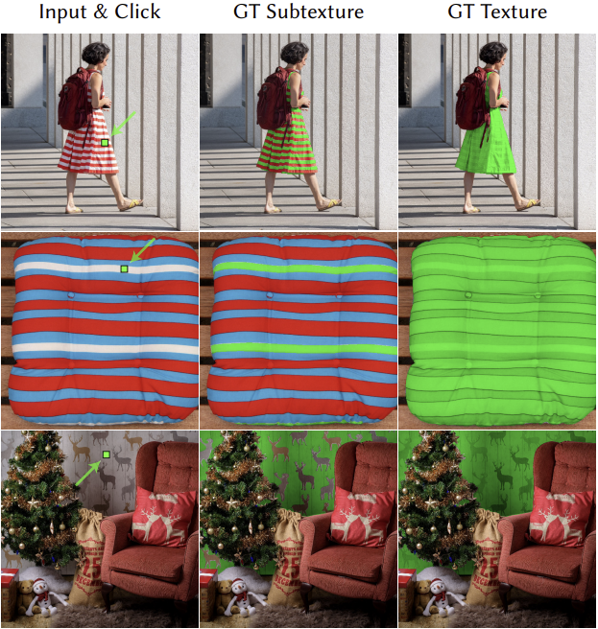
Core contributions
Two-Level Material Representation
  Texture Level
    Selects the entire texture
  Subtexture Level
    Distinguishes components inside a texture
    Example: Only black squares in the checkerboard
    Key advantage: Enables fine-grained editing

Slide 9
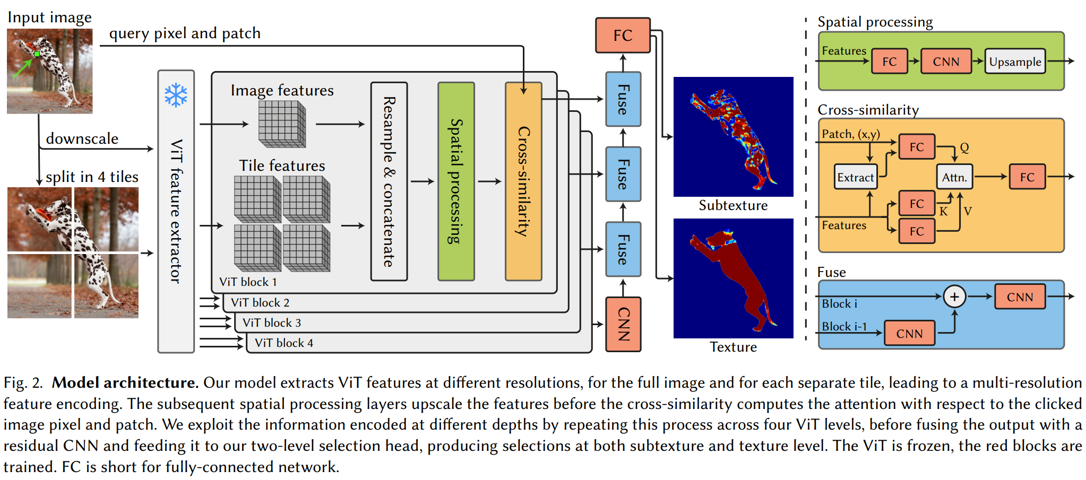
Method
Overall Architecture
  DINOv2 feature extraction
  Multi-resolution aggregation
  Cross-similarity computation
  Texture/Subtexture prediction

Slide 10
Method
DINOv2 Feature Extraction
  Vision encoder
    Compared encoders (DINOv2, SAM2)
  Reasons:
    Richer representation
    Better illumination robustness
    Improved material disentanglement

Slide 11
Method
Multi-resolusion Aggregation
  Motivation
    Problems of ViT: patch tokenization, low-resolution feature maps, reduced edge precision
  Proposed solution
    Process the full image at low resolution
    Simultaneously process high-resolution tiles
  Effects
    Better thin-structure recovery
    Sharper boundaries
Notes:
Also see fig.3 (blue feather image)

Slide 12
Method
Cross-similarity Computation
  Input
    Clicked query pixel
  Process
    Extract query feature
    Compute similarity against all pixel features
  Output
    Per-pixel material similarity map
  Final step
    Thresholding → binary selection mask

Slide 13
Method
Multi-query Training
  Previous approach: one query pixel per image
  Proposed approach: multiple query pixels from multiple materials
  Effects
    Improved training stability
    Better robustness
    Higher consistency
  Paper claims
    Better handling of challenging cases
    Improved robustness to illumination changes

Slide 14
Method
DuMaS Dataset
  Scale:
    816,415 synthetic images ( > Materialistic dataset: 50,000)
    Indoor and outdoor scenes
  Key characteristics
    Texture-level annotation
    Subtexture-level annotation

Slide 15
Method - Experiment
Experimental Benchmarks – Real-World Images
  Materialistic
    Texture-level annotation
  Two-Level Test Set
    Newly introduced dataset
    Texture + subtexture annotations
Additional evaluations
  Illumination consistency
  Zoom consistency
  Query consistency

Slide 16
Results
Qualitative Results
  Observed advantages
    Handles cluttered scenes well
    Improved thin-structure recovery
    Generalizes to unseen patterns
    Robust to strong lighting variations

Slide 17
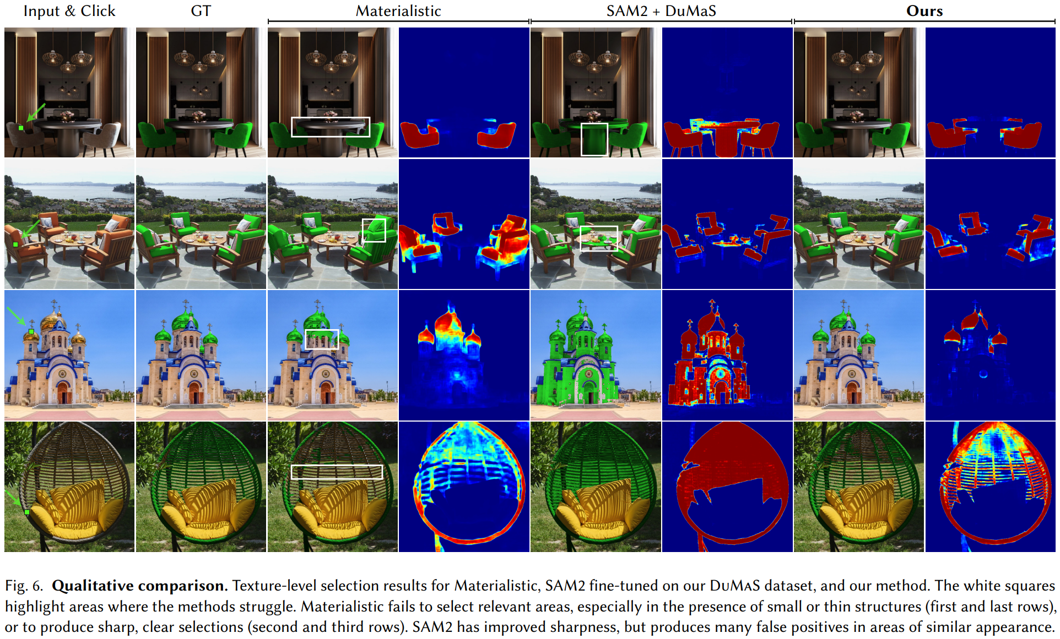
Results
Qualitative Results
  Observed advantages
    Handles cluttered scenes well
    Improved thin-structure recovery
    Generalizes to unseen patterns
    Robust to strong lighting variations
Notes:
GT = Ground truth
Materialistic vs DuMaS+SAM2 model vs DuMaS+DINOv2(proposed)
Materialistic
Blurry edges
Loss of fine details
SAM2
Sharp edges
Many false positives
Proposed Method
Sharper boundaries
Fewer false positives
Better consistency
Heat map images meaning: visualization of similarity

Slide 18
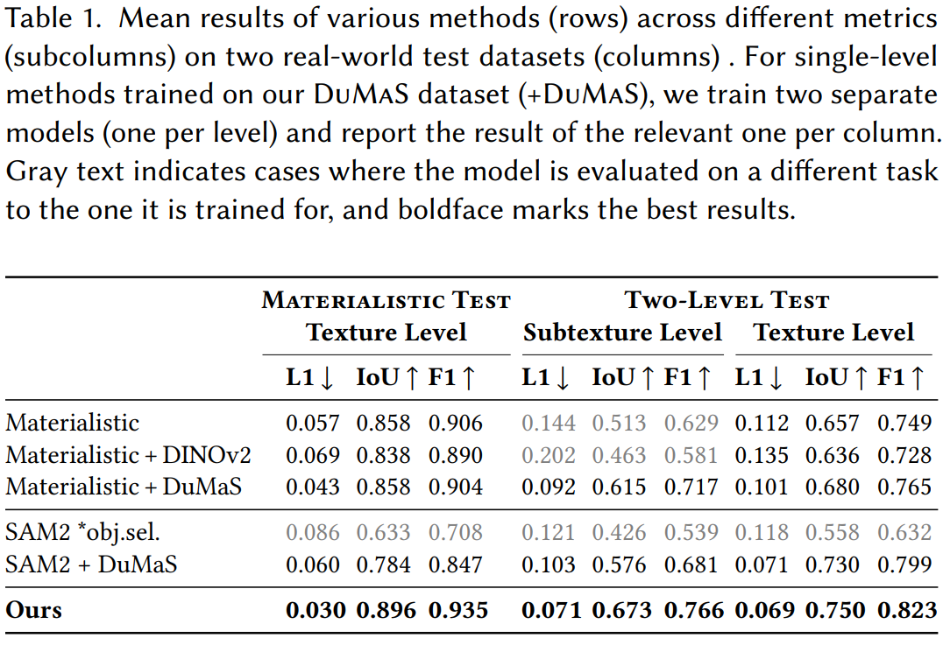
Results
Quantitative Results
Notes:
Best performance on both texture and subtexture tasks

Slide 19
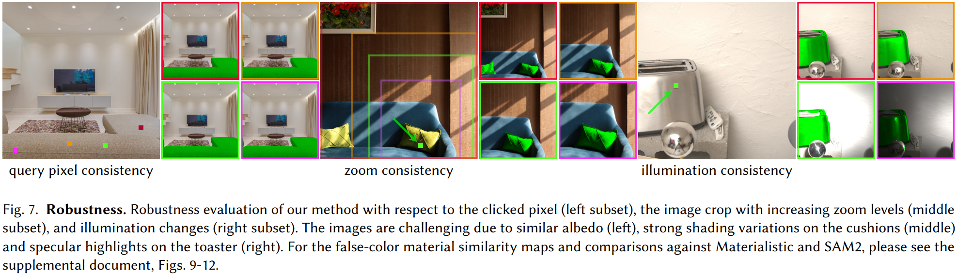
Results
Robustness
  Evaluated factors:
    Query pixel changes, Zoom changes, Illumination changes
  Results
    Approximately x1.8 higher consistency
    Robust under: Strong shadows, Specular highlights, Similar albedo conditions

Slide 20
Results
Ablation Study
  Without Multi-resolution
    Significant drop in thin-structure performance
  Without Multi-query Training
    Reduced robustness
  Replacing DINOv2 with other visual feature extractor(DINOv1, Hiera)
    Lower overall performance
Notes:
Conclusion: Every component contributes to performance improvement

Slide 21
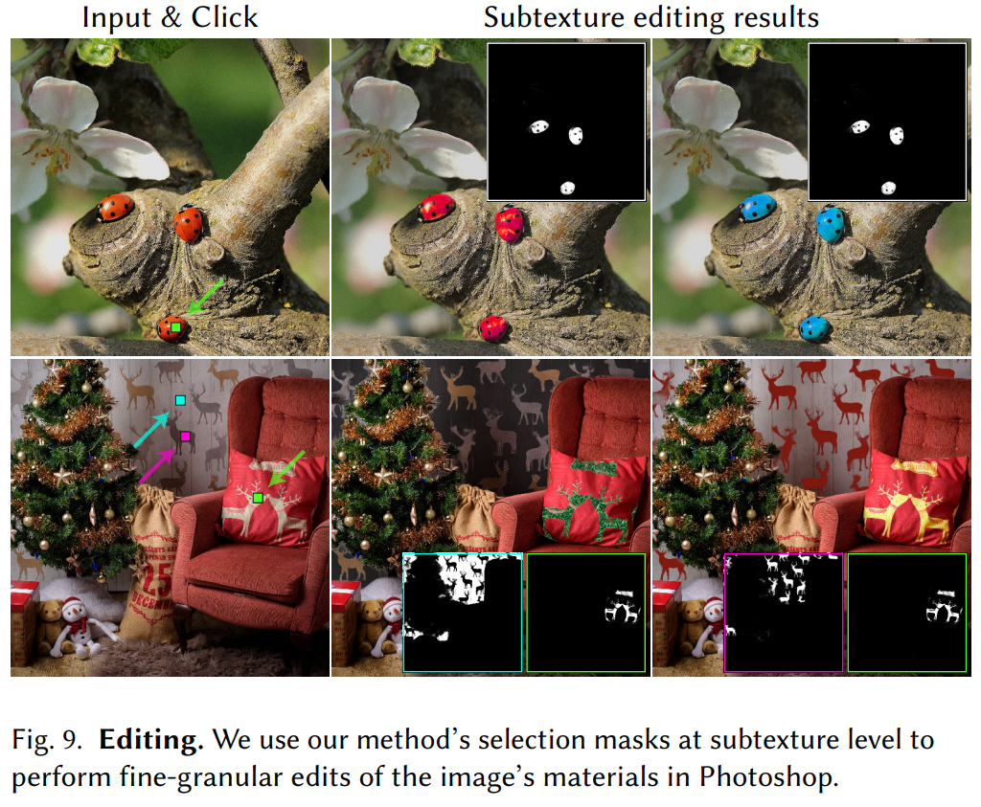
Results
Application: Material Editing
  Applications:
    Photoshop material editing
    Fine-grained texture editing
  Possible edits:
    Modify only flower patterns
    Edit wallpaper motifs
    Recolor specific patterns

Slide 22
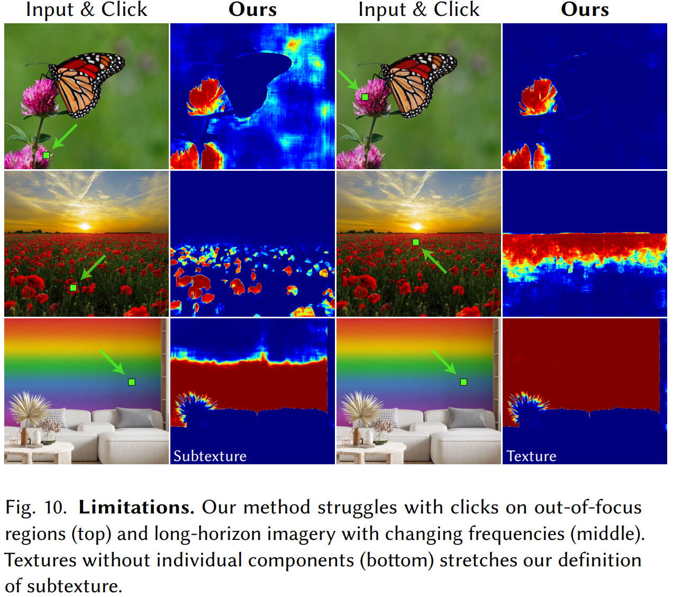
Limitations
Out-of-focus Regions
  Failure possible in blurred areas
Long-horizon Scenes
  Reduced consistency under
  strong perspective changes
Continuous Texture Ambiguity
  Subtexture boundaries become
  ambiguous in gradient textures

Slide 23
Conclusion
Main contributions
  Fine-grained material selection
  Texture/Subtexture dual-level representation
  Multi-resolution feature aggregation
  Large-scale DuMaS dataset
Results:
  Higher accuracy
  Better robustness
  More precise editing capability
Notes:
Key takeaway: “The paper enables highly precise material selection by combining multi-resolution ViT features with a dual-level material representation.”

Slide 24
Summary
I reviewed
  .

Slide 25
References
Julia Guerrero-Viu, Michael Fischer, Iliyan Georgiev, Elena Garces, Diego Gutierrez, Belen Masia, and Valentin Deschaintre. 2025. Fine-Grained Spatially Varying Material Selection in Images. In ACM Transactions on Graphics (Proc. SIGGRAPH Asia). https://github.com/juliagviu/finegrained_mat_selection
Prafull Sharma, Julien Philip, Michaël Gharbi, Bill Freeman, Fredo Durand, and Valentin Deschaintre. 2023. Materialistic: Selecting Similar Materials in Images. ACM Trans. Graph. 42, 4, Article 154 (August 2023), 14 pages. https://doi.org/10.1145/3592390

