Slide 1
PRISM: Privacy-Aware Routing for Adaptive Cloud-edge LLM Inference via Semantic Sketch Collaboration
Surin Lee
07 31, 2026
INFONET Journal Club Presentation
Notes:
Hi everyone. Today I’ll present a paper titled PRISM: Privacy-Aware Routing for Adaptive Cloud-Edge LLM Inference via Semantic Sketch Collaboration.
This paper focuses on privacy-preserving LLM inference in a cloud-edge setting, and the main idea is to adapt both the inference location and the privacy mechanism depending on how sensitive the user’s prompt is

Slide 2
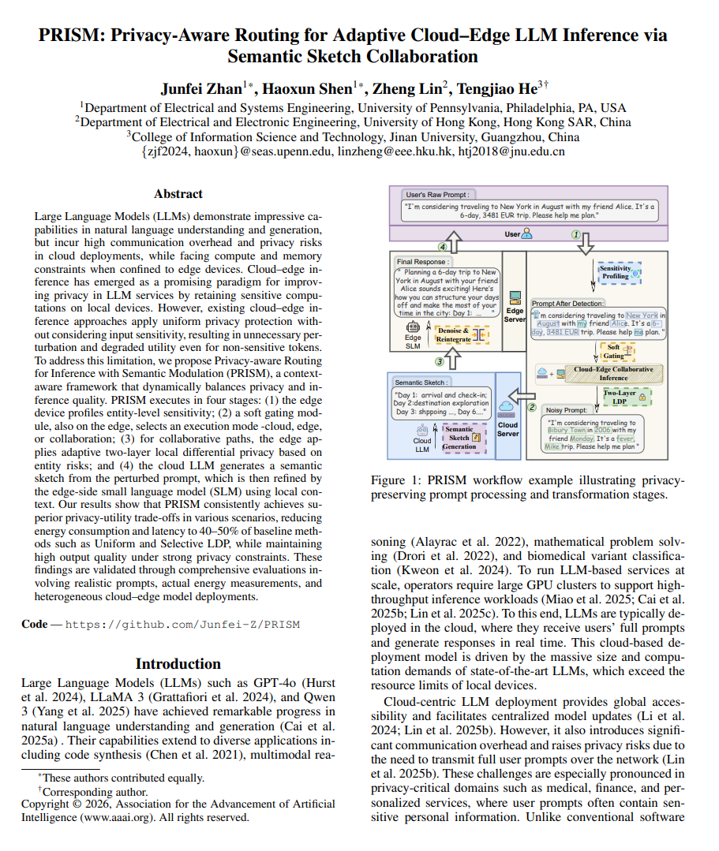
Overview
Title: PRISM: Privacy-Aware Routing for Adaptive Cloud-edge LLM Inference via Semantic Sketch Collaboration
Publisher: AAAI26
Key Idea: Cloud-Edge Inference, Adaptive Two-Layer Local Differential Privacy, Semantic Sketch
Notes:
This paper was published at AAAI 2026. There are three main ideas that I want to focus on today. The first is cloud-edge inference, where computation is divided between a cloud LLM and an edge-side smaller model.
The second is an adaptive two-layer local differential privacy mechanism, which protects sensitive entities before sending information to the cloud. And the third is semantic sketch collaboration, where the cloud does not generate the complete final response, but instead provides a structured semantic outline that is later refined on the edge. I’ll explain these using one running travel example throughout the presentation

Slide 3
Motivation: Cloud LLMs Create a Privacy–Utility Dilemma
Cloud LLMs are powerful, but user prompts may contain sensitive information.
Cloud LLM
  Strong reasoning capability
  Low local computation
  Raw prompts leave the user device
  Potential privacy leakage
Edge SLM
Sensitive data remain local
Better privacy
Limited compute and memory
Lower response quality
Can we preserve the capability of cloud LLMs without exposing sensitive user context?
Notes:
The motivation comes from a basic trade-off between cloud LLMs and edge models. Cloud LLMs provide strong reasoning and generation capabilities, and they require very little local computation from the user. However, the user has to send the raw prompt to the cloud, which creates a potential privacy risk. This becomes especially problematic when prompts contain medical, financial, or other personal information. On the other hand, if we perform the entire inference locally using a small language model, sensitive data can remain on the device. But edge devices have limited memory and computation, and the smaller model may provide lower response quality. So the main question is: Can we preserve the capability of cloud LLMs without exposing sensitive user context?”

Slide 4
Not All Prompts Have the Same Privacy Risk
Different prompts require different levels of protection.
Low Privacy Risk
  “What is the capital of France?”
  No personal information
  Little benefit from privacy perturbation
High Privacy Risk
  “I tested positive for HIV last week and have been experiencing fever and diarrhea.
  Should I be concerned about secondary infections?”
  Sensitive health information
  Personal context
  High privacy risk
Applying the same privacy mechanism to every prompt is unnecessary and may hurt utility.
Notes:
The next observation is that not all prompts have the same level of privacy risk . For example, the question ‘What is the capital of France?’ contains essentially no personal information. Applying a strong privacy mechanism to this query provides very little benefit and may unnecessarily reduce utility. In contrast, a medical prompt such as ‘I tested positive for HIV last week’ contains highly sensitive personal health information. So applying exactly the same privacy mechanism to both prompts is inefficient. This motivates the main design principle of PRISM: privacy protection should depend on the sensitivity and context of the input prompt.

Slide 5
Existing cloud–edge privacy mechanisms are often coarse-grained.
Binary Routing
  Sensitive → Edge
  Non-sensitive → Cloud
    Relies on a fixed threshold
    Misrouting can reduce privacy or utility
Uniform LDP(Local Differential Privacy)
  Entire Prompt → Perturb → Cloud
    Perturbs sensitive and non-sensitive tokens alike
    Can severely distort
Selective LDP
  Detected Entities → Perturb → Cloud
    Avoids perturbing every token
    Still applies similar protection across entities
Key limitation: neither routing nor protection is sufficiently context-aware.
Notes:
Existing approaches are generally more coarse-grained. One approach is binary routing. Sensitive prompts are processed on the edge, while non-sensitive prompts are sent to the cloud. This is simple, but it relies on a fixed decision boundary, so incorrect routing can either increase privacy risk or reduce utility. Another approach is Uniform LDP, where the entire prompt is perturbed before cloud inference. The main issue is that both sensitive and non-sensitive information are modified, so the semantics of the prompt can be heavily distorted. A slightly more targeted approach is Selective LDP, where only detected entities are perturbed. However, different entities may have different privacy sensitivity, and Selective LDP does not adapt protection sufficiently at that level. So the limitation identified by this paper is that both routing and privacy protection are still not sufficiently context-aware.

Slide 6
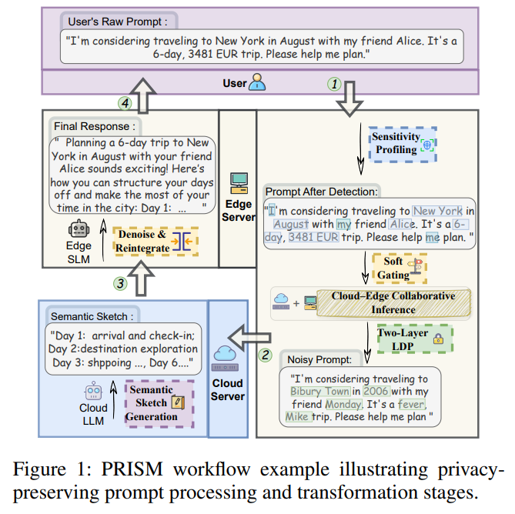
PRISM: Key Idea
PRISM adapts both where inference happens and
how much information is protected.
Route according to context sensitivity
Perturb entities according to privacy risk
Use the cloud for semantic guidance,
not private-context reconstruction
Notes:
To address this, the authors propose PRISM. PRISM adapts two things. First, it decides where the inference should happen Depending on the privacy risk, a query can be processed entirely in the cloud, entirely on the edge, or through cloud-edge collaboration. Second, it decides how the sensitive information should be protected. Instead of applying the same perturbation everywhere, it adjusts the protection according to entity-level privacy risk.
And in the collaborative path, the cloud is used mainly for semantic guidance rather than reconstructing private information. I’ll explain this process with a concrete travel request

Slide 7
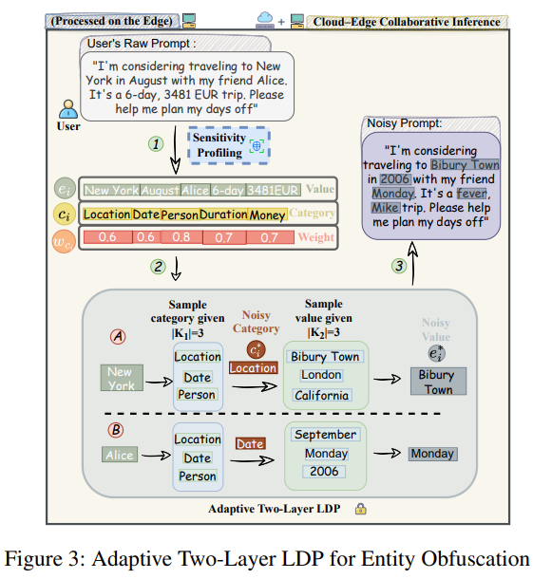
Running Example: A Private Travel Request
“I'm considering traveling to New York in August with my friend Alice. It's a 6-day, 3481 EUR trip.
Please help me plan.”
Detected Entity | NER Category
New York | LOCATION
August | DATE
Alice | PERSON
6-day | DURATION
3481 EUR | MONEY
This prompt contains useful task information, but also potentially sensitive personal context.
Notes:
This is the running example used throughout the paper. The user says: ‘I’m considering traveling to New York in August with my friend Alice. It’s a six-day, 3,481-euro trip.’ This prompt contains information that is useful for answering the task, but it also contains potentially sensitive personal context. Before anything is sent to the cloud, PRISM processes this prompt on the edge. A lightweight NER engine detects entities such as New York as a location, August as a date, Alice as a person, six-day as a duration, and 3,481 euros as money. An important point is that the edge SLM is not doing this entity extraction. The system uses a separate lightweight NER-based profiler. After extracting these entities, PRISM estimates how sensitive they are in the current context

Slide 8
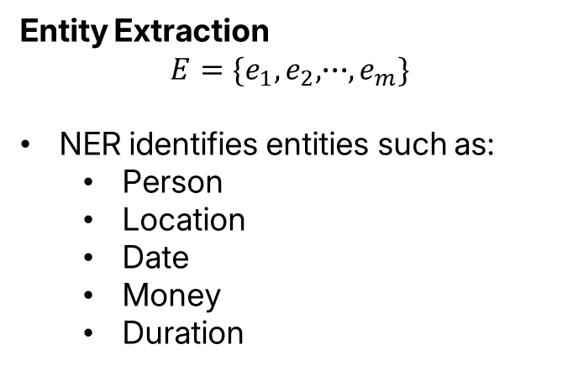

Step 1: Sensitivity Profiling
PRISM first estimates the privacy risk of the prompt.
Entity Extraction
$$E=\{e_{1},e_{2},∙∙∙,e_{m}\}$$
NER identifies entities such as:
  Person
  Location
  Date
  Money
  Duration
Context Signals
PRISM also considers contextual cues such as:
“I”
“me”
“my”
PERSON entities
I plan to travel solo to Tokyo for three days
Which country is Tokyo located in?
Outputs of the profiler
Risk Score $R\left(P\right)$
Sensitivity Mask d
Sensitivity depends not only on the entity type, but also on how it appears in context.
Notes:
The first step is sensitivity profiling. PRISM uses both entity information and contextual signals. First, the NER engine identifies entity types such as person, location, date, money, or duration. Each entity category has a predefined sensitivity weight. But entity type alone is not e nough. The system also considers contextual cues such as first-person expressions like ‘I,’ ‘me,’ or ‘my,’ as well as PERSON entities. The example here shows why context matters.
‘I plan to travel solo to Tokyo for three days’ and ‘Which country is Tokyo located in?’ both contain the same location entity, Tokyo. But the first prompt contains personal intent, while the second is simply a general knowledge question. So PRISM tries to distinguish privacy-sensitive use of an entity from non-sensitive use. The profiler finally produces two outputs: an overall risk score, and a sensitivity mask indicating which entities should be protected.

Slide 9
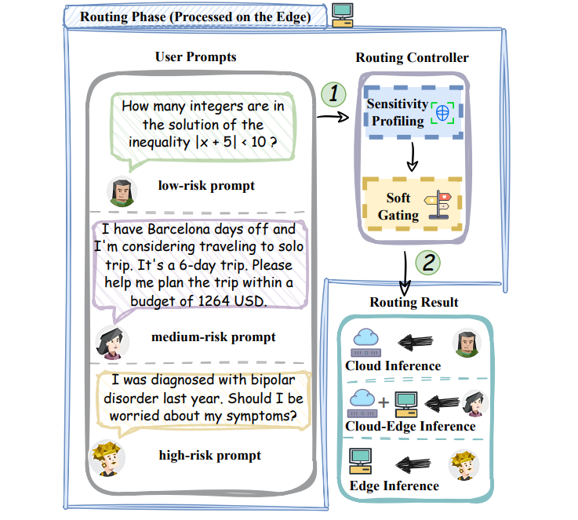
Step 2: Where Should the Prompt Be Processed?
Low Risk → Cloud
  No sensitive context
  Use the powerful cloud LLM directly
  Avoid unnecessary privacy overhead
Medium Risk → Cloud-Edge Collaboration
  Contains private context
  Still benefits from cloud capability
  Protect sensitive entities before transmission
High Risk → Edge
  Highly sensitive information
  Keep the original prompt entirely local
PRISM dynamically selects Cloud, Collaboration, or Edge based on the estimated privacy risk.
Notes:
Based on this privacy risk, PRISM chooses among three inference modes. For a low-risk prompt, it uses the cloud directly. There is no sensitive context, so there is no reason to pay the cost of additional privacy processing.
For a medium-risk prompt, PRISM uses cloud-edge collaboration. The prompt contains some private information, but the task can still benefit from the capability of a cloud LLM. So the sensitive information is protected before transmission. For a high-risk prompt, the whole inference is performed on the edge, so the original prompt remains local. So the key routing logic is: low risk goes to the cloud, medium risk uses collaboration, and high risk remains on the edge.

Slide 10
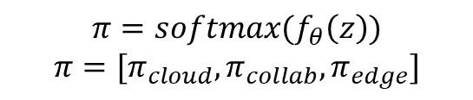
How Does PRISM Choose the Route?
Soft Gating for Three-Way Routing
Input Features
From Sensitivity Profiling:
  Risk score R(P)
  Sensitivity mask d
  Contextual sensitivity signals
$$π=softmax(f_{θ}\left(z\right))$$
$$π=[π_{cloud},π_{collab},π_{edge}]$$
Training: soft routing probabilities + entropy regularization
Inference: select the route with the highest probability
Notes:
The routing decision is made using a soft gating module. Its inputs come from the sensitivity profiling stage, including the risk score, the sensitivity mask, and contextual privacy signals. The gating model then outputs a probability distribution over three execution modes: cloud, collaboration, and edge. During training, the authors use soft routing probabilities together with entropy regularization. The entropy term encourages the model to make more confident routing decisions. At inference time, however, the process is deterministic. PRISM simply selects the mode with the highest probability. So although the model learns a soft probability distribution, only one path is actually executed.

Slide 11
Why Is Simple Masking Not Enough?
Why Not Simply Remove Names?
  “<NAME> owns a black dog and often walks it after dinner.”
  “The owner of the black dog takes out the trash every Tuesday.”
    Shared semantic clue: “black dog” → Linkage Attack
    Explicit identifiers may be removed, but contextual clues can still link records and reveal private information.
PRISM's approach: Perturb both the entity category and the entity value.
Notes:
Before introducing their privacy mechanism, the authors explain why simple masking may not be sufficient. Suppose we replace a person’s name with a generic token such as <NAME>. In the first sentence, we still know that this person owns a black dog. In another record, we again observe information about the owner of the same black dog. Even if the explicit name is removed, the shared semantic clue can potentially be used to link the records.
This is a linkage attack. So the paper argues that privacy protection should not only remove explicit identifiers. Instead, PRISM perturbs both the entity category and the entity value

Slide 12
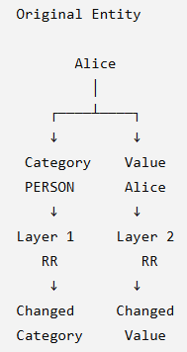
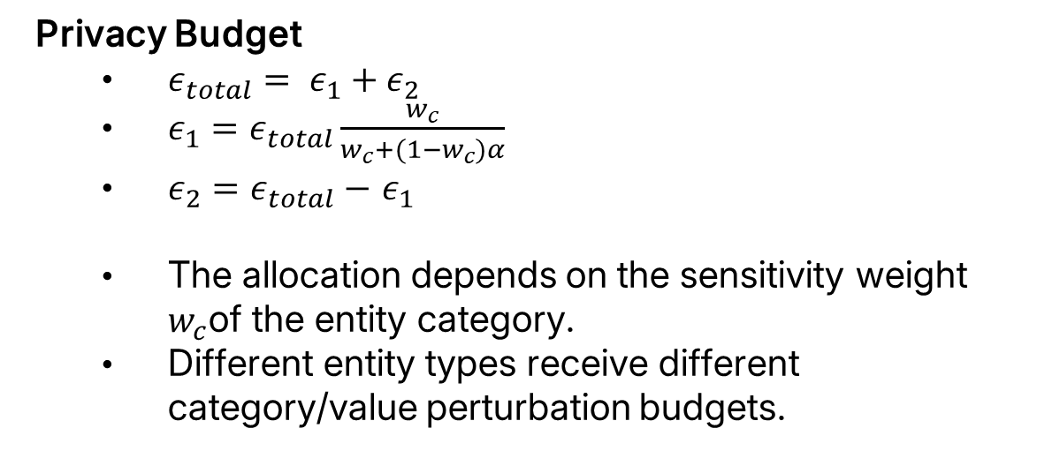
Step3: Adaptive TWO-Layer LDP
PRISM protects an entity at two levels
Privacy Budget
  $ε_{total}= ε_{1}+ε_{2}$
  $ε_{1}=ε_{total}\frac{w_{c}}{w_{c}+(1−w_{c})α}$
  $ε_{2}=$ $ε_{total}−$ $ε_{1}$
  The allocation depends on the sensitivity weight $w_{c}$of the entity category.
  Different entity types receive different category/value perturbation budgets.
Notes:
This leads to the proposed Adaptive Two-Layer Local Differential Privacy mechanism. An entity is protected at two different levels. The first layer perturbs the category of the entity. The second layer perturbs the actual entity value. The total privacy budget is divided into two parts, epsilon one and epsilon two. The important point is that this allocation is not fixed for every entity. Instead, it depends on the predefined sensitivity weight of the entity category. So different types of entities can receive different category-level and value-level perturbation budgets. This is what makes the mechanism adaptive

Slide 13
Step3: Adaptive TWO-Layer LDP
Two-Layer LDP transforms sensitive entities before cloud transmission.
Original
  New York, August, Alice, 6-day, 3481 EUR
Perturbed
  Bibury Town, 2006, Monday
  Original prompt → Sensitivity-aware perturbation → Perturbed Prompt → Sent to Cloud
  The cloud never receives the original private entities in the collaborative path.
  But can the cloud still provide a useful answer from such a distorted prompt?
Notes:
If we apply this mechanism to our travel example, the original entities can be transformed into different values. For example, New York may become Bibury Town, August may become 2006, and Alice may become Monday.
The important point is that the original private entities are not sent to the cloud in the collaborative path. Only the perturbed version of the prompt is transmitted. But this creates an obvious problem.
If the cloud receives such a distorted prompt, can it still generate something useful? This is exactly why the authors introduce semantic sketch collaboration.

Slide 14
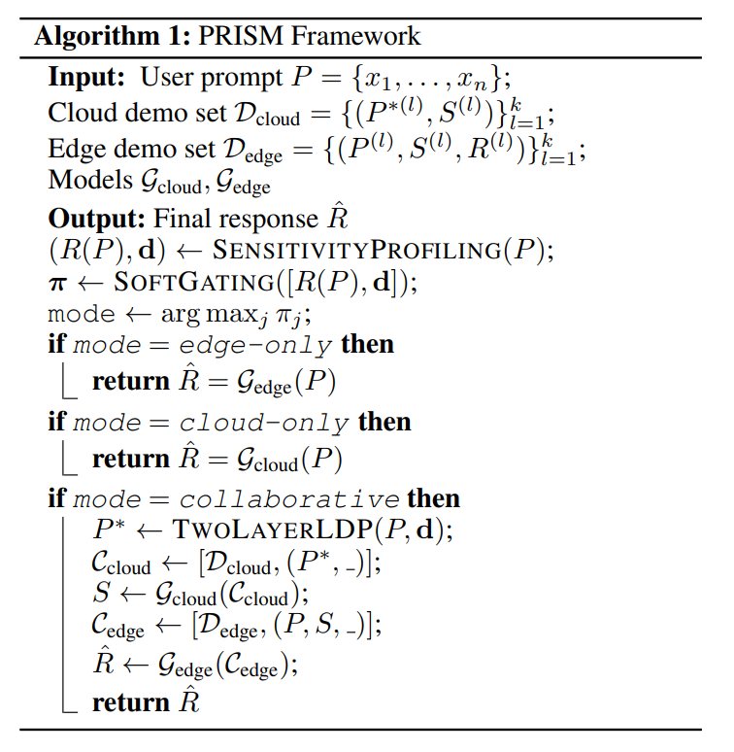
Cloud-Edge Semantic Sketch Collaboration
PRISM does not ask the cloud to generate the final answer.
Semantic Sketch
A concise and structured response outline
Captures the task semantics of the perturbed prompt
Does not attempt to reconstruct the original sensitive entities
What does the cloud provide?
  Task-level semantics
  Response structure
  High-level reasoning guidance
What does the cloud NOT need?
  Alice's real identity
  The original destination
  Exact private context
  Day 1: Arrival and check-in
  Day 2: Explore the destination
  Day 3: Local activities
  ...
  Day 6: Departure
Notes:
This is where the semantic sketch comes in. PRISM does not ask the cloud to generate the final answer. Instead, the cloud generates a semantic sketch. A semantic sketch is a concise and structured response outline. It captures the task semantics of the perturbed prompt, but it does not try to reconstruct the original sensitive entities.
For example, for a travel-planning task, the sketch can contain a structure like: Day one, arrival and check-in. Day two, explore the destination.Day three, local activities. And so on. So what the cloud provides is task-level semantics, response structure, and high-level reasoning guidance. What the cloud does not need is Alice’s real identity, the original destination, or the exact private context. The idea is that the cloud only needs to understand the task and generate a useful response structure

Slide 15
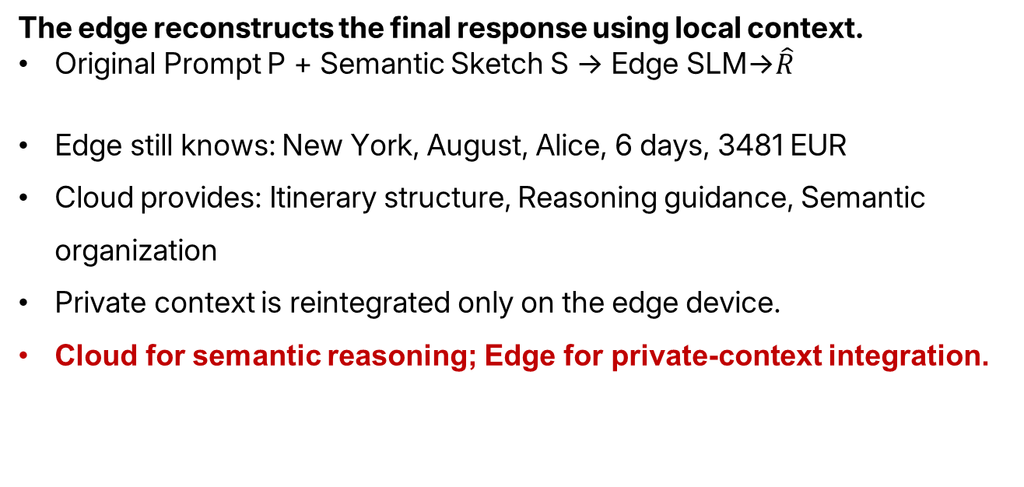
Edge-side Refinement
The edge reconstructs the final response using local context.
Original Prompt P + Semantic Sketch S → Edge SLM→$\hat{R}$
Edge still knows: New York, August, Alice, 6 days, 3481 EUR
Cloud provides: Itinerary structure, Reasoning guidance, Semantic organization
Private context is reintegrated only on the edge device.
Cloud for semantic reasoning; Edge for private-context integration.
Notes:
Once the semantic sketch is returned from the cloud, the final generation is performed on the edge. The edge still has access to the original prompt. So the edge SLM receives both the original prompt and the semantic sketch.
The original prompt provides the actual private context, such as New York, August, Alice, the trip duration, and the budget. The semantic sketch provides the response structure and high-level guidance from the stronger cloud model. The edge SLM then combines these two sources to generate the final personalized response. So the sensitive context is reintegrated only locally on the edge device

Slide 16
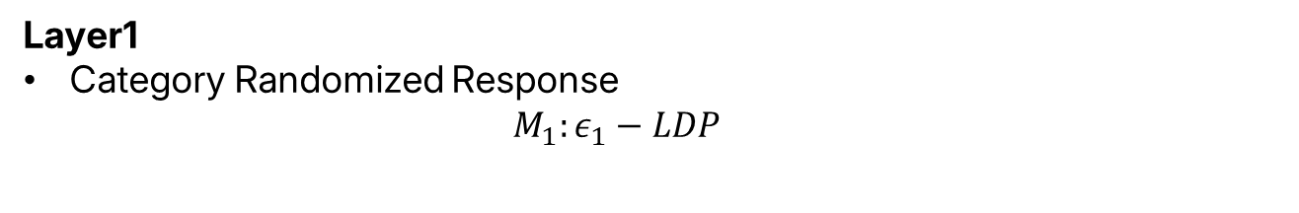
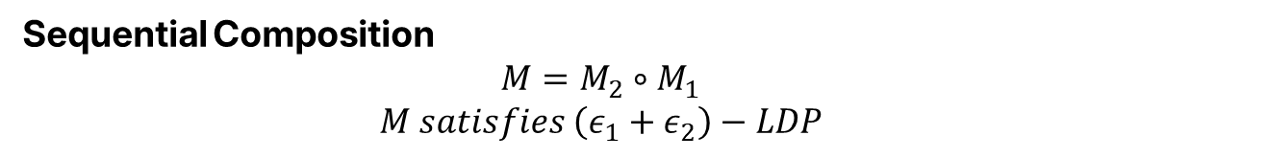
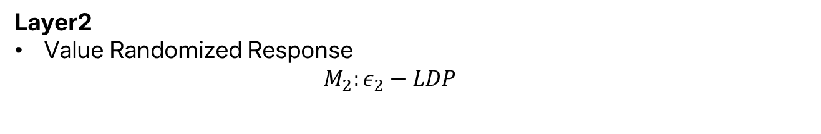
Privacy Guarantee
Does the two-layer mechanism satisfy LDP?
Layer1
Category Randomized Response
  $$M_{1}:ε_{1}−LDP$$
Theoretical Result
Formal LDP guarantee
Adaptive budget allocation
Sensitivity-dependent perturbation
Layer2
Value Randomized Response
  $$M_{2}:ε_{2}−LDP$$
Sequential Composition
  $$M=M_{2}∘{ M}_{1}$$
  $$M satisfies \left(ε_{1}+ε_{2}\right)−LDP$$
The privacy analysis establishes the formal guarantee of the proposed perturbation mechanism.
Notes:
The paper also provides a formal privacy analysis for the two-layer mechanism. The first category-level randomized response mechanism satisfies epsilon-one LDP. The second value-level randomized response mechanism satisfies epsilon-two LDP. Since these two mechanisms are applied sequentially, the authors use the standard sequential composition result. Therefore, the complete mechanism satisfies epsilon-one plus epsilon-two LDP.
So even though the privacy budget is adaptively divided across the two layers, the overall formal LDP guarantee is preserved. I’ll skip the detailed proof here.

Slide 17
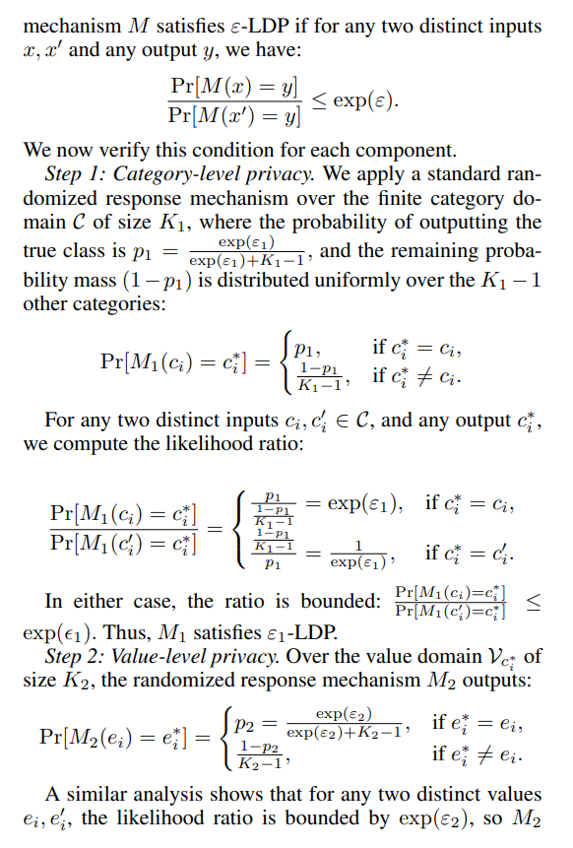
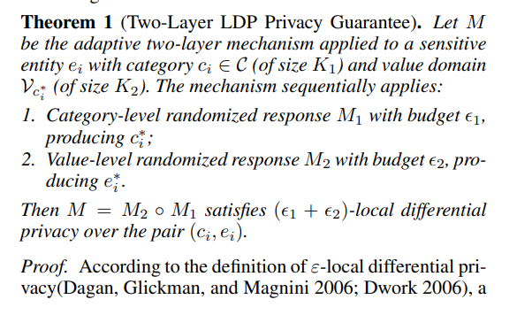
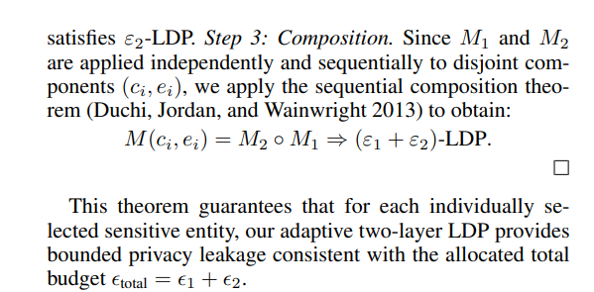
Privacy Guarantee
More details in Paper
Notes:
“I’ll skip the detailed proof and move directly to the experiments.”

Slide 18
Experimental Setup
Evaluation across privacy-sensitive application domains
Dataset
Domain | # Prompts
Tourism | 40
Medical | 40
Banking | 40
General Knowledge | 40
Total | 160
Baseline
Cloud-only
Edge-only
Uniform LDP
Selective LDP
PRISM
Metrics
Inference Quality: GPT-4o, 1-10
Completion Time: end-to-end latency
Energy Consumption: Edge-side energy in Joules
Notes:
For the evaluation, the authors construct a semi-synthetic dataset across four domains. These are tourism, medical consultation, banking, and general knowledge. Each domain contains 40 prompts, so the total dataset contains 160 prompts. They compare PRISM against four baselines: Cloud-only, Edge-only, Uniform LDP, and Selective LDP. They use three main evaluation metrics. The first is Inference Quality, scored from one to ten using GPT-4o as the judge. The second is Completion Time, which measures end-to-end latency. And the third is Energy Consumption, measured in Joules on the edge device. So the experiments evaluate not only response quality, but also system efficiency

Slide 19
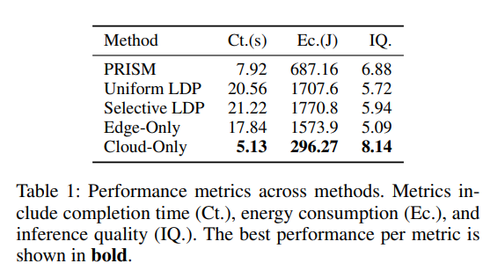
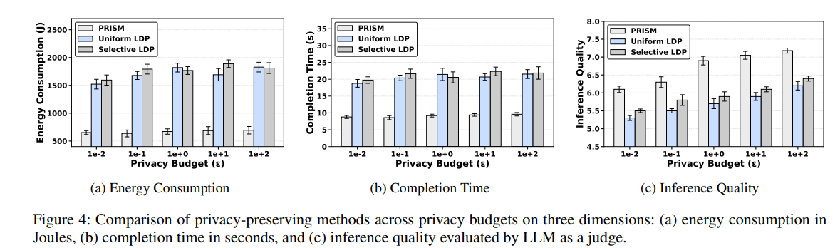
Main Results
PRISM achieves the best overall trade-off among privacy-preserving methods.
Key Observations
PRISM vs. Uniform / Selective LDP
  Much lower latency
  Much lower edge energy consumption
  Higher inference quality
Cloud-Only remains the strongest, but provides no privacy protection.
Notes:
This table shows the main performance results. Cloud-only achieves the best raw performance. It has the lowest latency, the lowest measured edge-side energy consumption, and the highest inference quality.
However, Cloud-only provides no privacy protection because it sends the original prompt directly to the cloud. So the more meaningful comparison is among the privacy-preserving approaches.
PRISM achieves a completion time of about 7.9 seconds, while Uniform and Selective LDP both require more than 20 seconds. Its edge energy consumption is about 687 Joules, compared with more than 1,700 Joules for the two LDP baselines. At the same time, its inference quality is also higher. So the main experimental claim is that PRISM provides the best overall quality-efficiency trade-off among the privacy-preserving methods evaluated in the paper

Slide 20
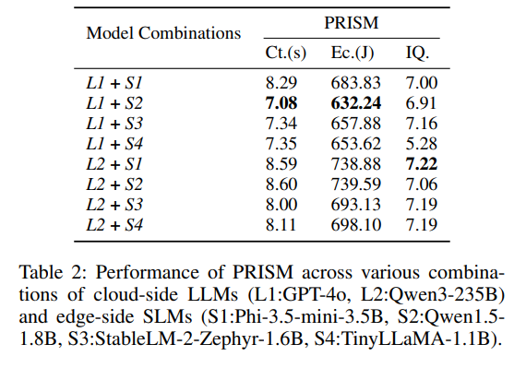
Main Results
Robustness Across Cloud–Edge Model Pairs
Fastest / Lowest Edge Energy
GPT-4o + Qwen1.5
7.08 s / 632.24 J / IQ 6.91
Highest IQ
Qwen3-235B + Phi-3.5
IQ 7.22
PRISM generally maintains similar efficiency and quality across heterogeneous model combinations.
Notes:
The authors also test whether PRISM depends on one specific cloud-edge model combination.
They evaluate two cloud models, GPT-4o and Qwen3-235B, with four different edge models.
The fastest and most energy-efficient combination is GPT-4o with Qwen1.5, with about 7.08 seconds of latency and 632 Joules of edge energy.
The highest inference quality is obtained using Qwen3-235B with Phi-3.5, with a score of 7.22.
Overall, the authors argue that PRISM maintains similar behavior across different cloud and edge model combinations.
This suggests that the framework can support heterogeneous deployments rather than relying on one specific model pair

Slide 21
Limitations
Limited empirical privacy evaluation
The paper provides an LDP guarantee, but does not directly evaluate:
  Sensitive-entity reconstruction
  Semantic inference attacks
  Cross-record linkage attacks
The motivation discusses linkage attacks, but the evaluation does not directly measure linkage resistance.
Small, semi-synthetic evaluation set (160 prompts across four domains)
  It remains unclear how the method performs on:
    Real user conversations
    Long-context interactions
    Multi-turn privacy leakage
Sensitivity profiling relies on relatively simple signals
  NER
  Predefined category weights
  First-person cues
Notes:
There are several limitations that I think are important.
The first, and probably the most important, is the limited empirical privacy evaluation.
The paper provides a formal LDP guarantee, but it does not directly test whether an attacker can reconstruct sensitive entities, infer sensitive semantic information, or successfully perform cross-record linkage.
This is especially notable because linkage attack is used as one of the motivations for the proposed two-layer mechanism.
So I think directly measuring linkage resistance would make the privacy claims much stronger.
The second limitation is the evaluation dataset.
It contains only 160 semi-synthetic prompts across four domains.
It is therefore unclear how well the framework would work in real multi-turn conversations, long-context interactions, or more realistic privacy scenarios.
Finally, the sensitivity profiling stage relies on relatively simple signals such as NER, predefined category weights, and first-person cues.
This may work well for explicit sensitive information, but it may be less effective for information that becomes sensitive only through more complex semantic inference.”

Slide 22
Takeways
PRISM in Three Ideas
1. Route according to sensitivity
  Cloud ∣ Collaboration ∣ Edge
2. Perturb according to entity risk
  Category LDP + Value LDP
3. Separate semantic reasoning from private context
  Cloud Sketch + Edge Refinement
  PRISM shows that privacy-aware routing and selective cloud–edge collaboration can substantially improve the privacy–utility–efficiency trade-off.
  However, stronger empirical evaluation of inferential and linkage privacy would make the privacy claims more convincing.
Notes:
To summarize, I think PRISM can be understood through three main ideas.
First, route according to sensitivity.
Instead of processing every prompt in the same way, PRISM chooses between cloud, cloud-edge collaboration, and edge inference.
Second, perturb according to entity risk.
In the collaborative path, it applies category-level and value-level LDP rather than uniformly perturbing the entire prompt.
Third, separate semantic reasoning from private context.
The cloud generates a semantic sketch that captures the task structure, while the edge uses the original private context to produce the final response.
Overall, the paper shows that privacy-aware routing and selective cloud-edge collaboration can provide a better balance between privacy, utility, latency, and edge-side energy consumption.
However, I think stronger empirical evaluation of reconstruction and linkage attacks would make the privacy claims more convincing.
That’s all for my presentation. Thank you

