Slide 1
Drift: Enhancing LLM Faithfulness in Rational Generation via Dual-Reward Probabilistic Inference
Surin Lee
May 01, 2026
INFONET Journal Club Presentation
Notes:
Hello everyone, today I will present a paper titled “Drift: Enhancing LLM Faithfulness in Rationale Generation via Dual-Reward Probabilistic Inference.” This is a long paper from ACL 2025, and the main focus is improving the faithfulness of explanations generated by large language models.

Slide 2
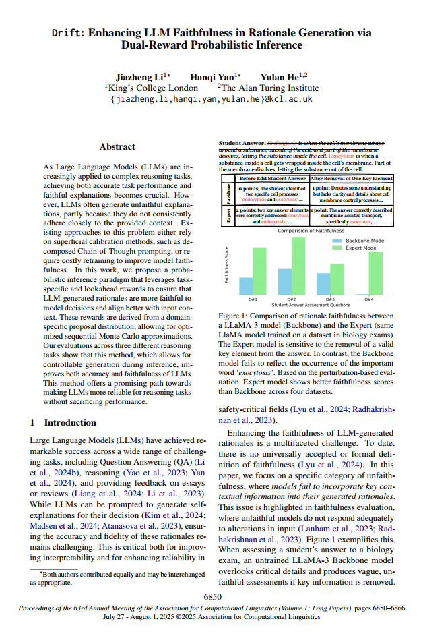
Overview
Title: Drift: Enhancing LLM Faithfulness in Rationale Generation via Dual-Reward Probabilistic Inference
Publisher: ACL 2025 (Long paper)
Key Idea: Guide the generation process at inference time using reward signals, instead of retraining the model
Notes:
This slide briefly introduces the paper. The paper proposes a method called Drift, which aims to improve both the correctness of answers and the faithfulness of explanations generated by LLMs. The key idea is to guide the generation process at inference time using reward signals, instead of retraining the model.

Slide 3
Motivation
Why Do We Care About Faithful Explanations?
Large Language Models (LLMs) are widely used for reasoning tasks
  Question Answering
  Natural Language Inference
  Educational feedback
LLMs can generate explanations (rationales) for their answers
However, these explanations are often:
  Fluent and convincing
  But not actually grounded in the input
Key point: An explanation can sound correct without reflecting the true reasoning process
Notes:
Recently, Large Language Models are being used not only for generating text, but also for reasoning tasks such as question answering, natural language inference, and educational feedback. In these tasks, models are often asked not only to provide an answer, but also to explain why the answer is correct. For example, in educational assessment, the model may assign a score to a student answer and then generate a rationale explaining the score. The problem is that these explanations are often very fluent and convincing, but they are not necessarily grounded in the actual input. In other words, the explanation may sound reasonable, but it may ignore important information from the context. So the key issue addressed in this paper is: How can we make LLM-generated explanations more faithful to the input and decision process?

Slide 4
Problem Statement
The Faithfulness Problem
Faithfulness refers to whether an explanation:
  is based on the input context
  reflects the model’s actual decision process
In practice, LLMs often:
  ignore important parts of the input
  rely on general knowledge instead
As a result: explanations may not change even if the input changes
Example intuition:
  Removing a key word from input
  Model still produces similar explanation → unfaithful
Notes:
This slide explains what the authors mean by “faithfulness.” Here, faithfulness means that the explanation should actually depend on the input context and reflect the model’s reasoning process. However, in practice, LLMs often rely heavily on their pretrained knowledge. As a result, they may generate generic explanations that sound plausible even when the input changes. For example, imagine we remove an important keyword from the input sentence.
If the explanation still remains almost identical, that means the explanation was not truly grounded in the input. So the paper argues that: A good explanation is not just fluent — it should also react appropriately to changes in the input.

Slide 5
Limitations of Existing Methods
Chain-of-Thought (CoT) prompting
  Generates step-by-step reasoning
  Improves interpretability
  But does not guarantee faithfulness
Post-hoc verification
  Uses external tools to check reasoning
  Can improve reliability
  But:
    Expensive
    applied after generation
Notes:
Now let’s look at existing approaches. First, Chain-of-Thought prompting generates step-by-step reasoning, which improves interpretability. However, it does not guarantee that the reasoning is actually grounded in the input.
Second, post-hoc verification methods use external tools to check reasoning, which can improve reliability, but they are expensive and applied after generation.

Slide 6
Limitations of Existing Methods
Fine-tuning for faithfulness
  Train models with supervision
  Effective but:
    Requires labeled data
    High training cost
Summary: Existing methods are either expensive or do not directly control faithfulness during generation
Notes:
Another approach is fine-tuning models specifically for faithfulness. This can be effective, but it requires labeled data and has high training cost. So overall, existing methods are either expensive or do not directly control faithfulness during generation.

Slide 7
Key Idea: Reward-Guided Inference
Instead of retraining the model, control generation at inference time
Introduce two types of rewards:
  Task Reward → encourages correct answers
  Rationale Reward → encourages faithful explanations
During generation:
  multiple candidate outputs are explored
  outputs with higher reward are preferred
Key intuition: Guide the model toward better explanations while generating text
Notes:
The core idea of this paper is actually quite intuitive. Instead of retraining the entire model, the authors try to guide the generation process during inference time. They do this by introducing two different reward signals.
The first is the task reward, which focuses on generating the correct answer. The second is the rationale reward, which focuses on generating explanations that are more faithful to the input. During decoding, the model explores multiple possible outputs. Then, outputs with higher rewards are preferred. So rather than changing the model parameters, the paper changes how the model searches for outputs. You can think of it as: “reward-guided decoding” instead of retraining.

Slide 8
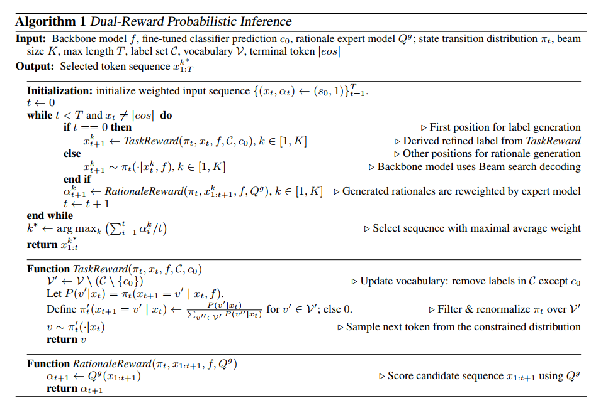
Drift Framework Overview
The generation process is structured as: Input → Answer → Rational
Process:
Generate answer first
Then generate explanation (rationale)
At each step:
  evaluate candidates using rewards
Select the best sequence
Key point:
Multiple candidate sequences (trajectories)
Each sequence receives a score
Final output is the highest-scoring one
Notes:
This slide shows the overall Drift framework. The process is divided into two stages: first generating the answer, and then generating the explanation, or rationale. Instead of generating only one sequence greedily, the framework keeps multiple candidate sequences, which the paper calls trajectories. This allows the model to compare different reasoning paths before selecting the final output. At every generation step, these trajectories are evaluated using reward signals. For example, one candidate may produce a better answer, while another candidate may generate a more context-aware explanation. The framework combines the original model probability with reward scores to evaluate each trajectory. As generation continues, higher-reward trajectories survive, while lower-quality candidates are removed. Finally, the framework selects the sequence with the highest overall reward. So overall, Drift treats text generation as a search problem: exploring multiple reasoning paths and selecting the best one.

Slide 9
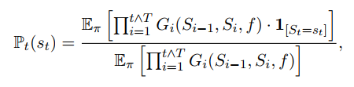
Probabilistic Inference Framework
Probabilistic Inference (Feynman-Kac)
Text generation is modeled as a sequence of decisions:
  choosing one token at each step
Each possible sequence (trajectory):
  has a probability
  receives a reward score
model probability + reward scores
→ to compute a weighted likelihood of each sequence
  Sequences with higher rewards become more likely to be selected
Notes:
Now let’s look at the probabilistic inference framework. The paper models text generation as a sequence of decisions. At each step, the model chooses the next token. Normally, LLMs select tokens mainly based on model probability. However, Drift additionally introduces reward scores into this process. So each candidate sequence now has: a model probability and a reward value. The framework combines these two signals to compute a weighted likelihood for each trajectory. As a result, sequences that are both probable and high-reward become more likely to survive during decoding. The important idea here is: the model is not only generating likely text, but also searching for more faithful explanations.

Slide 10
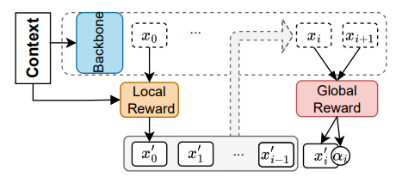
Task Reward (Improving Answer Accuracy)
A classifier predicts the correct label (answer)
During generation:
  restrict the vocabulary
  only allow the predicted label
Example:
  Possible labels: {entailment, contradiction, neutral}
  Classifier predicts: contradiction
  → Only “contradiction” is allowed
Forces the model to produce the correct answer
Notes:
The first reward component is the task reward. Its role is to improve answer accuracy. Here, the framework uses a separate classifier to predict the correct label. Then during decoding, the vocabulary is restricted so that only the predicted label is allowed. For example, in natural language inference, the possible labels are: entailment, contradiction, neutral. If the classifier predicts “contradiction,” then the decoder blocks the other labels and only allows “contradiction.” So this acts like a strong constraint on answer generation. The intuition is simple: force the model toward the correct answer before generating the explanation.
왼쪽의 Context는 입력 문맥, 이 input이 Backbone LLM으로 들어가고, Backbone이 일반적인 autoregressive decoding처럼 token을 생성. 위쪽 점선 흐름이 backbone의 일반적인 token generation 과정. 현재 생성 단계에서:
올바른 answer(label)를 강하게 유도 왜 Local Reward인가? 현재 시점의 token 선택에 직접 개입하기 때문. 즉:“지금 이 token이 맞는가?”를 locally 제어하는 reward.

Slide 11
Rational Reward (Improving Faithfulness)
Use a generative expert model
At each step:
  evaluate the generated partial sequence
  assign a reward score
If the explanation aligns well with the input:
                → higher reward
If it is generic or irrelevant:→ lower reward
Important property:
  The reward considers the sequence context
  Not just the current token
Encourages explanations that are more consistent with the input
Notes:
The second reward component is the rationale reward, which is the key part of this paper. Here, the framework uses another generative expert model to evaluate the explanation during generation. At each decoding step, the expert model checks whether the partially generated explanation aligns well with the input context. If the explanation is context-aware and relevant, it receives a high reward. If it is generic or unrelated to the input, it receives a lower reward. An important point is that this reward is not based only on the current token. Instead, it considers the sequence context and evaluates how plausible the future continuation will be. This is why the paper describes it as a lookahead reward. So the rationale reward encourages explanations that are: more context-sensitive, more input-aware, and less generic.
아래 회색 박스 = Candidate Trajectories, reward를 적용하면서 유지되는 candidate sequence들이야. 여러 decoding path 여러 reasoning trajectory 를 동시에 유지하는 공간. 현재까지 생성된 sequence 전체를 보고: explanation이 context와 잘 aligned되는지 자연스럽고 faithful한지 를 평가함. 왜 Global Reward인가? 현재 token 하나만 보는 게 아니라: x0 ~ xi 전체 trajectory 전체를 평가하기 때문. 즉: sequence-level reward 라고 볼 수 있음. α_i 는 해당 trajectory의 reward score. 즉: 현재 candidate sequence가 얼마나 좋은지, 얼마나 faithful한지 를 나타내는 점수. 기존 디코딩은 확률 높은 token만 선택, drift는 확률 + reward 함께 고려. 즉 backbone probability, local reward, global reward 를 동시에 사용해 더 좋은 explanation trajectory를 탐색하는 구조

Slide 12
Why It Works
Uses multiple candidate sequences instead of one
Evaluates sequences using:
  model probability
  reward signals
Key mechanisms:
  Lookahead effect: evaluates how well the sequence will continue
  Trajectory selection: chooses the best overall sequence
Result: More context-aware and consistent explanations
Notes:
So why does this approach work? Traditional decoding methods usually generate only one sequence greedily, or make local token-level decisions. In contrast, Drift explores multiple candidate trajectories simultaneously. It evaluates them using both: model probability, and reward signals. There are two important mechanisms here. The first is the lookahead effect. Instead of evaluating only the current token, Drift also considers how well the sequence is likely to continue in the future. The second is trajectory selection. Among many possible candidate sequences, the framework keeps high-quality ones and removes poor ones. As a result, the final explanation becomes more context-aware and more consistent with the input.

Slide 13
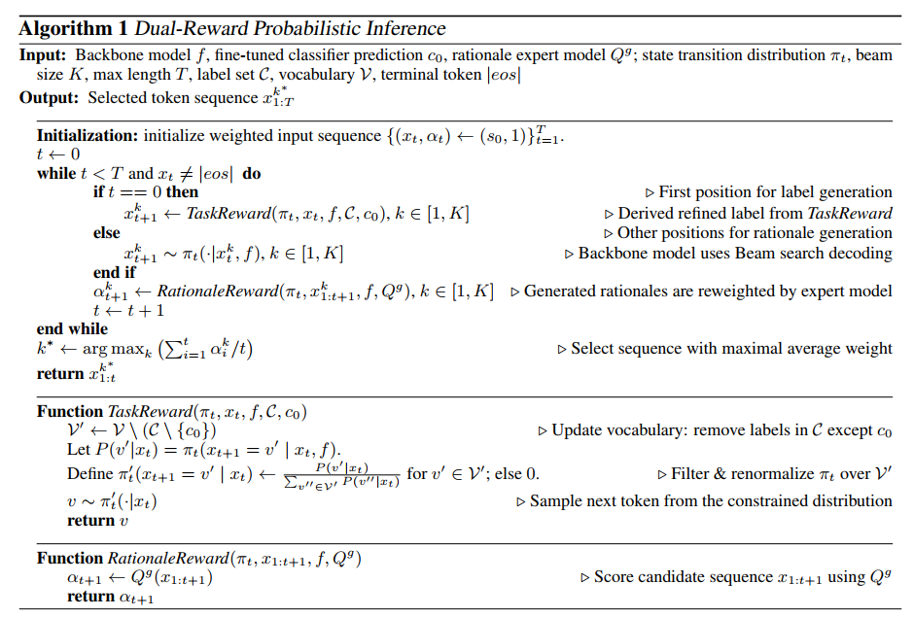
Dual-Reward Probabilistic Inference
Notes:
This slide shows the full algorithm. At a high level, the model generates multiple candidate sequences, applies task reward at the answer stage, and applies rationale reward during explanation generation. Then it selects the sequence with the highest average reward. So overall, it is a reward-guided decoding process.

Slide 14
Experimental Setup
Tasks:
  Student Answer Assessment (ASAP)
  Natural Language Inference (SNLI, MNLI)
  Question Answering (TruthfulQA)
Models:
  Backbone:
    LLaMA-3-8B
    Mistral-7B
  Reward models:
    classifier (task reward)
    expert LLM (rationale reward)
Evaluation Metrics:
  Accuracy → correctness of answer
  Faithfulness → sensitivity to input changes
Notes:
Now let’s move to the experiments. The method is evaluated on three tasks: student answer assessment, natural language inference, and question answering. In student answer assessment, the model predicts scores for student responses and generates rationales explaining the scores. In natural language inference, the model determines the relationship between two sentences, such as entailment, contradiction, or neutral. In question answering, the model answers questions while also generating explanations for the answers. They use LLaMA-3 and Mistral as backbone models. The classifier is a task-specific classification model used to improve answer correctness, while the expert model is a generative LLM that evaluates whether the explanation is well aligned with the input context. Performance is evaluated using two metrics: accuracy for correctness, and faithfulness, which measures sensitivity to input changes.
backbone 모델은 실제로 answer와 explanation을 생성하는 역할을 하며, 추가적으로 두 가지 reward model이 generation 과정을 제어한다. 먼저 classifier 모델은 task reward를 제공하며, 올바른 label을 예측하여 answer accuracy를 높이는 역할을 한다. 반면 expert LLM은 rationale reward를 제공하며, 생성된 explanation이 입력 context와 얼마나 잘 aligned되는지를 평가하여 explanation faithfulness를 향상시킨다. 마지막으로 성능은 answer correctness를 측정하는 accuracy와, 입력 변화에 explanation이 얼마나 민감하게 반응하는지를 측정하는 faithfulness metric을 통해 평가

Slide 15
Faithfulness Evaluation
Based on input perturbation
Method 1: Removal
  remove important part of input
  check if explanation changes
Method 2: Insertion
  add new words to input
  check if explanation reflects them
Metrics:
  Semantic change between explanations
  Whether new words appear in explanation
Larger change → more faithful explanation
Notes:
Now let’s look at how the paper evaluates faithfulness. The key idea is input perturbation. The authors intentionally modify the input and then observe whether the explanation changes accordingly. There are two perturbation methods. The first is removal: they remove an important part of the input and check whether the explanation changes. The second is insertion: they insert new words into the input and check whether the explanation reflects the inserted information. The assumption is: if the explanation truly depends on the input, then the explanation should also change when the input changes.
So larger semantic changes indicate higher faithfulness.
논문의 핵심 가정은 explanation이 실제로 입력에 grounded되어 있다면 입력이 바뀌었을 때 explanation도 함께 변화해야 한다는 것이며, 따라서 explanation의 변화가 클수록 더 faithful한 explanation이라고 판단 평가에서는 input perturbation 기반 방법을 사용한다. removal 방식은 입력에서 중요한 정보를 제거한 뒤 explanation이 얼마나 변화하는지를 확인. 두 번째는 insertion 방식으로, 새로운 단어나 정보를 입력에 추가한 뒤 explanation이 그 변화를 실제로 반영하는지를 평가. 이후 원래 explanation과 수정된 explanation 사이의 semantic change를 측정하거나, 새롭게 추가된 단어가 explanation에 포함되는지를 확인하여 faithfulness를 계산

Slide 16
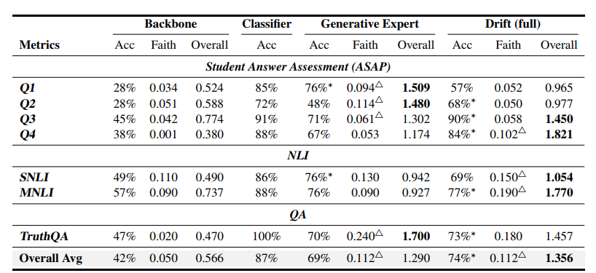
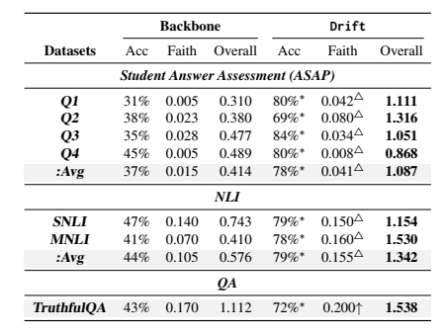
Main Results
Drift improves:
  answer accuracy
  explanation faithfulness
Compared to:
  backbone model
  expert model
Observation:
  Backbone → low accuracy and faithfulness
  Expert → better accuracy
  Drift → improves both
→ Drift achieves better overall performance across tasks
Notes:
These are the main experimental results. The authors compare four settings: the original backbone model, a classifier-based model, a standalone expert model, and the full Drift framework. They evaluate these models on multiple reasoning tasks using both answer accuracy and explanation faithfulness. Overall, Drift improves both answer accuracy and explanation faithfulness. Compared to the backbone model, Drift consistently performs better across different tasks. The expert model alone improves accuracy, but Drift further improves both metrics by combining task reward and rationale reward together. In several tasks, Drift even outperforms the standalone expert model. So the main conclusion from these experiments is: reward-guided decoding can improve both correctness and faithfulness at inference time.

Slide 17
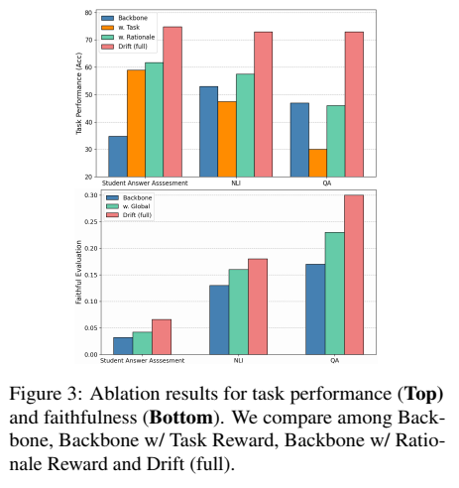
Ablation Study
Evaluate effect of each reward
Task reward only:
  improves answer accuracy
  does not improve explanation quality
Rationale reward only: improves faithfulness
Both together: best performance
→ Rationale reward is essential for faithfulness
Notes:
The ablation study analyzes the contribution of each reward component. When only task reward is used, answer accuracy improves, but explanation quality does not improve much. When only rationale reward is used, faithfulness improves significantly. And when both are combined, the framework achieves the best overall performance. This result suggests that rationale reward is the key component responsible for improving faithfulness.

Slide 18
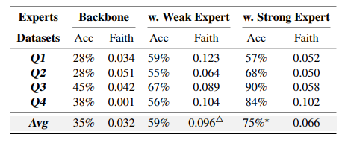
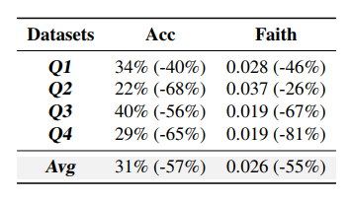
Further Analysis
Weak expert model
  Still improves performance
  Not dependent on strong expert
Comparison with logit fusion
  Drift performs better
  local token-level methods are less effective
Notes:
In further analysis, the authors show that the method still works even with weaker expert models. They also compare it with logit fusion, a token-level method, and show that Drift performs better. This suggests that sequence-level reward is more effective than local token-level control.

Slide 19
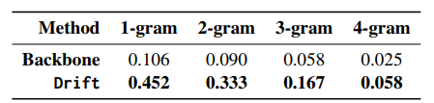
Further Analysis
Domain-specific words
  Drift includes more relevant terms from input
Conclusion: Drift generalizes well and captures input information better
Notes:
They also analyze domain-specific words. Drift includes more relevant words from the input in the explanation. This indicates that Drift captures input information more effectively and generalizes well.

Slide 20
Limitations
Limited to classification tasks
  Output space is restricted
  Not tested on open-ended generation
Strong constraint in task reward
  Hard restriction on labels
  May reduce flexibility
Limited exploration of expert models
  Only a few types tested
  performance may vary with different experts
Further work is needed to extend and generalize the approach
Notes:
Finally, the limitations. First, the method is only evaluated on classification tasks, and not on open-ended generation. Second, the task reward imposes strong constraints, which may reduce flexibility.
Third, only a limited number of expert models are explored. So further work is needed to extend and generalize this approach.

Slide 21
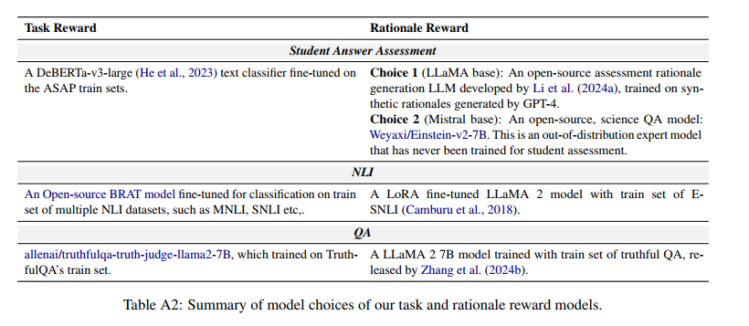
Appendix. Reward Model Details
Notes:
Key Point
Task reward models improve answer correctness
Rationale reward models evaluate explanation faithfulness
Drift supports both in-domain and out-of-domain expert models

Slide 22
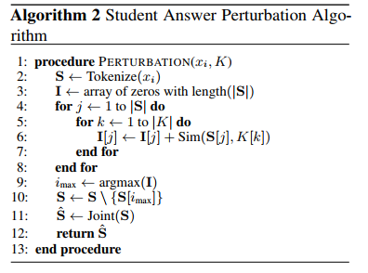
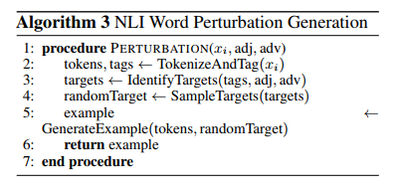
Appendix. Perturbation Algorithm

