Slide 1
Journal Club:
“ReMoE: Fully Differentiable Mixture-of-Experts With ReLU Routing”
Junsung Kim
May. 8th, 2026
INFONET Journal Club Presentation

Slide 2
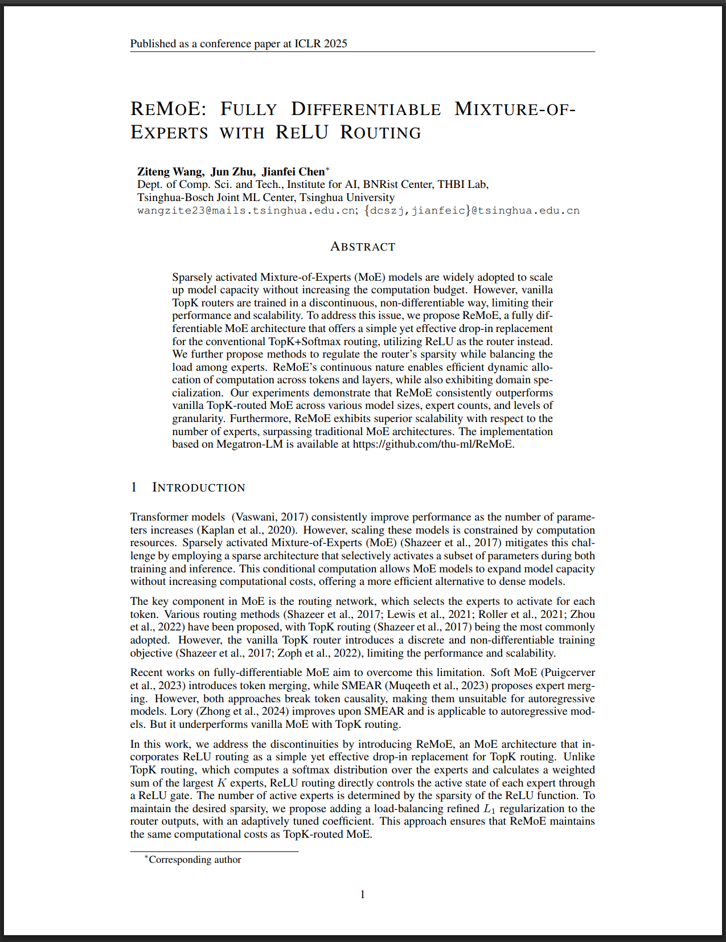
Paper Information
Paper Title: “ReMoE: Fully Differentiable Mixture-of-Experts With ReLU Routing”
Authors: Ziteng Wang, Jun Zhu, and Jianfei Chen
Affiliation: THBI Lab, Tsinghua University
Accepted conference: ICLR 2025

Slide 3
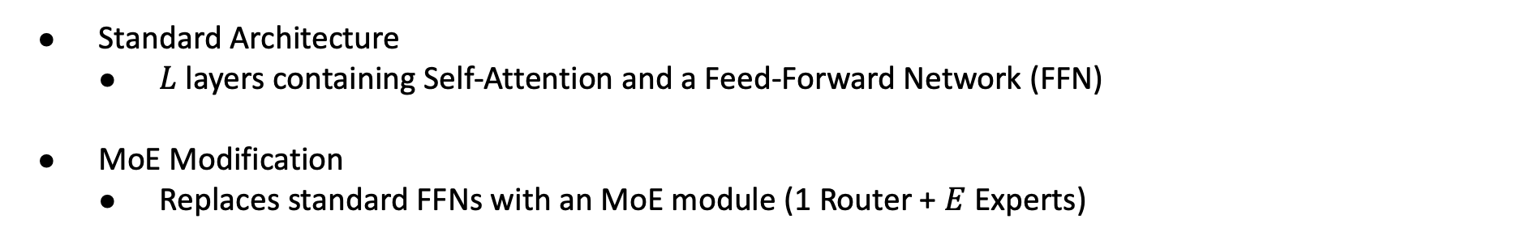
Preliminary: MoE for Decoder only Transformer
Standard Architecture
  $L$ layers containing Self-Attention and a Feed-Forward Network (FFN)
MoE Modification
  Replaces standard FFNs with an MoE module (1 Router + $E$ Experts)
Notes:
The explanations about these models on this paper is not enough. Need more search and summarization

Slide 4
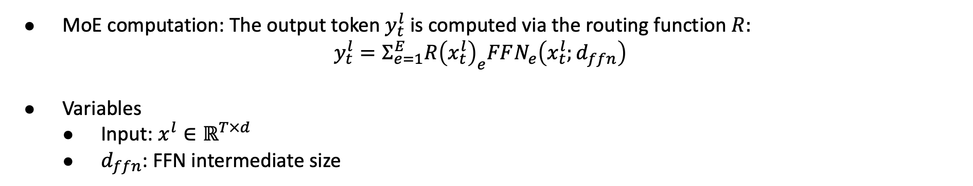
Preliminary: MoE for Decoder only Transformer
MoE computation: The output token $y_{t}^{l}$ is computed via the routing function $R:$
$$y_{t}^{l}=Σ_{e=1}^{E}R{\left(x_{t}^{l}\right)}_{e}FFN_{e}\left(x_{t}^{l};d_{ffn}\right)$$
Variables
  Input: $x^{l}∈ℝ^{T×d}$
  $d_{ffn}$: FFN intermediate size
Notes:
T: tokens
d: hidden size

Slide 5
Sparse MoE
The Scaling Bottleneck
  Increasing parameters improves Transformer performance
  Constrained by compute resources
The MoE Solution
  Conditionally activating only a subset of parameters during training and inference
Efficiency Gain
  Expands total model capacity without increasing compute costs
Challenge
  MoE relies on routing, typically TopK, to select experts per token
  It creates a discrete, non-differentiable training objective

Slide 6
Previous Approaches
Soft MoE & SMEAR
  Introduce token merging and expert merging
  Limitation 1: Break token causality
  Limitation 2: incompatible with autoregressive models
Lory
  Adapts expert merging for autoregressive compatibility
  Limitation: Underperforms TopK method
Notes:
Non-differentiable training objective that limits further scalability

Slide 7
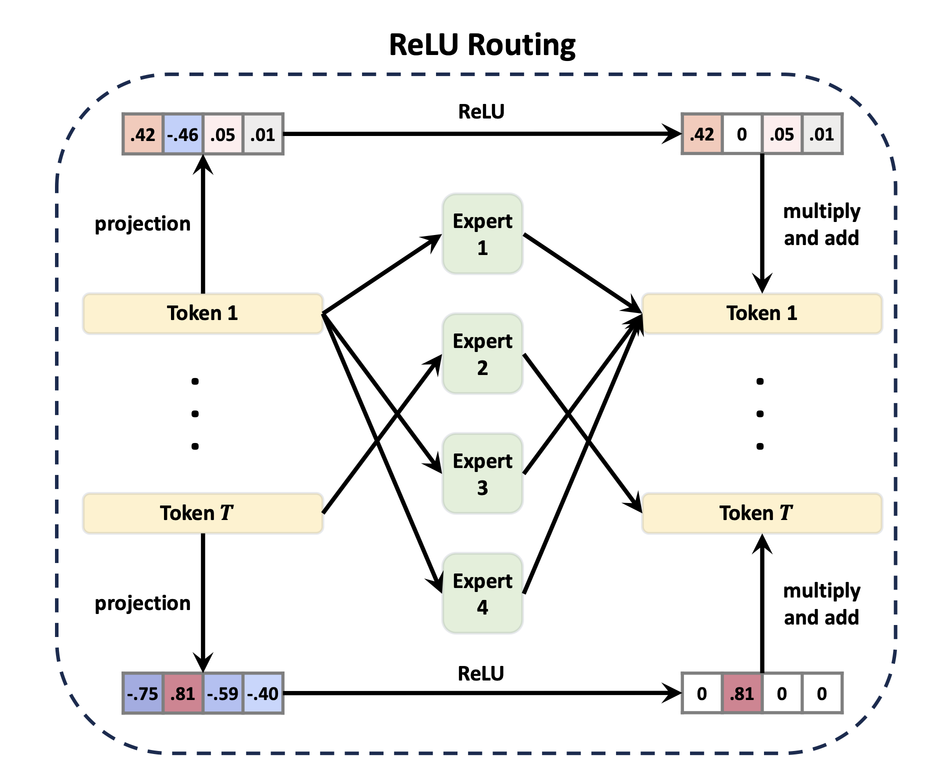
ReMoE: ReLU Routing
Notes:
Assign expert weights that allows exact zeros to drop unneeded experts

Slide 8
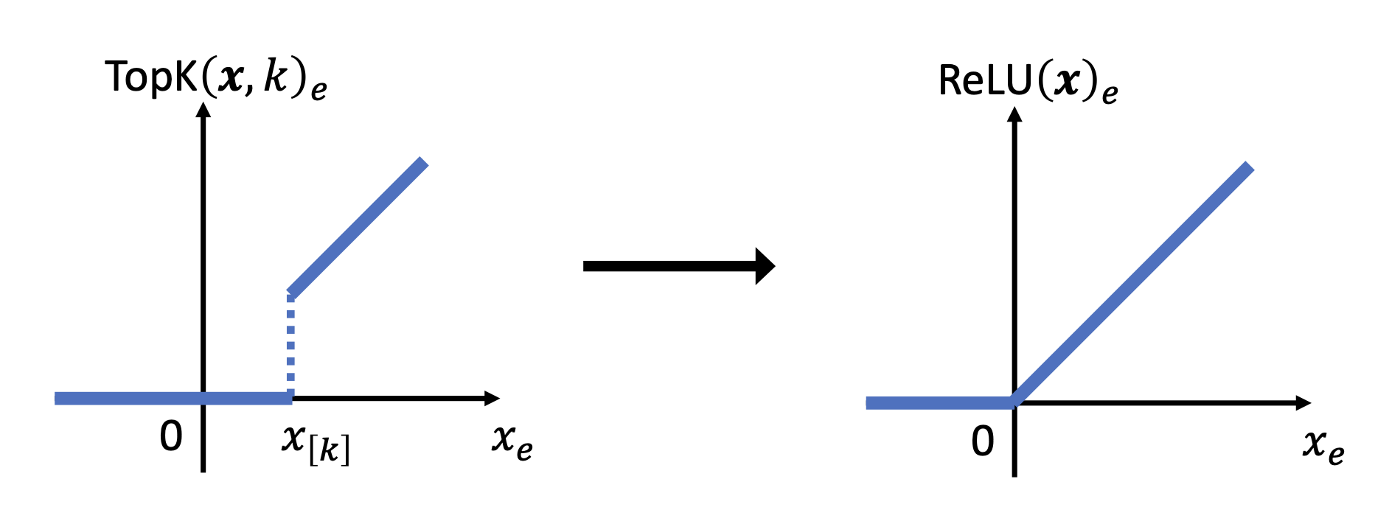
ReMoE: TopK vs ReLU

Slide 9
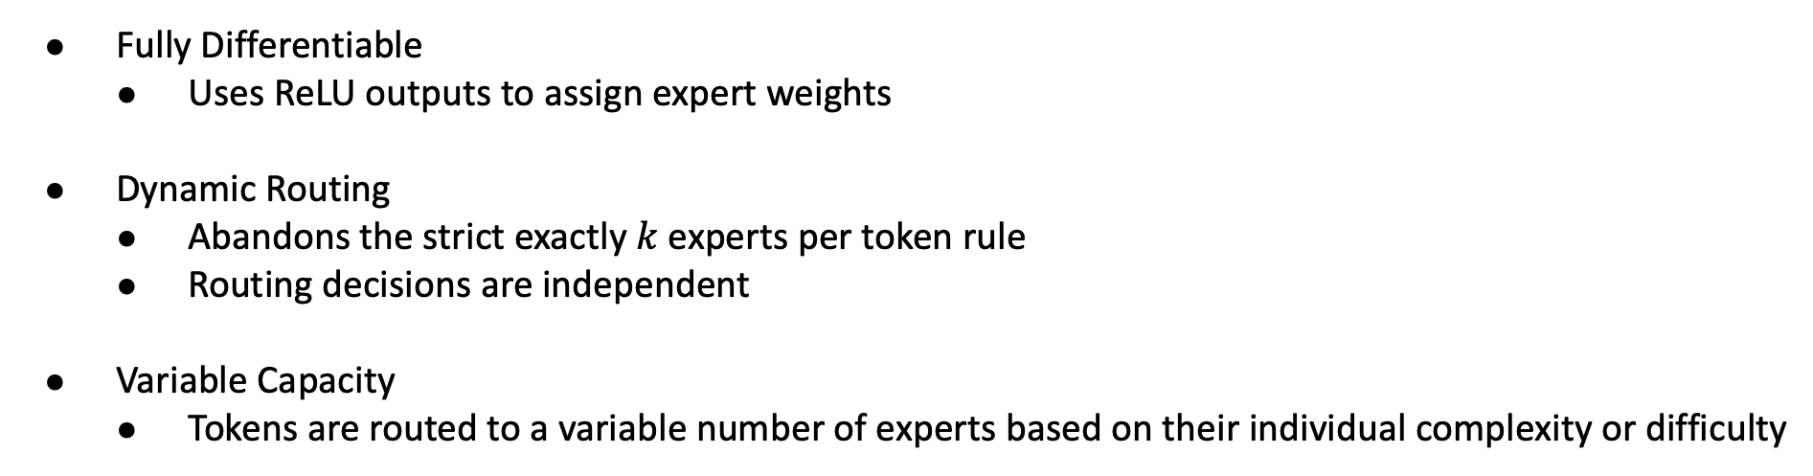
ReMoE: ReLU Routing
Fully Differentiable
  Uses ReLU outputs to assign expert weights
Dynamic Routing
  Abandons the strict exactly $k$ experts per token rule
  Routing decisions are independent
Variable Capacity
  Tokens are routed to a variable number of experts based on their individual complexity or difficulty
Notes:
Assign expert weights that allows exact zeros to drop unneeded experts

Slide 10
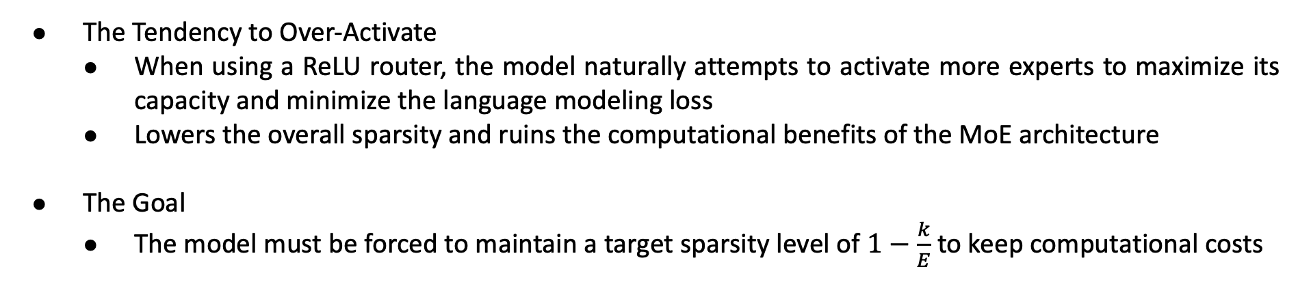
Controlling Sparsity
The Tendency to Over-Activate
  When using a ReLU router, the model naturally attempts to activate more experts to maximize its capacity and minimize the language modeling loss
  Lowers the overall sparsity and ruins the computational benefits of the MoE architecture
The Goal
  The model must be forced to maintain a target sparsity level of $1−\frac{k}{E}$ to keep computational costs

Slide 11
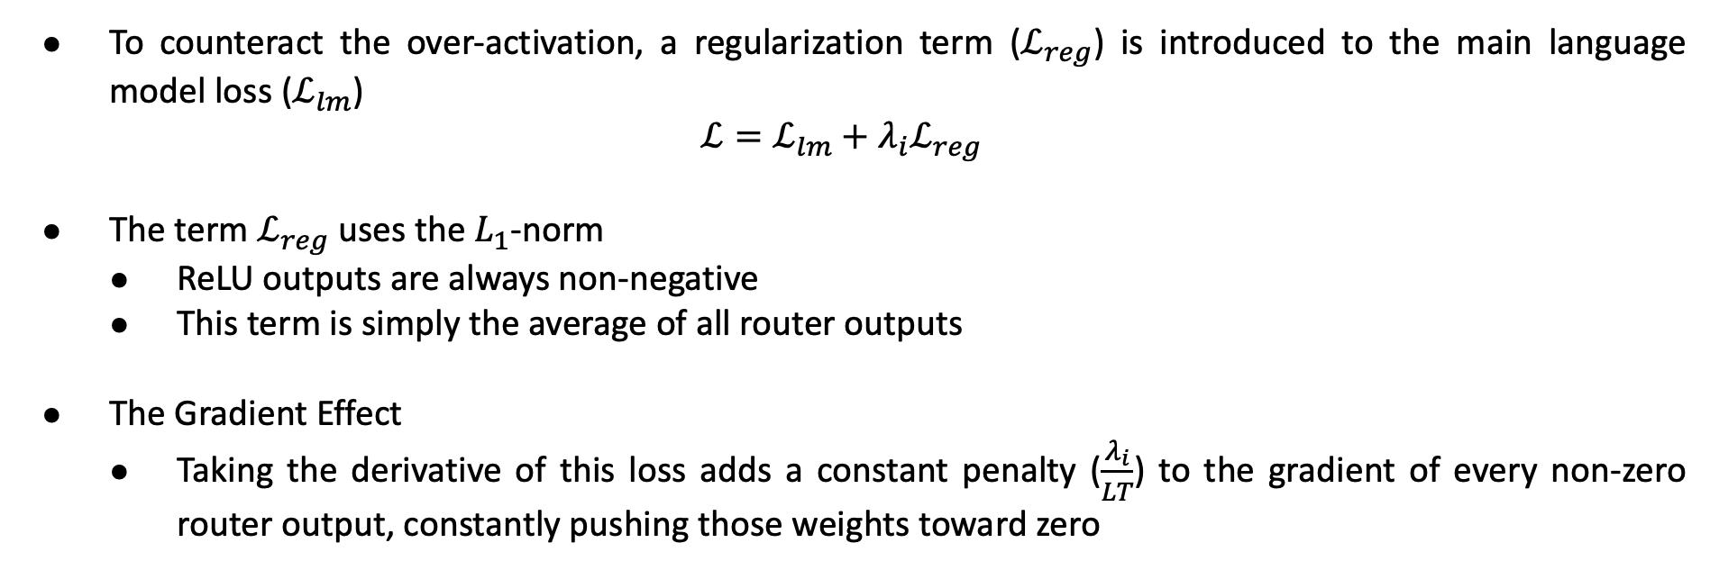
$L_{1}$ Regularization
To counteract the over-activation, a regularization term ($ℒ_{reg}$) is introduced to the main language model loss ($ℒ_{lm}$)
$$ℒ=ℒ_{lm}+λ_{i}ℒ_{reg}$$
The term $ℒ_{reg}$ uses the $L_{1}$-norm
  ReLU outputs are always non-negative
  This term is simply the average of all router outputs
The Gradient Effect
  Taking the derivative of this loss adds a constant penalty ($\frac{λ_{i}}{LT}$) to the gradient of every non-zero router output, constantly pushing those weights toward zero

Slide 12
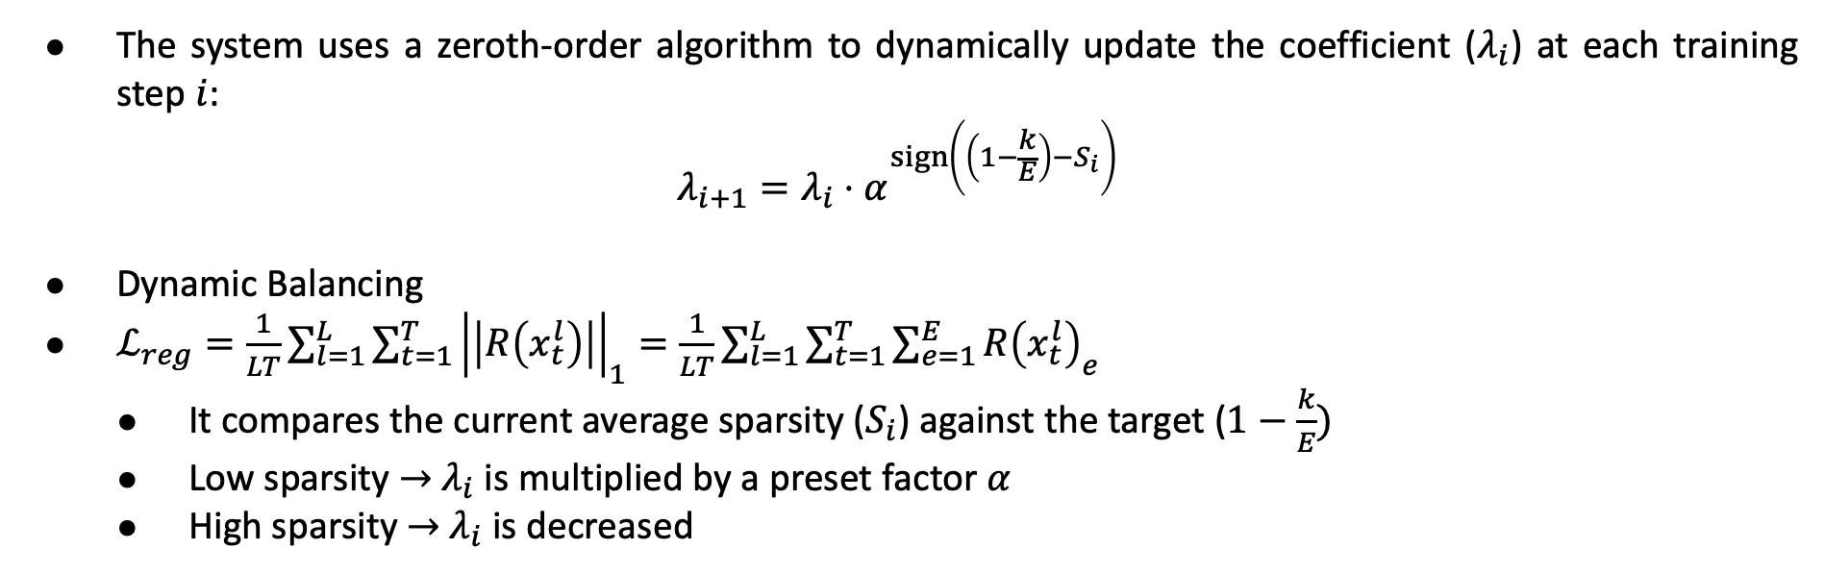
The Adaptive Coefficient
The system uses a zeroth-order algorithm to dynamically update the coefficient ($λ_{i}$) at each training step $i$:
$$λ_{i+1}=λ_{i}⋅α^{\operatorname{sign}\left(\left(1−\frac{k}{E}\right)−S_{i}\right)}$$
Dynamic Balancing
$ℒ_{reg}=\frac{1}{LT}\sum_{l=1}^{L}{\sum_{t=1}^{T}{{\left|\left|R\left(x_{t}^{l}\right)\right|\right|}_{1}}}=\frac{1}{LT}\sum_{l=1}^{L}{\sum_{t=1}^{T}{\sum_{e=1}^{E}{R{\left(x_{t}^{l}\right)}_{e}}}}$
  It compares the current average sparsity ($S_{i}$) against the target ($1−\frac{k}{E})$
  Low sparsity $→$ $λ_{i}$ is multiplied by a preset factor $α$
  High sparsity $→$ $λ_{i}$ is decreased
Notes:
A static penalty weight isn’t enough. So, the system uses ~~~
multiplied by a preset factor $α$, which increases the penalty and forcing more outputs to zero
$λ_{i}$ is decreased to loosen the restriction

Slide 13
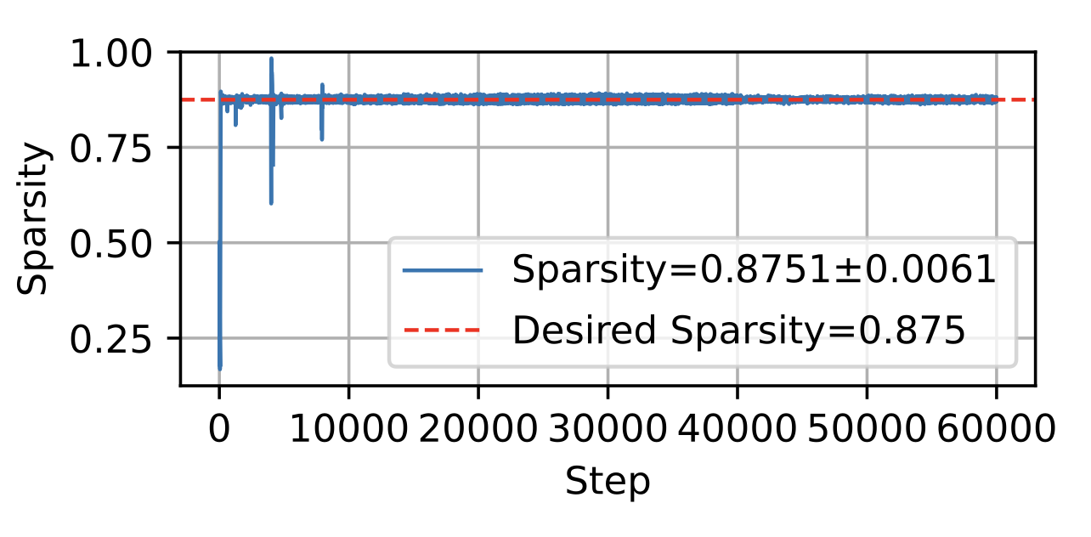
The Final Outcome
Notes:
Through this regularization, ReMoE sucessfullt locks average sparsity around the target, guaranteeing consistent computational efficiency

Slide 14
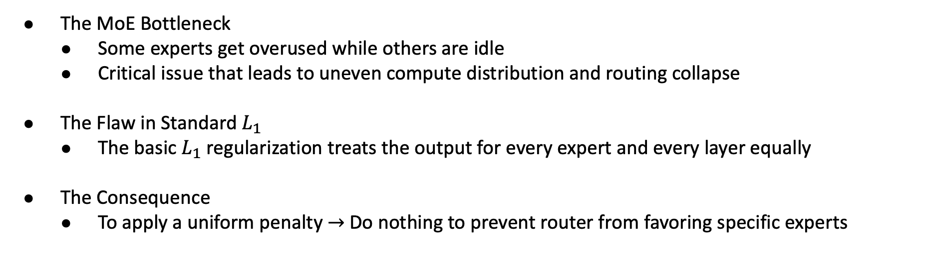
Load Balancing
The MoE Bottleneck
  Some experts get overused while others are idle
  Critical issue that leads to uneven compute distribution and routing collapse
The Flaw in Standard $L_{1}$
  The basic $L_{1}$ regularization treats the output for every expert and every layer equally
The Consequence
  To apply a uniform penalty $→$ Do nothing to prevent router from favoring specific experts
Notes:
To apply a uniform penalty $→$ Do nothing to prevent router from favoring specific experts. It worsens the load balancing problem

Slide 15
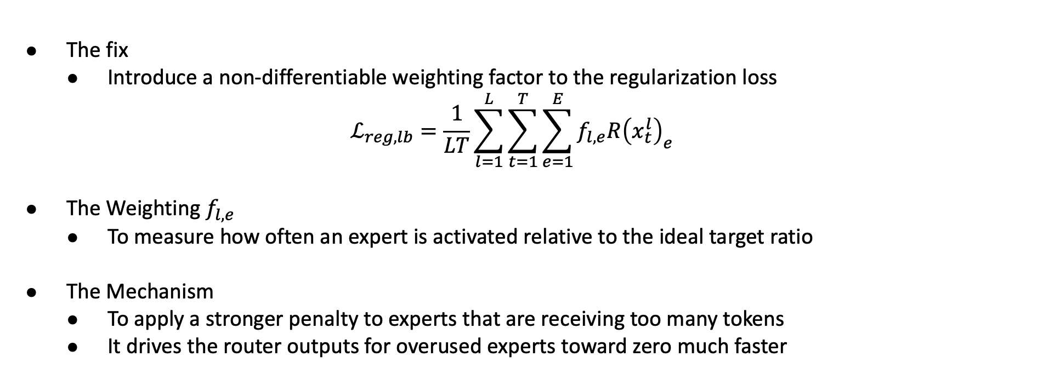
Load Balancing Refinement
The fix
  Introduce a non-differentiable weighting factor to the regularization loss
$$ℒ_{reg,lb}=\frac{1}{LT}\sum_{l=1}^{L}{\sum_{t=1}^{T}{\sum_{e=1}^{E}{f_{l,e}R{\left(x_{t}^{l}\right)}_{e}}}}$$
The Weighting $f_{l,e}$
  To measure how often an expert is activated relative to the ideal target ratio
The Mechanism
  To apply a stronger penalty to experts that are receiving too many tokens
  It drives the router outputs for overused experts toward zero much faster
Notes:
It drives the router outputs for overused experts toward zero much faster, and it naturally redistributes the load

Slide 16
Three-Stage Training
Stage 1: Warm-up (Dense Stage)
  The penalty coefficient starts very small
  The model acts like a dense model
  To allow experts to rapidly diversify from their random initializations while the main language loss drops quickly
Stage 2: Sparsifying stage
  The overall regularization term grows large enough to take effect
  The ReLU router beings aggressively pruning expert activations
  To force further expert specialization and drives sparsity straight up to the target without manipulating language model loss

Slide 17
Three-Stage Training
Stage 3: Stable Stage
  Sparsity hits and locks onto the preset target
  The model smoothly optimizes language model loss within the new sparse subspace
  The overall regularization penalty remains constant

Slide 18
Three-Stage Training
Computational Overhead & Mitigation
  Stage 1 and stage 2 activate a high number of experts
  It temporarily introduce higher memory and computational costs
Negligible Time Cost
  Typically resolve within 100 iterations
Memory Mitigation Strategies
  Micro-batching
  Activation Checkpointing
Notes:
100 iteration is accounted for only 0.17% of total training steps
Micro batching is to reduce batch size during the first 100 steps
Activation checkpointing is to discard intermediate activated expert results and recompute them dynamically during the backward pass to save VRAM

Slide 19
Comparison Against Other Routing Methods
Setup
  Active Params: 182M
  Number of Experts: 8
  Active Expert: 1
Baseline
  dMoE
  EC
  Hash
  Lory
  SparseMixer-v2
Notes:
dMoE --- Token-choice dropless TopK routing
EC --- Expert Choice TopK routing
Hash --- Deterministic hash routing
Lory --- Fully differentiable expert-merging
SparseMixer-v2 --- TopK with improved gradient estimation

Slide 20
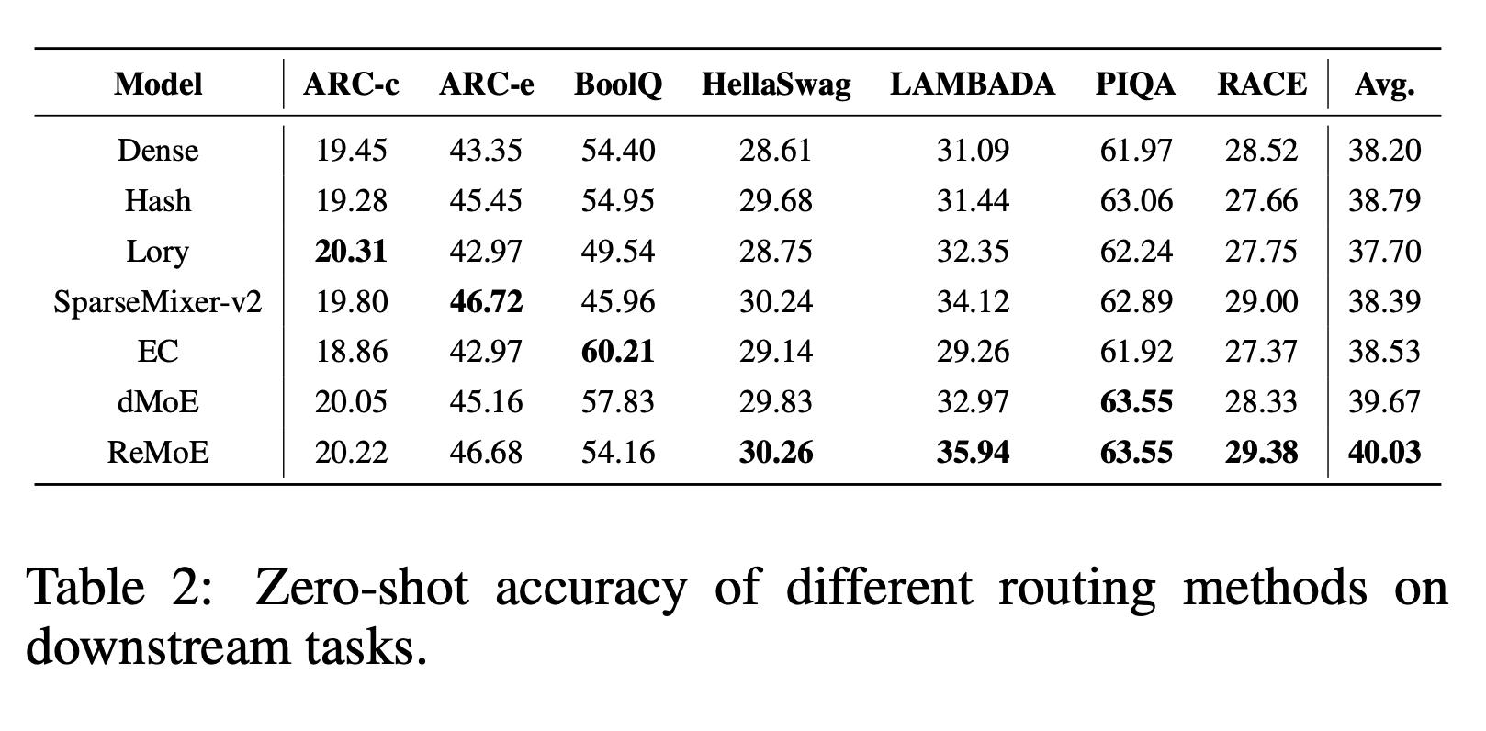
Comparison Against Other Routing Methods
Notes:
The overall takeaway is that ReMoE is the first fully-differentiable routing method to actually surpass TopK rather than trail it. Earlier differentiable approaches like Lory paid a quality cost for their differentiability, but ReMoE delivers both differentiability and superior performance simultaneously.

Slide 21
Scalability --- Active Params
Setup
  Active Params: 182M – 978M
  Number of Experts: 8
  Active Expert: 1

Slide 22
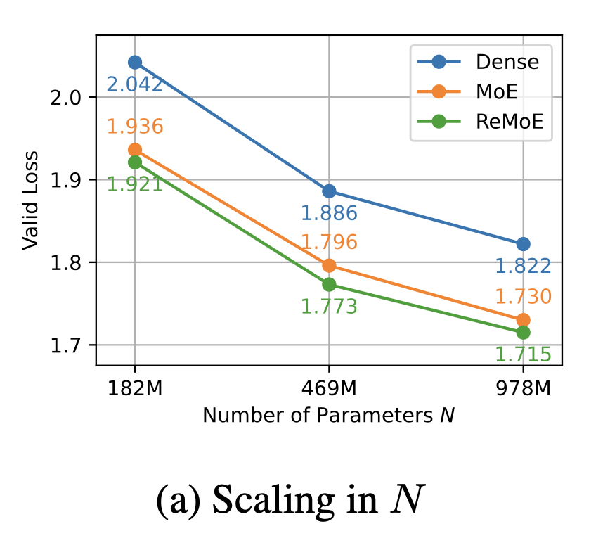
Scalability --- Active Params
Notes:
It consistently achieves a lower validation loss than standard MoE across all model sizes
The performance gap between ReMoE and MoE doesn’t not shink as the model grows, providing ReMoE maintains its architectural advantage at larger scales

Slide 23
Scalability --- Active Expert
Setup
  Active Params: 182M
  Number of Experts: 4 – 128
  Active Expert: 1

Slide 24
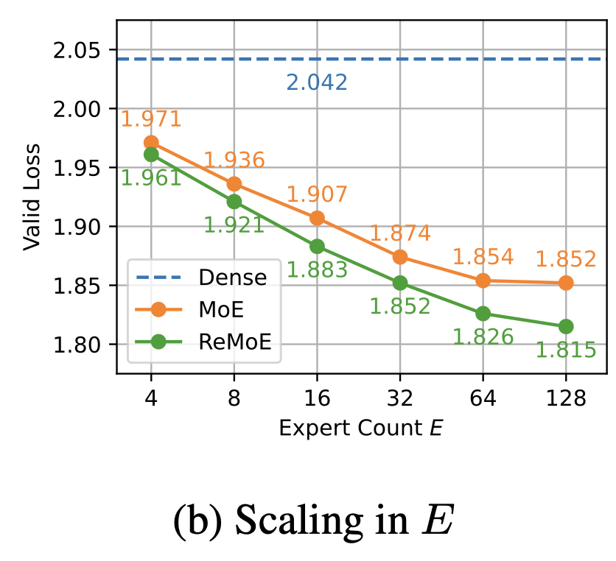
Scalability --- Active Expert
Notes:
It consistently outperforms standard MoE, but more importantly, ReMoE shows a much steeper slope of improvements as the number of active experts increases

