Slide 1
The Economics of Liquid Staking Derivatives:
Basis Determinants and Price Discovery
Hyeonmyeong Choi
2026.06.26
INFONET Journal Club Presentation
Notes:
For today's journal club I'm presenting a paper on the economics of liquid staking derivatives — basis determinants and price discovery. In short, it's about why tokens like stETH trade slightly off from the underlying ETH, and how much these tokens contribute to price formation. Let me get into it.

Slide 2
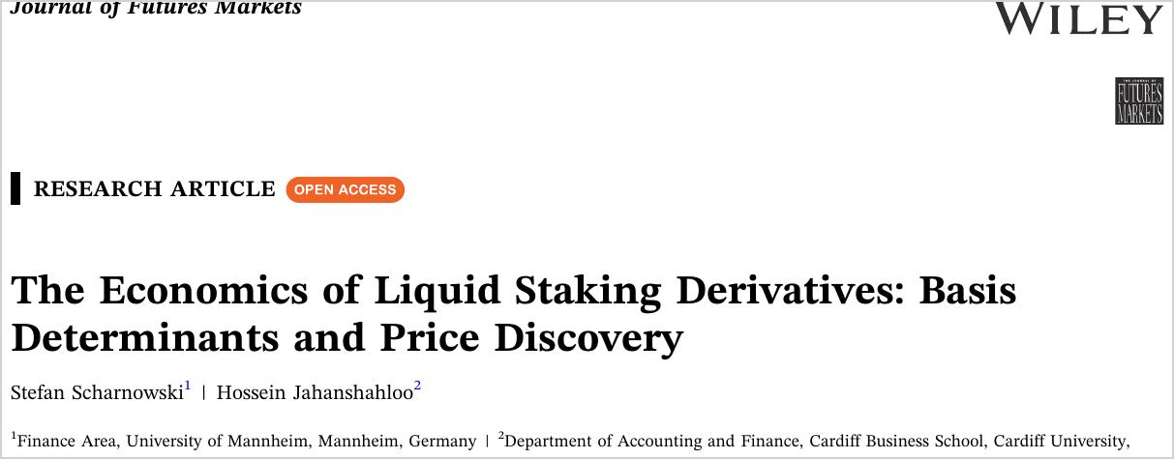

Paper information
Published in
Journal of Futures Markets, 2025 (Vol. 45, 91–117)
Authors
Stefan Scharnowski · University of Mannheim
Hossein Jahanshahloo · Cardiff University
Notes:
[~0:15] Quick note on the source

Slide 3
Main Contributions
First Analysis of the Liquid Staking Basis
: This is the first economic study of liquid staking tokens, the price gap between a staking token and its underlying asset.
Four Determinants Identified
: Staking rewards, concentration risk, limits to arbitrage, and behavioral factors are shown to drive the magnitude of the basis.
A Growing Role in Price Discovery
: Liquid staking tokens contribute a significant and growing share to the price discovery of the underlying cryptocurrencies.
Notes:
[~0:40] There’s Three contributions. First, this is the first economic study of the liquid staking basis — the price gap between a staking token and the asset. Second, they identify four drivers of that gap: I dealing with these in back stage. Third, they show these tokens contribute a growing share to the price discovery of the underlying coin. So the derivative isn't just following spot; sometimes it leads. Those three threads are basically the whole talk.

Slide 4
Introduction
Motivation
: Proof-of-Stake chains (such as Ethereum and Solana) have grown rapidly, but securing them requires locking up staked capital, which removes its liquidity.
Research Gap
: Liquid staking tokens grew fast — Lido stETH from about USD 20 million in 2021 to USD 15 billion in 2023 — yet little was known about their price dynamics.
This Study
: The paper gives a first empirical analysis of how these tokens are priced, what drives the gap to the underlying, and how much they add to price discovery.
Notes:
For motivation — pos chains like Ethereum and Solana grew fast, but securing them means locking up staked capital, and once it's locked it's illiquid.
=

Slide 5
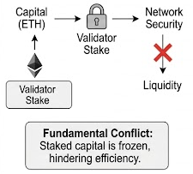
Background — The PoS Liquidity Dilemma
Staking Secures the Network
: Validators post a deposit (stake) that is locked to keep them honest, and they earn rewards on it in return.
Capital is Frozen
: While staked, the capital cannot be traded, lent, or used as collateral — it is working, but illiquid.
High Barriers to Direct Staking
: Running a validator also needs technical know-how and a high minimum (32 ETH on Ethereum).
Notes:
In POS archintecure, validators post a locked deposit. while staked, that capital is frozen, you can't trade it, lend it, or post it. And direct staking has high barriers — the technical setup plus a 32 ETH minimum. So for most people it's just not practical.

Slide 6
Background — How Liquid Staking Works
The Mechanism
: Users deposit coins into a smart-contract pool and receive a derivative token (e.g., Lido’s stETH) representing their share of the staked assets.
Advantages
: The token is tradeable, usable as DeFi collateral, has no minimum stake, and can often be exited by selling at any time.
But also have some drawback. Providers keep part of the rewards, yields become more volatile, and the design adds concentration and smart-contract risk.
Notes:
Liquid staking solves that. You deposit into a smart-contract pool and get back a derivative token something like stETH— representing your share of the staked assets. it's tradeable, usable as DeFi backup asset, no minimum, and you can usually exit by selling. But it's not free — the provider takes part of the rewards, yields get more volatile, and you pick up concentration and smart-contract risk

Slide 7
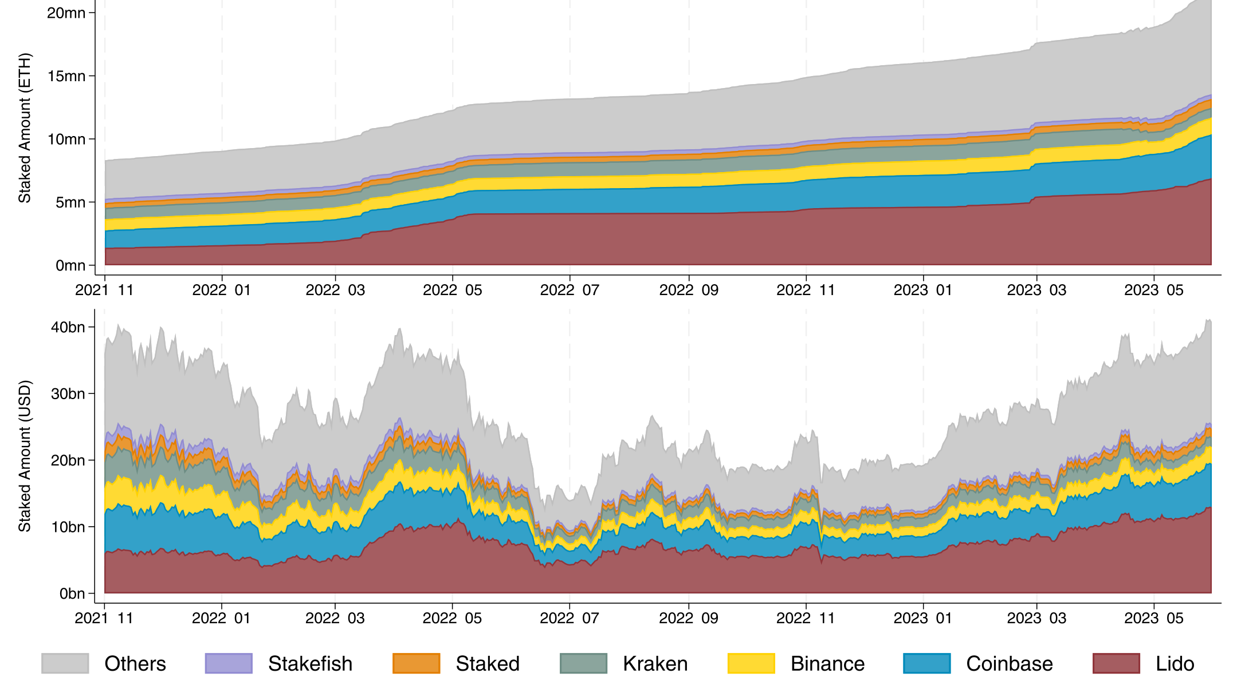
Just one pool now holds a third of all staked Ether!
Lido Dominates Ethereum Staking
: Lido’s share of all staked ETH rose from about 17% to 33% over the sample (average 27.6%).
Concentration Raises Risk
: When one provider controls roughly a third of all stake, it becomes a single point of failure for the network.
Figure 1 — Staked amount in Ethereum, six largest providers stacked. Lido is the dominant band.
Notes:
And here's the concentration point made concrete. Over the sample, stETH(issued by Lido) went from about 17% to 33%. The figure stacks the six largest providers, and Lido is the dominant band. The concern is simple: when one pool holds a third of all staked ETH, it's a single point of failure for the network. So concentration is one of the four determinants they test later, not just a footnote.

Slide 8
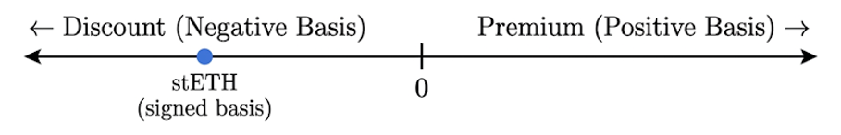
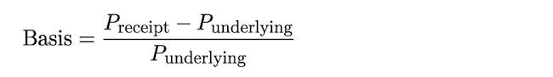
Basis Definition
Avg. absolute basis at Curve ≈ 96 basis points.
The signed basis bottomed near −6.85% during the crash.
Notes:
Let’s Defining the basis before we got the shot — it's just the relative price difference between the staking token and the underlying. Below the underlying is a discount, or negative basis; above is a premium. For stETH it's almost always a discount. To put numbers on it: the average absolute basis on Curve is about 96 basis points which means 1%, and at its worst during the crash the signed basis hit around minus 6.85%.

Slide 9
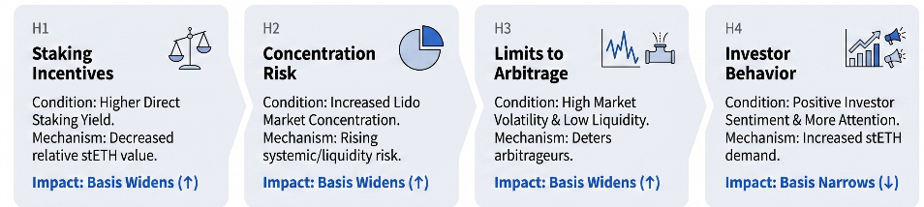
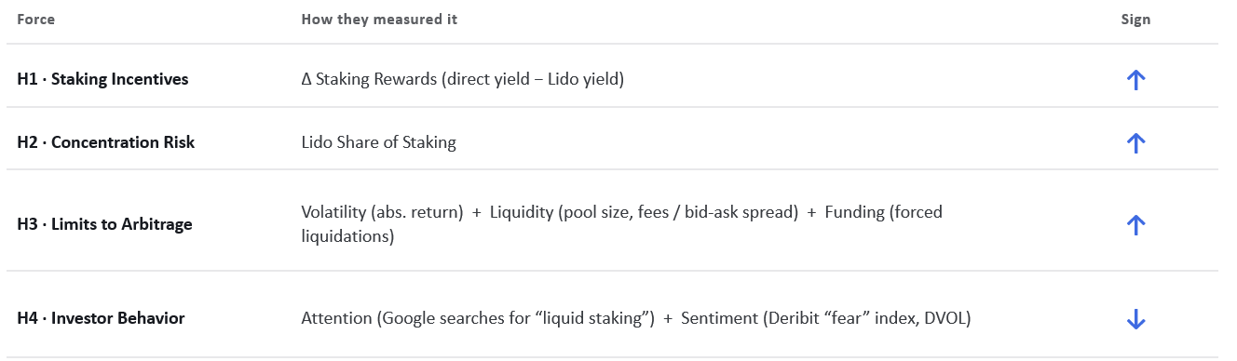
Hypothesis Development
Notes:
With that setup, this section lays out the hypotheses — the four forces they expect to move the basis, and which direction each one should push it.

Slide 10
Two Trading Venues as data resources
DEX (mainly Curve)
: The stETH/ETH pool (Nov 2021 – May 2023) captures most stETH trading and is the main sample.
CEX (FTX before Collapes…)
: stETH, mSOL, stSOL plus ETH/SOL spot and futures, ending Aug 2022, as a robustness check.
* Raw data is sampled at 15 seconds and aggregated to 1-hour intervals for the regressions.
Notes:
Data comes from two venue types. They use Curve and FTX. Everything is sampled at 15 seconds and aggregated to hourly for the regressions.

Slide 11
Methodology — Defining the Basis
The Liquid Staking Basis
: The relative price difference between a staking token and its underlying; analyses use its absolute value.
Two Payout Mechanics
: stETH is rebasable (rewards add tokens; price stays ~1:1);
mSOL/stSOL are reward-bearing (rewards lift value like Yield Bearing stable coin).
Notes:
One methodology point that matters a lot: the tokens pay rewards in two different ways. stETH is rebasing — rewards show up as more tokens in your wallet, so the price stays roughly one-to-one with ETH. mSOL and stSOL are reward-bearing, the same mechanic as a yield-bearing stablecoin. This matters because it changes what the raw basis even looks like for each token.

Slide 12
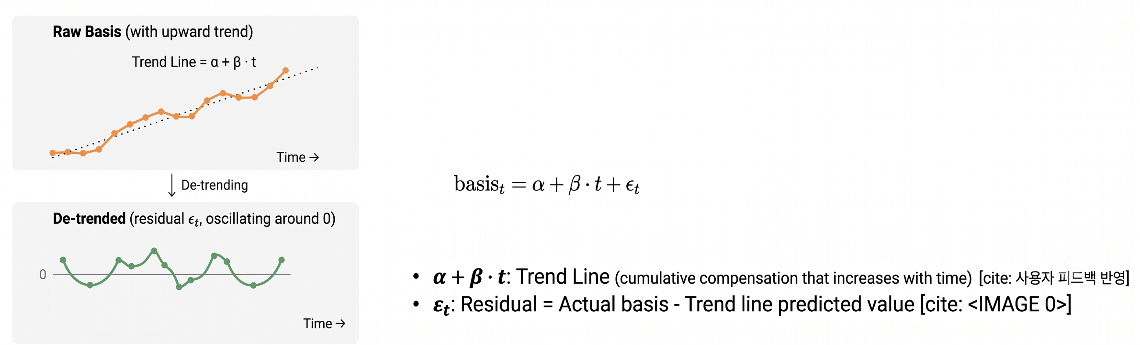
Methodology — Defining the Basis
De-trending
:Their basis is regressed on a linear time trend, keeping only the residuals (genuine economic deviations)
Notes:
[~0:25] And that's exactly why they de-trend. For reward-bearing tokens the value mechanically climbs over time, so the raw basis shows an upward drift that isn't real mispricing. So they regress the basis on a linear time trend and keep only the residuals — those residuals are the genuine economic deviations, and that's what they analyze.

Slide 13

Empirical Framework for Liquid Staking Basis Analysis (Methodology)
Notes:
This is the empirical setup in one equation. The basis is regressed on the four determinants — staking incentives, concentration risk, limits to arbitrage, and investor behavior — plus controls and an hour fixed effect. So each force enters as its own term, and the signs on those terms are what they're testing.

Slide 14
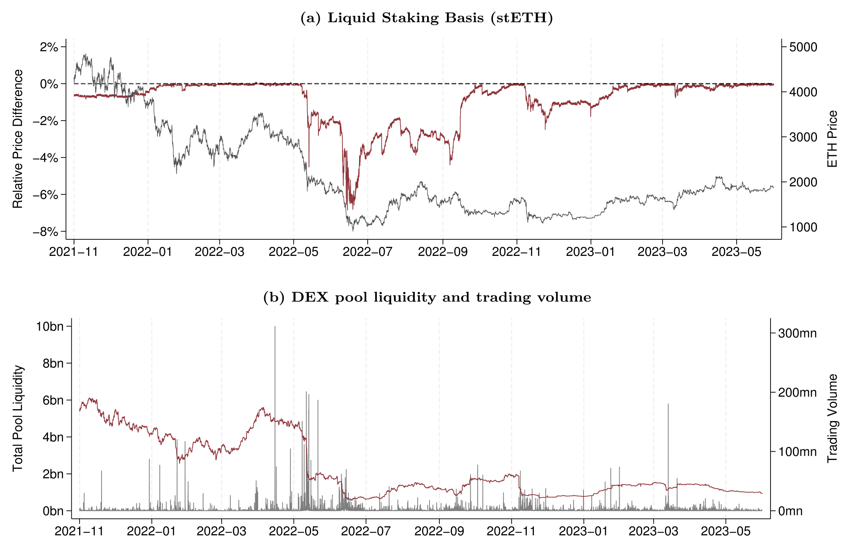
Results : Limits to Arbitrage
stETH Trades at a Discount
: The average absolute basis at Curve is about 96 bp, and the signed basis is almost always negative.
Crisis > More Volatile
: The discount reached an hourly low of −6.85% around the May 2022 TerraUSD collapse.
Pool Liquidity Fell
: Curve pool liquidity dropped from ~USD 6 bn (2021) to ~USD 1 bn (2023) –> Due to Crypto winter season..
Figure 2. (a) stETH liquid staking basis (relative price difference, left axis) and ETH price (right axis).
(b) Curve pool liquidity (left axis) and trading volume (right axis), Nov 2021–May 2023
Notes:
Actually, there's nothing major on this page. It just points out that stETH was cheaper than ETH, and the discount widened during rough market conditions.

Slide 15
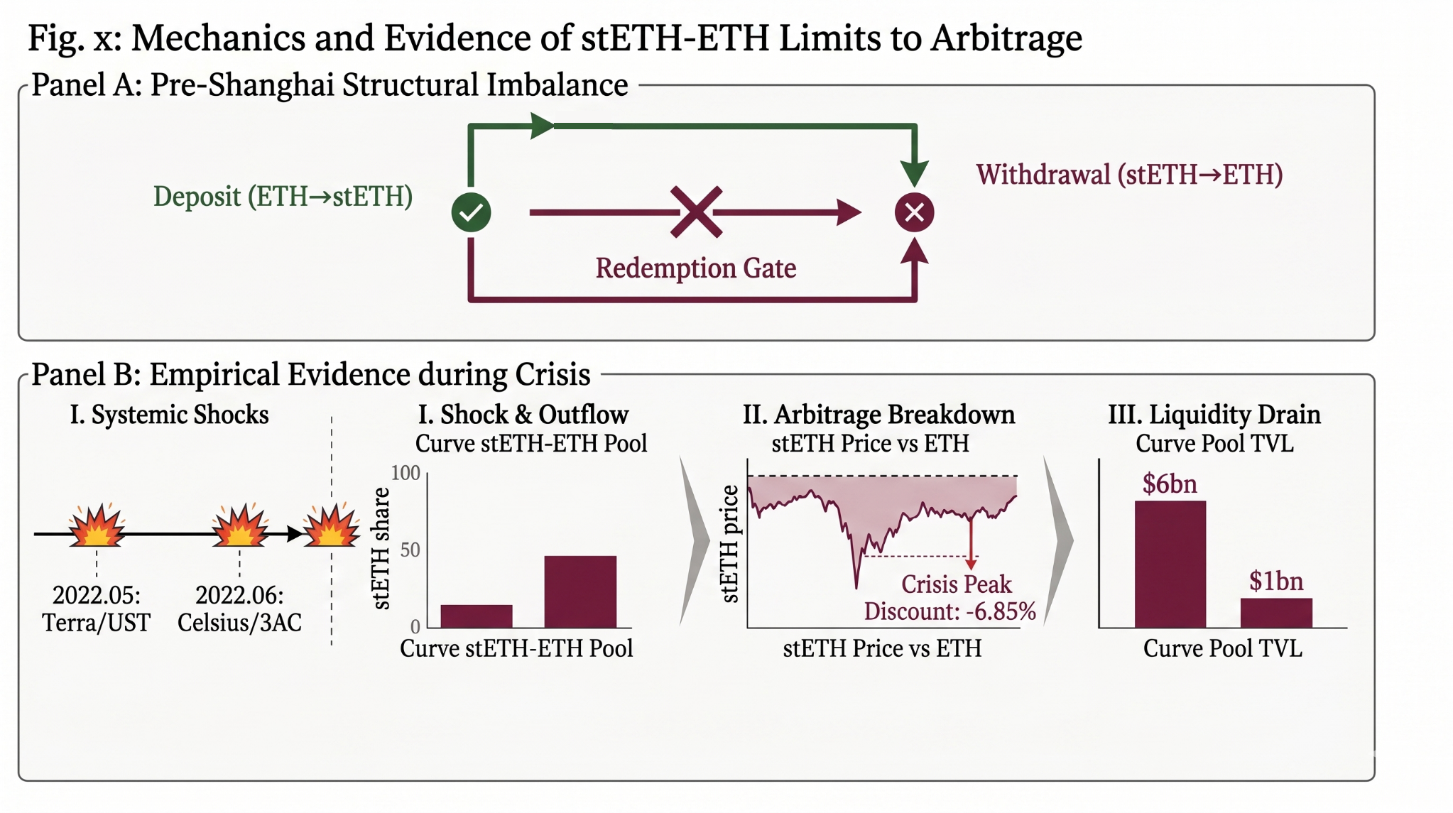
Results : Limits to Arbitrage
The arbitrage trap. Before the 2023 Shanghai upgrade, ETH→stETH deposits stayed open but stETH→ETH withdrawals were gated, so the only exit was selling on Curve. During the May–Jun 2022 crisis this one-way pressure drove stETH to a −6.85% discount as Curve pool TVL fell from $6bn to $1bn.
Notes:
This is the mechanism behind that blowout — the arbitrage trap. Before Shanghai upgrade, you could deposit ETH for stETH, but you couldn't go back . So the only exit was selling stETH on Curve. that one-way selling pressure drove stETH to the minus 6.85% discount while. there was literally no arbitrage path to close it.

Slide 16
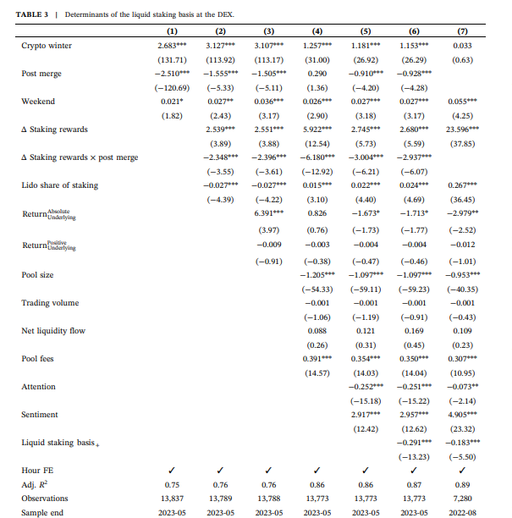

Results (All four forces show up in the data result!)
All Four Hypotheses Hold
: The basis widens with yield gaps, Lido’s share, volatility and spreads, and fear, and narrows with attention.
Exceptional event also considered.
: The crypto winter widens the basis ~2.7 pp; the Merge pulls it back ~2.5 pp — nearly cancelling.
Liquidity Matters Most
: A deeper pool tightens the basis ( approximately 1% larger ≈ 1 bp tighter); wider spreads and fees widen it.
It seems very high accuracy level (R^2) around 0.9 !
Columns (1)–(7) are separate OLS specifications).
All four determinants enter with the predicted signs, and Adj. R² ≈ 0.75–0.89.
Notes:
Here's the main regression, and the headline is that all four hypotheses hold. The basis widens with the yield gap, Lido's share, volatility and spreads, and fear — and it narrows with attention. They also handle the big events: the crypto winter widens the basis about 2.7 percentage points, the Merge pulls it back about 2.5, so they nearly cancel. Of the four, liquidity matters most — a deeper pool tightens the basis, while wider spreads and fees widen it. And the fit is strong: across seven separate OLS specifications the adjusted R-squared is roughly 0.75 to 0.89, so these four explain most of the variation.

Slide 17

Methodology — Price Discovery
One Efficient Price (Cointegration)
: stETH and ETH are cointegrated, so their basis is stationary — the two share one long-run efficient price and only deviate temporarily.
Who Leads? — Speed of Adjustment (α)
: In a Vector Error Correction Model (VECM), the market that barely corrects back to equilibrium (α ≈ 0) leads price discovery; the others adjust toward it.
VECM modeling : β′p: VECM’s core. If basis was zero, its value gonna be zero.
When the basis was going up, that values is upsiding.
Σᵢ Γᵢ Δp : short-run dynamics (Past earning that affect Todays returns) ,
ε : Unpredictable Information shock (?)
Notes:
Second half — price discovery. The starting point: stETH and ETH are cointegrated, so their basis is stationary — they share one long-run efficient price and only drift apart temporarily.

Slide 18
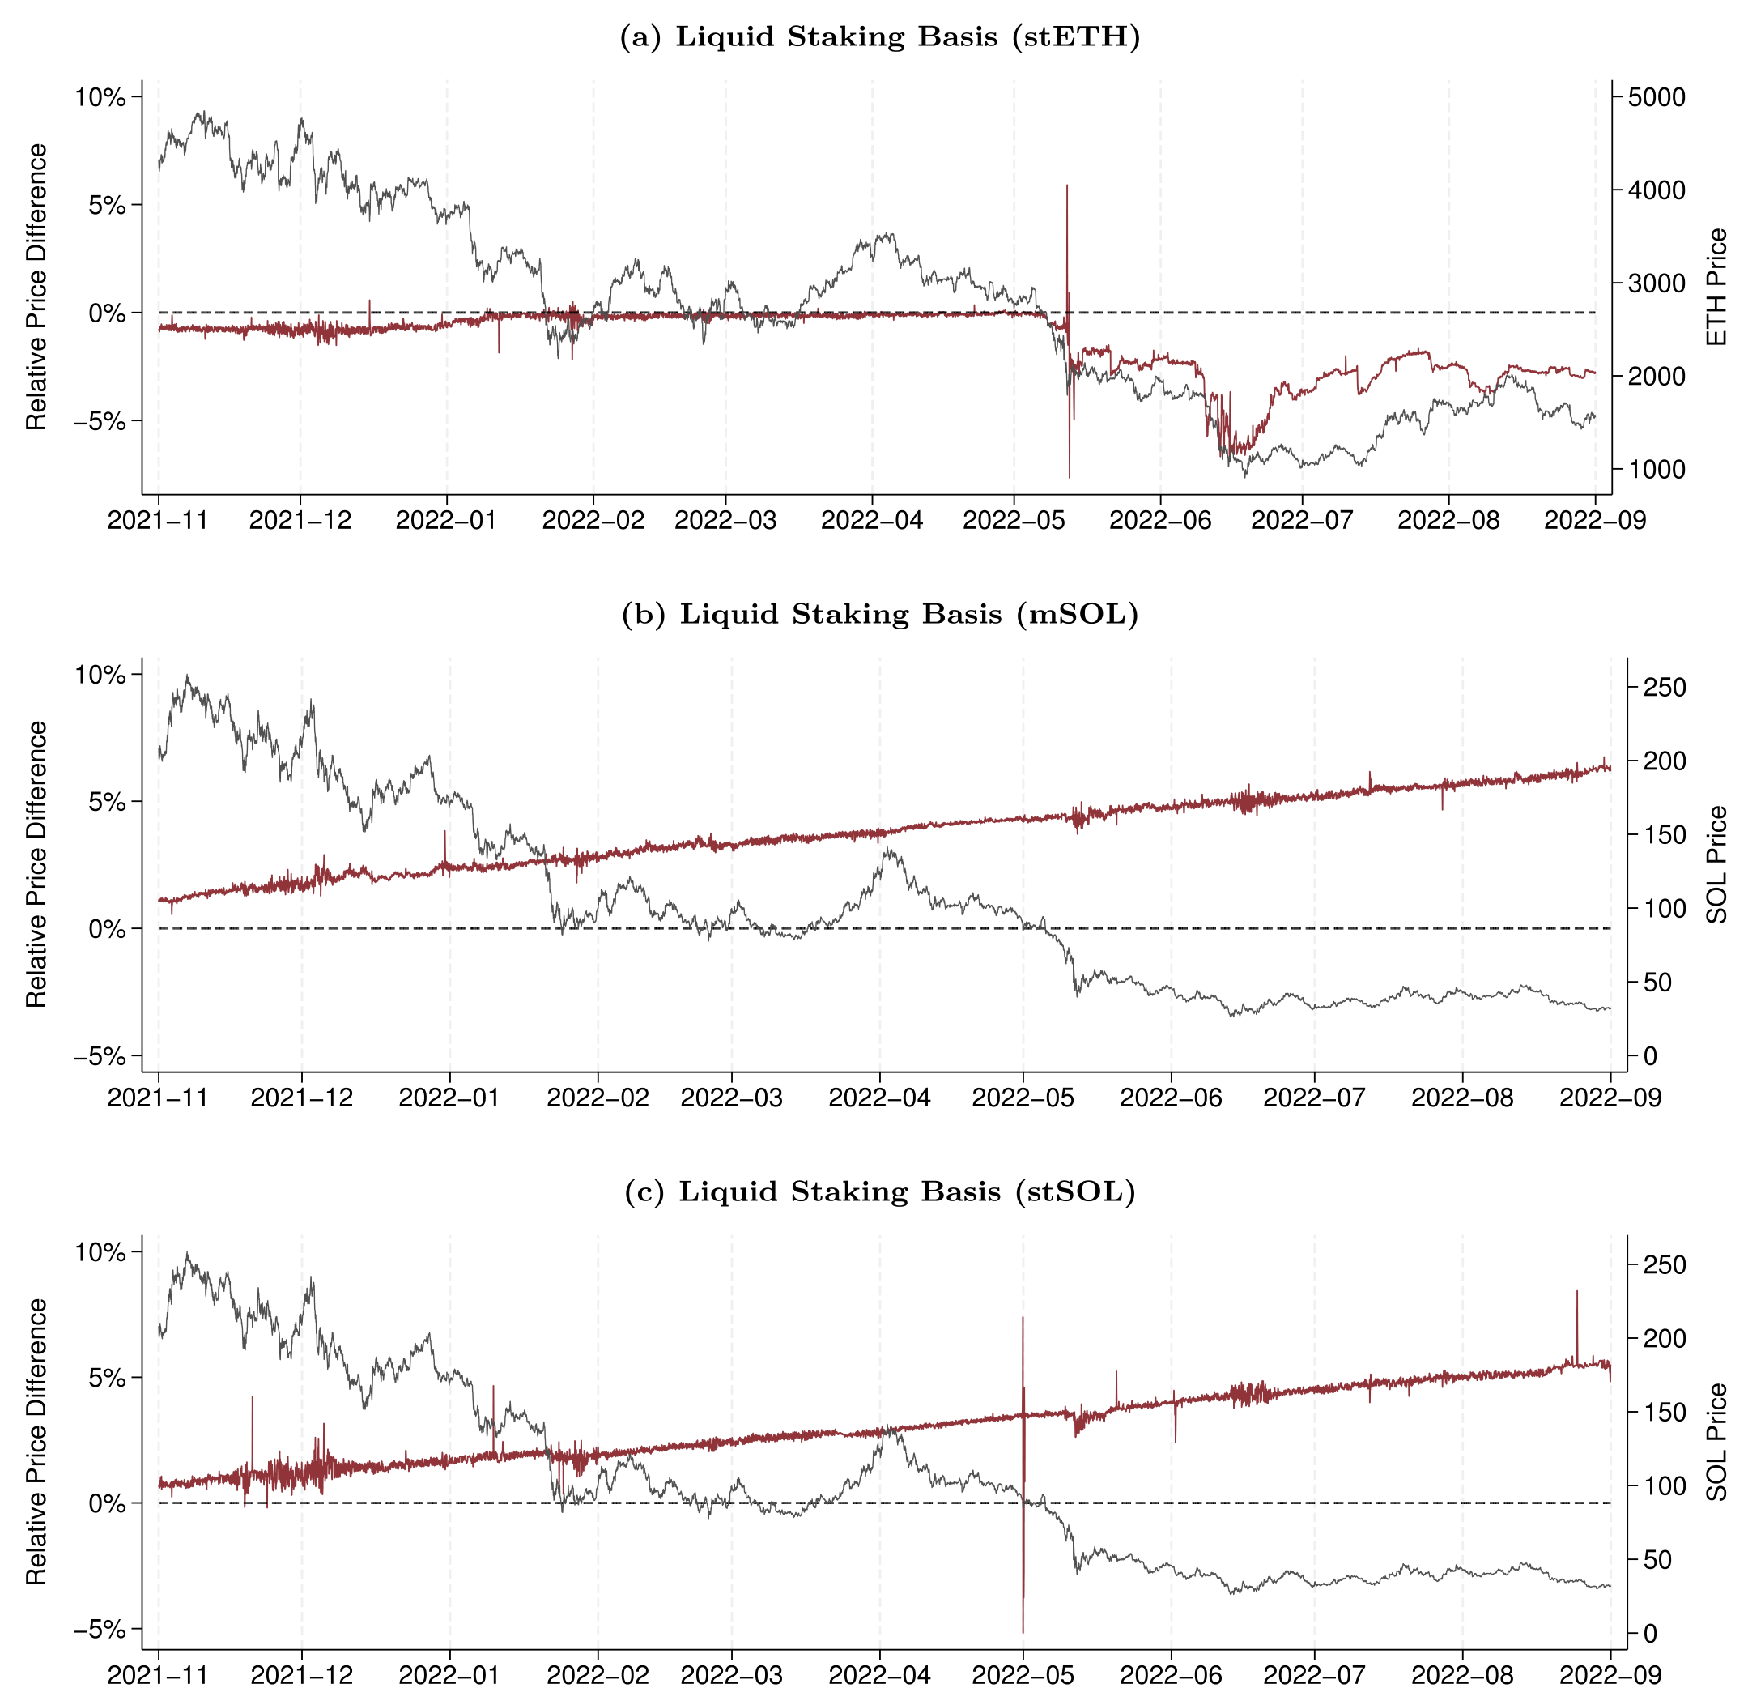
Results — Validating the De-trending
Two Tokens, Different Shapes
: stETH oscillates around zero; mSOL/stSOL climb linearly from their reward-bearing design.
No Solana Depeg
: Un-staking was already live on Solana, so supply could adjust and the basis held.
De-trending Validated
: After de-trending, the Solana basis behaves like stETH’s — the climb was mechanical, not mispricing.
Figure 3. Signed CEX basis (red, left) vs. underlying price (gray, right): (a) stETH, (b) mSOL, (c) stSOL.
Notes:
They also validate the de-trending using Solana. In raw form the two token types look different — stETH oscillates around zero, while mSOL and stSOL climb in a straight line from the reward-bearing design. there was no Solana depeg.
Un-staking was already live there, so supply could adjust and the basis held. And once you de-trend, the Solana basis behaves just like stETH's — confirming the climb was mechanical. So the de-trending is doing the right thing.

Slide 19
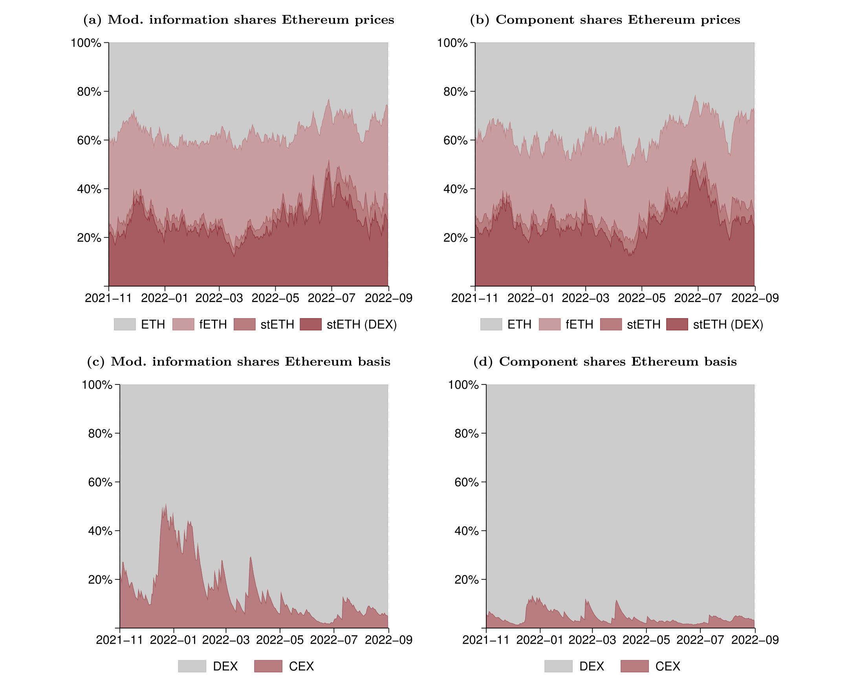
Price Discovery — Results
stETH even Leads, Not Follows
: DEX-traded stETH drives a median of about 23% of Ethereum’s price discovery.
Rising Under Stress
: Its share grows through the volatile second half of the sample — derivatives matter more when markets are stressed.
Figure 4. Daily price-discovery shares (smoothed). Top: information & component shares of ETH price across ETH spot, fETH, stETH(CEX), stETH(DEX). Bottom: DEX vs. CEX shares of the stETH basis, Nov 2021–Aug 2022.
Notes:
And here's the payoff result. stETH actually leads rather than follows — DEX-traded stETH drives a median of about 23% of Ethereum's price discovery.
So roughly a quarter of where ETH's price gets formed runs through the derivative, not the spot. And that share rises through the volatile back half of the sample — the derivative matters more, not less, under stress. Which is kind of the opposite of what you'd expect from something called a derivative.

Slide 20
Conclusion & Contribution
There‘s clear basis between Liquid staking token(ex : stETH) and Underlying asset(ETH).
And the basis has economically predictable movement,
Sometimes (quite great portion) Overlead underlying asset price discovery!
: That means the information pre-absorbed in Future market rather than Market.
Notes:
[~0:35] To wrap up. There's a clear, persistent basis between the staking token and the underlying — stETH versus ETH. It's not noise; it moves in economically predictable ways tied to the four determinants. And a good share of the time the derivative is actually leading price discovery rather than following. So the takeaway is that information gets absorbed into the staking-derivative market first, ahead of spot — these tokens are doing real price formation, not just tracking. That's the contribution.

Slide 21
Thanks
Notes:
[~0:05] That's it — happy to take questions.

