Slide 1
FrugalGPT: How to Use Large Language Models
While Reducing Cost and Improving Performance
"An adaptive LLM cascade for cost-efficient inference"
Youngin Choi
July 24, 2026
INFONET Journal Meeting Presentation
Notes:
Good morning/afternoon, everyone. I'll be presenting the paper "FrugalGPT: How to Use Large Language Models While Reducing Cost and Improving Performance" — an adaptive LLM cascade for cost-efficient inference.

Slide 2
Information
Authors: Lingjiao Chen, Matei Zaharia, James Zou
Affiliation: Stanford University (Chen, Zou) / UC Berkeley (Zaharia)
Publication: Transactions on Machine Learning Research (TMLR)
Year: 2024 (published December 2024)
Link: https://openreview.net/forum?id=cSimKw5p6R
Notes:
This paper was written by Lingjiao Chen, Matei Zaharia, and James Zou, from Stanford and UC Berkeley. It was published in Transactions on Machine Learning Research, TMLR, in December 2024.

Slide 3
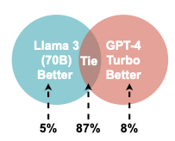
Problem
LLM APIs: Big Price Gaps, Inconsistent Performance
Prices differ by up to 100x across providers
No single LLM is best on every task
Hard to choose the right model within a fixed budget
Real-world cost can become unmanageable at scale
Figure 1. Pairwise comparison between Llama3 (70B) and GPT-4 Turbo on HEADLINES)
Notes:
Let's talk about the problem first.
LLM API prices are very different. They can differ by up to 100x. No single LLM is best on every task. So it's hard to choose the right model. It's hard to stay within budget. At large scale, the cost can become too high.
[Point to the Venn diagram]
Here is an example. This compares Llama3 and GPT-4 Turbo on HEADLINES. Llama3 was better on 5% of queries. The two models tied on 87%. GPT-4 was better on only 8%. So the two models mostly agree. And when they disagree, the cheaper model wins almost as often.

Slide 4
Methods: Overview
FrugalGPT Pipeline
Three components:
LLM Router — decides which model to call next
Generation Scorer — scores answer quality (DistilBERT-based)
Stop Judger — stops once the score passes a threshold
Notes:
So how does this paper solve the problem?
FrugalGPT has three parts.
First, the LLM Router. It decides which model to call next.
Second, the Generation Scorer. It scores how good an answer is. It's based on DistilBERT.
Third, the Stop Judger. It stops the process once the score is high enough.

Slide 5
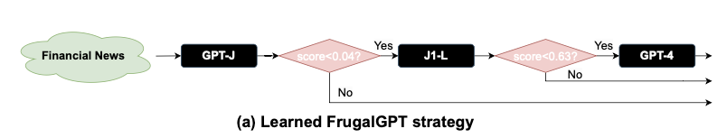
Methods: Example (HEADLINES)
Learned Calling Order on HEADLINES
Three components:
Call GPT-J (cheapest) → score ≥ 0.96 → accept
Else call J1-L (mid-cost) → score ≥ 0.37 → accept
Else call GPT-4 (most expensive) → final answer
Budget: $6.5 (≈ 1/5 of GPT-4 alone)
Figure 2. FrugalGPT's actual learned calling order on the HEADLINES dataset (GPT-J → J1-L → GPT-4)
Notes:
Let me show a real example. This is from the HEADLINES dataset.
First, it calls GPT-J. This is the cheapest model. If the score is 0.96 or higher, it accepts the answer.
If not, it calls J1-L. This is a mid-cost model. If the score is 0.37 or higher, it accepts the answer.
If it's still too low, it calls GPT-4. This is the most expensive model. GPT-4 gives the final answer.
The total budget is $6.5. That's about one-fifth of GPT-4's cost alone.

Slide 6
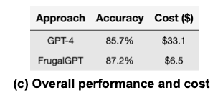
Results: Main Results
HEADLINES: GPT-4 Alone vs. FrugalGPT
Accuracy: 85.7% → 87.2% (+1.5pp)
Cost: $33.1 → $6.5 (−80%)
Figure 3. Accuracy and cost comparison on HEADLINES — GPT-4 alone vs. FrugalGPT
Notes:
Now let's look at the results.
We compared GPT-4 alone with FrugalGPT, on HEADLINES.
Accuracy went up. From 85.7% to 87.2%.
Cost went down. From $33.1 to $6.5. That's about 80% less.

Slide 7
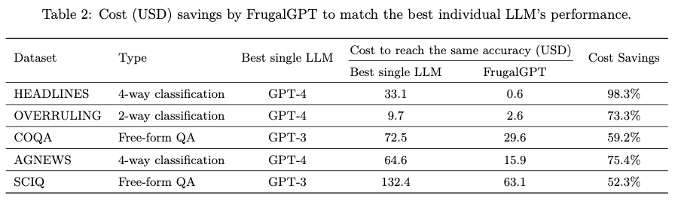
Results: Cost Savings & Routing
Consistent Savings Across Datasets
Cost savings: 52.3% (SCIQ) – 98.3% (HEADLINES)
Table 1. Cost savings achieved by FrugalGPT across all five datasets
Notes:
This pattern held across all datasets.
Cost savings ranged from 52.3% to 98.3%. The lowest was on SCIQ. The highest was on HEADLINES.

Slide 8
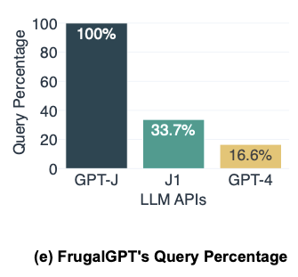
Results: Cost Savings & Routing
Consistent Savings Across Datasets
83.4% of queries resolved by low-cost models
Only 16.6% ever reach GPT-4
Figure 4. Share of HEADLINES queries reaching each model (GPT-J, J1-L, GPT-4)
Notes:
Why did this happen? Let's look at the routing.
On HEADLINES, 83.4% of queries were solved by cheap models. Only 16.6% ever reached GPT-4.

Slide 9
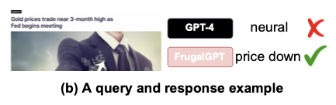
Results: Qualitative Example
"Gold prices trade near 3-month high as Fed begins meeting”
(연준(Fed)이 회의를 시작하면서, 금값이 3개월 최고치 근처에서 거래되고 있다 )
GPT-4 GPT-4 → wrong answer
  GPT-4 misled by the surface phrase "3-month high"
FrugalGPT → correct answer
  FrugalGPT captured the nuance of a possible pullback
Figure 5. An actual answer comparison between GPT-4 and FrugalGPT
Notes:
Let me show one real example.
The headline is: "Gold prices trade near 3-month high as Fed begins meeting."
GPT-4 answered "neutral." That was wrong.
FrugalGPT answered "price down." That was correct.
GPT-4 was misled by the phrase "3-month high." FrugalGPT caught the deeper meaning. It saw that a pullback might be coming.

Slide 10
Discussion
Strengths
  No retraining needed — works with existing APIs
  Flexible cost–performance trade-off
  Effective on both old and new models
Limitations
  Depends heavily on scorer quality
  Fails if all models in the chain are wrong
  Calling order is fixed, not query-specific
Notes:
Let's talk about strengths and limitations.
Strengths:
No retraining is needed. It works with existing APIs. It offers a flexible trade-off between cost and performance. It works well on both old and new models.
Limitations:
It depends a lot on the scorer's quality. If every model in the chain is wrong, FrugalGPT fails too. The calling order is fixed. It's not adjusted for each question.

Slide 11
Key Takeaways
The most expensive model isn't always right
A lightweight model can predict answer quality
Big cost savings from just "calling order + stopping condition" — no retraining required
Notes:
Let me close with the key takeaways.
The most expensive model isn't always right. A lightweight model can predict answer quality. Big cost savings are possible with just two things: a good calling order, and a good stopping condition. No retraining is needed.
Thank you. I'm happy to take any questions

