Slide 1
An empirical study of DeFi liquidations: incentives, risks, and instabilities
Youngu Lee
2026.03.06
INFONET Journal Club Presentation
Notes:
Hello everyone, let’s begin today’s Blockchain Journal Club

Slide 2

Paper
Published on
ACM Internet Measurement Conference
2 November, 2021
Authors
Shenyu Qin, Soumya Basu, Yuzhe Tang, and Arthur Gervais
Notes:
today I will present a paper titled “An Empirical Study of DeFi Liquidations: Incentives, Risks, and Instabilities.” This talk is about liquidation in DeFi lending, why it happens, who benefits from it, and how liquidation mechanisms can affect both fairness and system stability. This work was published at the ACM Internet Measurement Conference, and the publication date on this slide is November 2, 2021. The authors are here.

Slide 3
Why I chose this paper
Research connection: My research studies incentive design and risk in decentralized systems.
Core idea: This paper studies how liquidation rules change profit distribution and system stability in DeFi lending.
Data strength: It uses more than two years of on-chain data to show real liquidation behavior.
Future extension: The analysis can be extended to study new mechanism changes and redesigned incentive systems.
Notes:
I chose this paper for three reasons. First, it matches my research interest in incentives and risk in decentralized systems. Second, it uses more than two years of on-chain data, so it shows real behavior. Third, this idea can also be used to study new protocol designs in the future.

Slide 4
Motivation
Crypto prices change very fast and very often.
Because of this, many borrowing positions become unsafe.
When this happens, the protocol forces liquidation.
Key Question:
Are current liquidation rules fair and stable?
Do they protect the system, or mainly reward liquidators?
Notes:
In DeFi lending, users borrow assets by locking collateral. The problem is that crypto prices change very fast. When the collateral price drops, a borrowing position can quickly become unsafe. At that point, the protocol allows or forces liquidation. So liquidation is necessary for system safety. But here is the important question. Does liquidation mainly protect the protocol, or does it mostly create profit chances for liquidators? This is why the paper asks whether current liquidation rules are fair and stable. In other words, the paper is not asking only when liquidation happens. It is asking whether the liquidation mechanism is designed in a good way.

Slide 5
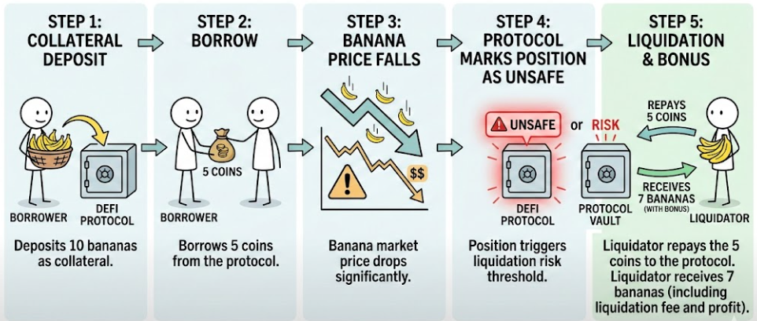
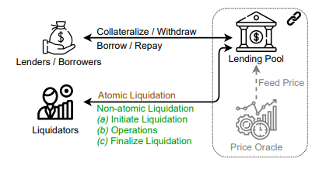
Background: How DeFi Lending Works
Volatility triggers liquidation.
Liquidators earn a bonus.
Borrowers lose extra collateral.
Notes:
To understand that question, we first need a simple background. In DeFi lending, users lock collateral and borrow assets. If the collateral value falls, the position becomes risky. Then liquidation is triggered. At that moment, liquidators repay part of the debt and receive collateral with a bonus. So liquidators make profit, while borrowers can lose extra collateral. This is the basic structure behind the paper. And with this background, we can now see what exactly the paper studies.

Slide 6
What This Paper Studies
It analyzes liquidation events across major DeFi lending protocols.
It studies how much liquidators earn.
It measures whether borrowers lose more collateral than necessary.
It examines how transaction fees affect bad debt and instability.
Core Focus:
Incentives, profits, and system risk.
Notes:
This paper studies liquidation events in major DeFi lending protocols. It asks three main questions. First, how much do liquidators earn? Second, do borrowers lose more collateral than necessary? Third, how do transaction fees affect bad debt and instability? So this paper is not only about liquidation itself. It is about incentives, profits, and system risk.

Slide 7
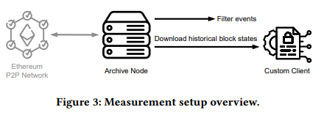
Data & Measurement
The study covers more than 2 years of on-chain data.
28,138 liquidations
807.46M USD liquidated collateral
2,011 liquidators
Notes:
The authors use more than two years of on-chain data and measure liquidation events at scale: 28,138 liquidations, 807.46 million USD of liquidated collateral, and 2,011 liquidators. So this is not a small case study. It is a large dataset that captures real behavior in the wild. With this measurement base, we can trust the next findings because they come from what actually happened on-chain, not just assumptions.

Slide 8
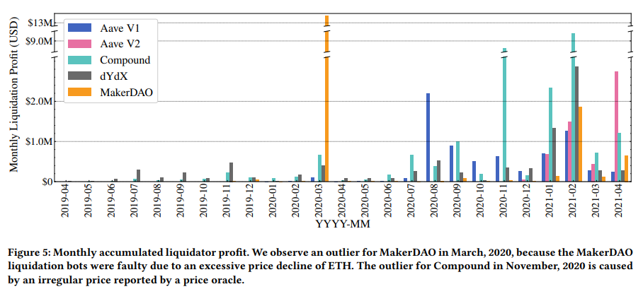
Finding 1: Liquidations Are Highly Profitable
807M USD in total collateral liquidated
Liquidators earn millions of USD in aggregate.
Profit sharply increases during market crashes.
Notes:
The first finding is simple: liquidation is highly profitable. In aggregate, liquidators earn millions of dollars, and the profit increases sharply during market crashes. This matters because crashes are exactly when the system is under stress, but at the same time, liquidators have even stronger reasons to participate quickly. Also, the total collateral liquidated in the dataset is about 807 million USD, so the economic size is large. This strong profit story naturally leads to the next point, if there is a lot of money, competition becomes intense.

Slide 9
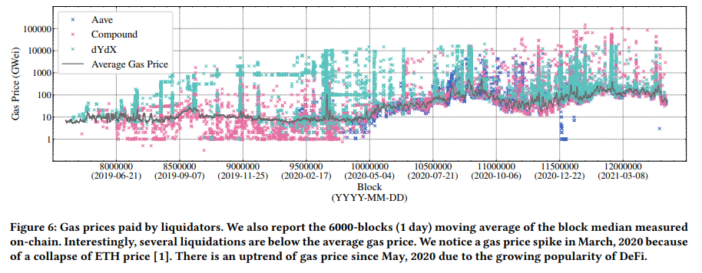
Finding 2: Liquidations Are Highly Competitive
73.97% of liquidations pay above-average gas fees.
Many liquidators bid aggressively to win the transaction.
Notes:
The second finding is that liquidation is very competitive. The paper shows that 73.97% of liquidations pay above-average gas fees, which means liquidators often spend extra fees to win the liquidation transaction. In simple terms, many liquidators are racing, and they bid aggressively because getting the liquidation can be very profitable. So we now have a clear chain: high profit creates intense competition. Next, I will connect this to behavior: how these incentives and protocol rules shape who gains and who loses.

Slide 10
Incentives Shape Behavior
Liquidators are strongly motivated by profit.
High competition pushes fast and aggressive execution.
Protocol rules decide how much collateral can be taken.
Key Point:
Incentive design shapes who gains and who loses.
Notes:
At this point, we can connect the first two findings. Liquidators are strongly motivated by profit, and high competition pushes them to act very fast and very aggressively. But one more thing matters here protocol rules. The rules decide how much collateral can be taken during liquidation. So behavior is not shaped by profit alone. It is shaped by both incentives and mechanism design. This is an important point, because the design of the protocol decides who gains and who loses. And this leads to the next finding, in some cases, the borrower loses more collateral than necessary.

Slide 11
Finding 3: Over-Liquidation Exists
Liquidators can repay more debt than necessary.
They receive more collateral than needed to restore safety.
Borrowers lose extra collateral.
Collateral = 9,000 USD
Debt = 8,000 USD
Liquidation threshold = 80%
Safe debt level = 7,200 USD
Repayment needed to restore safety: 8,000 - 7,200 = 800USD
But protocol allows: Liquidator repays 4,000 USD, Receives discounted collateral
Only 800 USD is needed, but 4,000 USD is liquidated
Notes:
The third finding is that over-liquidation exists. This means a liquidator can repay more debt than is actually needed to make the position safe again. As a result, the liquidator receives more collateral, and the borrower loses extra collateral. The example on this slide shows this clearly. If the safe debt level is 7,200 dollars and the current debt is 8,000 dollars, only 800 dollars of repayment is needed to restore safety. But the protocol may still allow a liquidator to repay 4,000 dollars and receive discounted collateral. So even though only 800 dollars is needed, 4,000 dollars can be liquidated. This is why over-liquidation is an important borrower-side problem.

Slide 12
Why Does Over-Liquidation Happen?
Protocol Rules
Large debt repayment is allowed in one transaction.
Close factor permits substantial liquidation.
No rule limits repayment to the minimum needed.
Effect
Repayment size follows profit incentives.
Excess collateral can be extracted.
Notes:
So why does over-liquidation happen? The paper says the main reason is protocol rules. Large debt repayment can be allowed in one transaction, and the close factor permits substantial liquidation. Also, there is no rule that limits repayment to only the minimum amount needed to restore safety. Because of this, repayment size follows profit incentives rather than borrower protection. In other words, extra collateral can be extracted simply because the mechanism allows it. This is an important result, because it shows that over-liquidation is not just a random accident. It comes from the design of the liquidation mechanism itself. Next, based on this problem, the paper moves to broader risks such as bad debt.

Slide 13
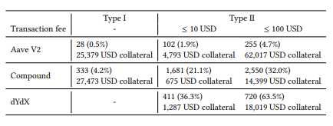
Risk 1: Bad Debt (Type I vs Type II)
Type I Bad Debt (Under-collateralized)
Collateral value falls below debt value.
Overdue liquidations increase Type I bad debt.
Type II Bad Debt (High transaction fees)
Closing an over-collateralized position is not worth the gas cost.
Excessive fees increase Type II bad debt.
Notes:
Now the paper moves from borrower loss to a broader protocol risk, which is bad debt. The paper explains two types. Type I bad debt happens when the collateral value falls below the debt value, so the position becomes under-collateralized. This risk becomes worse when liquidation is delayed. Type II bad debt is different. Even if a position is still over-collateralized, liquidation may not happen if the gas cost is too high. So the key point is that bad debt can come either from falling collateral value or from failed liquidation incentives.

Slide 14
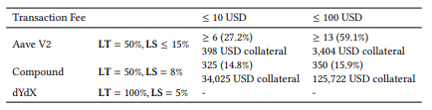
Risk 2: Unprofitable Liquidations (Gas Fee Impact)
A liquidation opportunity can be unprofitable when the liquidation bonus cannot cover the transaction fee.
These positions can remain unhealthy and later become Type I bad debt.
Notes:
This leads to the second risk, unprofitable liquidation. A liquidation chance may exist, but it is not always worth taking. If the liquidation bonus is smaller than the transaction fee, liquidators have no reason to act. Then the unhealthy position stays open, and later it can turn into Type I bad debt. So this slide shows that liquidation design is not only about how much bonus is given. It is also about whether the bonus is enough to make liquidation happen at the right time.

Slide 15
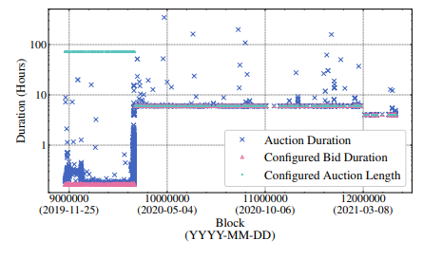
Risk 3: Auction Risk (Time Dimension)
Figure shows how long MakerDAO liquidation auctions last from initiation to finalization.
Auctions can last hours.
Long duration increases exposure to price changes and delays debt recovery.
Notes:
The third risk is auction risk, which adds a time dimension. In MakerDAO, liquidation auctions can last for hours from start to finish. This matters because long auctions increase exposure to price changes while debt recovery is delayed. So compared with fixed-spread liquidation, auction-based liquidation may reduce one problem but create another one. The key message here is that mechanism design always involves trade-offs, and time itself can become a source of risk.

Slide 16
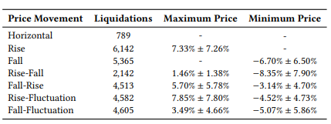
Supporting Evidence: Post-Liquidation Price Movement
Table classifies collateral price movement patterns within 1,440 blocks (about 6 hours) after liquidation.
Only 19.07% of liquidations end with the collateral price staying below the liquidation price after the observation window.
Notes:
This slide supports the auction risk we just discussed. The table looks at collateral price movement within 1,440 blocks, or about 6 hours, after liquidation. A key result is that only 19.07% of liquidations end with the collateral price still staying below the liquidation price after that period. This means that in many cases, prices recover after liquidation. So if the auction takes a long time, the system is exposed to unnecessary price risk during that window. In short, time matters, and delayed liquidation can make outcomes worse.

Slide 17
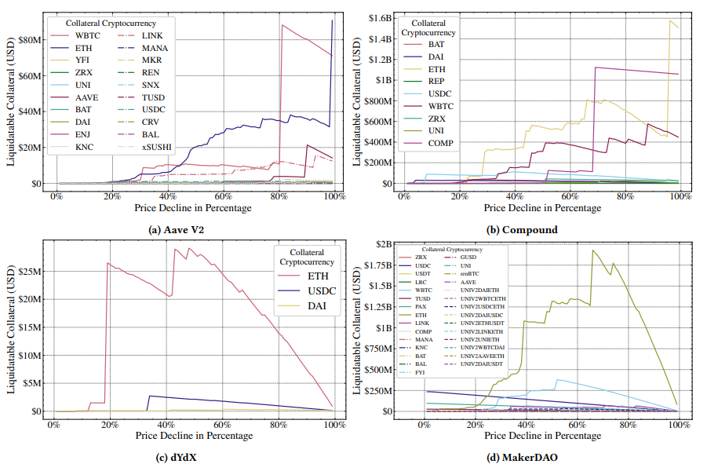
Instability 1: Liquidation Sensitivity (Stress Scenario)
43% ETH drop → 1.07B USD
(MakerDAO)
All platforms are highly sensitive to ETH price drops.
Notes:
After looking at individual risks, the paper now moves to system-level instability. This slide shows a stress scenario. The result is that all platforms are highly sensitive to ETH price drops. For example, in MakerDAO, a 43% drop in ETH can lead to 1.07 billion dollars of liquidation volume. This is a very large number, and it shows that liquidation risk is not only a small event-level issue. Under strong market shocks, liquidation pressure can grow to a system-wide scale.

Slide 18
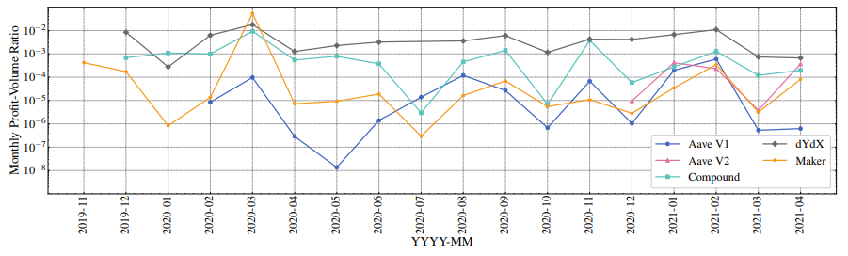
Instability 2: Comparing Mechanisms (Profit-Volume Ratio)
Figure compares protocols using the monthly profit-volume ratio
A lower profit-volume ratio means the mechanism is better for the borrower.
Notes:
Finally, this slide compares liquidation mechanisms across protocols. The figure uses the monthly profit-volume ratio, and a lower ratio means the mechanism is better for the borrower. So this comparison is useful because it does not only ask whether liquidation happens. It asks how costly that mechanism is from the borrower’s side. This helps us compare designs more directly. In other words, different liquidation mechanisms create different trade-offs between liquidator profit and borrower protection.

Slide 19
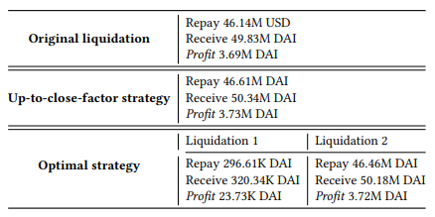
Optimal Liquidation Strategy (Case Study)
Step 1: Liquidate, but keep the position still liquidatable.
Step 2: Liquidate again up to the close factor.
Table compares three approaches:
Original liquidation, up-to-close-factor strategy, and optimal strategy.
The optimal strategy uses two successive liquidations to achieve higher total profit.
Notes:
In the final part, the paper shows that liquidation rules can even be used strategically. This table compares three approaches: original liquidation, up-to-close-factor strategy, and optimal strategy. The original liquidation is the basic one-time liquidation. The up-to-close-factor strategy liquidates as much as the rule allows in one step. But the optimal strategy is different. It uses two successive liquidations to earn higher total profit. In the first step, the liquidator repays only part of the debt and keeps the position still liquidatable. Then, in the second step, the liquidator liquidates again up to the close factor. So the key point of this table is that the timing and size of liquidation can be optimized for more profit. This means the mechanism is not only imperfect, but also strategically exploitable.

Slide 20
Takeaways and Discussion
Takeaways
Liquidations create strong incentives and intense competition.
Fixed-spread designs can cause over-liquidation and borrower losses.
High transaction fees lead to bad debt and missed liquidations.
Liquidation mechanisms affect system stability under price shocks.
Discussion Questions
How should protocols balance fast liquidation and borrower protection?
Should liquidation rules be redesigned to reduce strategic exploitation?
Notes:
Now let me summarize the main takeaways of this paper. Liquidation creates strong incentives and intense competition. Fixed-spread designs can cause over-liquidation and extra borrower losses. High transaction fees can lead to bad debt and missed liquidations. Also, liquidation mechanisms affect system stability during price shocks. So the main message of this paper is clear: liquidation is not just a safety tool. It is a design choice that changes incentives, profit distribution, and risk. Based on this, the discussion question is how protocols should balance fast liquidation and borrower protection, and whether the rules should be redesigned to reduce strategic exploitation.

Slide 21
Thanks
Notes:
Thank you for listening. Do you have any question?

