Slide 1
Co2: Efficient Distributed Training With Full Communication-Computation Overlap
Malika Bakhtawar
April 10, 2026
Journal Club Presentation

Slide 2
Overview
Paper Title: CO2: Efficient Distributed Training with Full Communication-Computation Overlap
Authors: Weigao Sun, Zhen Qin, Weixuan Sun, Shidi Li, Dong Li, Xuyang Shen, Yu Qiao, Yiran Zhong∗
Published In: ICLR
Published Year: 2024

Slide 3
Introduction/Motivation
The Problem: Training Large Language Models (LLMs) requires massive GPU clusters.
The High-Cost Barrier: High-speed interconnects (like NVIDIA NVLink/InfiniBand) are extremely expensive. Traditional Distributed Data Parallel (DDP) suffers from "Communication Bottlenecks" on cheaper, limited-bandwidth networks.
The Goal: "Democratize" large-scale training. Achieve high scalability even on low-bandwidth clusters (e.g., 80Gbps TCP/IP instead of 800Gbps RDMA).
The Solution: CO2. It fully "hides" the communication time by overlapping it entirely with the next round of computation

Slide 4
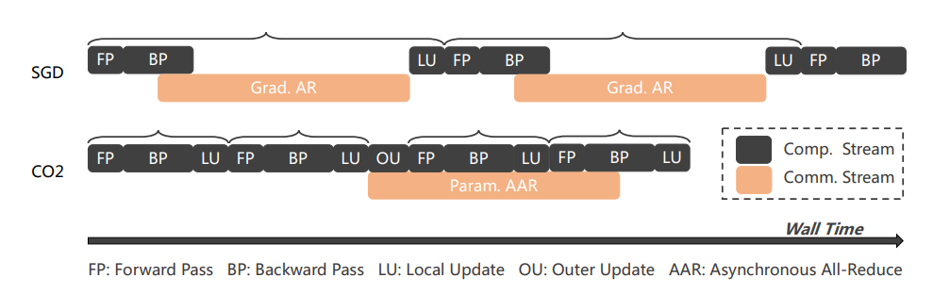
Core Methodology
CO2 stands for COmmunication-COmputation Overlap
Local Updating (The τ Step)
Instead communicating to other GPUs after every single step, each GPU works independently for τ steps.
This reduces the frequency of communication.
While GPUs are doing their next set of local updates, the gradients from the previous set are being sent asynchronously.
Asynchronous Communication
In standard DDP, the GPU stops and waits for the "All-Reduce" (Sync) to finish.
In CO2, the sync happens asynchronously. The GPU starts the next computation immediately using its local weights, while the network handles the weight exchange in parallel.

Slide 5
Solving the "Convergence" Problem
Asynchronous communication comes with "Staleness" (using old weights to calculate new gradients). CO2 introduces two tricks to keep the training stable:
Staleness Gap Penalty: It adds a mathematical "penalty" to the loss if the local weights drift too far from the global average. This forces the model to stay "correct" even when syncing is slow.
Outer Momentum Clipping: A technique to "smooth out" the updates. It prevents the model from making massive, erratic jumps in the weight space caused by delayed synchronization.

Slide 6
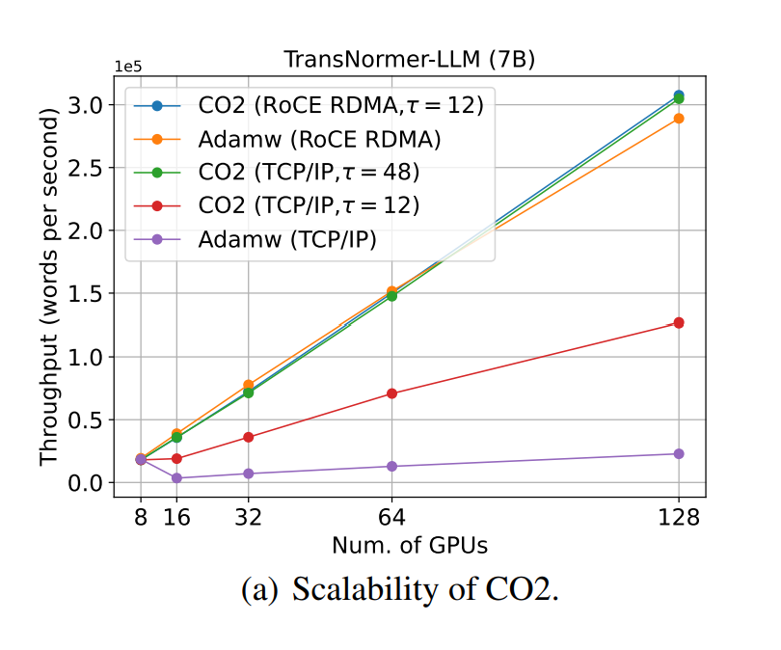
Results and Discussions
Throughput (words/sec) results on distinctive inter-node network configurations are presented.
CO2 exhibits perfect 100% scalability on both configurations.

Slide 7
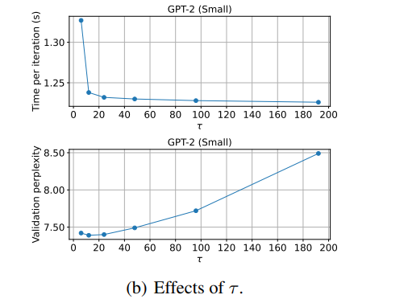
Results and Discussions
Training speed and generalization performance results w.r.t. τ are presented.
A larger value of τ leads higher communication efficiency but worse generalization behaviors.

Slide 8
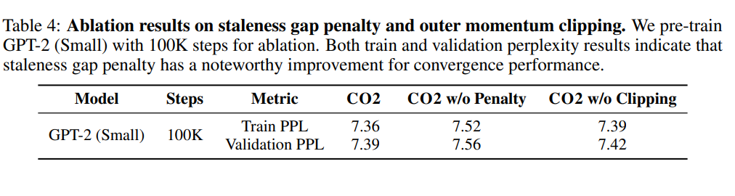
Results and Discussions
These results highlight the importance of balancing communication efficiency and model convergence through proper τ selection and stability mechanisms.

Slide 9
Effect of τ (Synchronization Delay)
Increasing τ reduces communication frequency, improving training speed
However larger τ values may introduce staleness, leading to higher perplexity.
Optimal balance observed at τ = 12, achieving:
Effective overlap of computation and communication
Improved training efficiency
Slight regularization effect, leading to better perplexity

Slide 10
Conclusion
Proposed CO2 for efficient large-scale distributed training on low-bandwidth clusters.
Enables scalability through local updates + asynchronous communication
Achieves near 100% scalability even with limited communication bandwidth.
Improves training stability using:
Staleness gap penalty
Outer momentum clipping
Provides theoretical convergence guarantees
Compatible with existing optimizers (e.g., ZeRO) for memory efficiency

Slide 11
Thankyou

