Slide 1
Multi-Agent Deep Reinforcement Learning With Progressive Negative Reward for Cryptocurrency Trading
S M Wahidur Rahman
March 27, 2026
INFONET Journal Club Presentation
Notes:
Good morning, everyone. Welcome to my Journal Club presentation session.

Slide 2
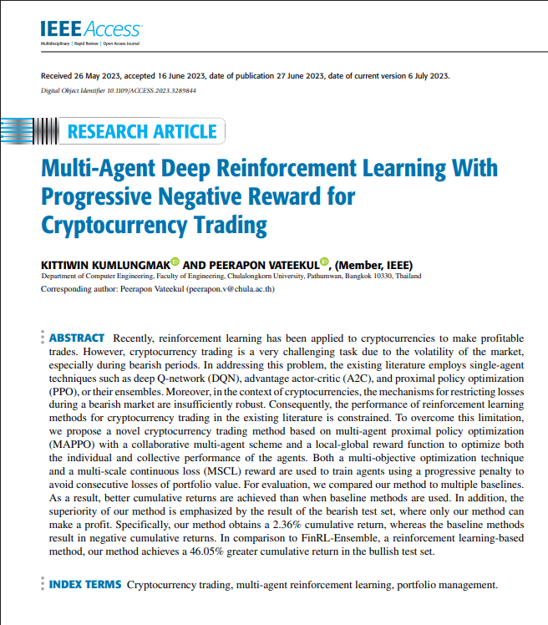
Paper Summary
Title: Multi-Agent Deep Reinforcement Learning With Progressive Negative Reward for Cryptocurrency Trading
Authors: Kittiwin Kumlungmak & Peerapon Vateekul
Journal: IEEE Access
Link: https://ieeexplore.ieee.org/stamp/stamp.jsp?tp=&arnumber=10164080&tag=1
Published Date: 27 June 2023
Journal Impact Factor: 3.6 (2024)
5-year Journal Impact Factor: 3.9 (2024)
Affiliation: Chulalongkorn University, Pathumwan, Bangkok, Thailand
This work is licensed under a Creative Commons Attribution-NonCommercial-NoDerivatives 4.0 License.

Slide 3
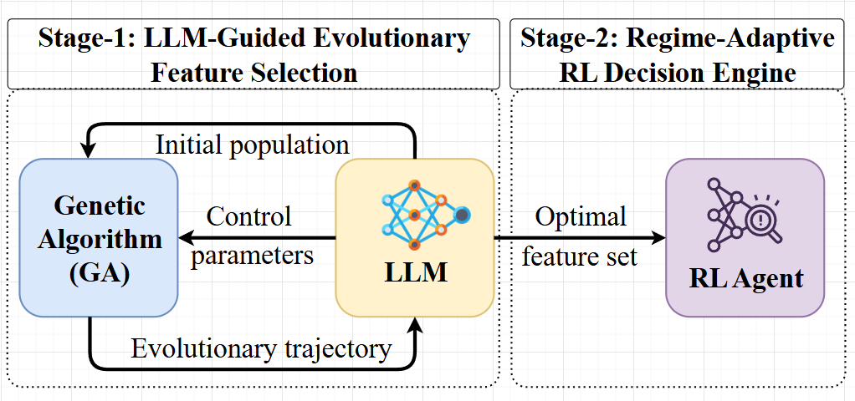
Why This Paper
To develop a regime-adaptive cryptocurrency trading framework that leverages LLM-guided evolutionary feature discovery and reinforcement learning to generate risk-adjusted trading decisions, aiming to achieve controlled risk exposure and
sustainable profitability under volatile and non-stationary market conditions.
Figure: Schema of LEADER.

Slide 4
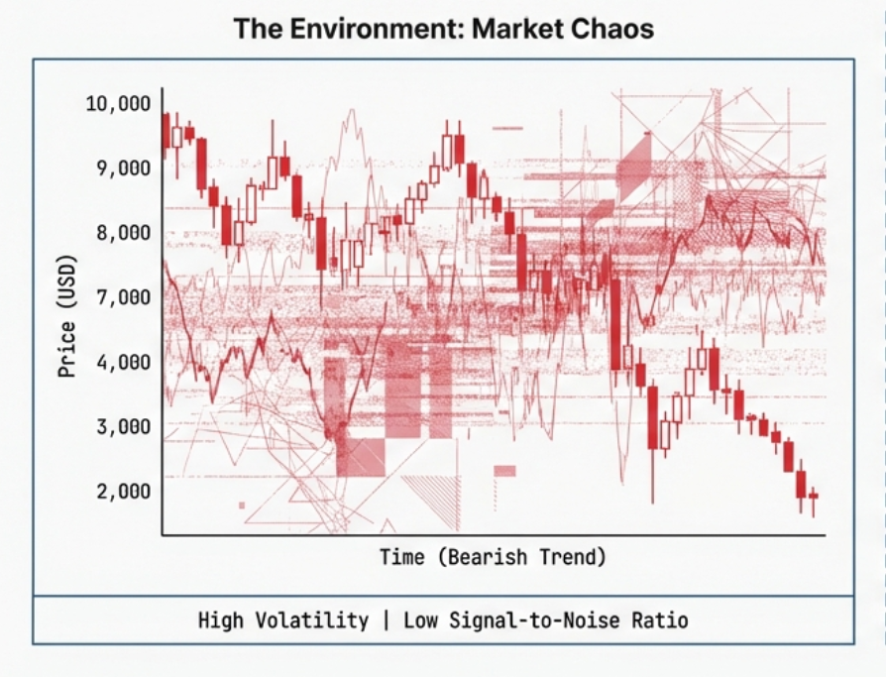
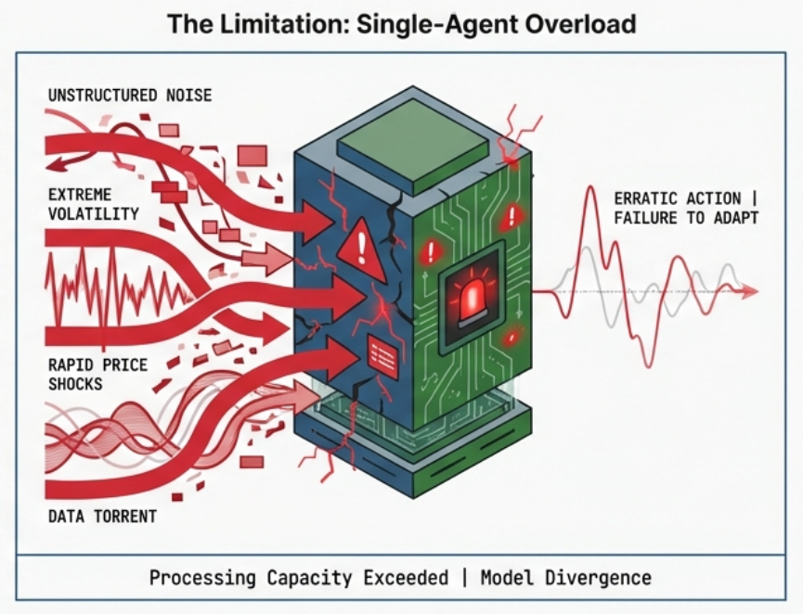
Motivation – Why Is Crypto Trading So Hard
Crypto markets are extreme volatile, swing 20-50% in days.
Balancing return, volatility and transaction cost simultaneously is an unsolved multi-objective problem.
While Deep Q-Netwroks (DQN) and Advantage Actor-Critic (A2C) models succeed in bullish traders, they consistently fail to restrict losses during bearish crashes. The cryptocurrency environment processes too much noise and volatility for single-agent mechanisms to survive sustained drawdowns.
Notes:
The paper begins by explaining the shift from traditional human-led trading to algorithmic trading, which uses math and data to make faster, more accurate decisions. It highlights why Bitcoin is a focus and identifies a gap in current research, those are most models don't balance high profit, low risk, and active trading simultaneously.

Slide 5
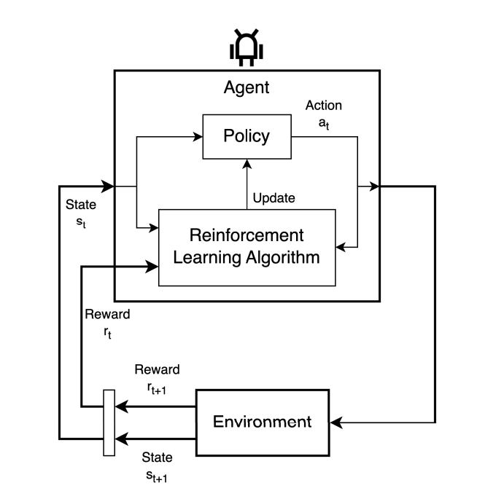
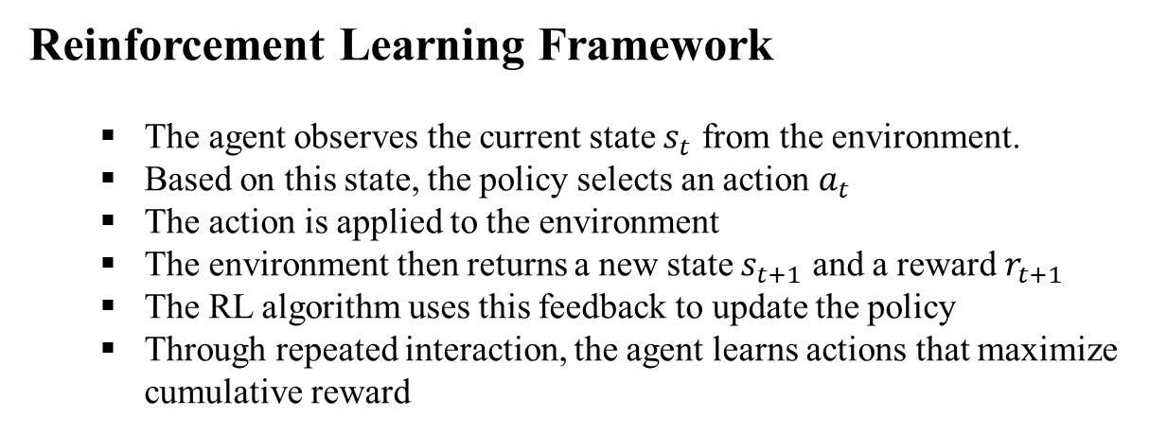
Agent Design – State, Observation & Action
Reinforcement Learning Framework
The agent observes the current state $s_{t}$​ from the environment.
Based on this state, the policy selects an action $a_{t}$ ​
The action is applied to the environment
The environment then returns a new state $s_{t+1}$ and a reward $r_{t+1}$
​The RL algorithm uses this feedback to update the policy
Through repeated interaction, the agent learns actions that maximize cumulative reward
This figure shows the basic reinforcement learning loop. The agent first observes the
current state of the environment. Based on that state, its policy chooses an action.
After the action is taken, the environment responds with the next state and a reward.
The learning algorithm then uses this feedback to update the policy, so that over time
the agent learns better decisions that maximize long-term reward.
Figure: Schema of reinforcement learning.
Notes:
The paper begins by explaining the shift from traditional human-led trading to algorithmic trading, which uses math and data to make faster, more accurate decisions. It highlights why Bitcoin is a focus and identifies a gap in current research, those are most models don't balance high profit, low risk, and active trading simultaneously.

Slide 6
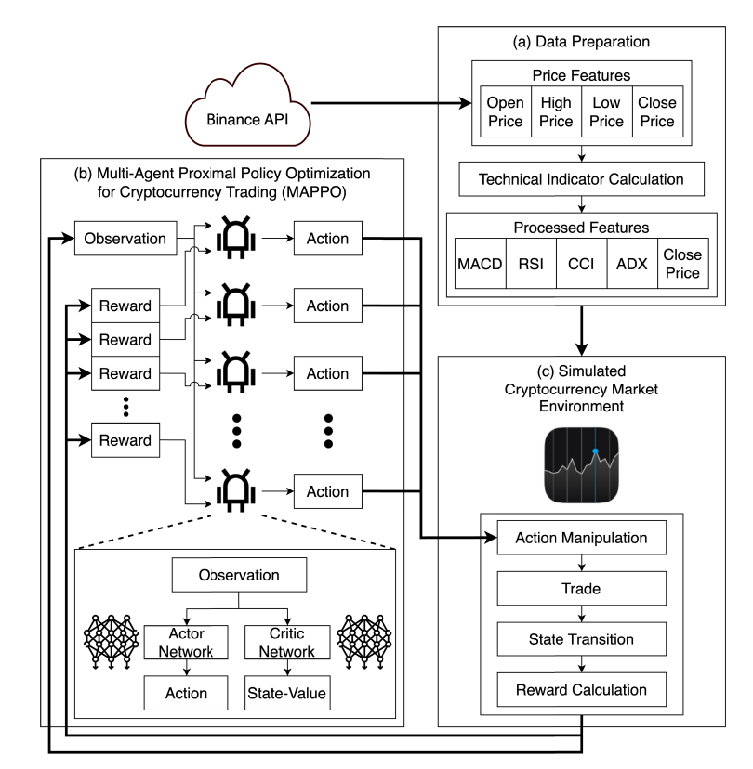
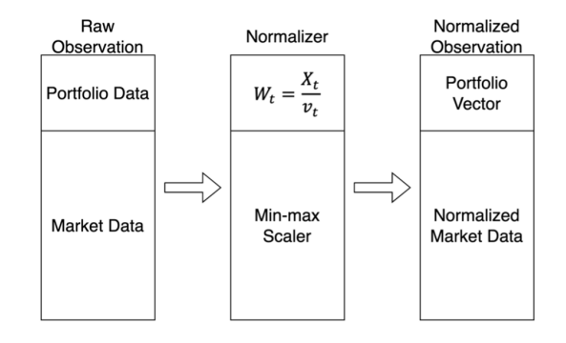
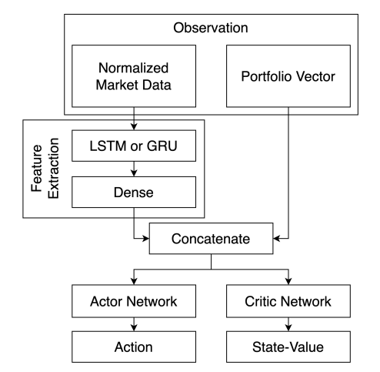
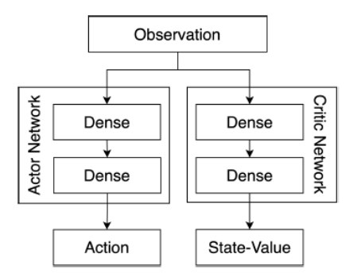
Method Overview – MAPPO System Architecture
The system architecture is a comprehensive framework for multi-agent cryptocurrency trading,
organized into three primary modules:
Data preparation, the multi-agent proximal policy optimization (MAPPO) scheme, and a simulated
market environment
The Data preparation architecture transforms raw Binance data into optimized portfolio weights by
concatenating deep temporal features with
real-time asset vectors.
The MAPPO-based Actor-Critic scheme enables
five collaborative agents to discover cross-asset
correlations through a unified observation space
and shared global rewards.
The simulated market environment enforces liquidity-aware trade execution and risk-adjusted reward
calculations, ensuring high-fidelity policy training for volatile cryptocurrency markets.
Notes:
The paper begins by explaining the shift from traditional human-led trading to algorithmic trading, which uses math and data to make faster, more accurate decisions. It highlights why Bitcoin is a focus and identifies a gap in current research, those are most models don't balance high profit, low risk, and active trading simultaneously.

Slide 7
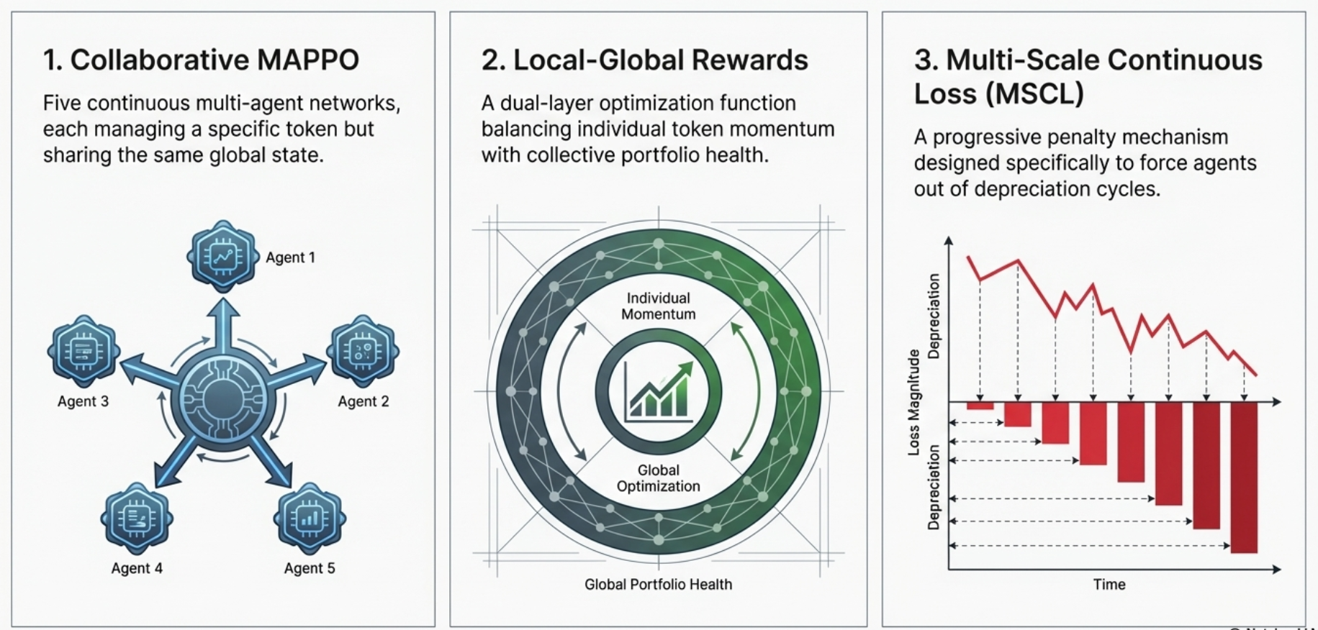
Key Innovation for Signal Extraction and Stability
Notes:
The paper begins by explaining the shift from traditional human-led trading to algorithmic trading, which uses math and data to make faster, more accurate decisions. It highlights why Bitcoin is a focus and identifies a gap in current research, those are most models don't balance high profit, low risk, and active trading simultaneously.

Slide 8
Key Innovation #1 – Collaborative MAPPO
A multi-agent trading framework for cryptocurrency portfolio management.
Five PPO agents, each responsible for one token.
All agents observe the full market state.
Enables learning of cross-token relationships and coordinated decisions.
Uses a local-global reward structure for both individual and portfolio optimization.
Outperformed single-agent methods in risk-adjusted performance.
The only method that achieved profit in bearish markets.
Notes:
The paper begins by explaining the shift from traditional human-led trading to algorithmic trading, which uses math and data to make faster, more accurate decisions. It highlights why Bitcoin is a focus and identifies a gap in current research, those are most models don't balance high profit, low risk, and active trading simultaneously.

Slide 9
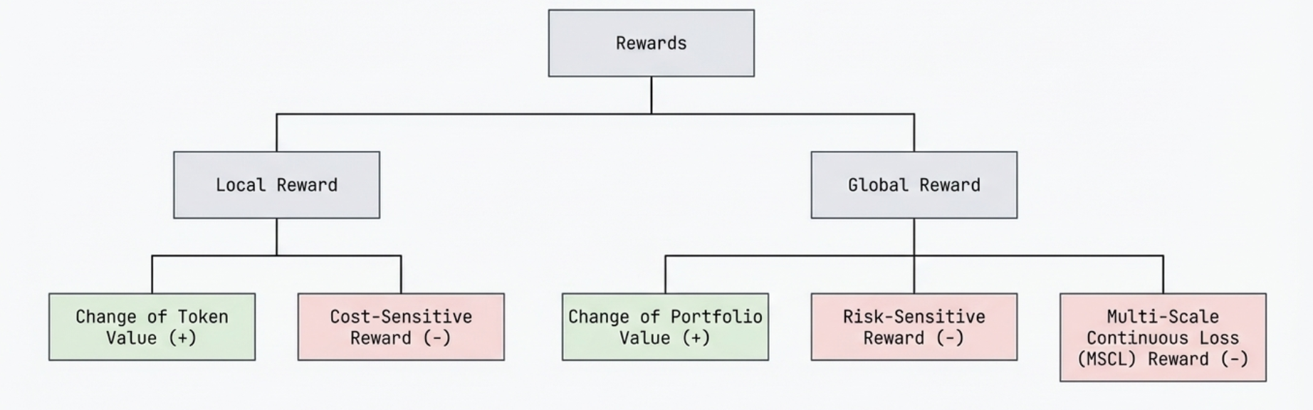
Key Innovation #2 – Local-Global Reward Function
Dual-layer Optimization: Balancing individual and collective goals.
Local reward evaluates each agent based on the performance of its assigned cryptocurrency. It combines token value change and a transaction-cost penalty, helping the agent learn when to buy, sell, or hold while avoiding overtrading. Together with the global reward, it improves both individual token strategy and overall portfolio performance.
Global reward is the same reward shared by all agents, aligning them toward the common goal of maximizing total portfolio value. It combines portfolio return, a risk penalty to reduce volatility, and an MSCL penalty to quickly detect and respond to sustained losses. This helps the system balance profitability, risk control, and crash awareness.
Notes:
The paper begins by explaining the shift from traditional human-led trading to algorithmic trading, which uses math and data to make faster, more accurate decisions. It highlights why Bitcoin is a focus and identifies a gap in current research, those are most models don't balance high profit, low risk, and active trading simultaneously.

Slide 10
Key Innovation #3 – Multi-Scale Continuous Loss (MSCL) Reward
Multi-Scale Continuous Loss (MSCL) reward, is a progressive penalty mechanism designed to help trading agents avoid sustained losses in portfolio value.
The primary goal of the MSCL algorithm is to identify when a portfolio is in a "continuous loss" state across different time horizons.
The “Multi-Scale” component means the system monitors performance across multiple time horizons at once. It first examines a longer window to determine whether the bot is losing money overall. If that condition is satisfied, it then checks a shorter window. By evaluating multiple scales, the agent can detect more quickly whether it is trapped in a sustained downward trend rather than reacting to a temporary price dip.
The "Three Strikes" Rule: A penalty is only triggered if three specific things are happening at once
Strike 1: The portfolio is worth less now than it was at the start of that time window.
Strike 2: During that time, the bot had more "losing" hours than "winning" hours.
Strike 3: The bot is losing money right now at this exact moment.
Why is this useful?
In volatile crypto markets, standard trading bots often keep trading during bearish periods and lose money. The MSCL reward teaches the agent to act more cautiously, helping it avoid unnecessary losses. As a result, it was the only method in the study that achieved a profit (2.36%) in a bearish market, while all standard methods lost money.
Notes:
The paper begins by explaining the shift from traditional human-led trading to algorithmic trading, which uses math and data to make faster, more accurate decisions. It highlights why Bitcoin is a focus and identifies a gap in current research, those are most models don't balance high profit, low risk, and active trading simultaneously.

Slide 11
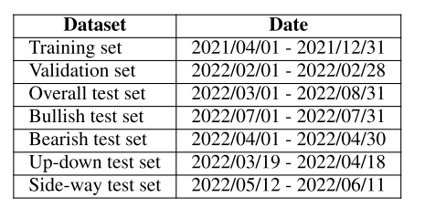
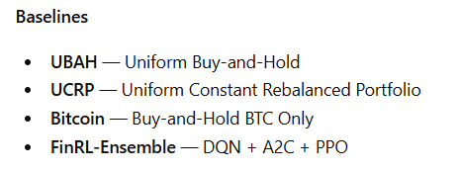
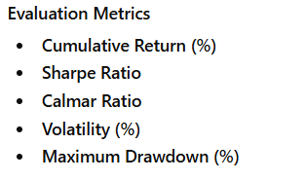

Experimental Setup
All methods were tested under the same trading assumptions
Initial capital: 1,000,000 USDT
Initial portfolio: 100% cash (USDT)
Maximum buy/sell size per token: 100,000 USDT
Transaction cost: 0.1% per trade
Market liquidity assumed: trades execute immediately at close price
Agent trades are assumed to have no market impact
All methods were trained on the same dataset for 1,000 episodes
The model with the best validation cumulative return was selected for testing
Notes:
The paper begins by explaining the shift from traditional human-led trading to algorithmic trading, which uses math and data to make faster, more accurate decisions. It highlights why Bitcoin is a focus and identifies a gap in current research, those are most models don't balance high profit, low risk, and active trading simultaneously.

Slide 12
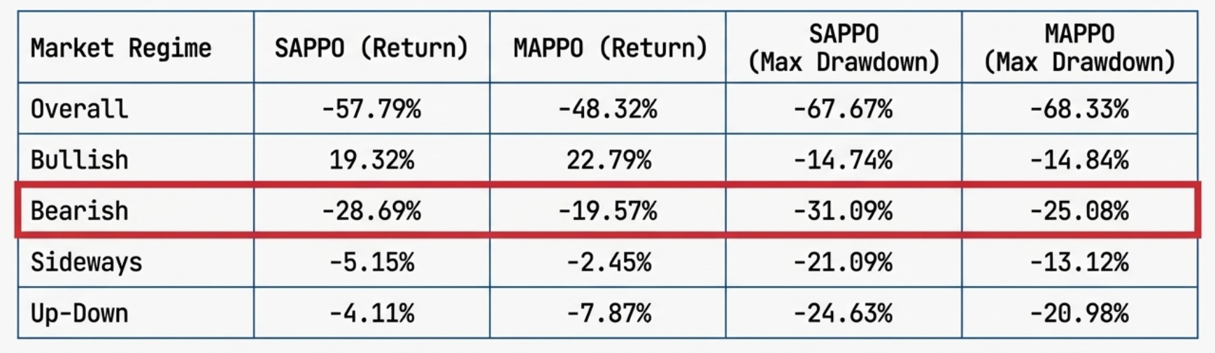
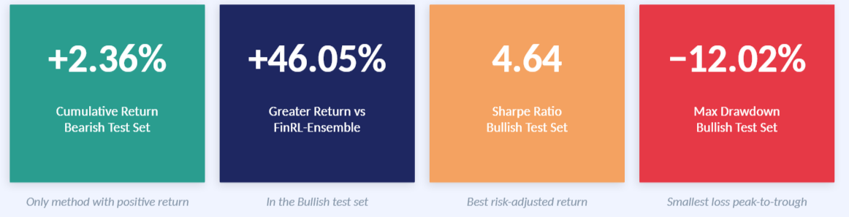
Results – Key Performance Numbers
Notes:
The paper begins by explaining the shift from traditional human-led trading to algorithmic trading, which uses math and data to make faster, more accurate decisions. It highlights why Bitcoin is a focus and identifies a gap in current research, those are most models don't balance high profit, low risk, and active trading simultaneously.

Slide 13
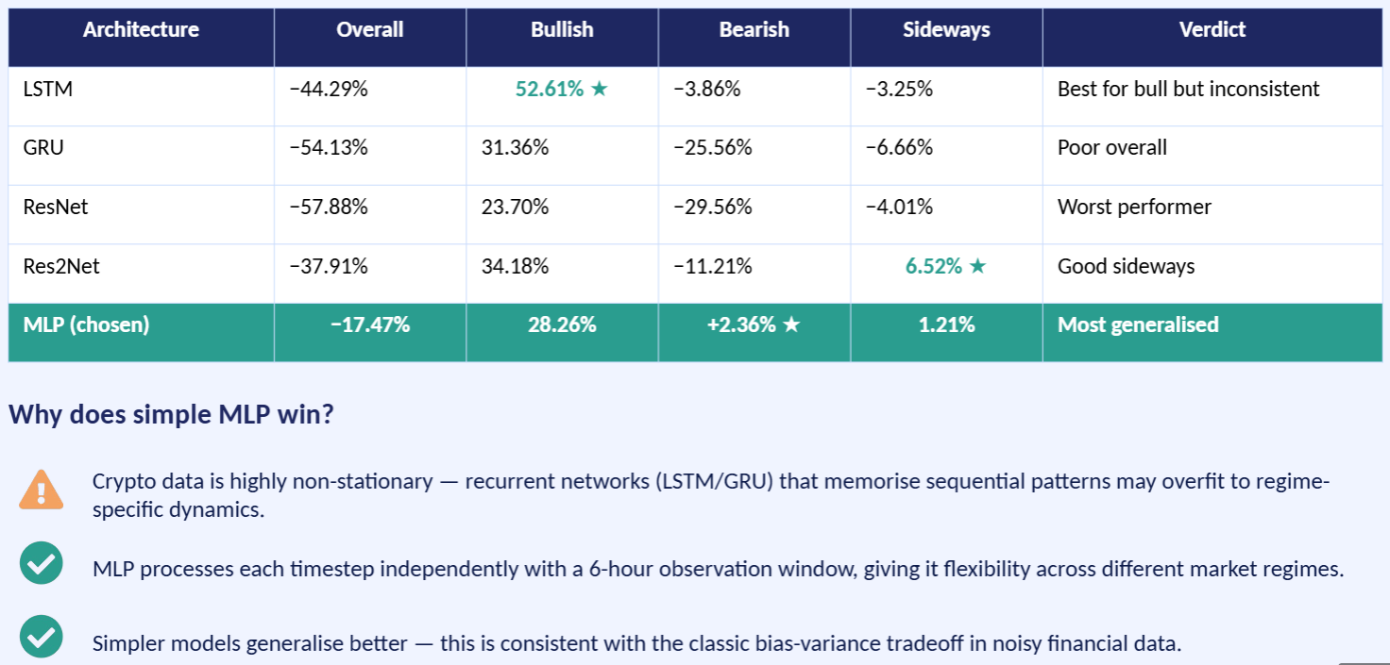
Ablation Study – Network Architecture Comparison
Notes:
The paper begins by explaining the shift from traditional human-led trading to algorithmic trading, which uses math and data to make faster, more accurate decisions. It highlights why Bitcoin is a focus and identifies a gap in current research, those are most models don't balance high profit, low risk, and active trading simultaneously.

Slide 14

Critical Analysis – Strengths & Weakness
Strengths
Only method that stayed profitable in bearish markets (+2.36%)
MSCL reward helped agents avoid sustained losses
Collaboration improved risk-adjusted returns and reduced volatility
Reward design balanced return, risk, and transaction cost
A simple MLP showed better generalization than more complex models
Weaknesses
Performance was weaker in sideways, highly volatile markets
Assumed perfect liquidity and no market impact
Complex models like LSTM/ResNet often did not improve results
Sharpe/Calmar ratios are less meaningful when returns are negative
MAPPO did not always achieve the best maximum drawdown
Notes:
The paper begins by explaining the shift from traditional human-led trading to algorithmic trading, which uses math and data to make faster, more accurate decisions. It highlights why Bitcoin is a focus and identifies a gap in current research, those are most models don't balance high profit, low risk, and active trading simultaneously.

Slide 15
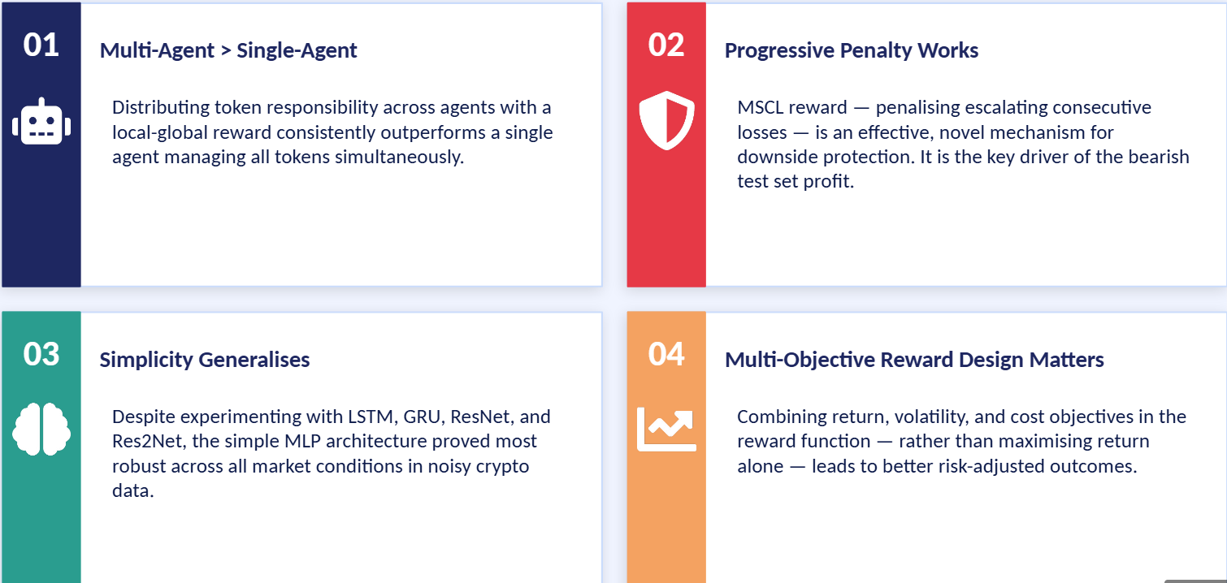
Key Takeaways – What This Paper Contributes
Notes:
The paper begins by explaining the shift from traditional human-led trading to algorithmic trading, which uses math and data to make faster, more accurate decisions. It highlights why Bitcoin is a focus and identifies a gap in current research, those are most models don't balance high profit, low risk, and active trading simultaneously.

Slide 16
Questions & Discussion

