Slide 1
Video-rate hyperspectral camera based on a
CMOS-compatible random array of Fabry-Pérot filters
Published: 2023, Nature Photonics.
Authors: Motoki Yako, et al. Panasonic Corp.
Jioh Lee

Slide 2
Why This paper [1]
Most recent paper, citing our two previous works.
  Computational spectrometer using compressed sensing (CS) framework [2] (2012).
  Filter design principle for CS spectrometer [3] (2013).
Consideration in industry.
  The authors work for Panasonic Corp.
Think this work is closer to ideal form hyperspectral camera than other works.
  Fabrication complexity.
  Imaging quality and speed.
  The demonstration is well done.

Slide 3
Background

Slide 4
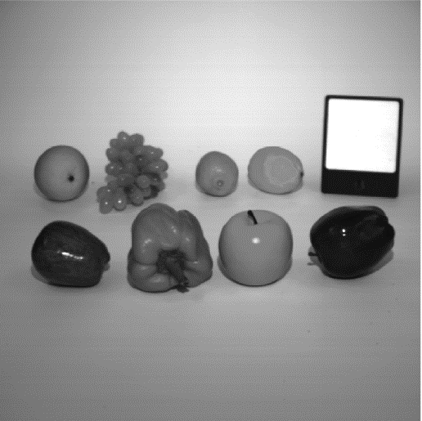
Hyperspectral Image (HSI)
  Image that contains spectral information (at multiple channels or bands) in each pixels.
  RGB image only contains three channels (R:650nm, G:550nm, B:450nm)
λ
RGB image
HSI

Slide 5
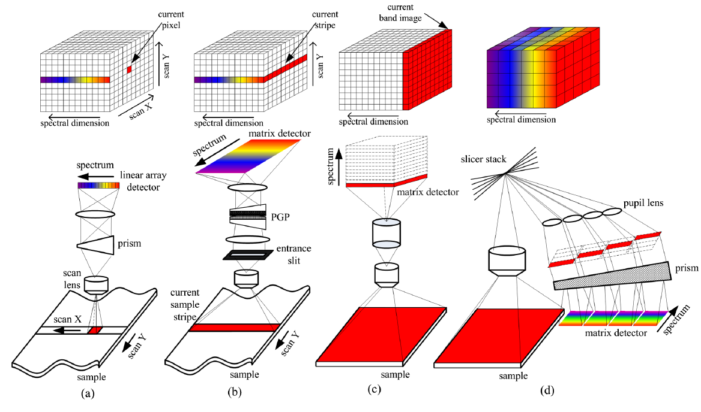
Hyperspectral Camera
Existing hyperspectral imaging method
Type | Properties
(a) Whiskbroom | Point scanning Large size High resolution Wide working range Long acquisition time In commercial
(b) Pushbroom | Line scanning Large size High resolution Wide working range Long acquisition time In commercial
(c) Staring | Wavelength scanning Large size Low spectral resolution Narrow working range High spatial resolution Moderate acquisition time
(d) Snapshot | Compact size Low spectral resolution Low spatial resolution Short acquisition time
Goal: Achieve low-cost, compact and high-resolution hyperspectral camera
by adopting snapshot structure and computational approaches

Slide 6

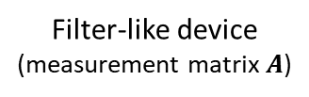


Computational Approach
Examples of snapshot computational hyperspectral camera.
  Coded Aperture Snapshot Spectral Imaging (CASSI) [4].
  Multilayer Thin Film filter array (MTFs)-based [5].
  Metasurface-based [6].
  Fabry-Pérot filter array [1].
Filter-like device
(measurement matrix $A$)
Reconstruction
Scene $\text{x}$
measurement $\text{y}$
Reconstructed Image $\hat{\text{x}}$

Slide 7
Video-rate hyperspectral camera based on a
CMOS-compatible random array of Fabry-Pérot filters

Slide 8
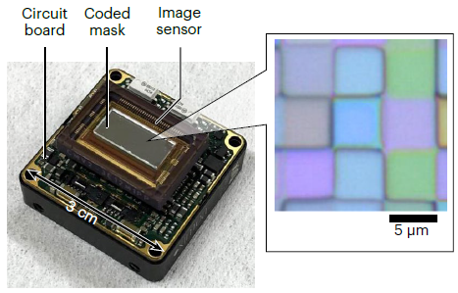
Overview
Limitation of existing method
  Sensitivity (light efficiency), Resolution (Spatial/Spectral), Speed (frame rate) trade-off.
  Bulky-size.
  Not CMOS compatible.
Develop a Hyperspectral camera
  Use Fabry-Pérot (FP) filter array. → CMOS compatible
  Has high sensitivity, resolution, speed simultaneously.
  Iterative reconstruction algorithm.
    Two-point Iterative Shrinkage Threshold (TwIST).
  AI-based reconstruction algorithm.
    CNN based UNet architecture in [7].
Fig 1. C, a photograph of proposed HS camera

Slide 9
Overview
Contribution
  Achieve video-rate (30~ fps), high spatial resolution (480p), high sensitivity (46.4%) at the same time.
Novelty
  Method to design random FP filter array.
    Incoherent between transmittance.
    Large variance of transmittance across the location of filter.
Limitation
  Spectral resolution is still low (20 bands, other HSI dataset has more than 30 bands).
  AI-based reconstruction results are not clear.
    They said that they achieved over 30 fps with FHD resolution using AI-based reconstruction, but no actual demonstration.

Slide 10
FP Resonator
  Distributed Bragg Reflector (DBR) reflects the light selectively in bands.
  Lights are resonating and can be canceled each other in some bands.
DBR
Input
Output (modulated)
Cavity Layer

Slide 11
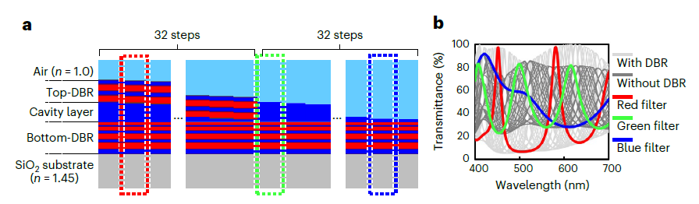
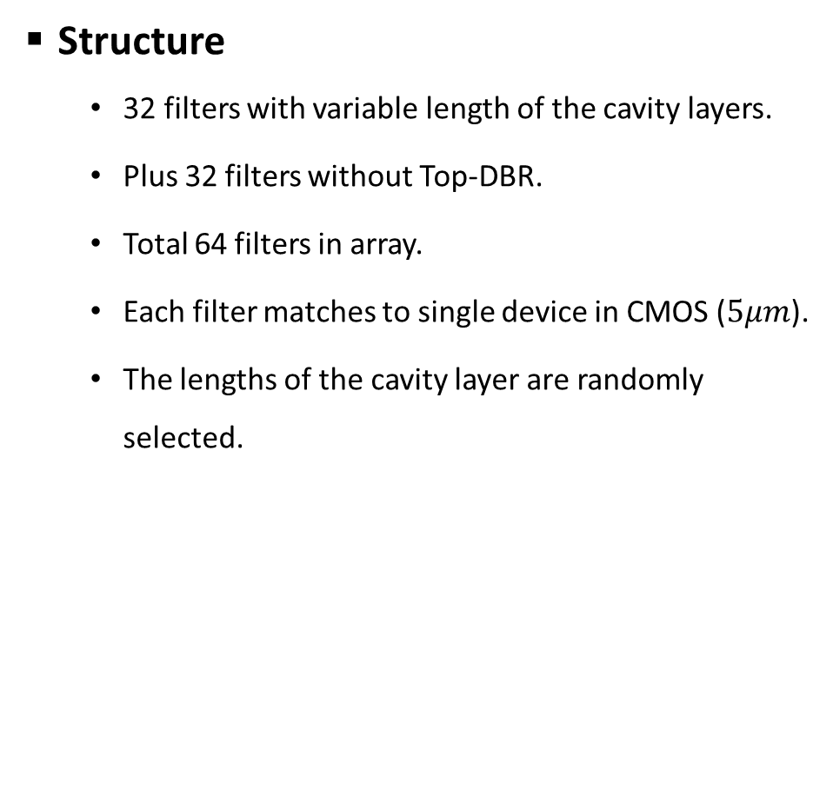
FP filters
Structure
  32 filters with variable length of the cavity layers.
  Plus 32 filters without Top-DBR.
  Total 64 filters in array.
  Each filter matches to single device in CMOS ($5μm$).
  The lengths of the cavity layer are randomly selected.
Properties
  450nm ~ 650nm
  Fully integrated onto the CMOS sensor during fabrication.
  Average transmittance of the filters is 46.4%
    High sensitivity.
Fig 2. a) Structure of FP filter. b) Simulated transmission spectra of FP.

Slide 12
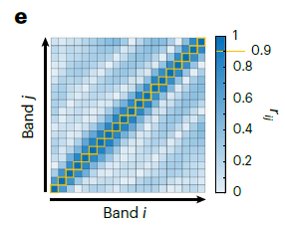
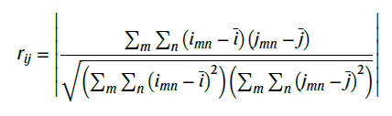
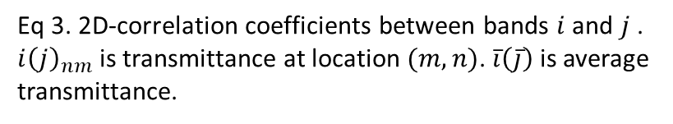
FP filters: Spectral Randomness
  Same filter, implemented across all pixels.
  Evaluate using 2D-correlation of transmittance between wavelengths.
  Smaller non-diagonal components, smaller reconstruction error.
  Same concept in [3], but 1D correlation.
Eq 3. 2D-correlation coefficients between bands $i$ and $j$ . $i{\left(j\right)}_{nm}$ is transmittance at location $(m, n)$. $\overline{i}\left(\overline{j}\right)$ is average transmittance.
Fig 2. e) 2D-correlation coefficients map

Slide 13
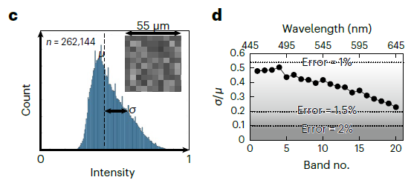
FP filters: Spatial Randomness
  Same filter are implemented multiple times onto CMOS sensor.
  Evaluate using distribution of transmittance at certain band.
  Larger variance, smaller reconstruction error.
Fig 2. c) Transmittance histogram of 512 $×$ 512 pixel. Standard deviation ($σ$) and the average transmittance ($μ$) at $λ=550nm$ d) evaluation index ($σ/μ$) for each bands.

Slide 14
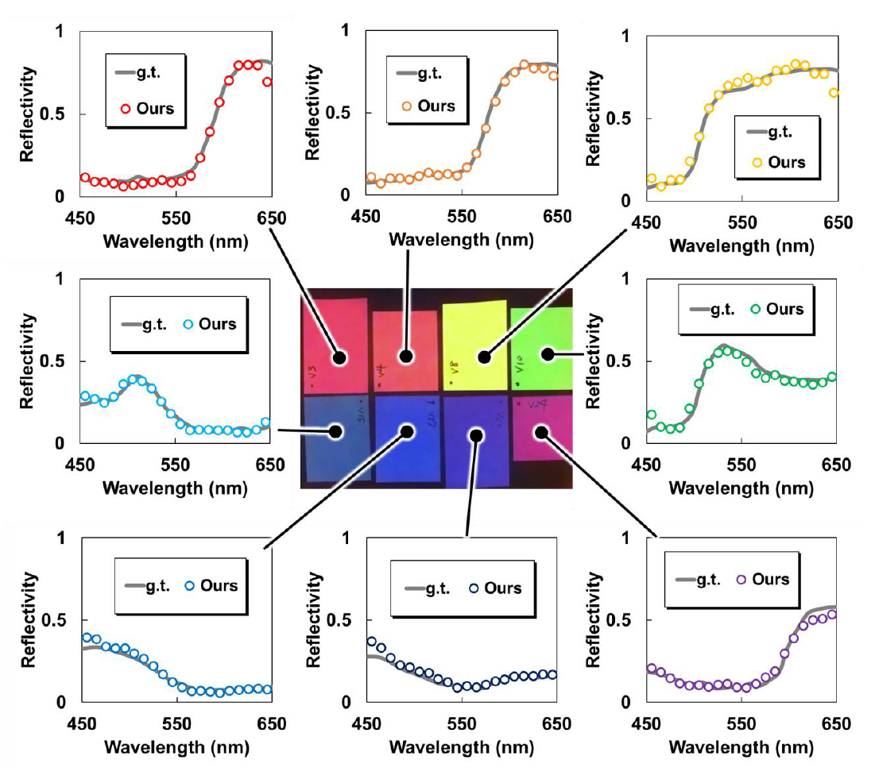
Results: Spectral Reconstruction
  Range: 450nm ~ 650nm
  # of Bands: 20
  The absolute error of 2.2%
Fig S15. The spectra of 8 color samples measured by proposed camera

Slide 15

Results: Video Demo
  Many analysis of device in
  supplementary information.
  Supplementary Video 1
  32 fps, VGA

Slide 16
Conclusion
  High sensitivity, spatial Resolution, video frame-rate are achieved at same time.
  CMOS-compatible and compact size, comparable with RGB camera.
  Low spectral reconstruction error (2.2%).
  Applicable to consumer product such as smartphone, drone, and IoT devices.

Slide 17
References
[1] M. Yako et al., "Video-rate hyperspectral camera based on a CMOS-compatible random array of Fabry–Pérot filters," Nature Photonics, vol. 17, no. 3, pp. 218-223, 2023/03/01 2023, doi: 10.1038/s41566-022-01141-5.
[2] J. Oliver, W. Lee, S. Park, and H.-N. Lee, "Improving resolution of miniature spectrometers by exploiting sparse nature of signals," Optics express, vol. 20, no. 3, pp. 2613-2625, 2012.
[3] J. Oliver, W.-B. Lee, and H.-N. Lee, "Filters with random transmittance for improving resolution in filter-array- based spectrometers," Optics Express, vol. 21, no. 4, pp. 3969-3989, 2013.
[4] X. Yin, L. Su, X. Chen, H. Liu, Q. Yan, and Y. Yuan, "Hyperspectral Image Reconstruction of SD-CASSI Based on Nonlocal Low-Rank Tensor Prior," IEEE Transactions on Geoscience and Remote Sensing, 2024.
[5] C. Kim, P. Ni, K. R. Lee, and H.-N. Lee, "Mass production-enabled computational spectrometers based on multilayer thin films," Scientific Reports, vol. 12, no. 1, p. 4053, 2022, doi: 10.1038/s41598-022-08037-y.
[6] M. Makarenko et al., "Real-time hyperspectral imaging in hardware via trained metasurface encoders," in Proceedings of the IEEE/CVF Conference on Computer Vision and Pattern Recognition, 2022, pp. 12692-12702.
[7] Y. Zhao, H. Guo, Z. Ma, X. Cao, T. Yue, and X. Hu, "Hyperspectral imaging with random printed mask," in Proceedings of the IEEE/CVF Conference on Computer Vision and Pattern Recognition, 2019, pp. 10149-10157.

