Slide 1
Journal Club Presentation
Sprints: Intermittent Blockchain Pow Mining
Cryptology ePrint Archive, 2023
Seungmin Kim
2024.06.04

Slide 2
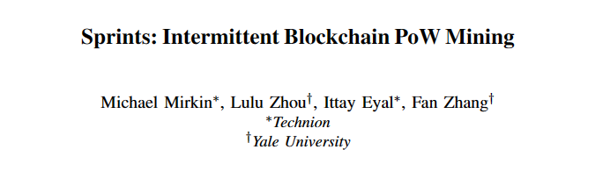
Paper Introduction
Mirkin, Michael, et al. "Sprints: Intermittent blockchain pow mining." Cryptology ePrint Archive (2023).
This paper was accepted into USENIX Security'24.
This is the most recent and notable research on PoW mining.

Slide 3
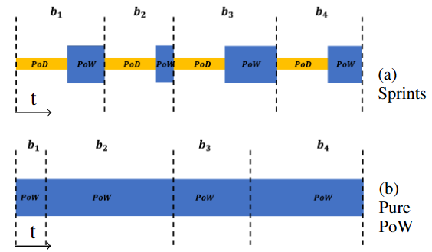
1. Introduction
Sprints Protocol
A blockchain protocol that maintains the advantages of PoW while reducing resource consumption.
Intermittent Mining: Alternating between Proof of Delay (PoD) and Proof of Work (PoW).
Sprints provides a safe and environmentally friendly alternative to traditional PoW cryptocurrencies.

Slide 4
1. Introduction
Key Features
PoD: Reduces overall resource usage by making miners wait before calculating PoW.
Security: Proven to be as secure as a pure PoW system.
Uniform Latency: Important for security purposes, all miners have the same latency.
Optimal strategy: Miners must solve PoW and PoD puzzles sequentially, offsetting the benefits of parallel mining.

Slide 5
2. Related Work
Review of energy-efficient PoW alternatives
Proof of Stake (PoS): Requires strong assumptions about network connectivity, validator behavior, etc. New nodes require cooperation from existing nodes.
Verifiable Delay Function (VDF): A protocol that combines PoS and VDF. Low attack threshold.
Other alternatives:
  HEB: 50% reduced power consumption, reduced security.
  REM/PoET: Requires reliable hardware.
  Chia: Converting power consumption to hardware cost,low security threshold.
  Permissioned Protocol: Requires prior approval, lacks decentralization.
PoW protocol analysis
Dembo et al.'s analysis proves that 'private attack' is the worst case.
Avoiding the Nakamoto block concept and proving security through a single race.

Slide 6
3. Modeling
System configuration
Participants: Made up of miners.
Block tree: Each miner maintains a tree data structure, and the vertices are called blocks.
Block: Contains transactions and instructions(payload).
Genesis block: All miners start from the same root block.
Metadata: Each block contains a hash pointing to its parent block (except genesis blocks).
Longest chain: The path with the most blocks in the tree. One chain selected by a deterministic random algorithm is called the main chain.
Block height: The number of blocks in the path from the genesis block to that block.

Slide 7
3.Modeling
Time and puzzles
Time progresses in discrete steps (t=0,1,...).
In each level, the miner can work on two types of puzzles:
  Proof of Delay (PoD): A function that maps arbitrary inputs and difficulty parameters to small outputs. Resolvable after a delay period (Δ_{PoD}).
  Proof of Work (PoW): A probabilistic puzzle solved with independent probability at each step. The number of steps to success follows a geometric distribution.
Block composition
A block consists of a tuple of (metadata M, payload D, puzzle solution Z).
  communications and networks
  Δ-synchronous broadcast network: When a message is sent at step t, it is received by all miners at t+Δ.
  Message delay: Δ < Δ_{PoD}.

Slide 8
3.Modeling
Block validation
  Validation function (V(b)): Checks the validity of block b and returns true if predefined conditions are met.
  Execution: The series of states through which the state of a system evolves. Each execution has a probability of occurrence.
Tree and execution view
  Parent Tree (T^{σ}(t)): A tree consisting of all valid blocks in the system up to step t.
  Local tree (T^{σ}_{p}(t)): A local copy of the parent tree that is updated according to the blocks each miner receives.
  Execution view (σ_{p}): Contains all information received by minor p and the results of local computations.

Slide 9
3.Modeling
Behavior and Mining Functions
  Mining function (q(σ_{p})): Defines mining goals for PoW and PoD and blocks to publish for a given view σp.
  Given protocol (V(·), q(·)): Implements the ledger if persistence and progress conditions are met.
Persistence
  Given ε > 0 and step t_{f}, ensure that for any attacker strategy A, persistence holds for all blocks b in t≤t_{f} in a randomly selected run σ.
Progress
  Given ε > 0 and t_{f}, we guarantee that for every step t₀≤t_{f} and attacker strategy A, the probability that a randomly selected run σ will not contain a mined block within t₀+δ is less than ε.

Slide 10
4.Sprints
Goal: The Sprints protocol defines a mining function q(σ_{p})) and a validity function V(b) for miner p to implement the ledger.
Valid blocks:
Puzzle Solutions: Includes two puzzle solutions: Proof of Delay (PoD) and Proof of Work (PoW).
Proof of Delay (b^{PoD}): Forcing sequential computations.
Proof of Work (b^{PoW}): The PoW puzzle.
Mining function:
Select the deepest block (full block or partial block) in the miner's view and return the required puzzle.
Full block: If the deepest block is a full block, perform the PoD puzzle of the next block. Perform one step of the PoD puzzle based on the hash of the previous block with metadata M.
Partial block: Perform PoW puzzle if the deepest block is a partial block.
A solution to the PoD puzzle of metadata b^{PoD} and a new block payload based on D, one step closer to the PoW puzzle.
If the PoW phase is successful, the miner creates a new block b=(M,D,(b^{PoD},b^{PoW})) posting.

Slide 11
4.Sprints
Validity function:
Verifies that block b's PoD and PoW puzzles are valid.
Validation:
PoD does not require the payload of a block, but PoW requires the payload of a block.
Chain Management:
When a node learns of a chain that is longer than the block it is currently working on, it abandons its current work and begins producing blocks that extend the new chain.
Key features:
Combination of PoD and PoW: Sprints combines PoD and PoW puzzles to implement a more efficient and secure blockchain system.
Guaranteed validity: Verifies the validity of PoD and PoW puzzles to ensure block validity.

Slide 12
5. Security
Sprints Protocol Proves to Achieve Persistence and Progress
1. Persistence:
  Goal: Prove that a block on the main chain will almost certainly remain in place.
  Method: Divide the problem into small "mini-games" focused on blocks of a certain depth, and calculate the overall probability of a permanence violation by adding up the probability of an attacker winning in each mini-game using a union bound.
2. Progress:
  Goal: Prove that there is a high probability that at least one honestly mined block will remain permanently on the main chain for a sufficiently long period of time.
  Method:
    Prove that when r > 0, an honest miner will discover r blocks within a sufficiently long period of time.
    Prove that from each honest miner's view, the probability that an attacker forms a tree deeper than r blocks is bounded by 2^{−Ω(r)}.

Slide 13
5. Security
Proof method:
1. Reduced to a simple game:
  In this game, attackers and honest miners mine each block tree, starting from the initial genesis block.
  Goal: When both trees reach the minimum r block length, the attacker catches up to or exceeds the honest miner's tree length.
  Prove that the sum of the probability of an attacker winning in an infinite set of games is limited to 2^{−Ω(r)}.
2. Optimal attack strategy:
  We assume that the attacker mines PoW and PoD puzzles in parallel, making the attacker stronger.
  Optimal strategy: A strategy in which the attacker mines PoW on the deepest block in his subtree.
  Stop PoW mining if PoD puzzle is not completed.
3. Proof process:
  Consider the worst attack:
    If the attacker and honest subtrees have the same length, they contain the same number of PoD blocks.
    This is proven using random walk analysis, reducing competition to only PoW calculations.

Slide 14
5.1 Terminology and Notation
Race definition:
  Race between honest miners and attackers
  Assume that the attacker chooses to mine PoD in parallel on all possible blocks.
  This is because strategy A₁, which PoD mines only some blocks, creates the same tree.
  For brevity, we define the mining operation at step t as the block that the attacker chose to mine PoW.
  If there are no blocks to mine in PoW, the attacker's action is defined as ⊥, i.e. an empty action.
  The attacker chooses a delay for each block b and the honest miner p.
  To simplify the analysis, we assume that the attacker can also delay the miner who discovered the block. This helps limit an attacker's chance of success.
Subtree definition:
  Given depth i, run σ, and honest block b of depth i:
  For every step t:
    T_{H}^{σ}(t) : b, a subtree of Tσ(t) containing descendants and ancestors known to all honest miners.
    T_{A}^{σ}(t) : A subtree of Tσ(t) containing b and its private aggressive descendants and ancestors.

Slide 15
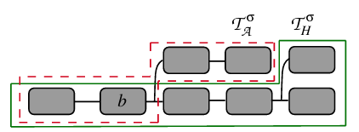
5.1 Terminology and Notation
Subtree definition:
  Given depth i, run σ, and honest block b of depth i:
  For every step t:
    T_{H}^{σ}(t) : b, a subtree of Tσ(t) containing descendants and ancestors known to all honest miners.
    T_{A}^{σ}(t) : A subtree of Tσ(t) containing b and its private aggressive descendants and ancestors.

Slide 16
5.1 Terminology and Notation
Partial and full blocks:
  A block data structure (M,D,(b_{PoW},⊥)) that contains only PoD puzzles is called a partial block, and all proofs are The valid block it contains is called the entire block.
  The depth of partial block b is expressed as ˜d(b).
PoD depth definition:
  PoD depth of the tree for a given run σ:
    Defined as the deepest block in the parent tree with a completed PoD puzzle in the subtree.
    This is ˜d_{b}^{σ}(t) of T_{A}^{σ}(t) and T_{H}^{σ}(t) Represented as ˜d¬^{b}σ(t) of T_{H}^{σ}​(t).
    For a particular π, the subset Σ_{πi_A} of Σ_{π} ​​is defined as if the attacker follows strategy A.
Define the optimality of the attacker's strategy:
  Consider each T^{σ}_{H}(t) and T^{σ}_{A}(t) separately:
    Finding a single strategy that minimizes and maximizes each depth.

Slide 17

5.2 Adversary tree
Goal: Find the optimal strategy for the attacker's subtree T_{A}^{σ}(t)
Define optimal strategy
(t_{f}, ℓ) - optimal strategy:
  Goal: Maximize the probability that the depth of T_{A}^{σ} at a given step tf is at least ℓ.
  Definition 2: (t_{f}, ℓ)-optimal if attacker strategy A satisfies
  for all prefixes π and strategy A′.
  Longest-Chain Mining (LCM):
  A strategy where the attacker selects the deepest partial block in t₀​..
  Definition 3: The attacker strategy of selecting blocks of B_{max}(T_{A}^{σ}(t)) in a given execution σ is LCM.

Slide 18
5.2 Adversary tree
Lemma 1:
  For all t₀​ length prefixes and t_{f} steps, the LCM strategy is (t_{f}, ℓ)-optimal.
Lemma 2:
  Given two sets of executions, if the first set has a higher partial depth at t₀​, it is more likely to be deeper in the t_{f} step.
Proof of optimal strategy
Proof of LCM strategy:
  Proof using double induction.
  Prove Lemma 1 and 2 together at each step by inducing from t_{0​} to t_{f}.
  We show that basic induction holds at t₀∈[q₀,t_{f}−1].
  Assume t₀∈[q₀−n,t_{f}−1] and t₀=t_{f}−n−1 Prove the inductive step by expanding to t₀​=t_{f}−n−1 steps.

Slide 19
5.2 Adversary tree
Defining unnecessary actions and improving LCM strategy
Backward Mining:
  When an attacker mines a PoW puzzle that does not extend the depth of the chain.
  Definition 4: In a given execution σ, the action Q_{A}^{σ}(t)=b_{PoD}of step t already has partial block b′_{PoD} Defined as backward mining when PoD is calculated.
Improved LCM strategy:
  Perform LCM strategy without meaningless backward mining.
  Definition 5: The (t_{f}, ℓ)-intermittent LCM strategy is (t_{f}, ℓ)-optimal and does not perform backward mining.
  Proof of optimality of intermittent LCM strategy
Lemma 3:
Prove that for all t_{f}, ℓ, LCM strategy A, the intermittent LCM strategy A′, which replaces all backward mining actions with ⊥, is (t_{f}, ℓ)-optimal.
Conclusion:
Intermittent LCM is the optimal strategy.
  Through Lemma 3, we prove that the intermittent LCM strategy is (t_{f}, ℓ)-optimal for all ℓ and t_{f}, showing that it is the optimal strategy.

Slide 20

5.3 Honest tree
Goal: Find a strategy that minimizes the depth of the subtree T_{H}^{σ}(t).
Define a malicious optimal strategy
Definition 6: (t_{f},ℓ) -A malicious optimal strategy is a strategy that satisfies
for all prefixes π and strategies A′.
If strategy A is (t_{f}, ℓ)-malicious optimal strategy for all t_{f} > t₀ and for all ℓ, then we call it malicious optimal.
Maximum Delay and No Mining Strategy (MDNM):
  The attacker does not mine new blocks, but sets the arrival delay of all honest blocks to a maximum of Δ.
  Definition 7: Given a prefix π, the MDNM strategy is one in which the attacker sets the arrival delay of all honest blocks to a maximum of Δ without mining any blocks.

Slide 21
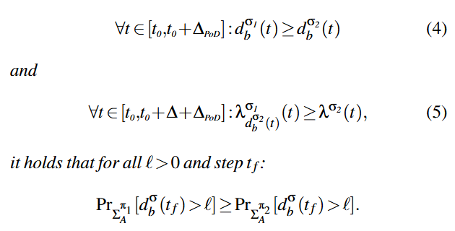
5.3 Honest tree
Advantages of MDNM Strategy
Lemma 4: Given two prefixes π₁ and π₂​, assume that MDNM strategy A works identically on both prefixes.
Proof of optimality of MDNM strategy
Lemma 5: Prove that the MDNM strategy is a malicious optimal strategy.
  Goal: Prove by back induction that the MDNM strategy is a malicious optimal strategy.
  Basics: Explain why MDNM is optimal at _{t}0∈[t_{f}−Δ_{PoD},t_{f}].
  Assumption: Assume that the assumption holds for all t₀∈[t_{f}−Δ_{PoD}−n,t_{f}].
  Inductive step: Prove that MDNM is optimal by considering both cases where a new block is discovered and when it is not.

Slide 22
5.3 Honest tree
Proof sketch:
Basic steps:
  In the initial time frame t₀∈[t_{f}−Δ_{PoD}, t_{f}], the Lemma holds naturally.
  A deeper prefix maintains its advantage for this short period with more miners.
Inductive steps:
  t₀= t_{f}−Δ_{PoD}−n−1 expansion. Prove that the leader prefix maintains the lead considering both cases where a new block is discovered and when it is not.
Conclusion:
  The MDNM strategy is optimal for delaying the arrival of honest blocks as much as possible while minimizing the depth of the tree by not mining new blocks. This proves that the MDNM strategy is a malicious optimal strategy.

Slide 23
5.4 Basic race
Introduce a two-phase (epoch) race in which an attacker attempts to fork a blockchain, and obtain an upper bound on the probability that an attacker will succeed in the attack.
Assume Δ=0.
Race settings:
  Block definition:
  Given an attack strategy A and an execution σ, b_{s}^{σ}(q) is defined as the first published block of depth q in σ.
  Secret and public trees:
  Secret tree T^{σ}_{A}(t,q) : Secret tree with root b_{s}^{σ}(q).
  Public tree T^{σ}_{H} (t,q) : Public tree with root b_{s}^{σ}(q). All blocks are public.
Race conditions:
For the attacker to win the race, at some stage step t d(T_{A}^{σ}(t,q))≥q+r and d(T_{A}^{σ}(t,q))≥d(T_{H}^{σ}(t,q)).

Slide 24

5.4 Basic race
Probability calculation:
Probability of winning:
Given a random run σ∈Σ_{A}, the probability that the attacker wins the race is denoted by χ(A,r).
Prove that S(r)=2^{−Ω(r)}.
Lemma 6:
When there are few attackers ( α_{A}<α_{H} ) and Δ=0, S(r)=2^{−Ω(r)}.

Slide 25
5.4 Basic race
Proof sketch:
Two stages of the race:
  The first stage ends when an honest miner finds m blocks.
  The second phase ends when the attacker wins the race.
  Let d_{A} the number of blocks the attacker has at the start of the first step, and Pr⁡[d_{A}=k] is the probability for a given k.
Remove the effect of PoD blocks:
  Proving that differences in Δ_{PoD} values ​​do not affect the probability of winning the race.
  The introduction of PoD affects both honest miners and attackers equally.
  Δ_{PoD}>0 and Δ_{PoD}=0 have the same probability.
Step-by-step probability calculation:
  P_{w}(k) is the probability that the attacker wins the race in the second stage for a given k.
  χ(A,m) is calculated as the combination of α_{A} and α_{H}​.
  S(r) is limited to 2^{−Ω(r)}.
Conclusion
As a result of the race, it is proven that S(r) is limited to 2^{−Ω(r)}, proving permanence and progress. It is used to. This means that when α_{A}<α_{H}, the attacker has a very low probability of winning the race.

Slide 26
5.5 Persistence and Progress
Proof of key results:
Lemma 7: Prove that persistence holds when Δ=0 and a small number of attackers.
Proof of Persistence:
Persistence violation events:
  For a given execution σ∈Σ_{A}​ and step t_{f​} and r>0, the event ¬Pers(σ,t₀,r) represents the case where r- Persistence is violated.
  Consider the scenario of an attacker trying to violate persistence for a block of a certain depth iii.
Divide into sub-races:
  An attacker attempts to violate Persistence through the secret tree T_{¬j}^{σ}(t′,i,r), targeting a block at a certain depth i.
  An attacker can maximize the probability of satisfying the first condition by keeping his chain private.
  To maximize the second condition, we need to maximize T_{¬j}^{σ}(t′,i,r) and minimize T_{j}^{σ}(t′,i,r).

Slide 27
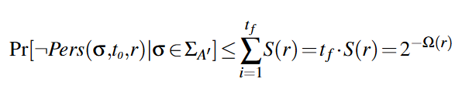
5.5 Persistence and Progress
Optimal strategy:
  Combining LCM mining and MDNM mining strategies to maximize the second condition.
  We can think of the game as using a strategy that maximizes the probability that the attacker will violate permanence.
Probability calculation:
  It is shown that χ(A,r+i−j)=Pr⁡[¬Pers_{i}^{j}(σ,r)∣σ∈Σ_{A}] holds.
  There are i possible honest blocks in the main chain.
Final Probability :
  The time when the first depth i block was mined at t₀​ is denoted by t_{σi}​.
  For all A′, q and r

Slide 28
5.5 Persistence and Progress
Lemma 8: Prove that Progress holds when Δ=0 and there are a small number of attackers.
Proof of Progress:
  target:
    Given ϵ > 0, finding δ such that at every step t₀ ≤ t_{f} the progression holds with probability 1 - ϵ.
  Conditions to progress:
    There must be a high probability that all blocks will be mined in the period [t₀, t₀+δ] in which the first r honest blocks after t₀ have been mined.
  If an attacker wants to exclude the first r honest blocks:
    To exclude a block from B^{σ}(t₀,r), the attacker must build a chain that does not contain that block.
    Divide into several subraces between the attacker's subtree and the honest chain.

Slide 29
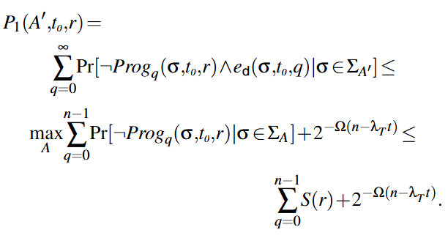
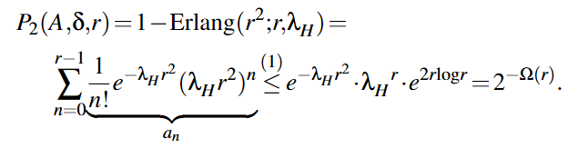
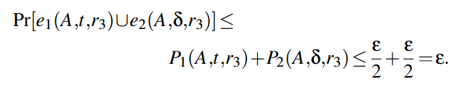
5.5 Persistence and Progress
Probability calculation:
  Given the attacker strategy A, the probability that the first r honest blocks after t₀ will not remain permanently in the main chain is denoted by P₁(A,t₀,r). It can hold using Poisson tail bounds.
  Calculate the probability P₂(A,δ,r) that there are r honest blocks within period δ using the Erlang distribution.
Final Probability :
  Select r₂ to obtain P₂(A,δ,r) smaller than ϵ.
  By selecting r₃=max⁡(r₁,r₂), we finally show that P₁(A,t,r₃)+P₂(A,δ,r₃) ≤ ϵ is established.

Slide 30
5.5 Persistence and Progress
Key take aways:
  Main Theorem 1: Sprints protocol implements a ledger.
  Proof: Using Lemma 7 and Lemma 8, we conclude that Sprints meets the ledger implementation requirements.
Conclusion:
  The Sprints protocol guarantees both persistence and progress, implementing a ledger that can be trusted even in the presence of a small number of attackers.

Slide 31
6.1 Implementation
The Sprints prototype was implemented by modifying Bitcoin Core.
  Changed block header data structure: changed to include delayed proof, modified mining and block verification process.
  Difficulty adjustment algorithm change: Changed to adjust the parameters of PoD and PoW.
Summary of major changes:
  Block header modification: Change the block header data structure to include PoD proof, and adjust the mining and block verification process accordingly.
  Difficulty adjustment algorithm: Adjusts the difficulty of PoD and PoW to keep the block generation interval and PoW ratio constant.
  Implementation of PoD: Implementation of PoD using Wesolowski VDF, designed to operate independently of the content of the block.
  Reduce propagation delay: Reduce block propagation delay by delaying PoD verification and prevent denial of service attacks through network-level optimization.

Slide 32
6.2 Attacker threshold analysis
Impact of network delay:
  Consider the impact of network latency on Sprints miners.
  The fork probability depends on the ratio of PoW time and PoD time. The shorter the PoW time, the more likely it is that nodes will complete PoW at almost the same time, resulting in a fork.
Fork Block:
  A forked block is a block that is not included in the main chain. The fork rate ϕ is defined as the ratio of forked blocks to all blocks.
  Conservatively assuming that the attacker does not experience a fork, the mining power of honest miners is reduced to 1−ϕ. Therefore, the attacker's threshold α_{A}​ becomes α_{A}​< 1-ϕ/ 2-ϕ​.
VDF verification delay:
  By delaying VDF verification during propagation, PoW forms an important barrier against denial-of-service (DoS) attacks.
  Each node verifies the PoW when it receives a block and simulcasts the block before validating the PoD. Blocks are processed only after the PoD puzzle has been verified.
  This network optimization does not affect the logic of the consensus mechanism.

Slide 33
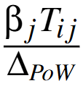
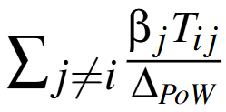
6.2 Attacker threshold analysis
Fork probability calculation:
Fork probability at block height h:
  When miner i mines a block at height h, calculate the probability that another miner j will mine the block before knowing the block at height h, creating a fork.
  The propagation delay from minor i to minor j is denoted by T_{ij}​.
  β_{j}​ represents the mining power ratio of node j.
  Assuming the difficulty is well adjusted, miner j has probability β_{j}​ of mining a block within Δ_{PoW​} time.
  Therefore, when Δ_{PoW​}=0, miner j has probability of mining a block within T_{ij}​ time.
  When miner iii produces a block, the average number of forks produced by other miners is

Slide 34



6.2 Attacker threshold analysis
Calculate number of forks:
  For the entire minor i, the average number of forks n_{f} is:
  In a distributed network blockchain system, data propagation is performed over multiple hops, expressed in terms of the average one-hop delay δ.
  For each miner pair, d_{ij} represents the number of hops between two nodes, so the total propagation delay is T_{ij}​=d_{ij}​×δ.
  When all nodes have the same mining power, we can simplify n_{f} above since β_{i}​=1/N​:
  ​ where d_{avg}​ is the average number of hops between any two nodes in the network.
  Fork ratio is calculated as below:

Slide 35
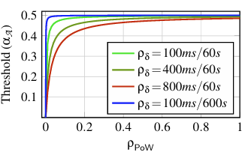


6.2 Attacker threshold analysis
Attacker Threshold
  The relationship between fork rate and attacker threshold is:
  The fork rate and the attacker threshold are a function of the ratio of the one-hop propagation delay to the block interval, ρ_{δ​}= δ / Δ_{block} ​​, and the ratio of the PoW average duration to the block interval, ρ_{PoW}​=Δ_{block}​/Δ_{PoW}​​.
Conclusion
  As the PoW ratio ρ_{PoW​} increases and the delay ratio ρ_{δ}​ decreases, the attacker threshold increases, approaching 0.5.
  For example, with a one-hop network delay of 100ms and a block interval of 600s, if Sprints only performs PoW 5% of the time, the attacker threshold is still 49% (compared to 50% for Bitcoin).

Slide 36
6.3 Evaluation
Verify the analytical results of the relationship between Sprints' attacker threshold, fork rate, and network parameters in a real-world environment.
6.3.1 Settings
  Run Sprints on a network of 100 nodes. Each node has two hardware threads and has approximately equal mining power. The network topology is generated by randomly connecting each node to four random neighbors. The average number of hops in the network is approximately 4.5.
6.3.2 Theory verification
  Experiments verify the theoretical analysis. Calculated the fork rate through logs until 100 blocks were generated.
Select parameters:
  The fork rate is determined based on ρ_{δ} and PoW ratio (ρ_{PoW}), which represents the network delay and block interval.
  To cover various delays, Set the ρ_{δ} values ​​to 100ms/60s, 400ms/60s, and 800ms/60s.
  For each ρ_{δ} value, experiments were performed with block intervals set to 30s, 60s, and 120s.

Slide 37
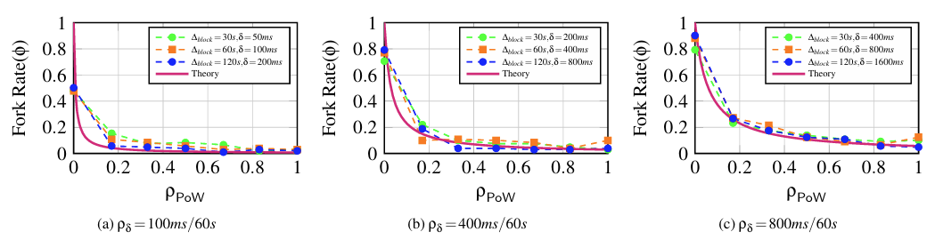
6.3 Evaluation
Result:
  Figure 5 shows the experimental results. Each graph represents a different value of ρ_{δ}.
  The y-axis of the graph is the fork rate, and the x-axis is the PoW rate (ρ_{PoW}).
  The experimental results are consistent with theory, especially at large one-hop delay δ values.
  This is because in addition to network delay, there are delays such as disk I/O and block verification.
  Without PoW, the measured fork rate is much smaller than theoretical. This is due to real network delay and variance in computation time.

Slide 38
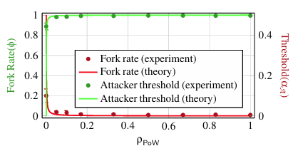
6.3 Evaluation
6.3.3 Actual parameters
  Evaluate the behavior of Sprints using real-world parameters similar to Bitcoin
  Used a block interval of 600s and a one-hop network delay of 100ms.
  The x-axis represents the PoW rate (ρ_{PoW}), the left y-axis represents the fork rate, and the right y-axis represents the attacker threshold.
  Compared the theoretical fork rate and experimental results, and also analyzed the attacker threshold.
  At a PoW ratio of 0.05, Sprints can withstand 49% of attacker mining power, which is very close to the ideal 50%.

Slide 39
6.4 Non-Negligible Propagation Delay
The impact of non-negligible propagation delay in the Sprints protocol.
Delayed PoD within each branch
  The propagation delay of Sprints and PoD combine to cause a delayed effect within each branch. This means that honest blocks are affected by PoD and propagation delay, which affects synchronization and potential forks within the network.
Key points:
  Propagation Delay Impact: Propagation delay can cause blocks to arrive at different times within the network, hindering overall chain growth and increasing the fork rate.
  Non-Markov Property: Sprints combine PoW and PoD to form a system where the future state depends not only on the current state but also on the past state. Unlike traditional PoW systems, it does not have memoryless characteristics, which complicates analysis.
  Fork rate analysis: Delayed introduction of PoD due to propagation delay allows miners to solve PoW puzzles at different times, increasing the likelihood of forks.
  Threshold analysis under delay: We seek to understand how non-negligible propagation delay affects the attacker threshold (α_{A}). Delayed PoD increases the likelihood that an attacker can efficiently exploit blocks in the network.

Slide 40
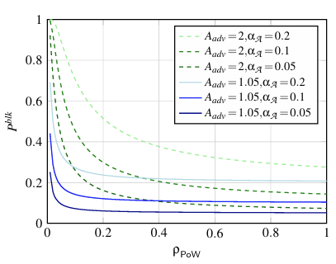
6.5 Imperfect PoD
Although Sprints assumes that attackers cannot solve PoDs faster than honest miners, in reality attackers may have an advantage. the attacker's block discovery probability (P^{blk}) is calculated as follows:
P^{blk} = 1 − (1 − α_{A}) · exp(−α_{A} / ρ_{PoW} (1 − A⁻¹_{adv}))
A_{adv} represents the attacker's advantage, α_{A} is the attacker's hash rate, and ρ_{PoW} is the PoW time rate.
when the attacker's advantage is small (e.g. A_{adv}=1.05), the attacker's success probability is affected when the PoW time ratio is small and the attacker's hash rate is large.
However, if the attacker's advantage is large, such as A_{adv}=2, the probability of success increases significantly, which may reduce the fairness of the system

Slide 41
7&8. Carbon Footprint Quantification and Conclusion
Carbon Footprint Quantification
  Sprints' primary goal is to reduce the carbon footprint of existing pure Proof-of-Work (PoW) protocols while maintaining their security.
  Sprints reduce the overall carbon footprint by 90.8% compared to pure PoW when the PoW time ratio (ρPoW) is set to 5%. In addition to reducing power consumption, we took into account the environmental impact of hardware production and disposal.
  Sprints limits the activity time of each mining rig to reduce power consumption, resulting in 15.7x lower power consumption than pure PoW.
Conclusion
  Sprints is a hybrid protocol that combines PoD and PoW, reducing carbon footprint by converting operational costs into capital costs while maintaining nearly the same level of security as pure PoW.
  When we reduced the PoW ratio to 5% while keeping the block interval the same as Bitcoin, the security threshold decreased slightly from 50% to 49%, but resource usage decreased by 10.9x and rare metal usage increased by 1.27x.
  Sprints opens up the possibility of an eco-friendly, decentralized PoW blockchain protocol.

