Slide 1
Infonet Journal Club
Presenter: S M Wahidur Rahman (20204076)
Advisor : Prof. Heung-No Lee
INFONET Lab
2024. 09. 26

Slide 2
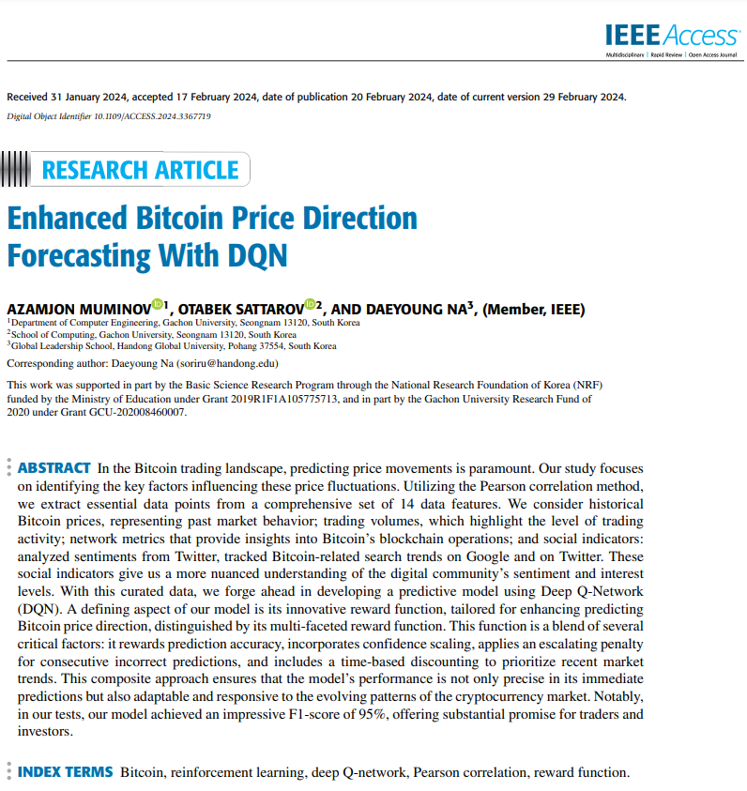
Paper Information
Paper Title: Enhanced Bitcoin Price Direction Forecasting With DQN
Author: Azmanjon Muminov, Otabke Sattarov, Daeyoung NA.
Affiliation: Gachon University, Seongnam, South Korea)
Published date: 20 February 2024
Publisher: IEEE Access
Paper link: https://ieeexplore.ieee.org/abstract/document/10440336

Slide 3
Motivation behind selecting this paper
I selected the paper 'Enhanced Bitcoin Price Direction Forecasting with DQN' as it aligns with my research on 'Cryptocurrency Price Trend Prediction.' This paper not only explores advanced predictive techniques like Deep Q-Networks (DQN), but also provides valuable insights into feature selection, which is crucial for improving forecasting accuracy in volatile markets like cryptocurrency.

Slide 4
Table of Contents
Paper Abstract
Key Contributions of this Paper
Data Preparation
Pearson Correlation Technique
Deep Q-Network
Evaluation of Deep Q-Network
Conclusion
Limitations of this paper and future work

Slide 5
Abstract of the Paper
Key Influencing Factors: The study focuses on identifying key factors influencing Bitcoin price fluctuations using a set of 14 data features, including historical prices, trading volumes, network metrics, and social indicators like Twitter sentiment and Google search trends.
Predictive Model Using Deep Q-Network (DQN): A predictive model is developed using a Deep Q-Network (DQN), incorporating an innovative reward function designed to improve Bitcoin price direction predictions.
Innovative Reward Function: The reward function is multifunctional, considering prediction accuracy, confidence scaling, penalties for consecutive incorrect predictions, and time-based discounting to prioritize recent market trends.
High Performance: The model achieved a high F1-score of 95%, indicating its strong predictive capabilities and potential utility for traders and investors.

Slide 6
Key Contribution of This Paper
A dataset was collected hourly, covering Bitcoin price, volume, on-chain network metrics, and social indicators from Twitter and Google Trends. These features provide context on past prices, network health, and digital community sentiment.
To improve model accuracy, the Pearson correlation method was used to rank features based on their impact on Bitcoin price changes. This ensured the model focused on the most relevant data for better predictions.
A new reward function was developed for the DQN model, incorporating confidence scaling, penalties for errors, and time-based relevance to improve Bitcoin price predictions. This approach, combined with advanced architecture and key features, achieved a 95% F1-score in prediction accuracy.

Slide 7
Data Preparation
This research analyzes the Bitcoin price market from April 1, 2014, to November 14, 2018. Data was extracted hourly, resulting in a dataset of 40,824 records that detail the nuances and shifts in the Bitcoin market. The close price and volume data were primarily sourced from the CryptoCompare API, and on-chain data was collected hourly using Blockchair.
To ensure the integrity and reliability of the dataset, a validation process was implemented, cross-referencing potential outliers with secondary databases like CoinGecko and CoinMarketCap, as well as periodically checking against Blockchain.com’s explorer tool.
For Bitcoin price prediction, key on-chain features include hash rate, transaction counts, average transaction values, active addresses, inflows and outflows on exchanges, miner outflows, stablecoin inflows, and options market data.
Additionally, over seven million Bitcoin-related tweets were collected using the Twitter API, focusing on keywords like #Bitcoin and #BTC, with sentiment analysis performed using the “VADER” Python library. Public interest in Bitcoin was measured through Google Trends, utilizing the PyTrends library to track search volume for the term "Bitcoin." Hourly trending data on Bitcoin was also extracted from the Twitter API's "Trends" endpoint using the Tweepy library.

Slide 8
On-chain Data Preprocessing
Handling Missing Values: Interpolation methods filled sporadic data gaps, especially in exchange metrics, preserving trend integrity.
Noise Reduction: A rolling window average reduced short-term volatility in metrics like exchange inflows and hash rates.
Feature Scaling: Min-Max normalization brought metrics like transactions and hash rates onto a common scale to ensure consistent model influence.
Temporal Alignment: Daily metrics, such as stablecoin inflows, were resampled to hourly values for uniform representation.
Feature Engineering: New metrics were created, such as "hash rate momentum" for the rate of change and "net inflow" for exchange liquidity dynamics.

Slide 9
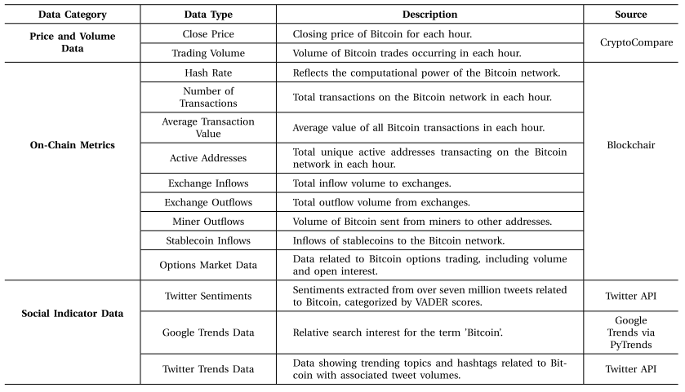
Summary of Data Sources
Detailed summary of data sources for bitcoin price direction prediction from April 1, 2014, to November 14, 2018, collected on an hourly basis

Slide 10
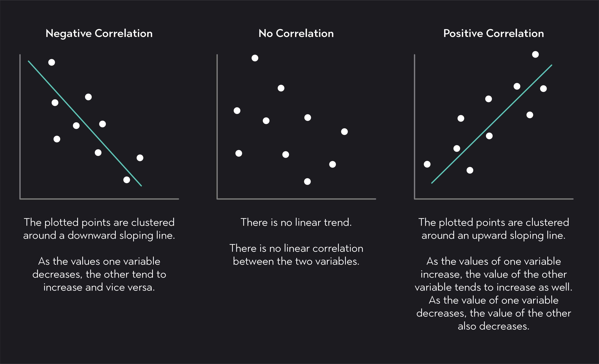

Pearson Correlation
The Pearson correlation analyses the relationship between two variables.
It measures the linear relationship between two variables.
It shows how strong the correlation is and which direction the correlation goes.
Pearson correlation is often represented as ‘r’, and its range is between -1 to +1.
Formula to calculate the Pearson correlation, $r_{x,y}= \frac{\sum{(x_{i}−\overline{x})(y_{i}−\overline{y})}}{\sqrt{\sum{{\left(x_{i}−\overline{x}\right)}^{2} {(y_{i}−\overline{y})}^{2}}}}$ [where $x_{i}$, $y_{i}$ are the value of the two variables, and $\overline{x}$, $\overline{y}$ are the mean values of x and y.]

Slide 11
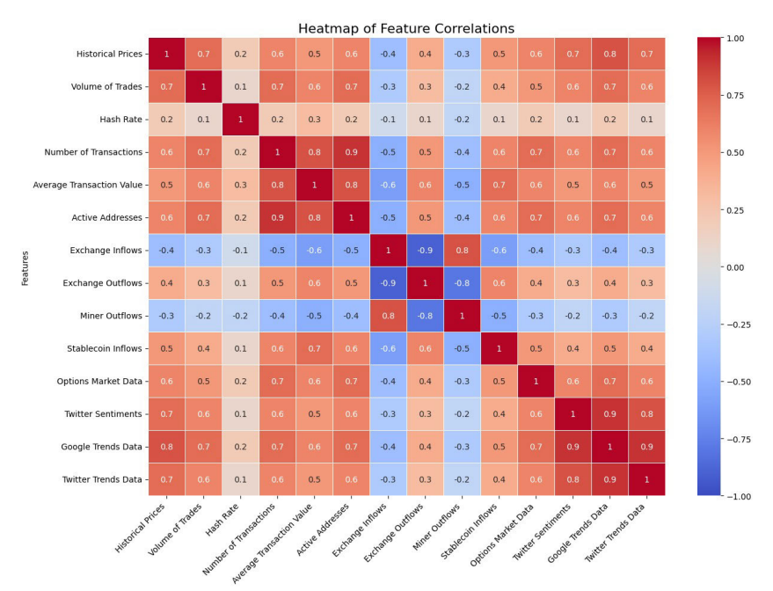

Feature Selection Using Pearson Correlation

Slide 12
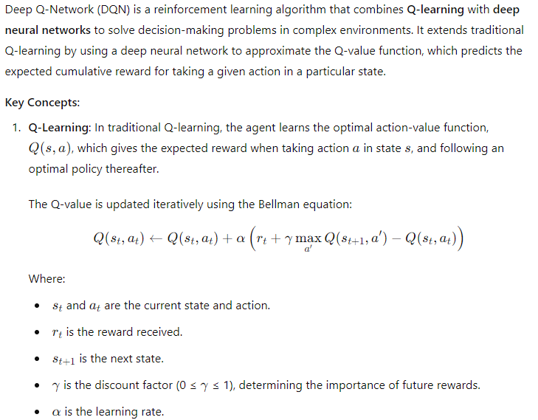
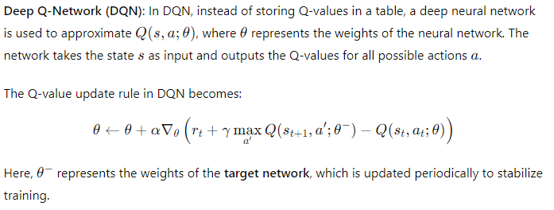
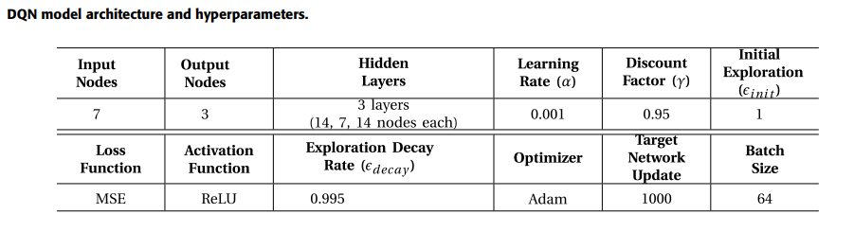
Deep Q-Network

Slide 13
State Space
The state space is the set of important factors used by the model to predict Bitcoin's price changes.
These factors are chosen using the Pearson correlation method to pick only the most relevant ones.
The state space is organized as a matrix, with each row representing data from one of the chosen factors.
This matrix updates every hour, giving the model detailed and timely information for its predictions.

Slide 14
Action Space
The action space refers to the choices the model can make about Bitcoin’s future price direction. It is simplified into three main actions that traders and investors care about:
    Increase: The model predicts Bitcoin's price will go up in the next hour, which signals traders to buy or hold for higher returns.
    Decrease: The model predicts the price will drop, helping traders sell to avoid losses or buy at a lower price.
    No-Change: The model expects the price to stay stable, giving traders a chance to pause or plan their next move.

Slide 15
Reward
Predictive Accuracy Incentive:
    It is a component of the reward function used in a model to encourage correct predictions and discourage incorrect ones. It works by giving a positive reward (+1) when the model accurately predicts the direction of price movement (up, down, or no change) and penalizes incorrect predictions with a negative reward (-1).
Confidence-Adjusted Scaling:
    It adjusts rewards based on how confident the model is in its predictions. The confidence score, ranging from 0 (low) to 1 (high), scales the reward using a factor (γ). Higher confidence in correct predictions leads to larger rewards, while lower confidence reduces the impact. This approach encourages the model to make both accurate and reliable predictions.
Consecutive Error Penalty:
    Consecutive Error Penalty discourages a model from making repeated mistakes by applying an increasing penalty for consecutive incorrect predictions. Each time the model makes an error, the penalty grows exponentially, with the rate controlled by a factor (α). This encourages the model to learn from its errors and avoid falling into repetitive mistakes.

Slide 16
Reward
Time-Based Discounting:
    Time-Based Discounting reduces the importance of older predictions, encouraging the model to focus on recent data in a volatile market like Bitcoin. It applies a discount factor (δ) that diminishes the value of predictions as they age. This ensures the model prioritizes current trends and adapts to fast-changing market conditions, enhancing its relevance and responsiveness to recent shifts.

Slide 17
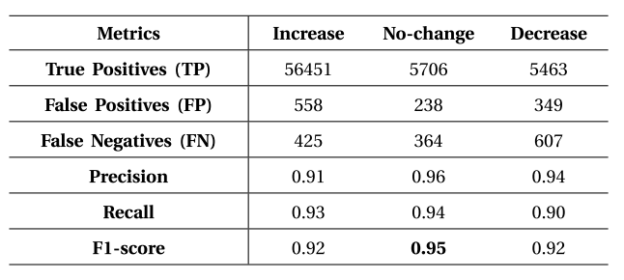
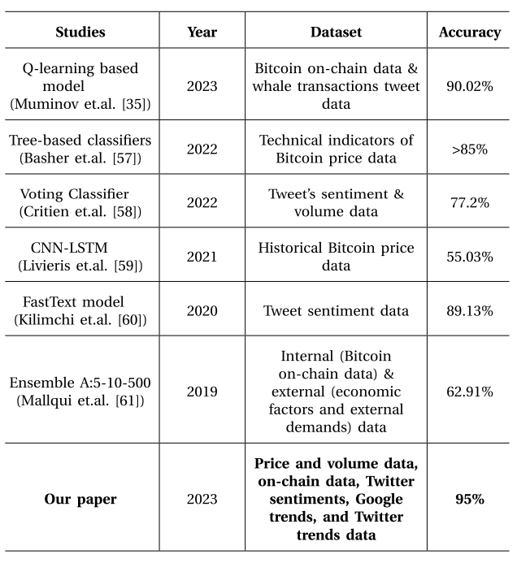
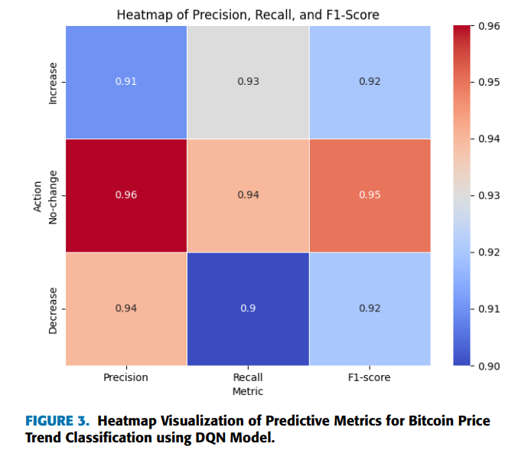
Evaluation of DQN Model’s Prediction
Table: Evaluation of DQN model’s prediction.
Table: Performance comparison with other results.

Slide 18
Conclusion
This study aimed to improve Bitcoin price direction predictions by analyzing 14 data types, including price, volume, and social media trends, and narrowing them to seven key features using Pearson correlation. The model, built using the Deep Q-Network (DQN) algorithm, was enhanced with a novel reward function to align with real-world conditions. The model achieved 95% accuracy, outperforming other studies in this area.
Limitations: While the DQN algorithm contributed significantly, it has inherent limitations, such as difficulties in handling highly volatile environments and extended training times. The study may also have been limited by the exclusion of other potentially relevant data features.
Future Directions: Future research could explore more sophisticated algorithms to handle market volatility, incorporate additional data sources, and refine the reward function to further improve prediction accuracy. Additionally, applying this approach to other cryptocurrencies or markets could extend its utility.

Slide 19
Q&A

