Slide 1
Infonet Journal Club
Presenter: S M Wahidur Rahman (20204076)
Advisor : Prof. Heung-No Lee
INFONET Lab
2024. 05. 10

Slide 2
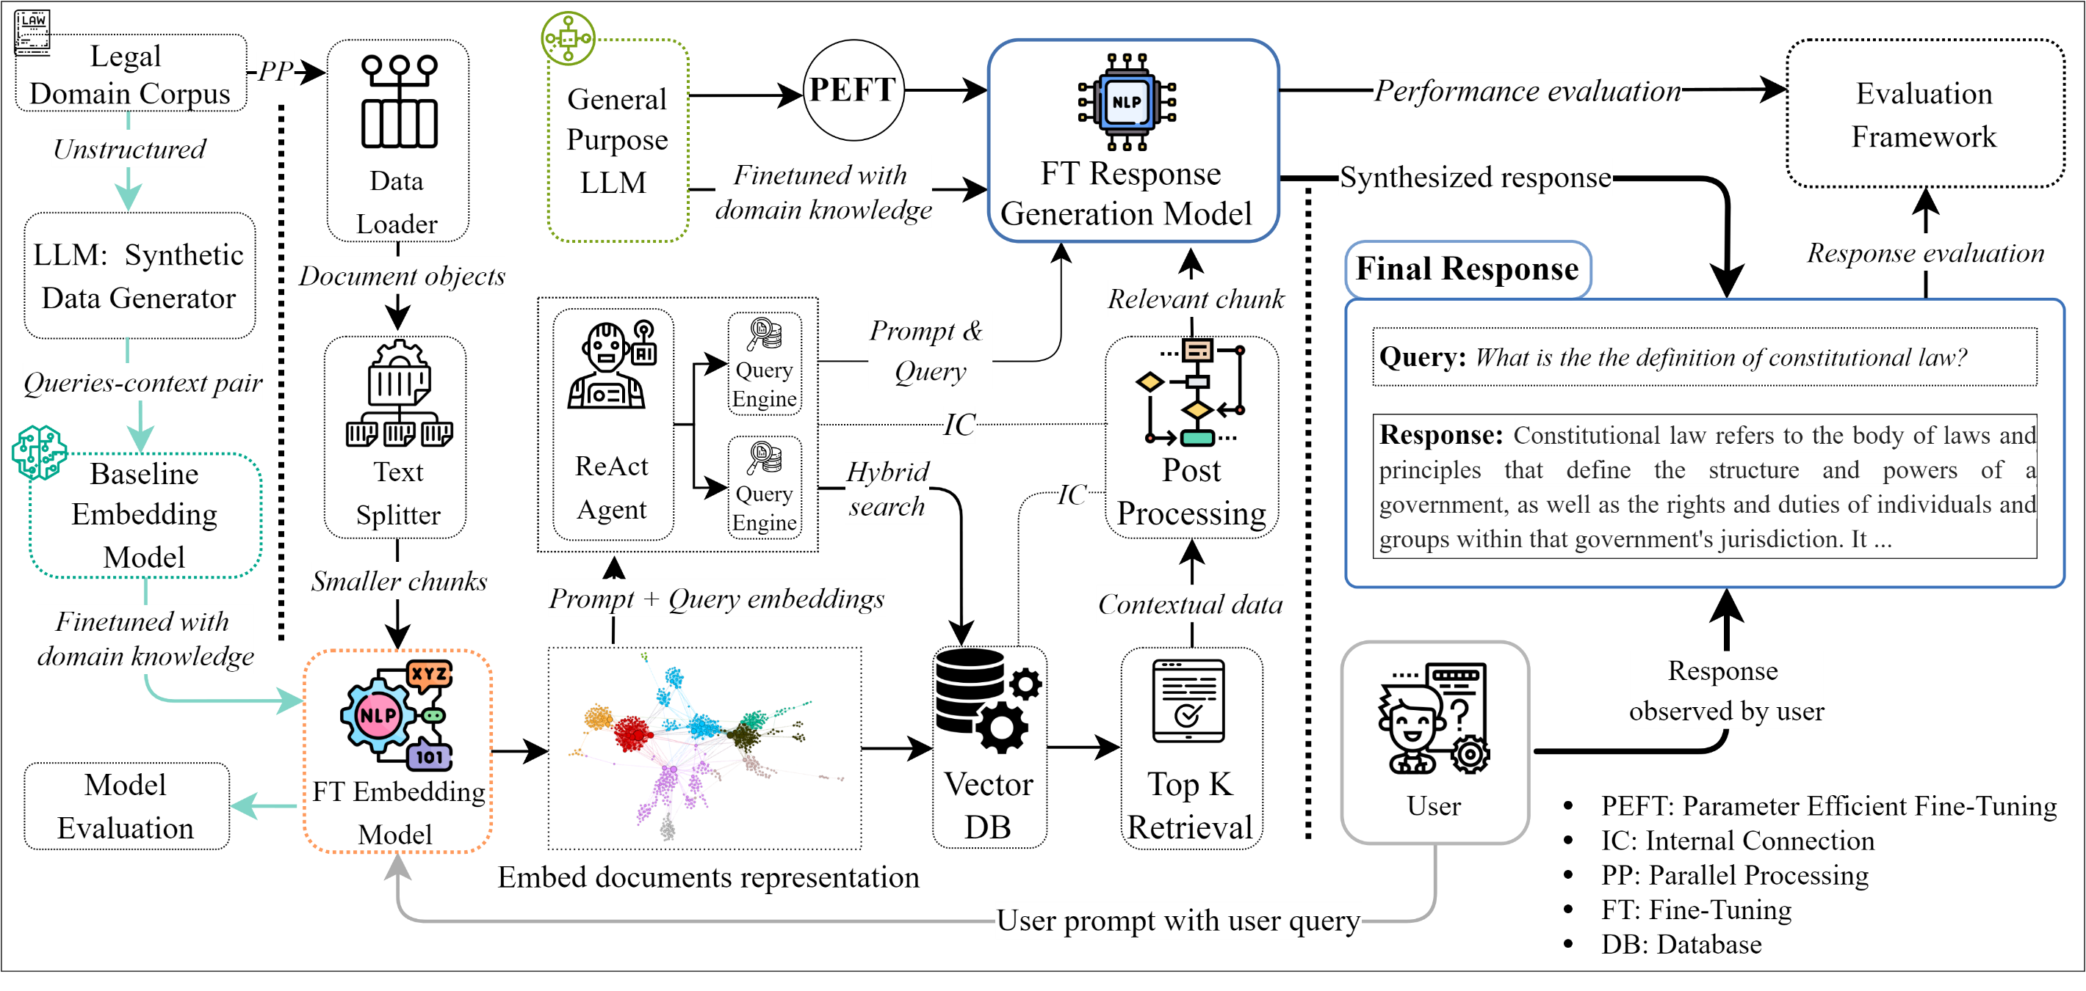
Paper Info & Motivation
Paper Title: Retrieval-Augmented Generation for Large Language Models: A Survey
Author: Yunfan Gao, et al. (Shanghai Research Institute for Intelligent Autonomous Systems, Tongji University)
Published date: 27 March 2024
Paper link: https://arxiv.org/pdf/2312.10997
My Current Research:
This research aims to develop a production-grade Smart RAG (Retrieval Augmented Generation) model specialized in the Legal domain. Our main goal is to develop a RAG system that is capable of generating accurate and contextually appropriate responses. Additionally, we aim to optimize response generation time for time efficiency and ensure that the model does not produce incorrect or hallucinated answers.
Figure: Proposed Model Architecture

Slide 3
Table of Contents
Paper Abstract
Key Contributions of this Paper
RAG Overview
Limitations of Naive RAG
Optimization Techniques of RAG Pipeline
RAG Evaluation
RAG Future Prospects
Conclusion

Slide 4
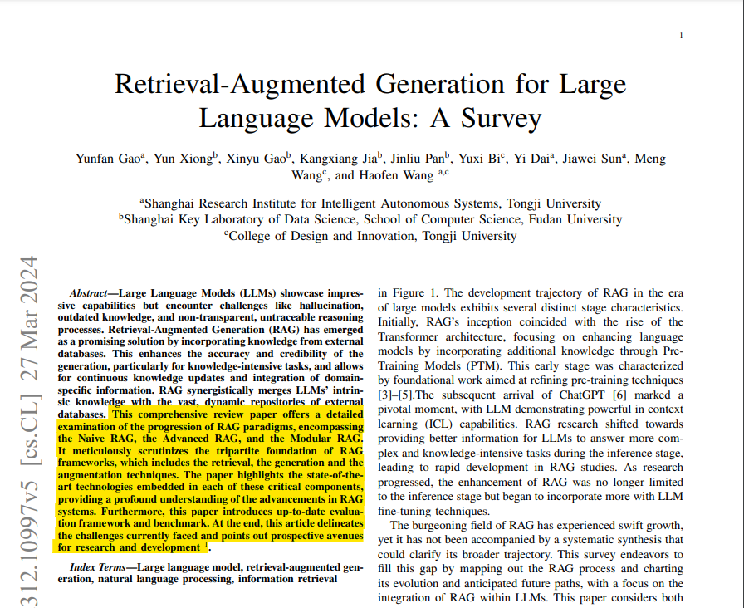
Abstract of the Paper
Notes:
This comprehensive review paper explains the evolution of the RAG system.
The authors categorize the RAG system into three distinct paradigms: Naïve RAG, Advanced RAG, and Modular RAG.
They also explore the core technologies behind the RAG system, including retrieval, generation, and augmentation.
Additionally, the paper explores the evaluation framework, addresses current challenges, and outlines future prospects for the RAG system.

Slide 5
Key Contribution of This Paper
They offer a comprehensive review of state-of-the-art RAG methods, outlining their evolution through paradigms such as naive RAG, advanced RAG, and modular RAG. Thus, they contextualize RAG research within the landscape of LLMs.
They identify and discuss central technologies crucial to the RAG process, with specific attention to Retrieval, Generation, and Augmentation, delving into their synergies and illustrating how these components intricately collaborate to shape a cohesive and effective RAG framework.
They summarized current RAG assessment methods, including 26 tasks and nearly 50 datasets, and discussed evaluation objectives, metrics, benchmarks, and tools, while also anticipating future RAG directions and potential enhancements for current challenges.

Slide 6
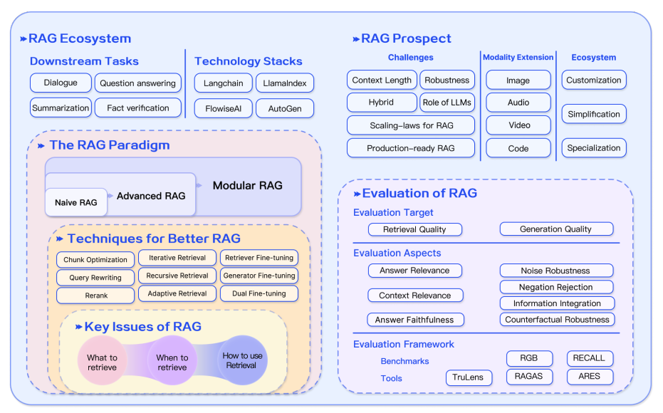
RAG Ecosystem
Figure: Summary of RAG ecosystem
Notes:
This is the overall RAG ecosystem that includes –
The key issues of RAG
Technologies for better RAG
RAG paradigm
RAG framework
Downstream task
RAG prospect and so on..

Slide 7
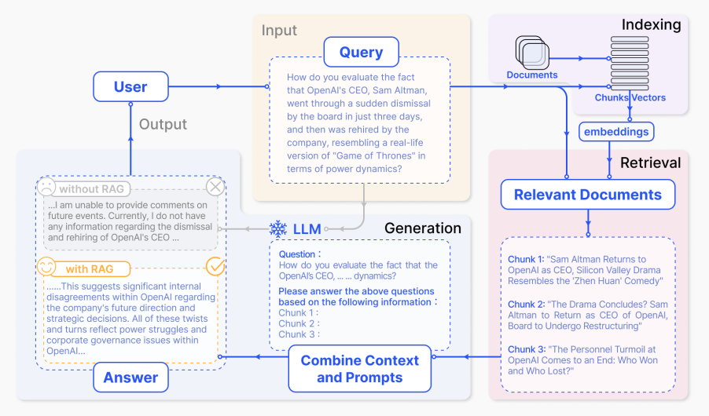
RAG Definition & Its Workflow
RAG is a paradigm that enhances LLMs by integrating external knowledge bases. This enhances the generation’s accuracy and credibility, particularly for knowledge-intensive tasks, and allows for continuous knowledge updates and integration of domain-specific information.
Figure: A representative instance of the RAG process applied to question answering. It mainly consists of 3 steps. 1) Indexing. Documents are split into chunks,
encoded into vectors, and stored in a vector database. 2) Retrieval. Retrieve the Top k chunks most relevant to the question based on semantic similarity.
3) Generation. Input the original question and the retrieved chunks together into LLM to generate the final answer.

Slide 8
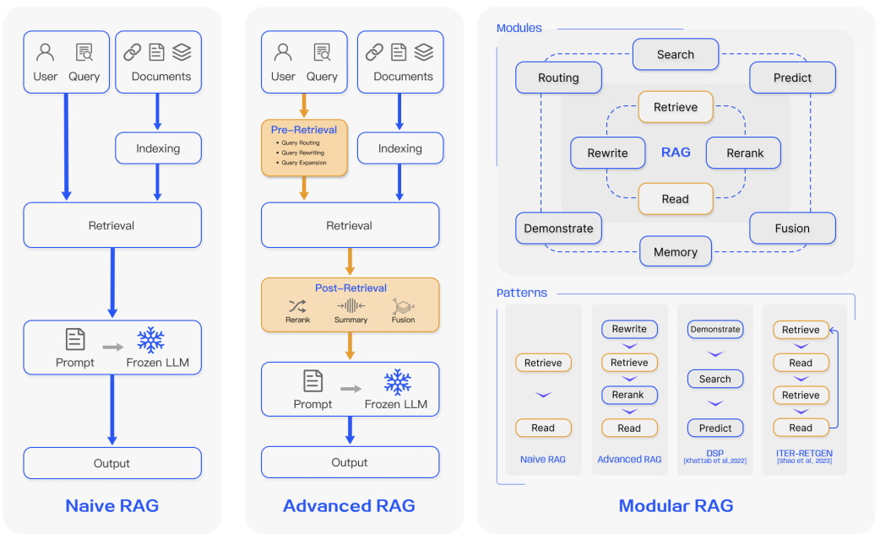
RAG Framework
Figure: (Left) Naive RAG mainly consists of three parts: indexing, retrieval and generation. (Middle) Advanced RAG
proposes multiple optimization strategies around pre-retrieval and post-retrieval, with a process similar to the Naive RAG.
(Right) Modular RAG inherits and develops from the previous paradigm. The overall process is not limited to sequential retrieval and
generation; it includes methods such as iterative and adaptive retrieval.

Slide 9
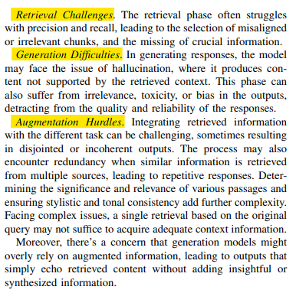
Limitations of Naive RAG
Retrieval Challenges: Low precision, low recall, outdated information.
Generation Difficulties: Hallucination, toxic or bias response.
Augmentation Hurdles: Disjointed or incoherent output. Redundancy and repetition.

Slide 10
Optimization Techniques of RAG Pipeline
Retrieval | Generation | Augmentation
Indexing Optimization Query Optimization Embedding | Context Curation LLM Fine-tuning | Iterative Retrieval Recursive Retrieval Adaptive Retrieval

Slide 11
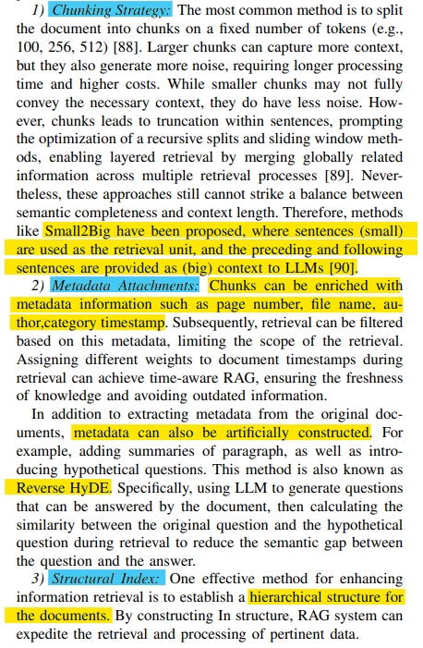
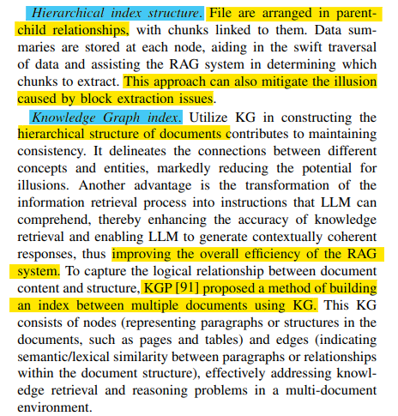
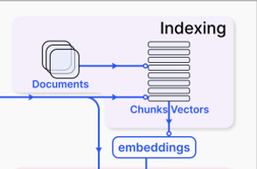
Retrieval: Indexing Optimization
In the Indexing phase, documents are processed, segmented, and transformed into embeddings to be stored in a vector database. The quality of index construction determines whether the correct context can be obtained in the retrieval phase.
Techniques for enhancing index optimization include:
Chunking Strategy
Metadata Attachments
Structural Index
Hierarchical Index Structure
Knowledge Graph Index
Notes:
We can call this the Data ingestion stage. In this phase, documents are processed, segmented, and transformed into embeddings to be stored in a vector database.
Remember, the quality of our indexing directly translates into the efficiency of our retrieval. So, the better our indexing, the smoother our retrieval process.
We can set the chunking strategy so that the target document is chucked at a fixed rate, like 128 tokens, 256, or 512…. Or we can set a Small2Big chunking strategy for a more efficient method.
Besides that, metadata attachments create the index more efficiently,
Hierarchical indexing or knowledge graph are other indexing methods.

Slide 12
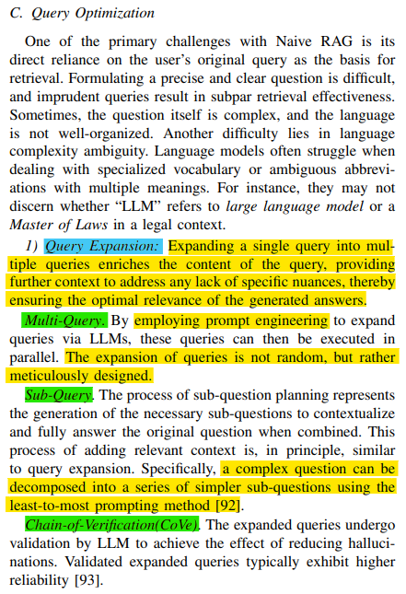
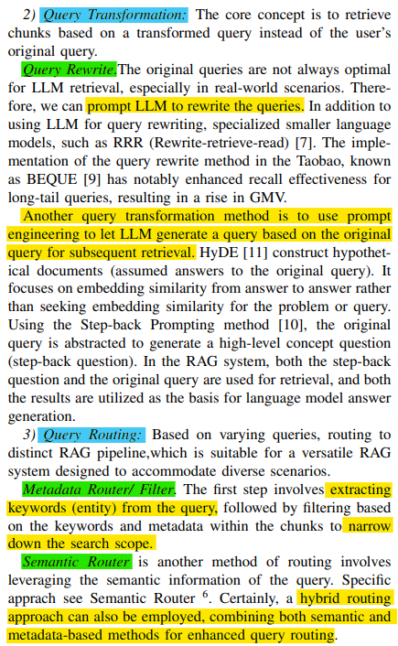
Retrieval: Query Optimization
Unclear or poorly formulated queries can result in ineffective retrieval. Additionally, language complexity and ambiguity can hinder the performance of language models.
For instance, they may not discern whether “LLM” refers to large language model or a Master of Laws in a legal context
Techniques for enhancing query optimization :
Query Expansion
Multi-Query
Sub-Query
Chain-of-Verification (CoVe)
Query Transformation
Query Rewrite
Query Routing
Metadata Router / Filter
Semantic Router

Slide 13
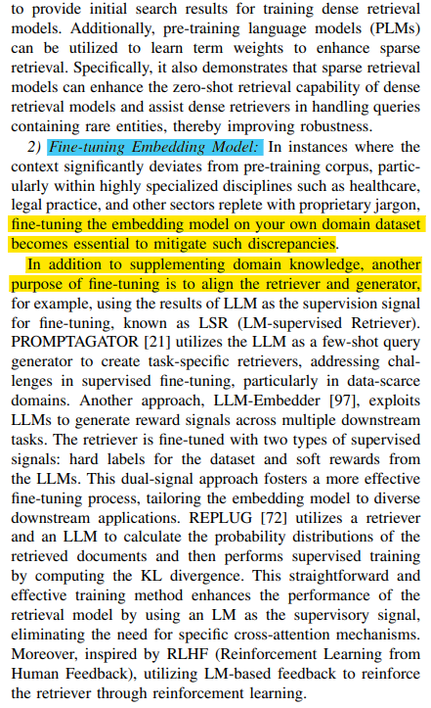
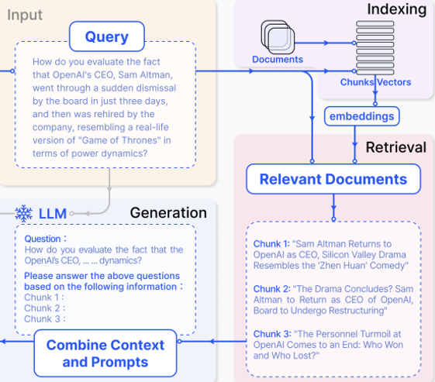
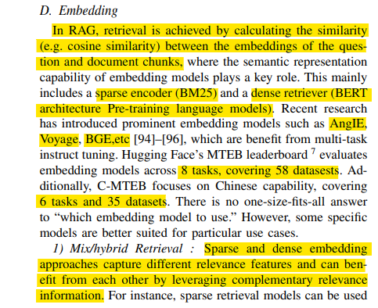
Retrieval: Embedding
RAG retrieves information by comparing the similarity of embeddings between the question and document chunks, using techniques like cosine similarity. It employs both sparse encoding methods like BM25 and dense retrievers such as BERT for effective retrieval.
Techniques related to embedding for better Retrieval:
Mix / Hybrid Retrieval
Fine-tuning Embedding Model

Slide 14
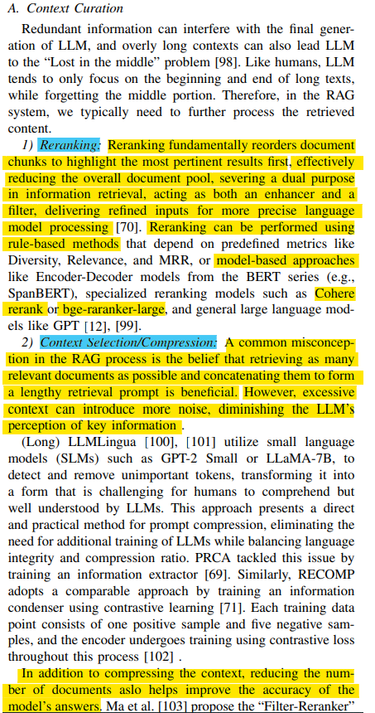
Generation: Context Curation
Redundant information and lengthy contexts can disrupt LLM generation, potentially causing it to overlook middle portions. To mitigate this, further processing of retrieved content is often necessary in RAG systems.
Techniques that can enhance Context Curation:
Re-ranking
Context Selection / Compression

Slide 15
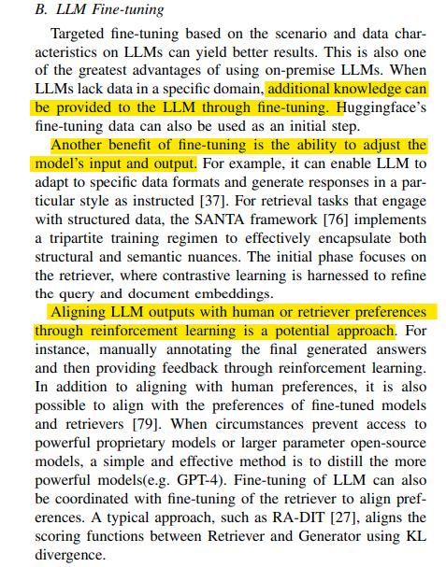
Generation: LLM Fine-tuning
Domain knowledge injection: When LLMs lack data in a specific domain, additional knowledge can be provided to the LLM through fine-tuning.
Generate natural responses: To improve the RAG system, the generator can be further optimized or fine-tuned to ensure that the generated text is natural and effectively leverages the retrieved documents.
Alignment with Preferences: Leveraging reinforcement learning techniques facilitates the alignment of LLM outputs with either human or retriever preferences, optimizing performance.

Slide 16
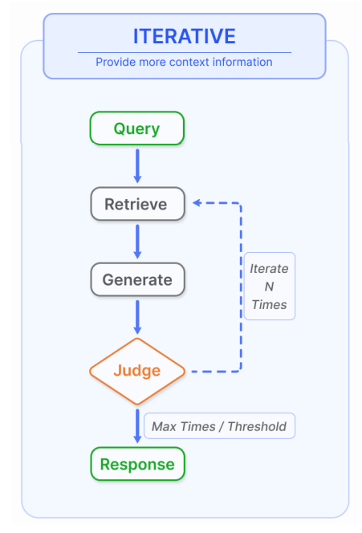
Augmentation: Iterative Retrieval
Iterative retrieval is a process where the knowledge base is repeatedly searched based on the initial query and the text generated so far, providing a more comprehensive knowledge base for LLMs.
Figure: Iterative retrieval involves alternating between retrieval and generation, allowing for richer and more targeted context from the knowledge base at each step

Slide 17
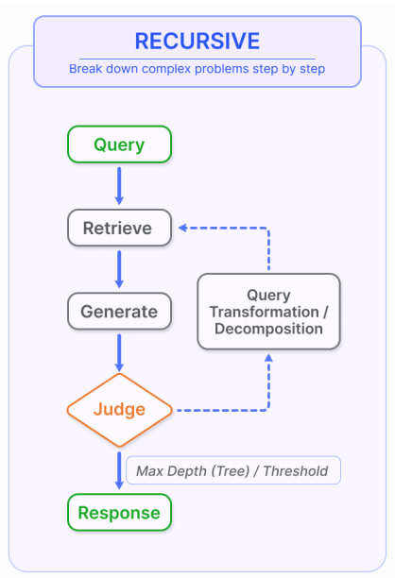
Augmentation: Recursive Retrieval
Recursive Retrieval aims to enhance the search experience by gradually converging on the most pertinent information through a feedback loop.
Figure: Recursive retrieval involves gradually refining the user query and breaking down the problem into sub-problems, then continuously solving complex problems through retrieval and generation.

Slide 18
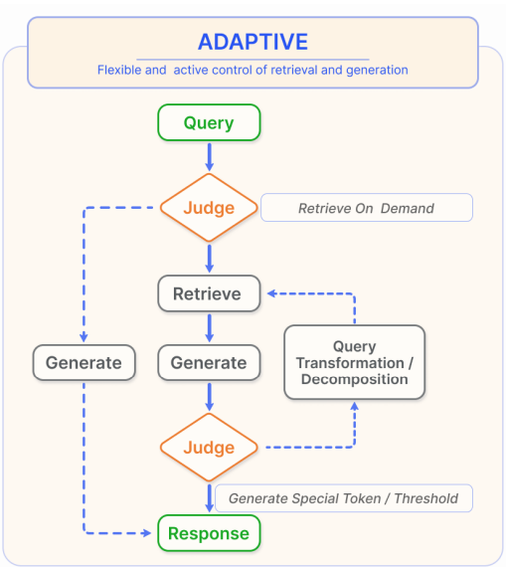
Augmentation: Adaptive Retrieval
Adaptive retrieval methods enable LLMs to actively determine the optimal moments and content for retrieval, thus enhancing the efficiency and relevance of the information sourced.
Figure: Adaptive retrieval focuses on enabling the RAG system to autonomously determine whether external knowledge retrieval is necessary and when to stop retrieval and generation, often utilizing LLM-generated special tokens for control.

Slide 19
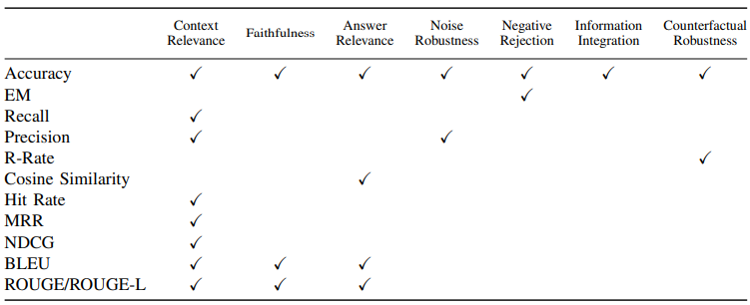
RAG Evaluation
The primary objective of RAG evaluation is to understand and optimize the performance of RAG models across diverse application scenarios.
Evaluating a RAG framework focuses on three primary quality scores and four abilities.
Quality scores include measuring context relevance (i.e., the precision and specificity of retrieved context), answer faithfulness (i.e., the faithfulness of answers to the retrieved context), and answer relevance (i.e., the relevance of answers to posed questions).
Four abilities help measure the adaptability and efficiency of a RAG system: noise robustness, negative rejection, information integration, and counterfactual robustness.
Three Primary quality
Four abilities
TABLE: SUMMARY OF METRICS APPLICABLE FOR EVALUATION ASPECTS OF RAG

Slide 20
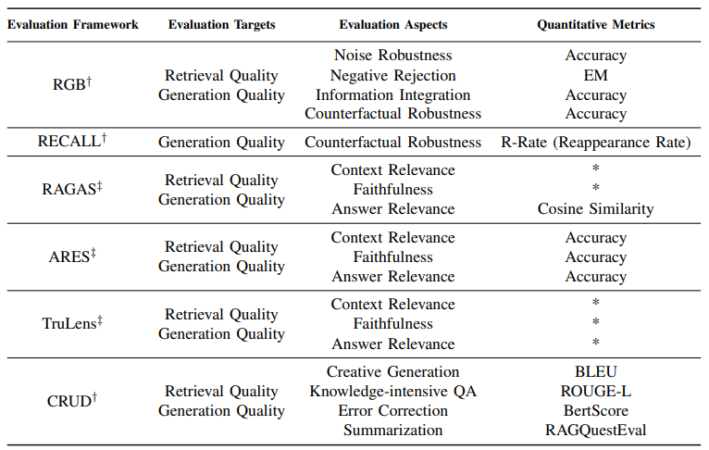
RAG Evaluation Framework
TABLE: SUMMARY OF EVALUATION FRAMEWORKS

Slide 21
Challenges & Future of RAG
Context length: LLMs continue to extend context window size which presents challenges to how RAG needs to be adapted to ensure highly relevant and important context is captured.
Robustness: Dealing with counterfactual and adversarial information is important to measure and improve in RAG.
Hybrid approaches: There is an ongoing research effort to better understand how to best optimize the use of both RAG and fine-tuned models.
Scaling laws: Investigation of LLM scaling laws and how they apply to RAG systems are still not properly addressed.
Production-ready RAG: Production-grade RAG systems demand engineering excellence across performance, efficiency, data security, privacy, and more.
Multimodal RAG: While there have been lots of research efforts around RAG systems, they have been mostly centered around text-based tasks. There is increasing interest in extending modalities for a RAG system to support tackling problems in more domains such as image, audio and video, code, and more.
Evaluation: The interest in building complex applications with RAG requires special attention to develop nuanced metrics and assessment tools that can more reliably assess different aspects such as contextual relevance, creativity, content diversity, factuality, and more. In addition, there is also a need for better interpretability research and tools for RAG.

Slide 22
Conclusion
RAG systems have evolved rapidly including the development of more advanced paradigms that enable customization and further the performance and utility of RAG across a wide range of domains. There is a huge demand for RAG applications, which has accelerated the development of methods to improve the different components of a RAG system. From hybrid methodologies to self-retrieval, these are some of the currently explored research areas of modern RAG models. There is also increasing demand for better evaluation tools and metrics.

Slide 23
Q&A

