Slide 1
An EEG-Based BCI System for 2-D Cursor Control
by Combining Mu/Beta Rhythm and P300 Potential
Yuanqing Li et al.
IEEE Trans. Biomedical Eng. (2010.10)
Presenter : Younghak Shin
GIST, Dept. of Information and Communication, INFONET Lab.
Notes:
Good afternoon everyone~
First of all, thank you for attending my MS defense presentation.
My name is Younghak Shin
Im a member of INFONET lab. at GIST
The title of my thesis is this

Slide 2
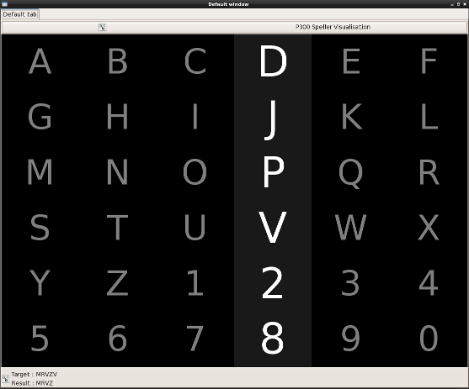
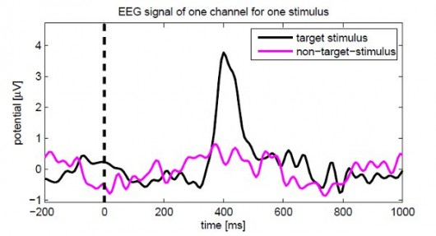
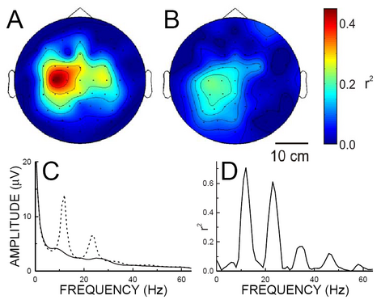
Background
P300
Motor imagery (Mu/Beta Rhythm)

Slide 3
Introduction & Motivation
Brain computer interface is a communication and control pathway to directly translate brain activities into computer control signals.
An important issue in BCI research is cursor control: to map brain signals to movements of a cursor on a computer screen.
Cursor control is a basic and necessary application in BCIs.
In the EEG-based BCI field, most related studies were focused on 1-D cursor control using motor imagery feature. (our experiment)
Multidimensional cursor control enables enhanced interfacing between the user and the machine (much wider range of applications)

Slide 4
Introduction & Motivation
The development of 2-D control BCI is impeded by the difficulty in obtaining two independent control signals from the noisy EEG data of poor spatial specificity.
The first EEG-based 2-D cursor control BCI is remarkable [Wolpaw 2004]: two independent control signals could be derived from combinations of the rhythmic powers(mu and beta).
However, the downside of this approach is the required intensive user training (some weeks or months).
Also other forms of 2-D BCI were reported that adopted a discrete control paradigm using the steady-state visual evoked potential (SSVEP) and P300.

Slide 5
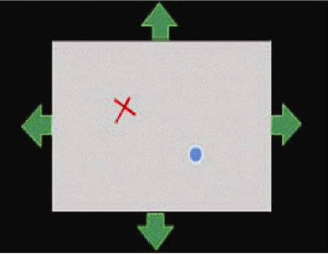
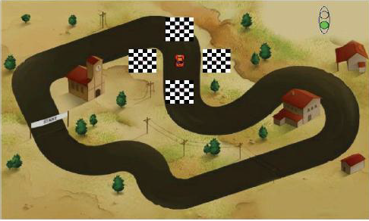
Introduction & Motivation
P300 and SSVEP based BCI cursor control system
For each update of the position, the cursor takes only one of a few fixed directions (discrete).
This leads to unsmooth, zigzag like moves of the cursor.

Slide 6
Introduction & Motivation
More efficient 2-D control is required for real world application
This could be implemented through the combination of two independent control signal for vertical and horizontal movements
In this paper, they propose a new paradigm for 2-D cursor control by simultaneously detecting two brain signals; P300 and motor imagery (hybrid BCIs)
The user control the vertical movement by using a P300.
At the same time, the user also use a motor imagery to control the horizontal movement.

Slide 7
Introduction & Motivation
The P300 allows to select one of the three states: moving upwards, moving downwards, or no vertical movement.
The motor imagery translates motor imagery into a continuous value that determine the direction and the velocity of the horizontal movement.
Through selecting the vertical movement state and manipulating the horizontal speed with direction, users will move the cursor along any direction in a self-paced manner.
Since the neural mechanism of motor imagery differs largely from that of P300, the two signals can be independently controlled by the user.

Slide 8
Method
- Experimental Procedure
To evaluate the proposed method, they conduct an online experiment involving six subjects.
After a short calibration(training) session for subject-specific P300 and motor imagery modeling,
the subjects undergo a few sessions of feedback training using the GUI, and subsequently perform cursor control tasks in test sessions.
In particular, the feedback training emphasizes on learning of motor imagery control.

Slide 9
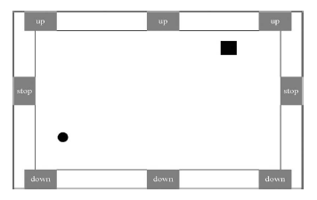
Method
- GUI and Control Mechanism
In each trial, the initial cursor and target randomly appear inside a rectangular workspace.
Eight flashing buttons are located at the side, which would generate P300 potentials when the user focus attention on one of them.
The main objective for the arrangement of three “up” and “down” buttons is for user’s convenient use.
For example, if the cursor is now in the right-hand side, then the user can choose the “up” or “down” button located in the same side
The horizontal movement of the cursor is controlled by motor imagery.
The ball and the square, respectively, represent a cursor and a target.
the GUI has a dimension of 1166 pixels ×721pixels.

Slide 10
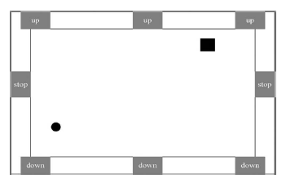
Method
- Test trial
A trial begins when a target and a cursor appear.
At 100 ms later, the eight buttons begin to flash alternately in a random order.
Each button is intensified for 100 ms, while the time interval between two consecutive button flashes is 120 ms.
The trial ends when the cursor hits the target or when the 60-s timeout limit occurs.
The interval between two consecutive trials is 2 s.
The cursor’s position is updated every 200 ms; the user is able to control the cursor’s movement at any time at will (self-paced)

Slide 11
Method
- Control of Vertical Movement Based on P300 Potential
Let c(k) ∈ {1,−1, 0} represents the output: 1 for “down,” −1 for “up,” and 0 for “stop” (applied to vertical movement only).
The vertical movement model: y(k + 1) = y(k) + c(k)v0
where y(k) represents the vertical position at the k-th update, at a fixed interval of 200 ms and v0 is a positive speed constant.
If the output c(k) is 0, the cursor stops vertical movement; if the output is 1 or −1, the cursor moves up or down at a speed of 10 pixels every 200 ms.

Slide 12
Method
- Algorithm (vertical)
Feature extraction
30 channel EEG signals are filtered in the range of 0.1–20 Hz
Extract a segment from 0 to 600 ms after a button flashes
The obtained data vector is denoted as Pai,j,q , where i, j, and q represent the i th channel, the j th button associated with this flash, and the q th round,
Construct a feature vector corresponding to the j th button and the q th round by concatenating the vectors Pai,j,q from all channels, i.e.,
Fej,q = [Pa1,j,q , . . . ,Pa30,j,q ].
2. Train a support vector machine (SVM) classifier.
Using the feature vectors of the training dataset {Fej,q, j = 1, . . . , 8; q =1, . . . , 64} and their corresponding labels, we train an SVM classifier.
If the subject is focusing on the j th button in the q th round,
then the label of Fej,q is 1 (p300 presence),
while the labels of Feu,q (u j) is −1 (p300 absence).

Slide 13
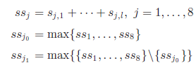
Method
3. P300 detection with SVM scores
For the l th round, we extract feature vectors Fej,l (j = 1, . . . , 8)
Applying the trained SVM to Fej,l, we obtain eight scores denoted as sj,l
P300 detection requires discriminating between non-P300(idle state) and P300 rounds self-paced
The detection of P300 is accomplished by a threshold mechanism
Calculate the sum of SVM scores for each button obtained from l accumulated rounds
Find maximum and the second maximum of the eight summed scores
where the j1 th button is obviously different from the j0 th button
define a threshold condition :
where the threshold θ0 is a predefined positive constant, and is empirically set at 0.3
If the threshold condition is satisfied, then the system makes a decision that P300 potential occurs at the j0 th button

Slide 14
Method
4. Movement Decision
when P300 is detected for the l th round at the j0 button
if the j0 button is one of the three “up” buttons, set c(k) = −1 (the cursor will go up);
if the j0 button is one of the two “stop” buttons, set c(k) = 0 (the cursor will have no vertical movement).
If P300 is not detected for the l th round, i.e., the threshold condition is not satisfied,
then the system does not change the direction of the vertical movement of the cursor, i.e., c(k) = c(k − 1).

Slide 15
Method
- Control of the Horizontal Movement Through Motor Imagery
The horizontal movement model:
where k represents the k th update of the cursor position, x(k) is the horizontal coordinate of the cursor, f(k) is the continuous output (score) of the SVM classifier, and a and b are two constants.
They introduce delays into the control model to make the cursor move smoothly
The score f(k) is generated by an SVM classifier at every 200 ms.
pre-processing steps
spatial filtering with common average reference (CAR)
bandpass filtering in specific mu rhythm band (8–13 Hz)
spatial filtering based on a common spatial pattern (CSP) matrix W.
The feature vector is fed into an SVM classifier that is trained using the training data to separate the two classes of feature vectors

Slide 16
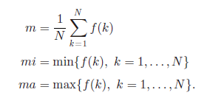
Method
In motor imagery, the cursor shall not move, if the user is in idle state.
This is accomplished by the introduction of the two parameters: a and b
An EEG dataset is collected when the user is in idle state. This dataset contains N time segments of 200 ms (N = 600), i.e., lasts 2 min.
They calculate the SVM scores f(1), . . . , f(N).
Set
Then we calculate a and b as
The parameter h is used for adjusting the velocity of the cursor. h is fixed to 8 for all the subjects.
Considering the model :
and the parameter setting of a and b, the average horizontal movement during the idle state Is close to zero.
Thus, the cursor almost does not change its horizontal position, if the subject is in the idle state. This has been demonstrated during the online experiments.

Slide 17
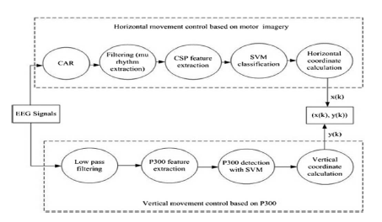
Method
Combining the algorithms for vertical and horizontal movement control, they obtain the algorithm for 2-D cursor control
The horizontal movement control based on motor imagery and the vertical movement control based on P300 are performed simultaneously
[Diagram of the algorithm for 2-D cursor control]

Slide 18
results
we can find out that the accuracy rates of all the six subjects are satisfactory. However, the control time of each trial was not short (about 28 s in average).
The relative small size of the cursor and the target.
The ratios of the size of the cursor, target, and the workspace are fixed to be 0.00084:0.003:1.
Triggering and effectively detecting P300 are time consuming to some degree (repeated round).

Slide 19
Data Analysis and Discussions
For efficient 2-D control, the two control signals need to be as independent as possible.
First, analyze the data collected from online experiment and assess the independence between the two control signals by correlation method.
There exist horizontal and vertical control variables with values f(k), c(k)
Here, f(k) is an SVM score from motor imagery, while c(k) with value of 1, −1, or 0 is determined by the button
The button at which P300 occurs is determined by ssj0(k), the maximum of 8 SVM scores corresponding to the eight buttons.
Since ssj0(k) is generally positive, they let c(k)ssj0(k) to be a new vertical control variable with signs and amplitude.
For each trial, they also define two position variables representing the relative position of the cursor and the target
where t and c means the target and the cursor (at its initial position)

Slide 20
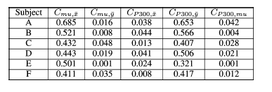
Data Analysis and Discussions
Calculate the correlation coefficients for each pair of control variable (f(k) or c(k)ssj0 (k)) and position variable ($\left.\overline{x}(k\right)$ or $\left.\overline{y}(k\right)$)
and the correlation coefficient for the two control variables.
From the result, each control variable correlates strongly with its own dimension of target cursor position
and does not correlate with the other variables’ dimension
and also does not correlate with the other variable.
Hence, such results support the independence of the horizontal and vertical control variables.

Slide 21
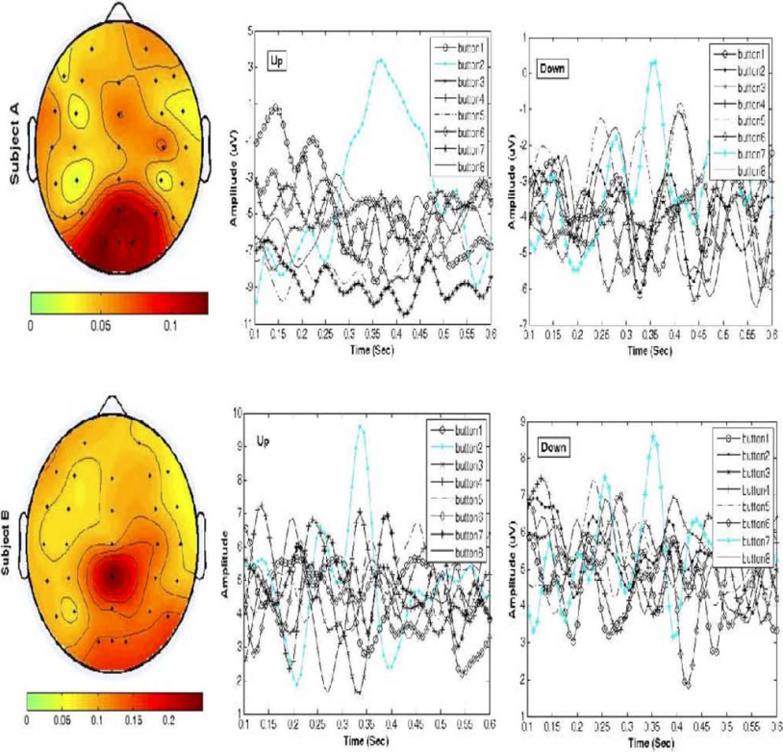
Data Analysis and Discussions
Next, they present their data analysis results to show that the subjects truly used P300 and motor imagery in the 2-D cursor control.
P300 detection is mainly based on those channels located in the occipital and parietal areas rather than the frontal area (considered EOG).
we can see P300 potentials elicited by the two chosen buttons and no P300 potentials elicited by other buttons.

Slide 22
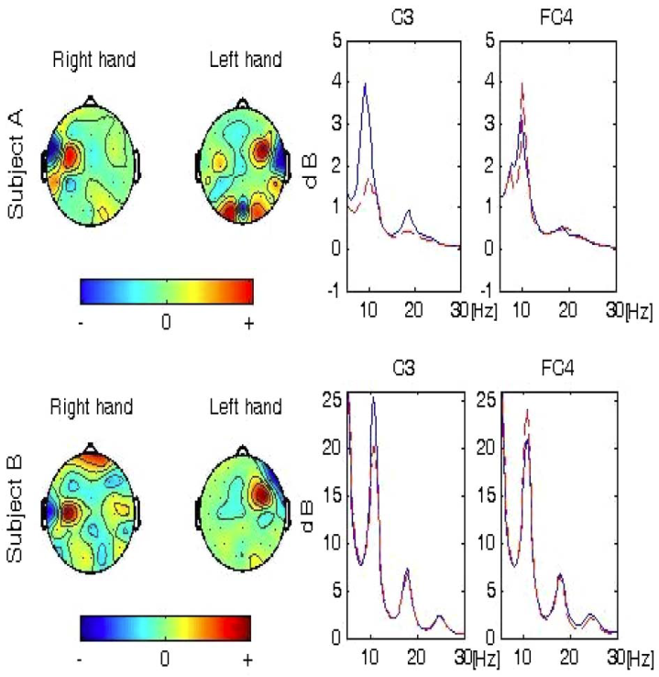
Data Analysis and Discussions
They also plot the topographies of CSP filters and the power spectra of two channels of raw EEG signals calculated based on the training dataset.
CSP filters (the first and the last rows of W) are displayed which are easily related to the motor imageries of right and left hands
The discriminability of the brain signals corresponding to the right and left hands is demonstrated.

Slide 23
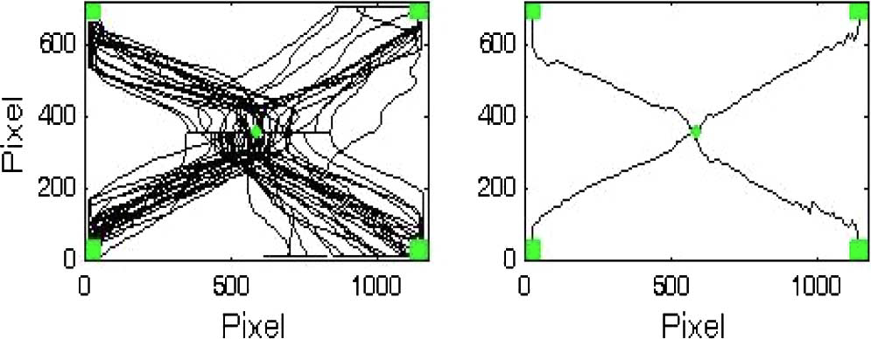
TWO SUPPLEMENTARY EXPERIMENTS
In order to show the average trajectory of the cursor based on desired movements, the trajectories of the cursor starting at the center of the GUI and moving to one of the four fixed targets at four corners
The hit rate and the average control time are 97.5% and 24.7 s
The trajectories of single trials and the average trajectories for four target positions are quite smooth.
Left: trajectories of the cursor obtained in 80 trials. Right: four average trajectories

Slide 24
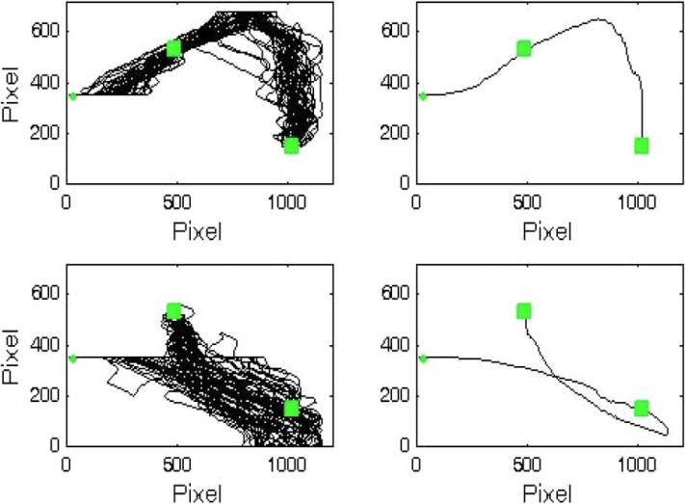
TWO SUPPLEMENTARY EXPERIMENTS
Second experiment, to show P300 and motor imagery control work simultaneously.
fix two targets, and fix the initial position of the cursor at the middle left
In each trial, the subject needs to move the cursor to hit these two targets sequentially without stop. (two classes of trial)
first class, the subject move the cursor to first hit the target at the middle of upper part and then hit the target at down-right corner
second class, the subject move the cursor to first hit the target at down right corner and then hit the target at the middle of upper part.

Slide 25
TWO SUPPLEMENTARY EXPERIMENTS
80 trials were collected for two classes of trials (40 trials for each class)
The hit rate and the average control time are 98.75% and 49.1 s
for each trial, the direction of vertical movement of the cursor is changed while the cursor simultaneously moves to the right.
Thus, the cursor can be simultaneously controlled (no zigzag) by the two control signals of P300 and motor imagery.

Slide 26
Conclusion
They have presented a new BCI and its implementation for 2-D cursor-control by combining the P300 potential and motor imagery.
Two independent signals have been obtained for controlling two degrees of movements of a cursor simultaneously.
Through an online experiment involving six subjects performed 2-D cursor control tasks.
The six subjects successfully carried out 2-D cursor control with satisfactory accuracies (>80%).

Slide 27
Thank you

