Slide 1
SPoC: A novel framework for relating the amplitude of neuronal oscillations to behaviorally relevant parameters
Sven Daehne et al, NeuroImage (2014)
Presenter: Evgenii Kim
Biophotonics Laboratory
GIST

Slide 2
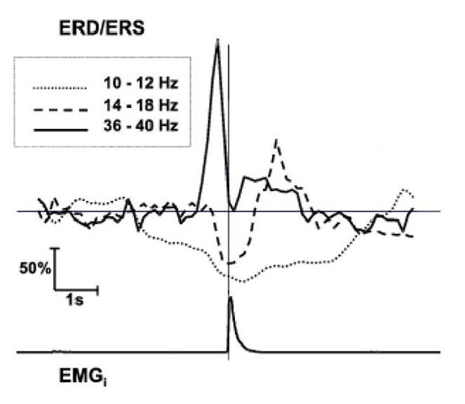
Introduction
Some cognitive phenomena (attention, sleep stages) have been shown to correlate with band power modulations (alpha, beta, gamma rhythms).
Brain rhythms are able to be measured by EEG/MEG

Slide 3
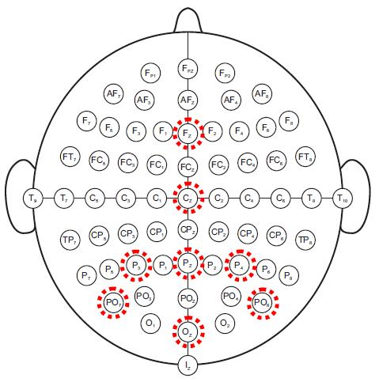
Introduction
The main disadvantage of EEG is poor spatial resolution
Spatial filters:
Laplace
Common average reference
CSP
ICA
SSD

Slide 4
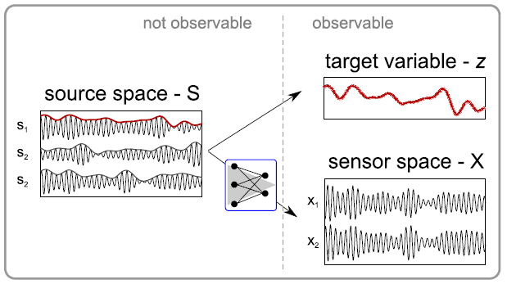
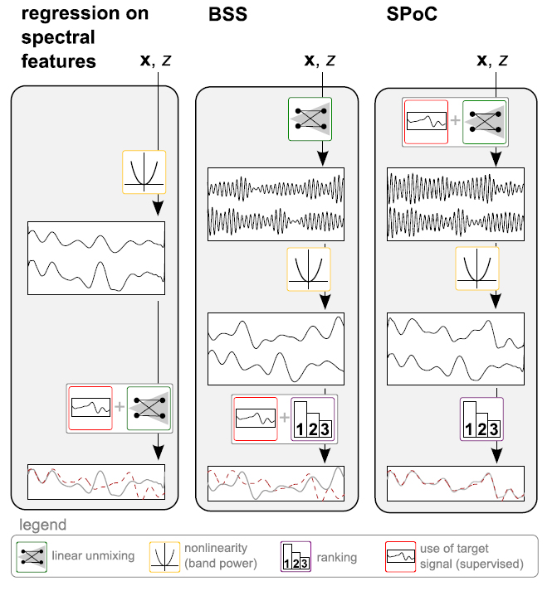
Source Power Comodulation (SPoC)
$$\underset{w∈R^{c}}{maxize}{Corr[\tilde{z}\left(e\right),z(e)]}$$

Slide 5
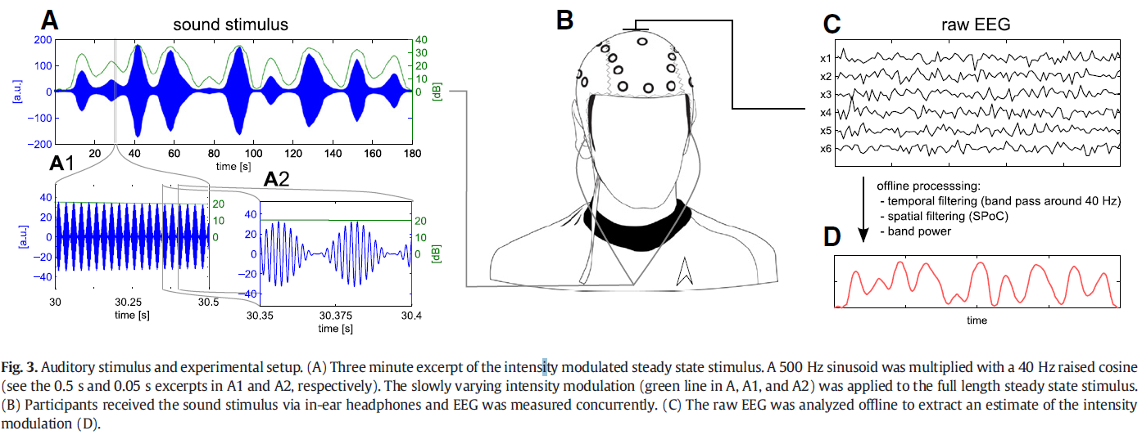
Real Data
7 Subjects participated steady-state evoked potentials (SSAEPs)

Slide 6
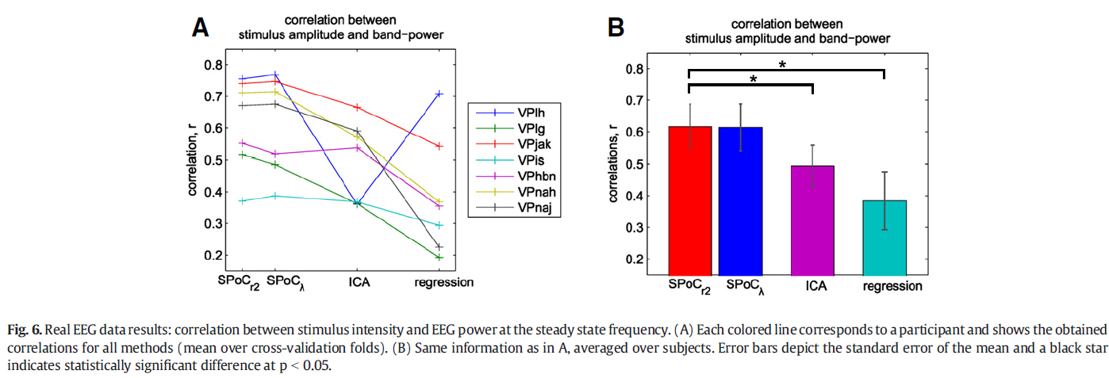
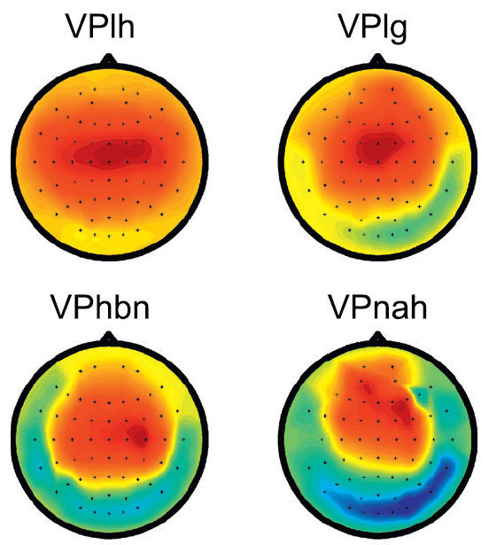
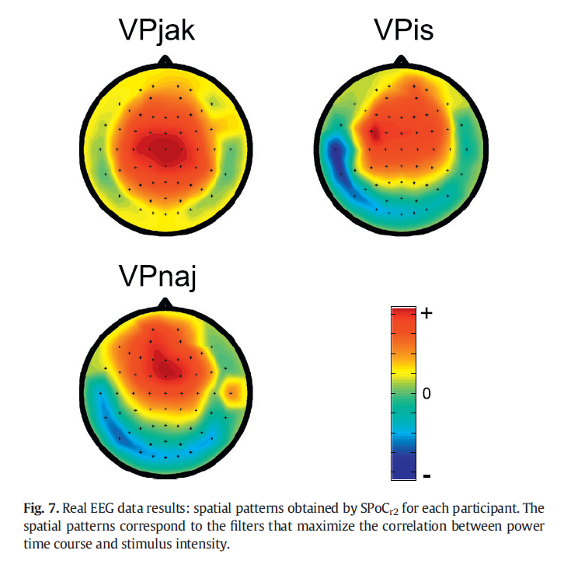
Results

Slide 7
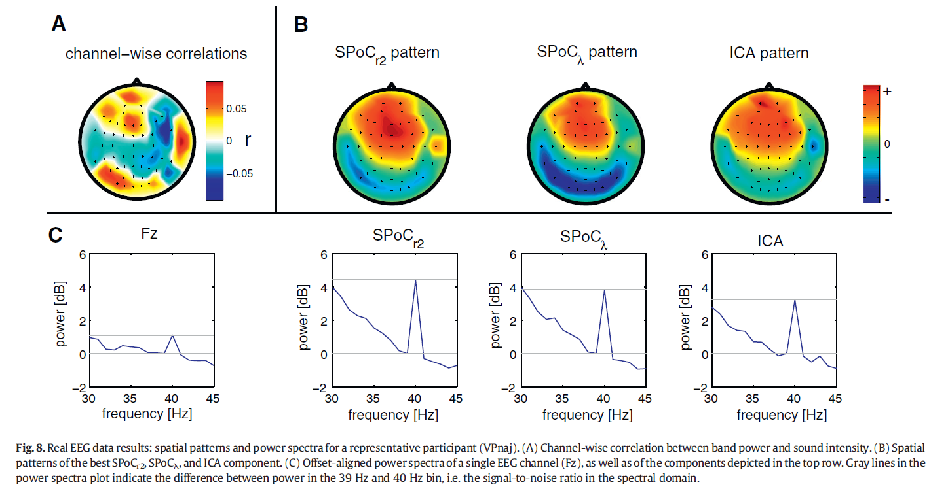
Results

Slide 8
Conclusion
SPoC shows itself as an approach that enables a reliable and fast extraction of neuronal oscillations, whose power time course comodulates with an external target function

