Slide 1
An auditory brain–computer interface
evoked by natural speech
M A Lopez-Gordo, E Fernandez, S Romero, F Pelayo and
Alberto Prieto
Journal of Neural Engineering (2012)
Presenter : Younghak Shin
GIST, Dept. of Information and Communication, INFONET Lab.
Notes:
Good afternoon everyone~
First of all, thank you for attending my MS defense presentation.
My name is Younghak Shin
Im a member of INFONET lab. at GIST
The title of my thesis is this

Slide 2
Introduction
The vast majority of BCIs use visual interaction with the subjects, either as stimulation, biofeedback or as visual support for the paradigm.
Examples are the BCIs based on steady-state visual evoked potentials or the P300.
However, some patients (in an advanced stage of ALS with visual impairment or patients under the condition of unresponsive wakefulness syndrome, who still preserve the necessary level of consciousness to process auditory stimuli and follow verbal instructions) can not use the above BCIs.
In this regard, an auditory BCI seems to be a more appropriate solution.
There have not been many attempts to use the auditory modality instead of the visual one.

Slide 3
Introduction
The auditory BCIs present some inconveniences that have not been suitably addressed so far.
For instance, the number of channels used (e.g. 67 and 16 channels in [10, 27] respectively), because it can be a limitation in the usability and increases the time for the initial setup.
This BCI requires considerable cognitive effort in terms of training (up to several weeks [33]), length of the trials or number of stimuli
The use of synthetic sounds instead of natural ones (e.g. tone beeps [10]) or complex auditory paradigms [27, 34] - since they can affect the level of interest and cognitive effort of the participants.
In this paper, they postulate that an auditory BCI based on natural sound (e.g. human voice), a simple and low-demanding task (e.g. selective attention), a small number of electrodes and a simple paradigm (e.g. binary class) with little or no training.

Slide 4
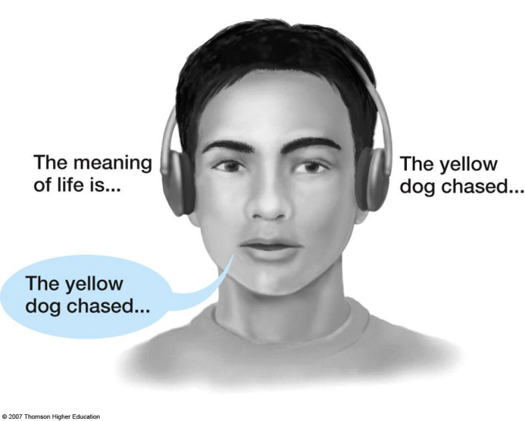
Objective
The main goal of this study is to determine the viability of a BCI based on a dichotic listening task with natural speech
The usability is expected to be improved due to a careful design based on:
first, a minimum number of EEG channels, namely, just one, which makes this BCI suitable for subjects attached to electronic devices in a hospital or lying on a bed;
second, minimum cognitive effort by means of short trials;
third, no need of formal training, which was substituted for a calibration run and the use of the native-to-human selective attention in a dichotic listening paradigm.
Dichotic listening is a psychological test commonly used to investigate selective attention within the auditory system
pay attention to the stream of stimuli delivered to one ear and to ignore the stream delivered to the other one

Slide 5
Methods
The experiment is based on the dichotic listening paradigm
The essence of dichotic listening is to pay attention to the stream of stimuli delivered to one ear and to ignore the stream delivered to the other one.
A dichotic listening paradigm was established by means of two streams of stimuli, one per ear, which were presented simultaneously to the subject through earphones
Five stimuli are given per second (ISI = 200 ms) and an interleaving interval (ILI) is 100 ms between streams.
The beginning and the end of each trial was signaled by means of a high beep and a low beep, respectively.

Slide 6
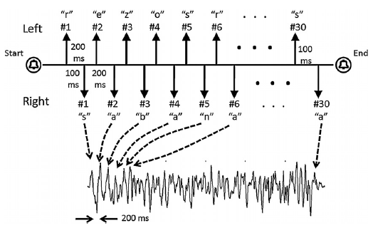
Methods
The figure shows the typical structure of a evaluation trial
After the beep, the trial starts with two streams of 30 stimuli per ear.
Each stimulus corresponds to a letter from words with five and six letters (left and right respectively) that are repeated six and five times respectively.
In this example the words ‘rezos’ and ‘sabana’ were used for both streams.
The lower graph shows the typical steady response obtained after the average of the calibration trials for one of the streams.

Slide 7
Methods
It is established that early components of the human auditory evoked potentials, namely N1 and P2 are larger when the stimulus is attended compared to when it is ignored [38, 39].
This effect can be observed in the dichotic listening paradigm.
Because the ISI and ILI of each stimulation were fixed to a value (respectively, 200 and100 ms)
for the two streams of stimuli, to two counter-phased responses of the same frequency (5 Hz =ISI−1) whose amplitudes can be cognitively modulated.
The net effect is a sinusoidal-shaped response with most of the energy located around the frequency of 5 Hz

Slide 8
Subjects and recording
A total of 12 healthy subjects (7 men, 5 women; aged 31.1 ± 6.0 years) participated in the experiment.
No type of auditory or cognitive disease was reported by the subjects
The experiment was conducted in a quiet room isolated from external disturbances throughout.
As visual stimulation was not needed, the subjects were recommended to close their eyes during the whole experiment.
They configured a single channel with an active electrode placed on the vertex (Cz) and referenced to the mean value of the mastoids.
The ground electrode was placed between the Fpz and the Fz.
The recordings were acquired on Neuroscan, were band-pass filtered between 1 and 30 Hz and were sampled at a rate of 1 kHz.

Slide 9
Stimulation
Two conditions were established:
first, a dichotic listening condition wherein two distinct streams of letters were read out simultaneously (condition 1)
second, the same as condition 1 except that complete sentences were used rather than letters (condition 2).
Letters in condition 1 that were randomly picked from a dictionary with more than 13 000 entries.
The letters were previously sampled (16 bits per sample at 44100 Hz and 200 ms length) from a male voice that read the Spanish alphabet.
a total number of 30 stimuli (6 × 5 or 5 × 6) were delivered to each ear
The total duration of the stimulation was 6.1 s.
For condition 2, two different speeches were delivered simultaneously, one per ear
The sentences were previously recorded with the same characteristics as depicted for condition 1.
The subjective perception of the stimuli of condition 2 is similar to a low-quality cellular phone call

Slide 10
Experimental design
Because the experiment was purely auditory without any visual stimulation, an assistant was needed to give verbal statements to the participants.
The experiment consisted of two sessions, namely the spelling session (condition 1) and the speech session (condition 2).
Each session consisted of five runs that, in turn, consisted of ten trials.
The first run of each session was used for calibration and the other four were used for evaluation.
Because selective attention is a native skill for humans, no training was needed to perform the dichotic listening task
only the first ten trials (first run) of each session dedicated to calibrate the system (calibration for classifier).
During the calibration, only one stream was delivered at a time to one of the ears.
The result was that a very stable and reliable pattern was extracted in just one run.

Slide 11
Experimental design
During the evaluation, and previous to the stimulation onset, an auditory sentence was read by an assistant to the participant
After beep, the participant had to take a binary decision, either ‘yes/true’ or ‘no/false’, for that sentence.
The sentence was randomly picked from a list and sentences were composed in such a way that the number of positive and negative answers was the same.
e.g., ‘I am Spanish’, ‘I am not Spanish’ or ‘two plus three equals five’, ‘two plus three equals six’
If the correct answer was ‘yes/true’, the participant had to pay attention to the stimulus delivered to the left ear and vice versa if the decision was ‘no/false’.

Slide 12
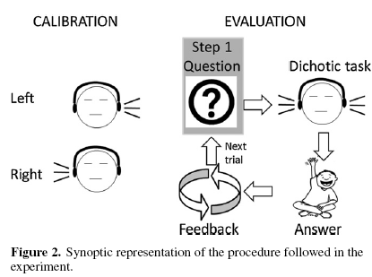
Experimental design
In general, the communication was intended as a conversation initiated by the assistant in which he asks binary response questions to which the participant answers
e.g., ‘Do you need pain relief?’, or ‘Would you prefer a warmer room?’.
The correct word was given to the participants as feedback at the end of each trial
The feedback was solely intended to help them to find a more efficient strategy to focus their attention.

Slide 13
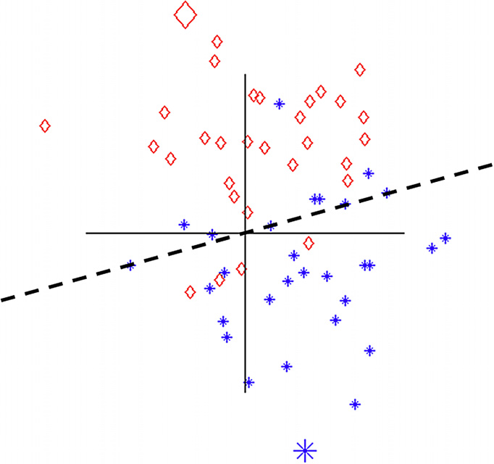
Feature extraction and Classification
The data collected during the calibration trials were separated into the left ear and right ear data; these two types of data were averaged separately.
The DFT was computed on each and the DFT coefficients at the frequency of repetition (5 Hz) were extracted and used as patterns for classification.
These coefficients are complex numbers that convey information about the amplitude and phase of the event-related responses.
As both streams were presented at the same frequency but with an ILI of half period (100 ms), the DFT coefficients differed only in the phase (180◦).
The typical representation of the DFT coefficients in polar coordinates
(stars and diamonds represent the left and right, respectively; the big star and diamond for the patterns).

Slide 14
Feature extraction and Classification
Given that during the evaluation both sequences were delivered simultaneously, the amplitudes of the features extracted are smaller than the patterns.
Because the responses to both sequences are counter-phased (180◦ phase shift), they partially cancel each other, thus giving rise to lower levels of signal.
During the evaluation, the extracted features of each trial were compared to the pattern and were classified under the criterion of the minimum Euclidean distance: ,
where${ S}_{t}$ is the classification decision for trial t, $ψ_{i}$ are the DFT coefficients of the two patterns extracted, $ψ_{t}$ is the DFT coefficient extracted from trial t

Slide 15
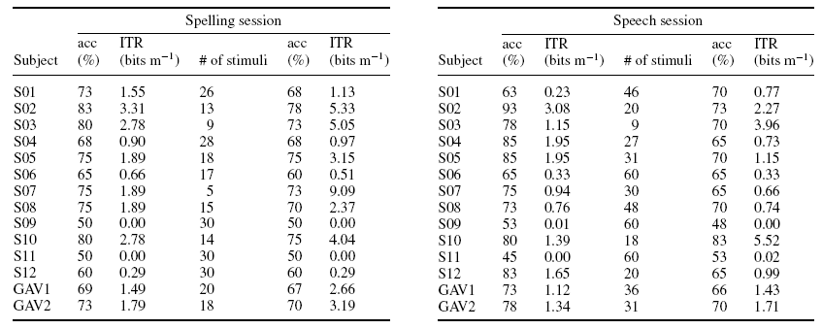
Results
The experiment did not work for two of the twelve participants (S09, S11).
Columns two and three denote the full-length trials and last three columns denote the optimum number of stimuli.
Two grand averages across the subjects are presented, one across all of the participants (GAV1) and the other excluding S09 and S11 (GAV2).

Slide 16
Results
S09 and S11 were not able to transmit any amount of information (ITR = 0.0, accuracy = 50%).
However, when both are excluded to compute GAV2, accuracies exceed 70%,with an ITR of 3.19 (70%- 1.71 for speech session) for the optimal number of stimuli.

Slide 17
Results
For the optimal number of stimuli, incremental fractions of trials in steps of 200 ms (each including unitary incremental of responses)were extracted and classified.
The optimal length of trials was defined, for each subject, as the mean of two numbers.
The first number is calculated as the number of stimuli for which fewer stimuli always cause an accuracy equal to or below 70%.
The second number is the number of stimuli for which a higher number of stimuli always yield an accuracy equal to or above 70%.
According to [45], 70% corresponds to the minimum accuracy that guarantees meaningful communication.

Slide 18
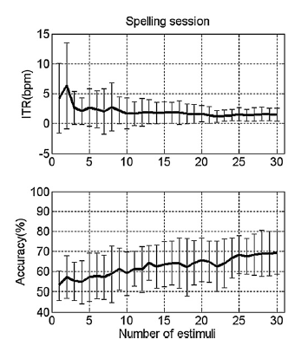
Results
Figure 4 (left) shows the averaged performance across subjects versus the number of stimuli used for the classification of the spelling session.
Both the ITR and the accuracies smoothly converge to 1.49 bits min−1 and 69%, respectively, as the number of stimuli increases. (see table1, GAV1)
The ITR is 6.3 bits min−1, obtained for just two stimuli, corresponding to an accuracy of 57%, far below 70%.
Figure 4(left). Mean performance (thick lines) and standard deviation (vertical bars) across subjects versus incremental number of stimuli for the
spelling and speech sessions (left and right respectively).

Slide 19
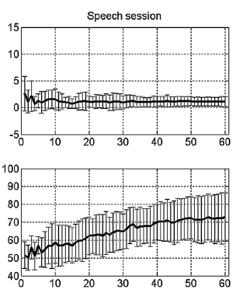
Results
Figure 4 (right) shows the averaged performance across subjects achieved during the speech session.
The ITR–accuracies converge to 1.12–73%(see table 2, GAV1)
The maximum ITR obtained corresponds to 2.7, which was achieved with an accuracy of 52% and just one stimulus
However, this accuracy is considerably under 70% and chance level.
Figure 4(right). Mean performance (thick lines) and standard deviation (vertical bars) across subjects versus incremental number of stimuli for the
spelling and speech sessions (left and right respectively).

Slide 20
Conclusions
This intuitive and easy to use auditory BCI founds a novel approach in the field of BCIs
This system may provide a clinically useful communication device to those that are in a locked-in state.(can not use visual stimuli)
From the results, they can state that the use of the dichotic listening paradigm is a feasible approach for auditory BCIs.
Beyond the performance, the results show that an auditory BCI based on natural speech is a reasonable approach indicated for users unable to use a visual BCI.
The use of selective attention enhances the usability of the system, with a minimum of training (one run for calibration) and a minimum number of EEG channels (just one).
In the future, simultaneous feedback will be allowed; thus, they expect an improvement in the performance.

Slide 21
Thank you

