Slide 1
A new (semantic) reflexive brain–computer interface: In search for a suitable classifier
A. Furdea et al. University of Tubingen, Germany
Journal of Neuroscience Methods (2012)
Presenter : Younghak Shin
GIST, Dept. of Information and Communication, INFONET Lab.
Notes:
Good afternoon everyone~
First of all, thank you for attending my MS defense presentation.
My name is Younghak Shin
Im a member of INFONET lab. at GIST
The title of my thesis is this

Slide 2
Objective
The goal of this study is to find a suitable classifier for EEG data derived from a new learning paradigm which aims at communication in paralysis.
A reflexive semantic classical (Pavlovian) conditioning paradigm is explored as an alternative to the operant learning paradigms, currently used in most BCIs.
Four classification algorithms are compared for classifying off-line data collected from a group of 14 healthy participants
stepwise linear discriminant analysis (SWLDA)
shrinkage linear discriminant analysis (SLDA)
linear support vector machine (LIN-SVM)
radial basis function kernel support vector machine (RBF-SVM)

Slide 3
Introduction
BCIs provide a non-muscular communication channel for individuals who are no longer able to communicate due to severe physical impairment.
Over the last years it has been shown that patients with severe motor disability are able to control an EEG based BCI (e.g. sensori-motor rhythm (SMR) and P300)
However, there are no documented cases of CLIS(completely locked-in state : all motor control is lost) patients communicating by means of BCI
It has been suggested that a paradigm shift from instrumental-operant learning to classical conditioning is necessary to overcome the failure of CLIS patients to achieve BCI control
The aim of this study is to find a suitable classifier and to assess the relative performance of four classification techniques on EEG data derived from a classical conditioning paradigm.

Slide 4
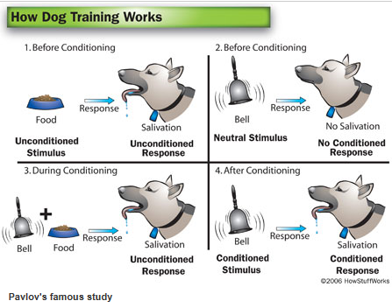
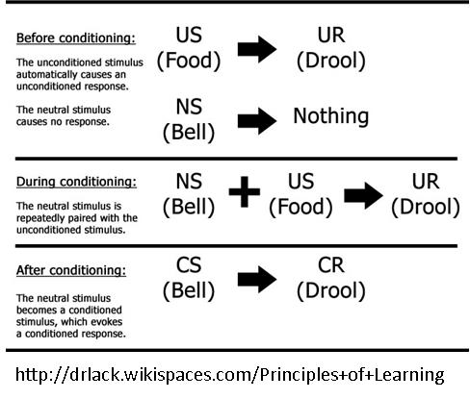
Introduction
Classical conditioning ( Pavlovian conditioning)

Slide 5
Data collection
Participants
Fourteen healthy participants (8 women and 6 men, mean age 24.36, SD 5.4, range 21–42) took part in this study
Task procedure and design
All participants took part in two experimental sessions
Each session was divided into three blocks, each block consisted of 50 true and 50 false sentences, i.e. trials.
In each block, the sentences were presented in random order through earphones.
The conditioned stimuli (CS) were either ‘yes’ or ‘no’ sentences, according to the type of the sentence (CS1 and CS2).

Slide 6
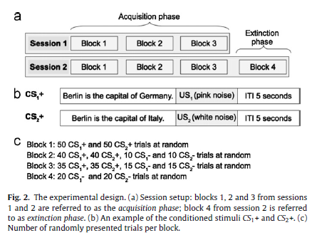
Data collection
Task procedure and design
To learn ‘yes-’ or ‘no-thinking’ two different unconditioned stimuli (US) were used:
a pink noise US1 immediately following a true sentence
a white noise US2 immediately following a negative sentence which produced the unconditioned brain response(UR)

Slide 7
Data collection
Both US were set to have the same duration of 500 ms and were presented monaurally at different intensities.
US1 was always presented to the right ear with an intensity of 75 dB and US2 was always presented to the left ear with an intensity of 105 dB.
For each session, during the first block, every CS was paired with an US and denoted as CS1+ and CS2+.
In the second block 10 CS, at random, were not paired with US1 and US2 and are referred to as CS1− and CS2−.
In the third block 15 CS, at random, were not paired with US1 and US2.
CS1- and CS2- are of a particular importance for on-line communication because in an on-line scenario only unpaired sentences can be used.
At the end of the second session a fourth block of sentences was introduced, further referred to as the extinction phase.
The purpose of this phase was to assess the lasting effects of conditioning.

Slide 8
Data acquisition and processing

Slide 9
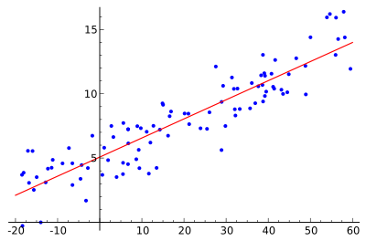
Data collection
stepwise Linear Discriminant Analysis
Example of simple linear regression

Slide 10
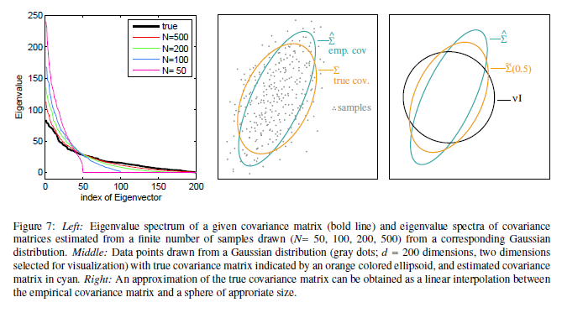
Methods
Shrinkage LDA

Slide 11
Thank you

