Slide 1
Localisation of cognitive tasks used in EEG-based BCIs
M. Dyson *, F. Sepulveda, J.Q. Gan
Clinical Neurophysiology (2010.3)
Presenter : Younghak Shin
GIST, Dept. of Information and Communication, INFONET Lab.
Notes:
Good afternoon everyone~
First of all, thank you for attending my MS defense presentation.
My name is Younghak Shin
Im a member of INFONET lab. at GIST
The title of my thesis is this

Slide 2
Objective
In BCIs, motor and non-motor(e.g., auditory) cognitive states are used.
To provide candidate electrode sites and neurophysiological reference information used in brain–computer interfacing research, they investigate six cognitive tasks.
This is the first study to provide candidate electrode sites for multiple tasks used in brain–computer interfacing

Slide 3
Methods
Cognitive tasks
Six cognitive tasks were tested against the idle state
The idle state was used as a baseline against each task in order to observe changes in the activation associated
Arithmetic
Subtraction was selected as an arithmetic task
Generate a three digit number and a single digit number for each trial
The single digit number was to be repeatedly subtracted from the results of each calculation
continuing for the duration of the trial.
Navigation imagery
Subjects were instructed to select a familiar route between two locations
Subjects were required to bring to mind images associated with the route.

Slide 4
Methods
3. Auditory recall
Auditory recall involved recall of a tune familiar to subjects
and involved the mental rehearsal of the said song.
4. Phone imagery
This task was an alternative auditory task
and involved subjects bringing to mind a familiar telephone bell or ringtone and retain the sound for the duration of the trial
It was emphasized that this was an auditory task and associations should not be made with motor activities associated with telephone use
5. Motor imagery of the left hand
A wrist extension was demonstrated to subjects.
Motor imagery was defined as bringing to mind these associations without performing the task itself
6. Motor imagery of the right hand
- Instructions matched those for left hand motor imagery.

Slide 5
Methods
Data collection
Subjects : Seven male subjects (age 24–35) took part in the study. All subjects were able bodied, free from medication and any disorders of, or injuries to the central nervous system.
Protocol
Each run contained 10 trials (randomly ordered)
trials within each run were split equally between the active task condition and the idle condition.
Each run was repeated six times, producing 30 trials for each mental task and 30 trials of associated idle data.
The number of runs per session was dependent on subject preference.
Within each run cues appeared after a 60 s pre-trial period

Slide 6
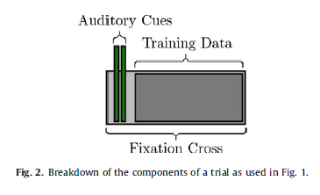
Methods
Protocol
A trial began with the presentation of a fixation cross in the centre of the screen.
Paired beep sounds were used to cue the active task condition and the idle task.
Two 70 ms duration tones were presented
The first sound was consistently 1 kHz, the second either 1 or 1.3 kHz.
If the two tones were perceived as the same tone the subject performed the given mental task for the run
If the tones were different the subject relaxed for the duration of the trial
Subjects were instructed to attempt to perform each task until the fixation cross disappeared from the screen

Slide 7
Methods
Recordings
EEG was recorded from 64 electrodes positioned according to the international 10–20 layout using a BioSemi Active2 system.
EEG signals were filtered between 0.1 Hz and 100 Hz (Butterworth– Order 5)
Data were sampled at a frequency of 256 Hz
Feature extraction
Features were extracted in two representations, band power and reflection coefficients.
Band power extraction was performed on 10 frequency bands, corresponding to the delta (0.1–5 Hz), theta (5–8 Hz), alpha (8–12Hz), sigma (12–15 Hz), beta (15–25 Hz) bands and the five bands in the gamma range (25–35, 35–45, 45–55, 55–65, 65–75 Hz).
Features were extracted for each band on each channel, giving a total of 640 features based on band power.

Slide 8
Methods
Feature extraction
Reflection coefficients, or partial correlation (PARCOR) coefficients, are obtained via autoregressive analysis and are related to autoregression coefficients
An autoregressive model represents a time signal as an output of an all pole filter driven by white noise.
Filter coefficients are calculated from a block of samples as input signal
The notation AR(p) indicates an autoregressive model of order p. The AR(p) model is defined as
where are the parameters of the model, c is a constant,
and is white noise.

Slide 9
Methods
Feature selection
A sequential forward floating search (SFFS) [Pudil et al. 1994] algorithm was used to obtain electrode-feature combinations for each subject-task dataset.
The algorithm works on the extracted feature space Y, which contains a finite number of features, D:
Output is a subset of extracted features X, consisting of the k features producing best discrimination in the feature space:
The selected features subset is initialized as an empty set with no features selected (k=0).
Halting occurs when k reaches the required number of selected features (k = 10).
The SFFS algorithm proceeds via two steps.
‘Inclusion’ step and ‘Conditional Exclusion’ step.

Slide 10
Methods
SFFS algorithm
‘Inclusion’ step
the most significant feature with respect to the currently selected feature set , is determined:
This feature is added to the selected features subset and the feature count incremented accordingly k=k+1
‘Conditional Exclusion’ step
the least significant feature, , of the current selected features subset is determined:
The least significant feature is removed from the current selected feature set, , the feature count is decremented, k=k-1
and the conditional exclusion stage is repeated.
if no improvement in discrimination be found, the algorithm returns to the inclusion step.
Search terminated at 10 features (k = 10).
The function J maximized was mean classification accuracy achieved by LDA (10-fold cross-validation)

Slide 11
Methods
To analyze that which electrode positions and frequency bands were used. They have used electrode maps for different tasks.
Cross subject electrode frequency(# of counts)
electrode site was selected multiple times during a search based on differing features,
i.e. a single channel selected at differing frequency bands,
each instance would contribute independently towards an electrode frequency count.
Cross subject electrode maps
To visualize the distribution of channels selected across subjects gradient maps are produced based on the frequency count of channels selected.
subject group gradient maps of selected channels are obtained by smoothing frequency counts over all channels.

Slide 12
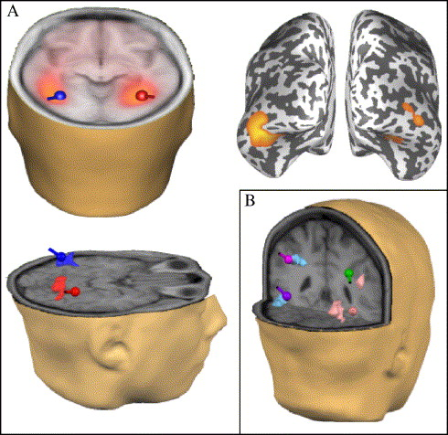
Methods
Localization with sLORETA
To obtain localization results, we used Standardised Low Resolution Brain Electromagnetic Tompography (sLORETA) [Pascual-Marqui, 2002].
sLORETA is a linear method of computing a statistical map from EEG data which indicates the location of underlying source processes with less error.
Underlying sources providing spatial activation with closest correspondence to electrodes selected through feature selection were selected.

Slide 13
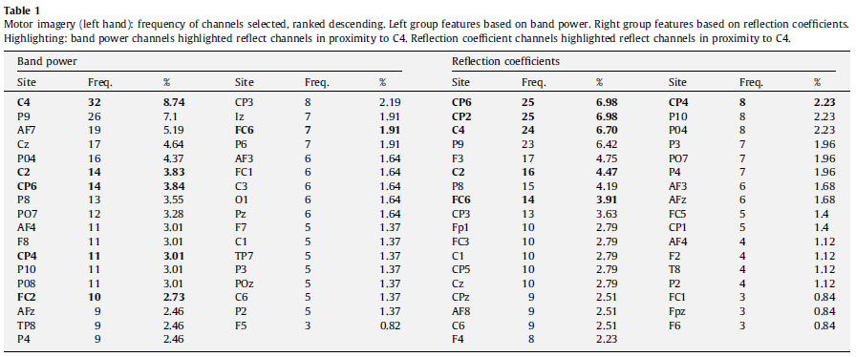
Results
Classification results derived through cross subject electrode selection are presented in parallel with source localization results.
Based on activations derived from localization results we obtain closest match Brodmann area and attempt to identify neural structures
Motor imagery (left hand)
- Table 1 shows the frequency of channels utilized in discrimination of motor imagery of the left hand from idle activity

Slide 14
Results
Fig. 3(a) and (b) shows gradient maps, obtained using band power and reflection coefficients based on the values outlined in Table 1
For both feature representations electrode C4 achieves the highest frequency value
Fig. 3(c)–(e) shows localization results with activation most similar to activity displayed in gradient maps.
The closest match Brodmann area is BA4, the primary motor cortex, located on the precentral gyrus.
This localization activity was found in the upper alpha/mu band (10.5–12 Hz)

Slide 15
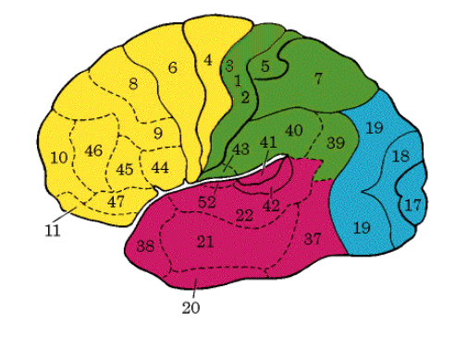
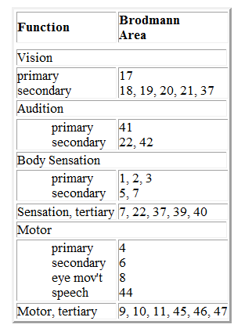
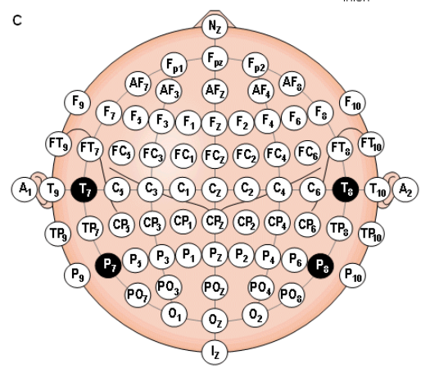
Results
Functional Areas of the Brain
A Brodmann area is a region of the cerebral cortex defined based on its cytoarchitectonics(세포구축), or structure and organization of neurons.

Slide 16
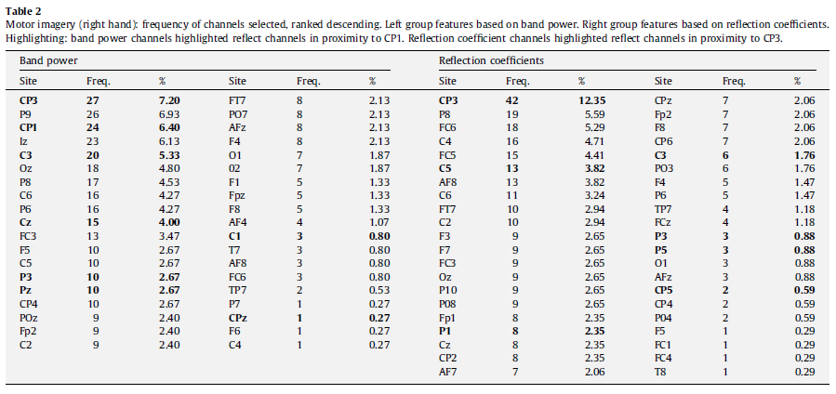
Results
2. Motor imagery (right hand)
- Table 2 shows the frequency of channels utilized in discrimination of motor imagery of the right hand from idle activity

Slide 17
Results
Fig. 4(a) and (b) shows gradient maps, obtained using band power and reflection coefficients based on the values outlined in Table 2
For both feature representations electrode CP3(near the C3) achieves the highest frequency value
Fig. 4(c)–(e) shows localization results with activation most similar to activity displayed in gradient maps (a) and(b).
The closest match Brodmann area is BA3 located on the primary somatosensory cortex
This localization activity was found in the upper alpha/mu band (10.5–12 Hz)

Slide 18
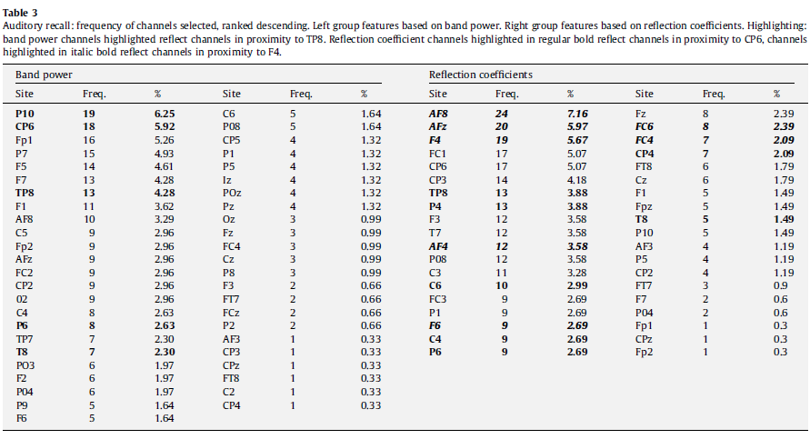
Results
3. Auditory recall
- Table 3 lists the frequency of channels used in the discrimination of auditory imagery from idle activity

Slide 19
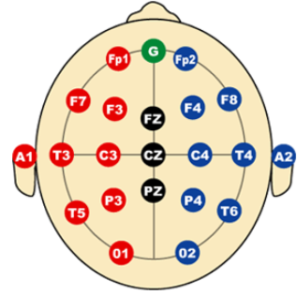
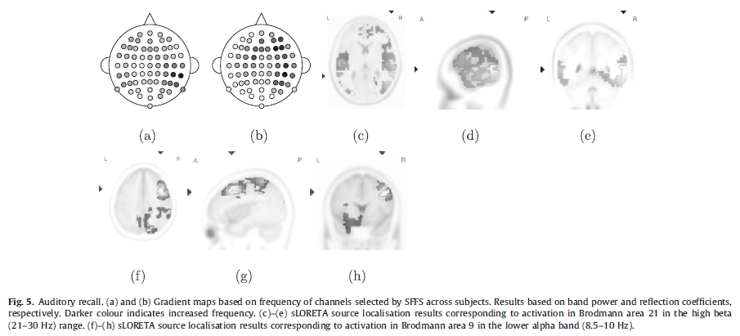
Results
Fig. 5(a), the gradient map based on band power, has greatest density of channels selected around TP8
Fig. 5(b), show a primary area of main density around electrode CP6 with a secondary area commonly selected around FP4
Fig. 5(c)–(e) has closest match in Brodmann area 21 located in the middle temporal gyrus (high beta (21–30 Hz) range).
Fig. 5(f)–(h) has closest match is Brodmann area 9 on the precentral gyrus (lower alpha band (8.5–10 Hz)).

Slide 20
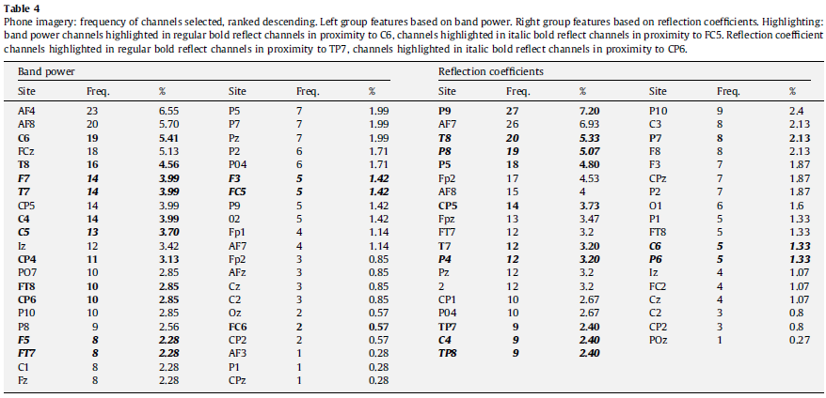
Results
4. Phone imagery
- Table 4 lists the frequency of channels used in the discrimination of phone imagery from idle activity

Slide 21
Results
Fig. 6(a), the gradient map based on band power, has greatest density of channels selected around C6, secondary area surrounding FC5.
Fig. 6(b) which has two areas of density centered around TP7 and CP6
Fig. 6(c)–(e) shows localization results which best explain the pattern of activation found in gradient maps (Fig. 6(a) and (b)).
Closest match Brodmann area is BA21 located on the middle temporal gyrus (freq. : mid beta (18.5–21 Hz) range).
In comparison to the auditory recall results shown in Figs. 5(a) and (b), Figs. 6(a) and (b) show a greater degree of bilateral activity.

Slide 22
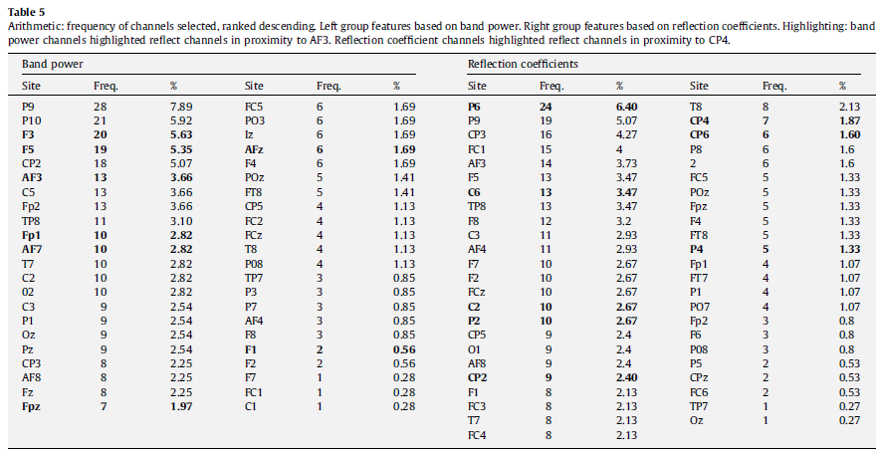
Results
5. Arithmetic
Table 5 lists the frequency of channels used in the discrimination of arithmetic from idle activity
Table 5 shows greatest frequency at AF3 for band power features, and at CP4 when discrimination is based on reflection coefficients.

Slide 23
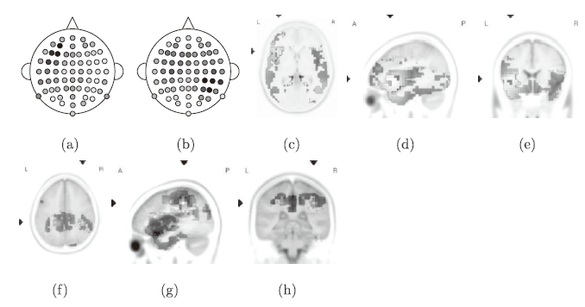
Results
Fig. 7
Arithmetic mental activity shows distinct differences in classification areas obtained dependent on feature extraction method, band power and AR coefficients.
Fig. 7(c)–(e) and Fig. 7(f)–(h) represent areas of activation best describing patterns of activation found with Fig. 7(a) and Fig. 7(b) respectively .
The closest match Brodmann area related to activation was BA46 in the inferior frontal gyrus of the left hemisphere (low beta band (12.5–18 Hz)).
Fig. 7(f)–(h) shows activation centered on Brodmann area 40, inferior parietal lobe, in the area of the supramarginal gyrus (theta band (6.5–8 Hz)).

Slide 24
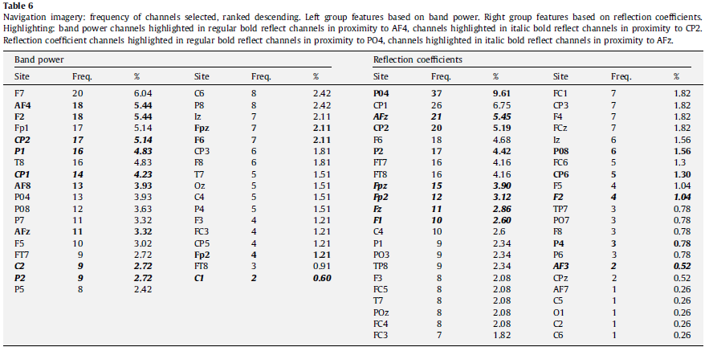
Results
6. Navigation
Table 6 lists the frequency of channels used in the discrimination of navigation imagery from idle activity

Slide 25
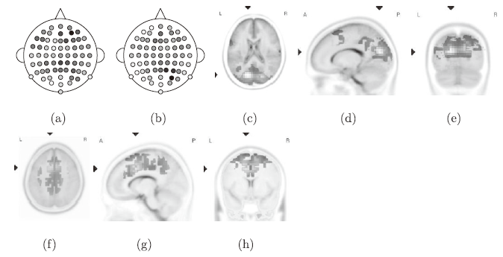
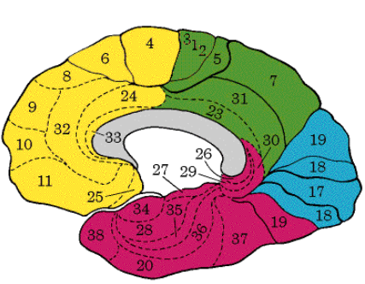
Results
Fig. 8
Fig. 8(a) shows gradient maps produced from band power features, the greatest density value is centered around AF4 with a second area of increased density located around CP2.
The equivalent values for Fig. 8(b) are centered at PO4 and AFz.
Activity centered around CP2 in the case of band power, and PO4 in the case of reflection coefficients is best matched by localization activity shown in Fig. 8(c)–(e).
The closest matched Brodmann area is BA31, on the parietal lobe in the mid beta band(18.5–21Hz).
Frontal activation found in Fig. 8(a) and (b), centered around AF4 and AFz is best matched by Fig. 8(f)–(h) in the lower beta band (12.5–18 Hz) at Brodmann area BA32.

Slide 26
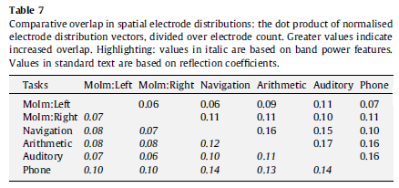
Results
Contrast of feature distributions
they calculate the relative overlap in spatial electrode distributions using two methods.
dot product of feature vectors
The values in Table 7 show the dot product of feature vectors divided over a fixed electrode count of 64.
Higher values indicate greater overlap in the cross subject distribution maps
The lowest levels of overlap are associated with contrasts of the distributions produced by motor imagery tasks
The highest degree of overlap is found between the auditory imagery and arithmetic task based on reflection coefficients

Slide 27
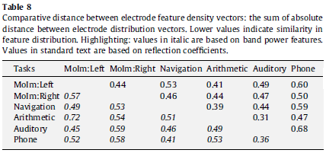
Results
Contrast of feature distributions
2. distance between the density of features
The values in Table 8 are the summed absolute distance between paired feature vectors
providing a measure of the difference in density distributions of features for contrasted cognitive tasks
The greatest distance in Table 8 is found between motor imagery of the left hand and arithmetic in the band power domain
The lowest distance, is found between the auditory imagery and arithmetic tasks based on reflection coefficients.

Slide 28
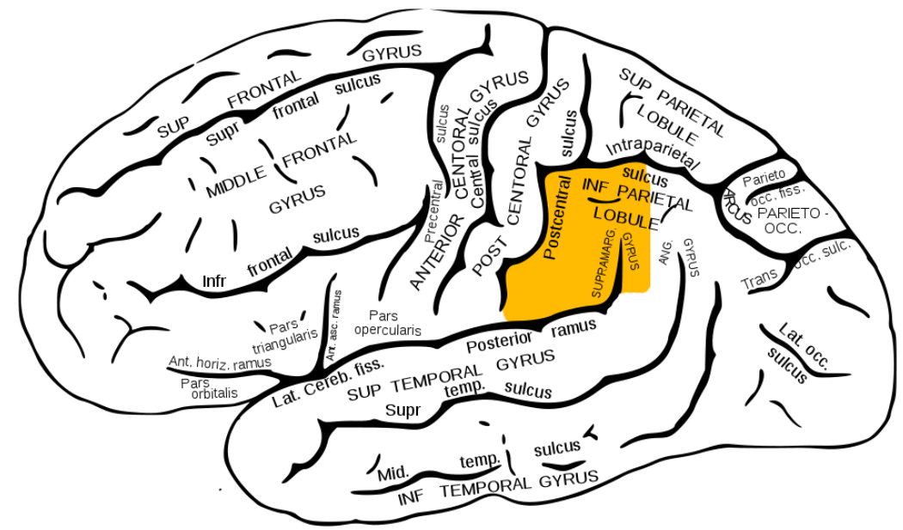
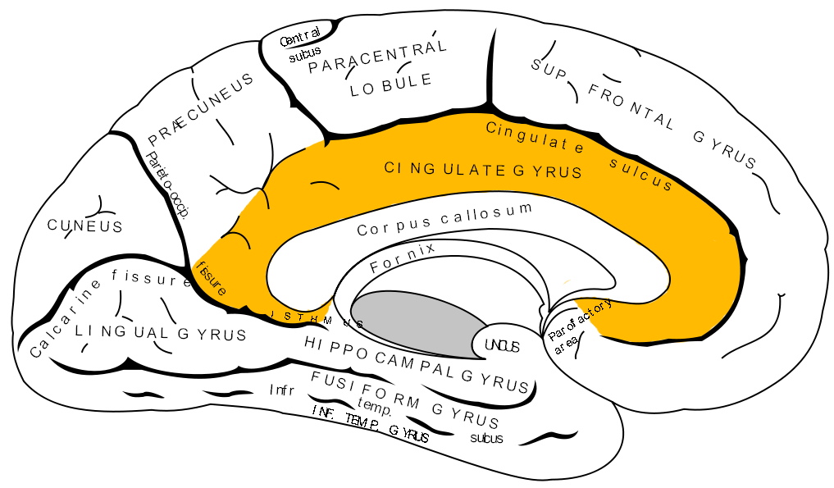
Conclusions
Primary centers of activity for motor imagery tasks are localized to the pre- and postcentral gyrus
Auditory-based tasks show activity in the middle temporal gyrus
Calculation activity was localized to the left inferior frontal gyrus and right supramarginal gyrus
Navigation imagery produced activity in the praecuneus and anterior cingulate cortex.
Spatial areas of activation suggest that arithmetic and auditory tasks show promise for pairwise discrimination based on single recording sites.
sLORETA results suggest that motor imagery tasks will show greatest discrimination from baseline EEG activity(idle state)

Slide 29
Thank you

