Slide 1

Diffuse optical imaging of brain activation: approaches of optimizing image sensitivity, resolution and accuracy
David A. Boas et al.
NeuroImage (2004)
Presenter : Evgenii Kim
GIST, Dept. of Information and Communication
Notes:
Good afternoon everyone~
First of all, thank you for attending my MS defense presentation.
My name is Younghak Shin
Im a member of INFONET lab. at GIST
The title of my thesis is this

Slide 2
Outline
Introduction
Diffuse optical imaging forward and inverse problem basics
Optimum wavelengths and cross-talk in estimating hemoglobin concentrations
Systemic physiological signal interference
Improving image resolution with overlapping measurements
MRI structural and functional spatial priors for improving quantitative accuracy of DOI
Conclusion

Slide 3
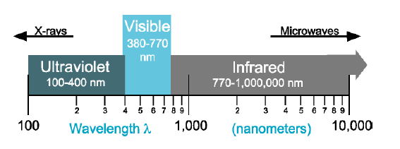
Introduction
Near – infrared spectroscopy (NIRS) and diffuse optical imaging (DOI) are techniques applied to study neural activity in the brain.
Infrared light is composed of a broad range of electromagnetic waves from 770 nm to 1 mm.
http://www. en.wikipedia.org/

Slide 4
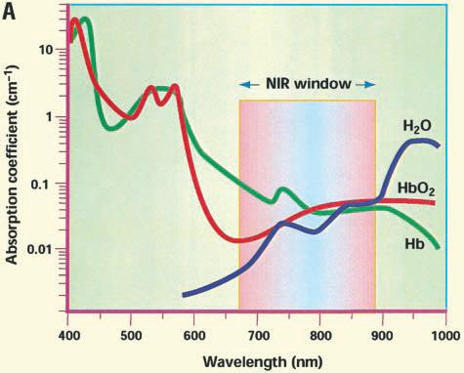
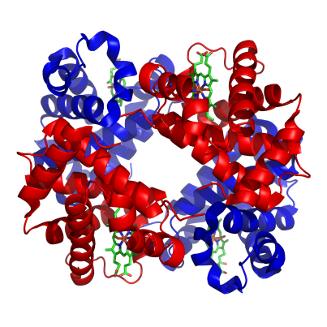
Introduction
Optical Window
Hemoglobin is the iron-containing metalloprotein in the red blood cells.
Hemoglobin
http://www. en.wikipedia.org/

Slide 5
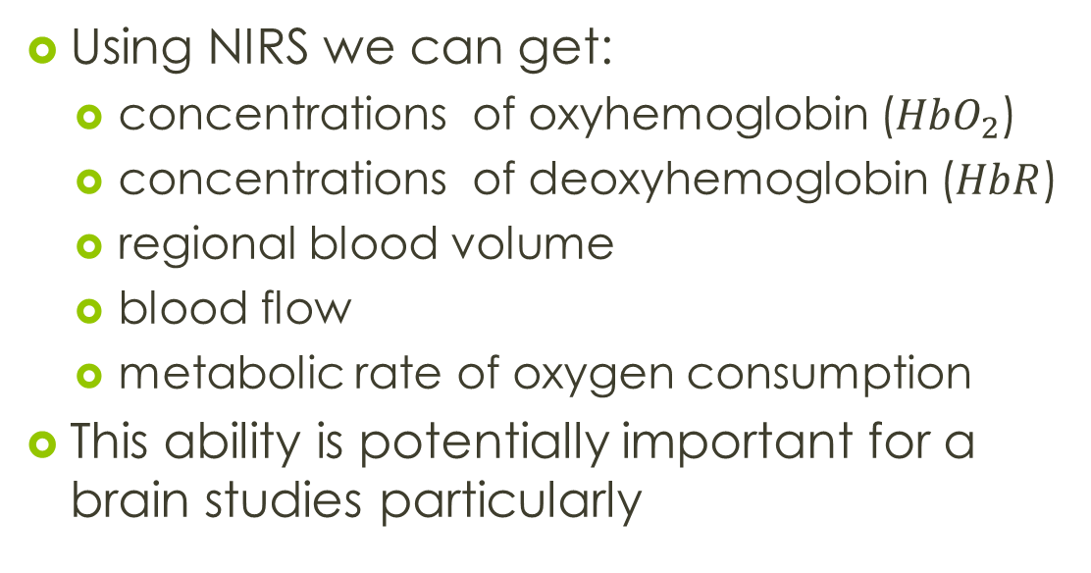
Introduction
Using NIRS we can get:
  concentrations of oxyhemoglobin (${HbO}_{2}$)
  concentrations of deoxyhemoglobin ($HbR$)
  regional blood volume
  blood flow
  metabolic rate of oxygen consumption
This ability is potentially important for a brain studies particularly

Slide 6
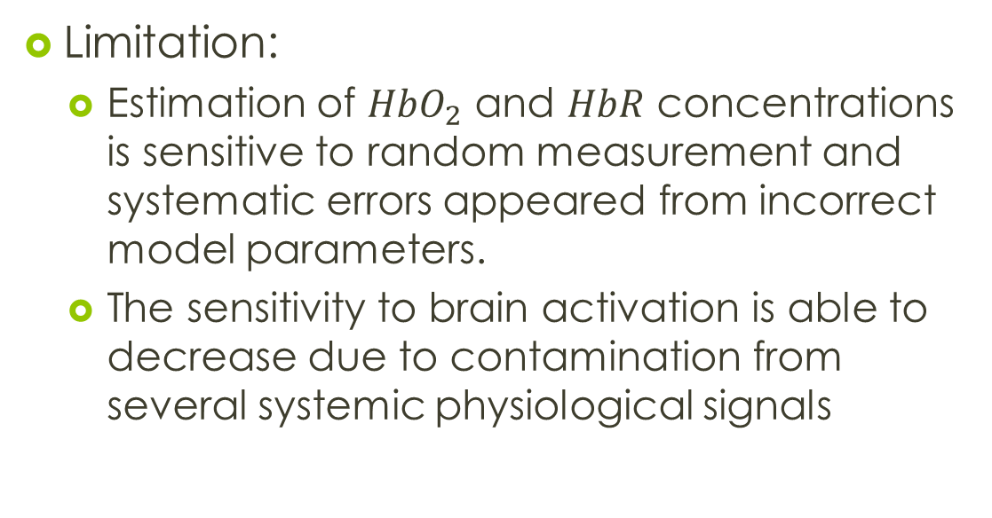
Introduction
Limitation:
  Estimation of ${HbO}_{2}$ and $HbR$ concentrations is sensitive to random measurement and systematic errors appeared from incorrect model parameters.
  The sensitivity to brain activation is able to decrease due to contamination from several systemic physiological signals

Slide 7
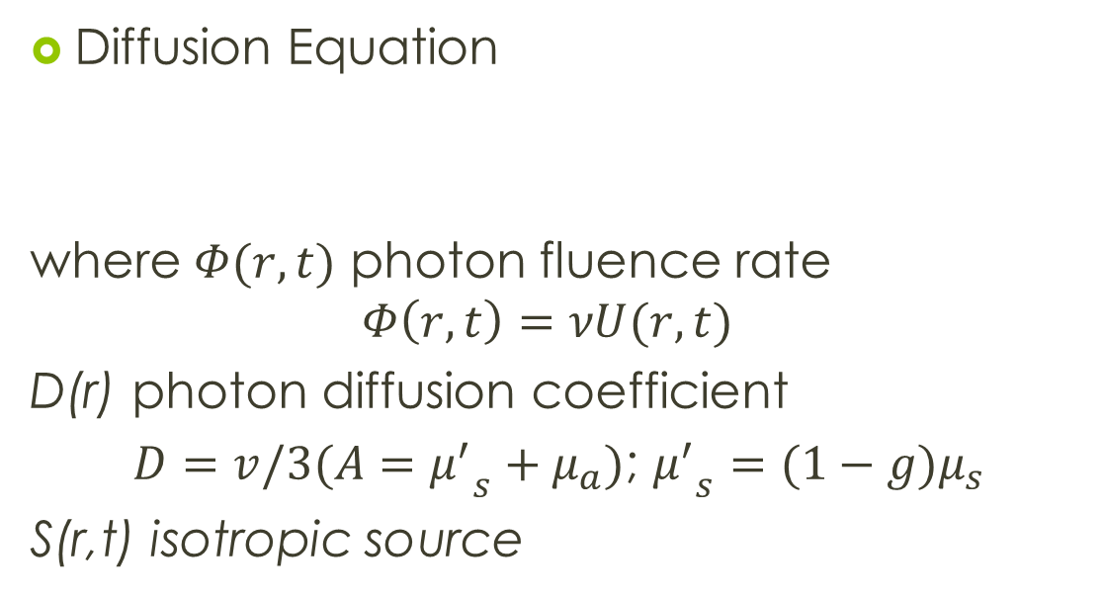
Diffuse optical imaging forward and inverse problem basics
Diffusion Equation
where $Φ(r,t)$ photon fluence rate
$$Φ\left(r,t\right)=νU(r,t)$$
D(r) photon diffusion coefficient
$D=v/3(A={μ^{′}}_{s}^{}+μ_{a})$; ${μ^{′}}_{s}^{}=(1−g)μ_{s}$
S(r,t) isotropic source

Slide 8
Monte Carlo Simulation
For REF
Monte Carlo methods are a class of computational algorithms that rely on repeated random sampling to compute their results.
The path of each photon packet is determined by the sampling of random numbers and a set of functions or probability distributions describing the likeliness of for example the step length and scattering angles.
This way of stochastic simulation relies on the simulation of a large number of photon packets and the solutions provided are more or less noisy depending on the number of photons simulated.

Slide 9
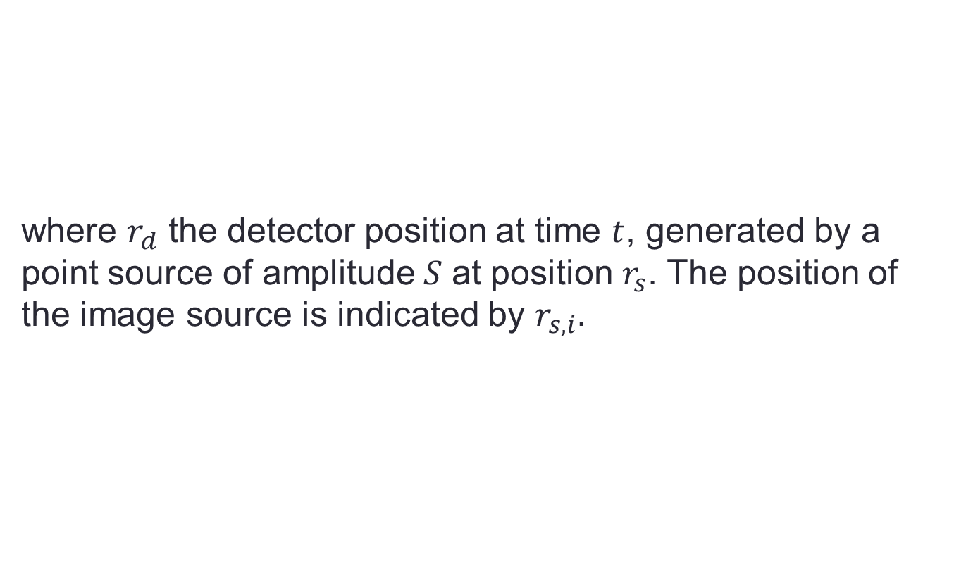
Solutions of the Diffusion Equation for Comparison with Monte Carlo
For REF
where $r_{d}$ the detector position at time $t$, generated by a point source of amplitude$S$ at position $r_{s}$. The position of the image source is indicated by $r_{s,i}.$

Slide 10
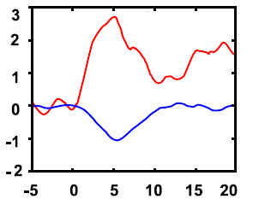


The modified Beer-Lamber law
$∆{OD}_{i}\left(t,λ\right)=−\log\left(\frac{Φ\left(t,λ\right)}{Φ_{0}\left(λ\right)}\right)=\sum_{j=1}^{N_{vox}}{Δμ_{a,j}\left(t,λ\right)L_{i,j}(λ)}$
where $OD$ is the attenuation measured in optical densities; $Φ_{0}$ is average detected photon fluence; $L_{i,j}$ is the effective pathlength of detected photons for ith measurement in the jth voxel.
$${\text{HbO}}_{2}$$
Concentration Change
HbR
Time (sec)

Slide 11
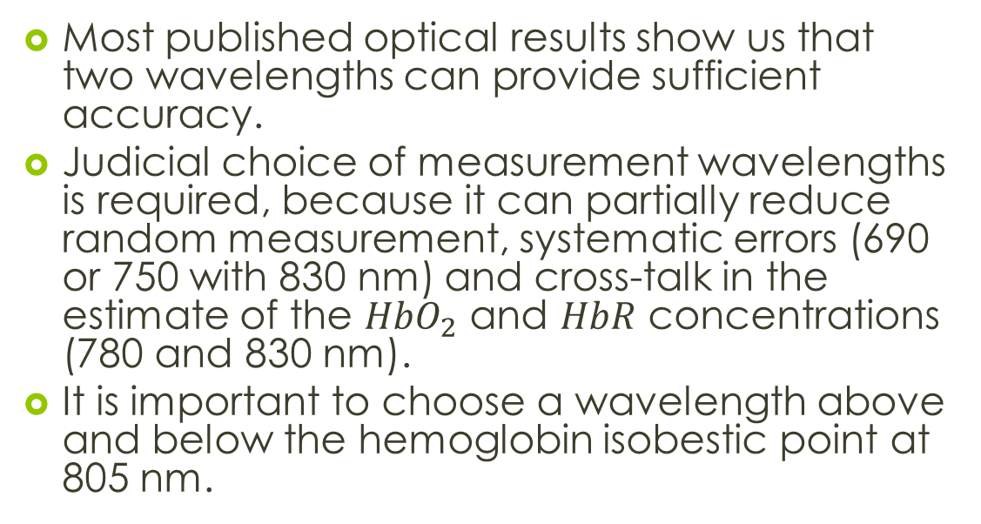
Optimum wavelengths and cross-talk in estimating hemoglobin concentrations
Most published optical results show us that two wavelengths can provide sufficient accuracy.
Judicial choice of measurement wavelengths is required, because it can partially reduce random measurement, systematic errors (690 or 750 with 830 nm) and cross-talk in the estimate of the ${HbO}_{2}$ and $HbR$ concentrations (780 and 830 nm).
It is important to choose a wavelength above and below the hemoglobin isobestic point at 805 nm.

Slide 12
Systemic physiological signal interface
The system has numerous sources of systemic signal interference that reduce its sensitivity to weaker brain activation signals.
To improve the optical sensitivity to brain activation it is required to use special signal processing methods that distinguish the different source signals in space and time. Some research used a principle component analysis (PCA)

Slide 13
Principle component analysis
For REF
PCA is a way of identifying patterns in data, and expressing the data in such a way as to highlight their similarities and differences.
The main advantage of PCA is that once you have found these patterns in the data, you can compress the data, by reducing the number of dimensions.
Lindsay I Smith, 2002

Slide 14
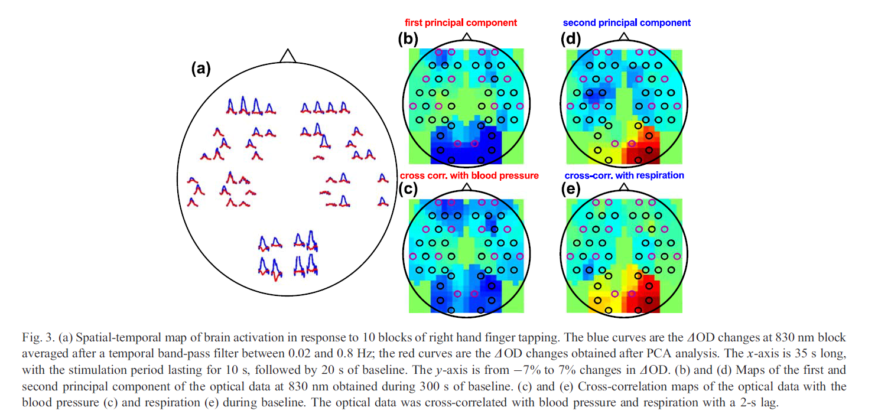
Using PCA

Slide 15
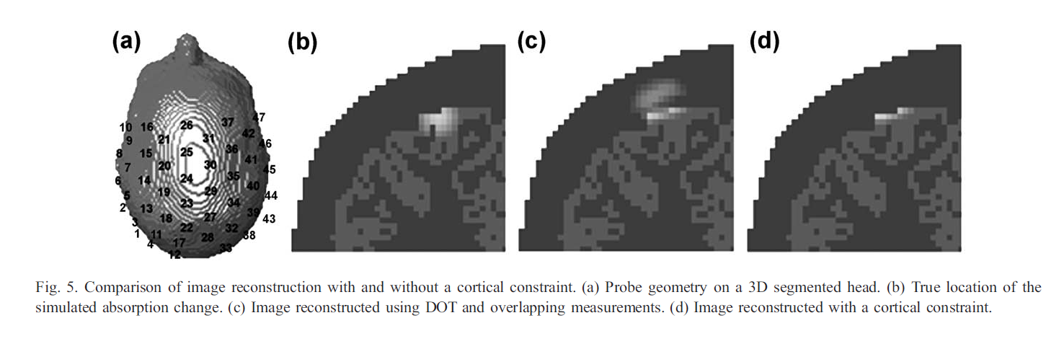
MRI structural and functional spatial priors for improving quantitative accuracy of diffuse optical imaging

Slide 16
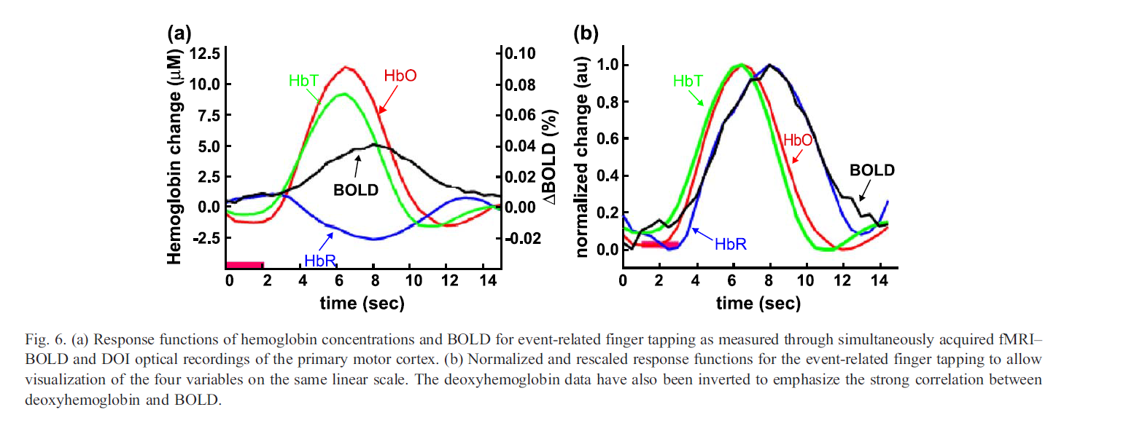
Temporal correlation of fMRI and DOI

Slide 17
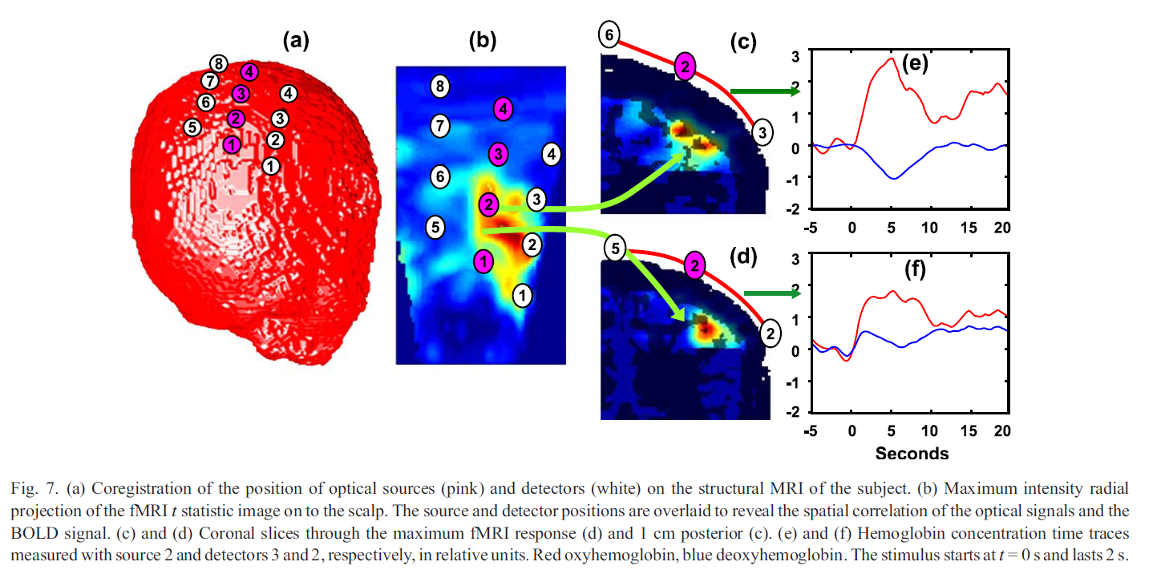
Spatial correction of fMRI and DOI

Slide 18
Conclusion
NIRS gives us enough function information about tissue, to be widely used in the study of human brain.
In addition, the extension of NIRS to DOI will improve the sensitivity, resolution and accuracy of the optical estimates of the hemodynamic response to brain activation

Slide 19
References
Boas D.A., Dale M., Franceschili M. A., 2004. Diffuse optical imaging of brain activation: approaches of optimizing image sensitivity, resolution and accuracy. NeuroImage 23(2004), 275-288
Boas, D.A., Culver, J., Stott, J., Dunn, A.K., 2002. Three dimensional Monte Carlo code for photon migration through complex heterogeneous media including the adult head. Opt. Express 10, 159– 170.
Smith L. I., 2002, A tutorial on Principal Components Analysis.

