Slide 1
Supervised Machine Learning: A Review of Classification Techniques
Kotsiantis S.B.
Informatica (2007)
Presenter : Evgenii Kim
GIST, Dept. of Information and Communication
Notes:
Good afternoon everyone~
First of all, thank you for attending my MS defense presentation.
My name is Younghak Shin
Im a member of INFONET lab. at GIST
The title of my thesis is this

Slide 2
Outline
Introduction
General issues of supervised learning algorithms
Logic based algorithms
Perceptron-based techniques
Instance-based learning
Support Vector Machines
Discussion
Conclusion

Slide 3
Introduction
Machine learning (ML) is about the construction and study of systems that can learn from data.
There are three types:
Supervised
Unsupervised
Reinforcement (The training information provided to the learning system by the environment)
Numerous ML can be set up as supervised

Slide 4
General issues of supervised ML
There are several main steps:
Collecting the dataset. In case of unknowing required feature we are measuring everything available in the hope that it is right. But in most of cases it contains noise and missing feature values, therefore the pre-processing is significant.
Data pre-processiong. The goal is to maintain the mining quality while minimizing the sample size.
Feature subset selection (feature extraction). It is a process of identifying and removing as many irrelevant and redundant features as possible. This reduces the dimensionality of the data
Classification

Slide 5
Algorithm selection
The choice of which specific learning algorithm we should use is a critical step. The classifier’s evaluation is most often based on prediction accuracy.
There are at least three techniques:
Split training set by two-thirds for training and the other third for estimate accuracy.
Cross-validation
Leave-one-out

Slide 6
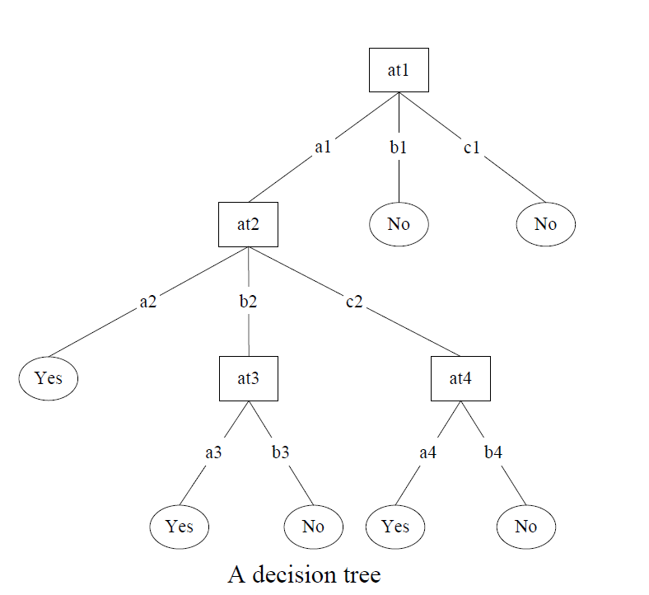
Decision trees
Decision trees are trees that classify instances by sorting them based on feature values.
Each node in the tree represents a feature in an instance to be classified
Each branch represents a value that the node can be assume
The feature that best divides the training data would be the root node of the tree.
This method is quite sensitive to overfitting
The most straightforward way of tackling overfitting is to prune the decision tree.
One of the famous algorithm to generate a decision tree is C4.5

Slide 7
Single layered perceptrons
Input feature values
Connection weights/predication vector (typically real numbers in the interval [-1,1])
The single layered perceptron computes the sum of weighted inputs: and output goes through an adjustable threshold: if the sum is above threshold, output is 1; else it is 0.
WINNOW (1994) is based on the perceptron idea and updates its weights.
If prediction value and actual value is 1 , then the weights are too low; so, for each feature , , where
If and actual value is 0, then the weight is too high

Slide 8
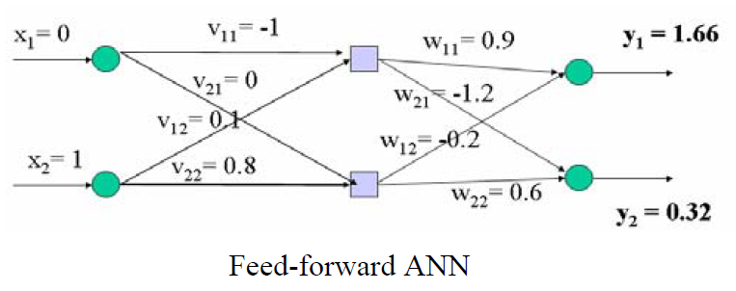
Multilayered perceptrons
Perceptrons can not classify non-linear problem.
To solve this problem the multilayered perceptron has been created.
A multi-layer neural neural network consists of large number of units joined together in a pattern of connections
Units are usually segregated into three classes: input units; output units; and units in between known as hidden units

Slide 9
Multilayered perceptrons
Generally, properly determining the size of the hidden layer is a problem, because to small number can be cause lower accuracy , while excessive nodes can result of overfitting.
The second important step is to calculate weight
The most well-known and widely used learning algorithm to estimate the values of the weights is the Back Propagation

Slide 10
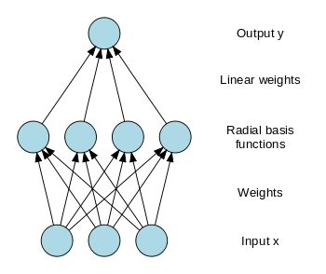
Radial Basis Function (RBF) networks
An RBF network is a three-layer feedback network, in which each hidden unit implements a radial activation function aand each output unit implements a weighted sum of hidden units outputs
Training procedure:
Determining of hidden layer
Connections between hidden layer
and output are determined by LMS
The problem of selecting the appropriate number of basis functions remains a critical issue for RBF.

Slide 11
Instance-based learning
Instance-based learning is lazy- learning algorithm, as they delay the induction or generalization process until classification is performed.
It is required less time during training (compare with decision tree, neural, Bayes) but more time during making decision.
One the instance-based algorithm is nearest neighbour
The absolute position of the instances within this space is not as significant as the relative distance between instances.
This distance is determined by using a distance metric

Slide 12
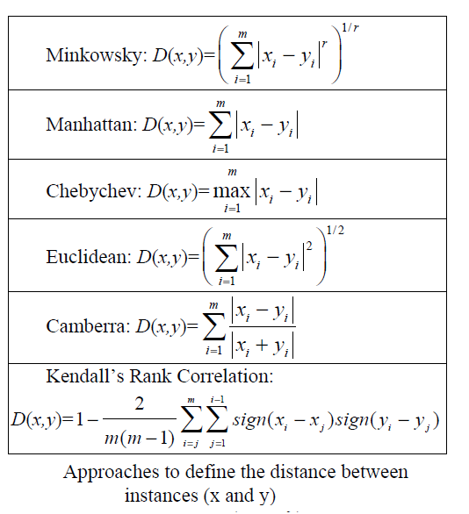
kNN
The power kNN has been demonstrated in a number of real domains, but it also has some problem:
It is required large storage
It is sensitive to the choice of the similarity function that is used to compare instances
There is not principle way to choose k

Slide 13
Support Vector Machines
SVMs revolve around the notation of a “margin”- either side of hyperplane that separates two data classes.
Maximizing the margin and thereby creating the largest possible distance between the separating hyperplane and the instances on either side of it has been proven to reduce an upper bound on the expected generalization error.
If the training data is linearly separable, then a pair (w,b) exists such that
With the decision rule given by
Kernel trickes

Slide 14
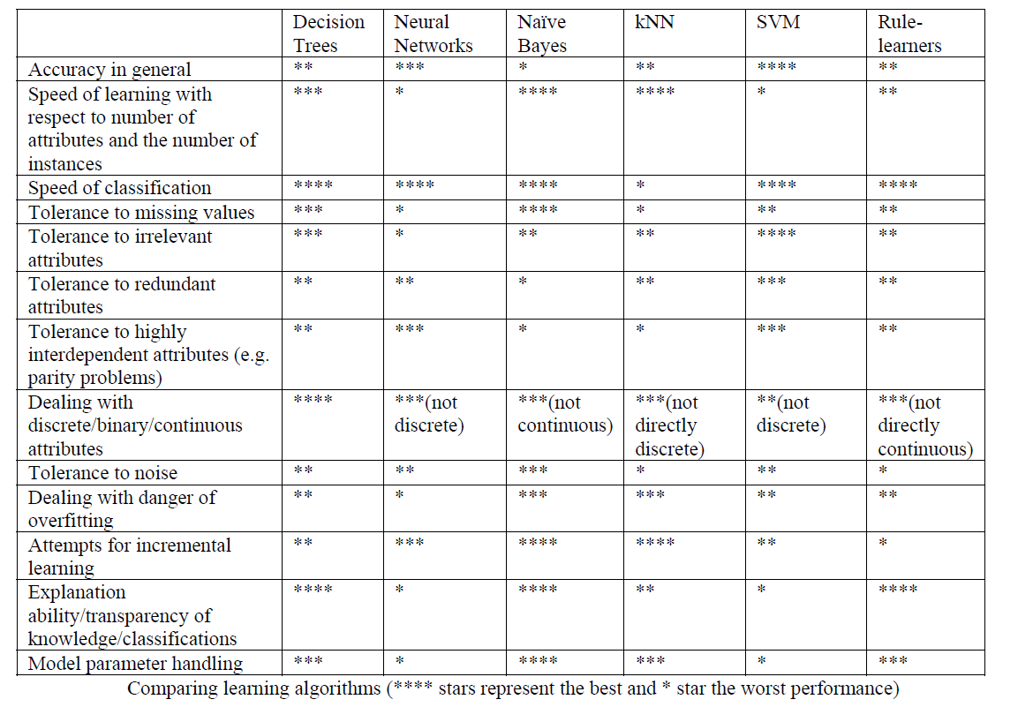
Discussion

Slide 15
Conclusion
The SVM has been shown the best accuracy, but it also has weak point.
By combination of different ML algorithms the efficiency can be improved.

