Slide 1
Active illumination single-pixel camera based on compressive sensing.
Filipe Magalhaes et al.
APPLIED OPTICS. (2011.02)
Presenter : Eunseok Jung
GIST, Dept. of Mechatronics , BiO-scopy Lab.
Notes:
Hi Every one.
OK. Now I start today’s j-club.
The name of this journal is “Faster storm using compressed sensing”.
Roughly speaking, it is kind of application of compressed sensing.

Slide 2
Contents
Background
- Active illumination concept
- Single pixel camera
Experiment & result
Conclusion
Notes:
Before introduce this journal contents, I explain what is the storm.
The author used STORM. It is a kind of optical microscopy system.
Here, Stochastic means random blinking. Single-molecule emit fluorescence light.

Slide 3
Background
Active illumination
- Direction, intensity, and pattern of illumination are controlled by commands or signals.
Single pixel camera
- Single pixel camera, developed originally at Rice University, is one
of the paramount examples of CS.
- It can be seen as an optical computer comprising:
= digital micromirror device(DMD) (1024x768 micromirros)
= two lenses
= single photodetector
= A/D converter.
Notes:
Before introduce this journal contents, I explain what is the storm.
The author used STORM. It is a kind of optical microscopy system.
Here, Stochastic means random blinking. Single-molecule emit fluorescence light.

Slide 4
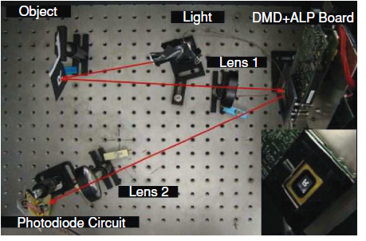
Background
Single pixel camera
The process which include changing DMD pattern and taking signal from PhotoDiode will be repeated until M values are acquired.
Each of these values (output voltage of the photodiode) can be interpreted as the inner product of the desired image x with a measurement basis $Φ\left(m\right)=1, 2, …, M.$
The resolution of the reconstructed image is limited by the pixel arrangement of the DMD.
Notes:
Before introduce this journal contents, I explain what is the storm.
The author used STORM. It is a kind of optical microscopy system.
Here, Stochastic means random blinking. Single-molecule emit fluorescence light.

Slide 5
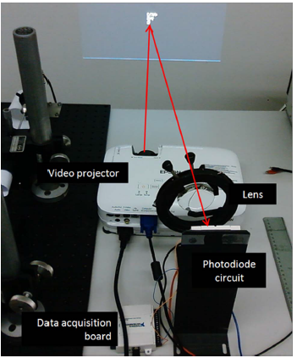
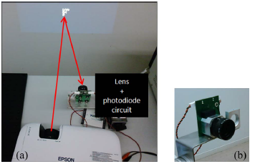
Active illumination Single-pixel camera
Instead of the DMD, Active illumination single-pixel camera setup used video projector to incorporate the random measurement matrix into the system.
Notes:
Before introduce this journal contents, I explain what is the storm.
The author used STORM. It is a kind of optical microscopy system.
Here, Stochastic means random blinking. Single-molecule emit fluorescence light.

Slide 6
Active illumination Single-pixel camera
The video projector was used to project the result of the product between the image to be reconstructed and the random measurement patterns.
Each of the output voltages of the photodiode amplifier circuit is representative for the inner product between the pattern used for that measurement and the image to be reconstructed.
Notes:
Before introduce this journal contents, I explain what is the storm.
The author used STORM. It is a kind of optical microscopy system.
Here, Stochastic means random blinking. Single-molecule emit fluorescence light.

Slide 7
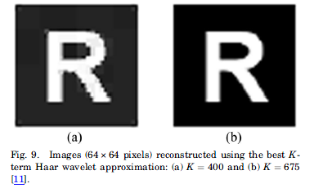
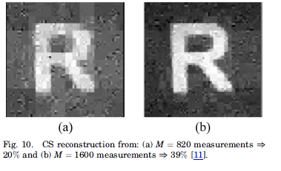
Result
Traditional Single-pixel camera(Rice university version)
Haar wavelet
Ideal image with 64*64 pixels

Slide 8
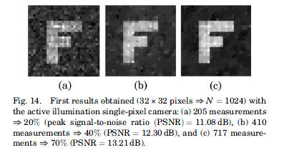
Result
Active illumination single-pixel camera
Sharp edge was increased when use active illumination single pixel camera.
This system is cheaper and more compact than Rice university one.
It doesn’t need active illumination source.

Slide 9
Thank you

