Slide 1
Faster STORM using compressed sensing
Lei Zhu et al.
Nature method. (2012.04)
Presenter : Eunseok Jung
GIST, Dept. of Mechatronics , Bioscopy Lab.
Notes:
Good afternoon everyone~
First of all, thank you for attending my MS defense presentation.
My name is Younghak Shin
Im a member of INFONET lab. at GIST
The title of my thesis is this

Slide 2
Background
STORM (Stochastic optical reconstruction microscopy)
STORM is a super-resolution optical microscopy
technique based on stochastic switching of single-molecule fluorescence signal.
STORM utilizes fluorescent probes that can switch between fluorescent
and dark states so that in every snapshot, only a small, optically resolvable fraction
of the fluorophores is detected.
This enables determining their positions with high precision from the center positions
of the fluorescent spots.
Cited form : http://huanglab.ucsf.edu

Slide 3
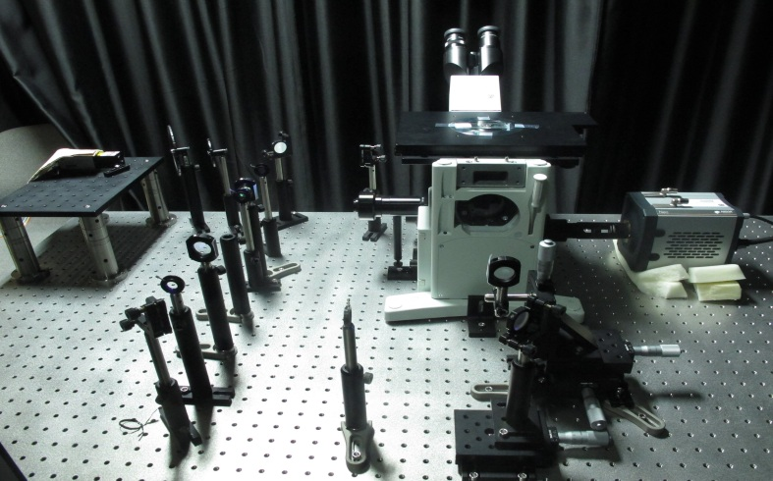
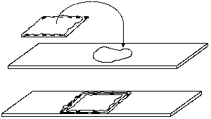
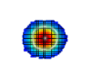
Fluorephore(Yes)
Fluorephore(No)
Matrix(A)
Optic system - LTI
Original Image(X)
Microscope image
-Blurred picture
From : http://www.ruf.rice.edu/
Notes:
[그림 ] 연구 내용 개념도 (2). Compressed sensing을 이용한 시스템 성능 개선

Slide 4
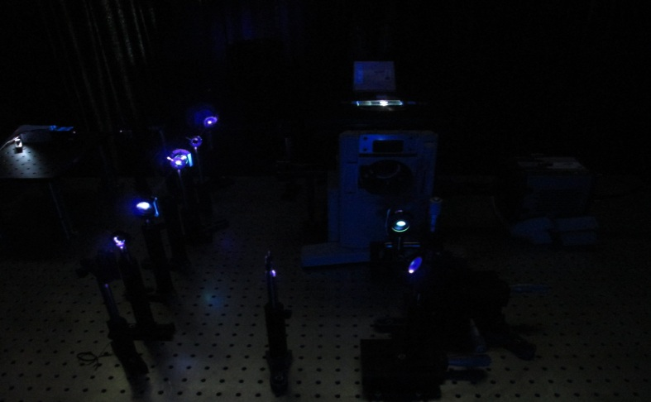
Fluorephore(Yes)
Fluorephore(No)
Matrix(A)
Optic system - LTI
Original Image(X)
Microscope image
-Blurred picture
From : http://www.ruf.rice.edu/
Notes:
[그림 ] 연구 내용 개념도 (2). Compressed sensing을 이용한 시스템 성능 개선

Slide 5
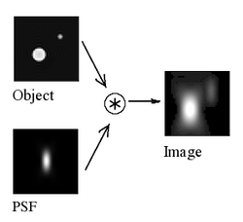
Background
Point spread function(PSF)
The point spread function (PSF) describes the response of an imaging system to a point source or point object.
A more general term for the PSF is a system's impulse response, the PSF being the impulse response of a focused optical system.
From : http://en.wikipedia.org

Slide 6
Introduction & Motivation
Super resolution microscope overcome traditional optical
microscope limit.(According to Abbe’s theory : )
The super resolution microscope and fluorescence technique make spatial resolution closer to the molecular scale.(Approximately : 30nm)
Now we can see a ten nanometer scale cell structure.
$$\frac{Light wave length}{2}\text{≈}\text{200}\text{nm}$$
From : Imaging Intracellular Fluorescent Proteins at Nanometer Resolution, E. Beitzig, science, 2006

Slide 7
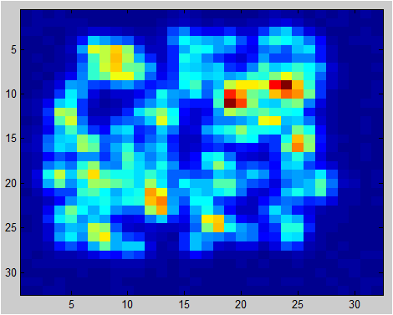
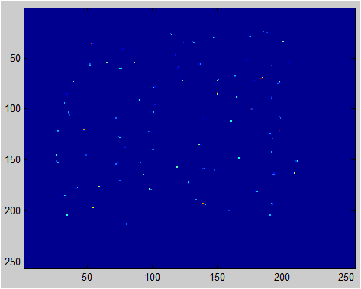
Introduction & Motivation
Benefit of compressed sensing in fluorescence imaging.
C.S.
Algorithm
Microsocpe image
32*32 pixel
High resolution
result
Reconstruction
256*256 pixel
Conventional fluorescence image
Compressed sensing image

Slide 8
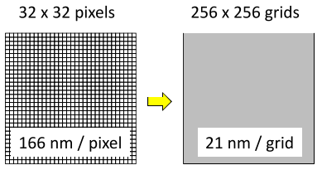
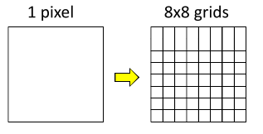
Oversampling
For increasing spatial resolution, the author used grid method.
According to the nyquist theorem, we need 2 times more sampling for reconstruct singal. In here, 21nm*2=42nm.
Finally, the reconstruction image can get a 42nm spatial resolution.
1 : 64

Slide 9
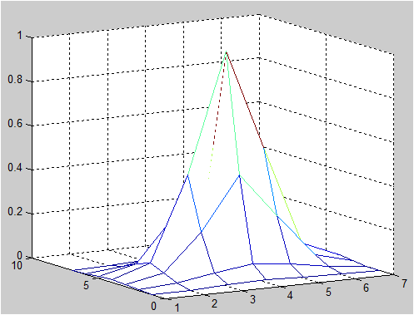
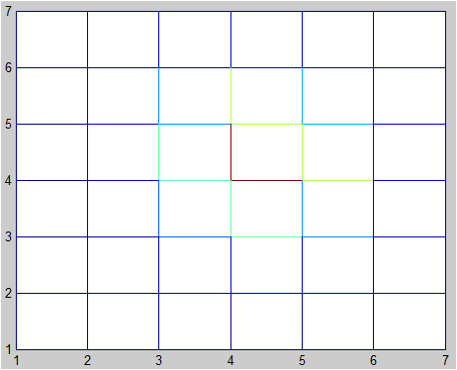
Measurement matrix (1)
Measure the PSF of optic system.
Fit the Gaussian function.
Optic system is LTI system.

Slide 10
Measurement matrix (2)
A$∈R^{MXN}$
(M<N)
x$∈R^{N}$
b$∈R^{M}$
A = Measurement matrix
x = Reconstruct image

Slide 11
Measurement matrix (3)
- Measurement matrix A
A$∈R^{MXN}$
(M<N)
x$∈R^{N}$
b$∈R^{M}$
A = Measurement matrix
x = Reconstruct image

Slide 12
Measurement matrix (4)
- Measurement matrix A
A$∈R^{MXN}$
(M<N)
x$∈R^{N}$
b$∈R^{M}$
A = Measurement matrix
x = Reconstruct image

Slide 13
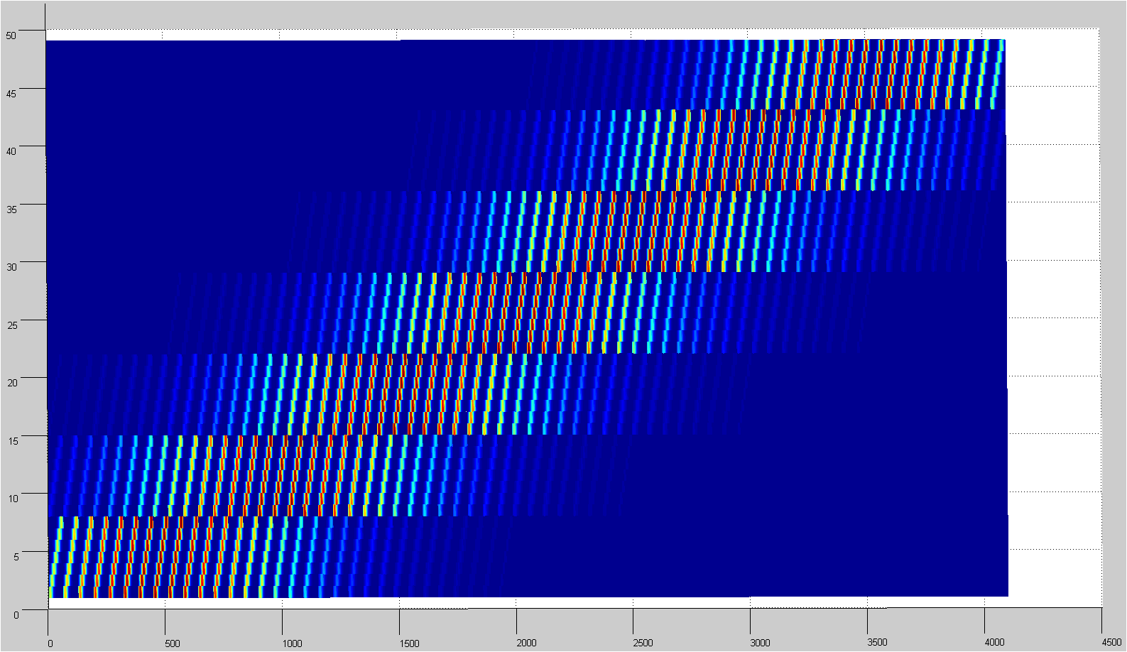
Measurement matrix (5)
64 : 1
A$∈R^{MXN}$
(M<N)
x$∈R^{N}$
b$∈R^{M}$
A = Measurement matrix
x = Reconstruct image

Slide 14
Fluorephore(Yes)
Fluorephore(No)
Matrix(A)
Optic system - LTI
Original Image(X)
Microscope image
-Blurred picture
From : http://www.ruf.rice.edu/
Notes:
[그림 ] 연구 내용 개념도 (2). Compressed sensing을 이용한 시스템 성능 개선

Slide 15
Reconstruction
The matrix A is determined by the point-spread function (PSF)
of the imaging system.
The i ^{th} column of A corresponds to the acquired raw image
if only one molecule emits fluoroscopic photons at the position index i of x.
The weight vector c is to account for the difference of the total contribution
to the camera image from one fluorescent molecule at different locations.
The value of the i ^{th} element of c equals the summation of the i ^{th} column of A.
The minimization term c^{T}x is equivalent to a weighted L1 norm of x
because x is non-negative.

Slide 16
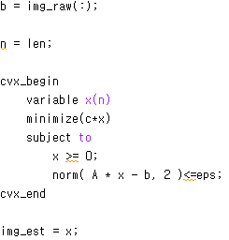
Reconstruction
CVX converts the above problem to an SOCP (Second-order cone programming), and solves it.

Slide 17
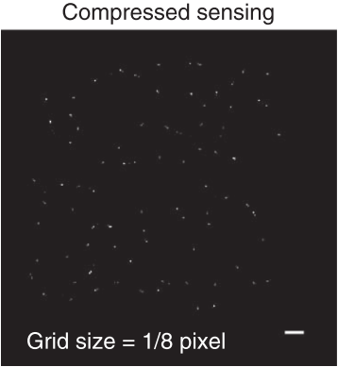
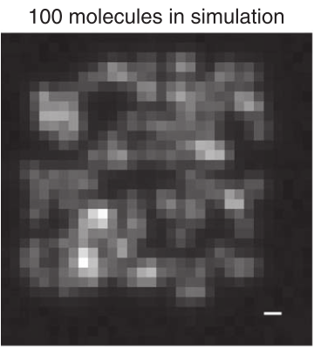
Results
C.S.
Algorithm
Scale bar : 300nm
FOV : 4um*4um
Pixel : 32*32
Scale bar : 300nm
FOV : 4um*4um
Pixel : 256*256
The pixel size of 166nm, the 21nm grid size should be able to support a final image resolution of 42nm.

Slide 18
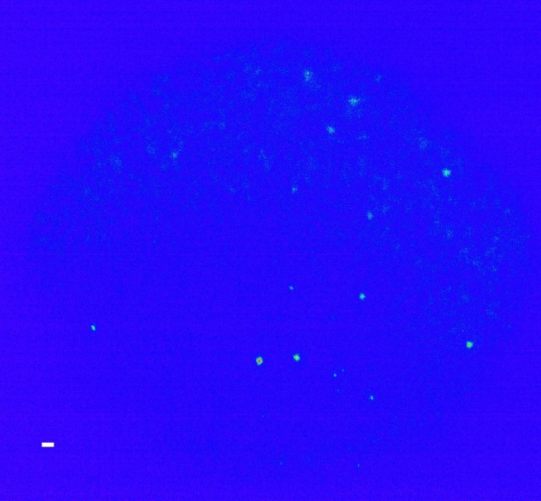
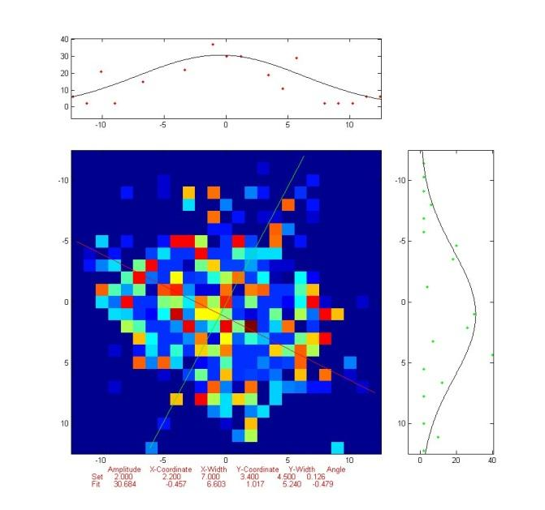
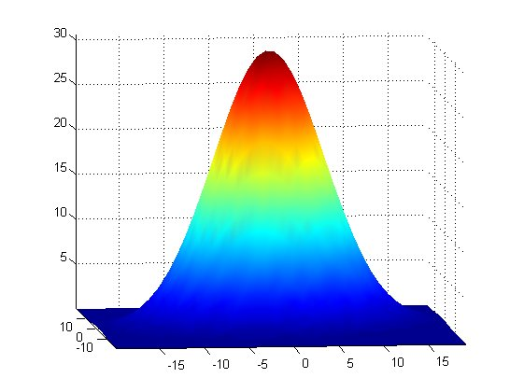
Results
Conventional fitting

Slide 19
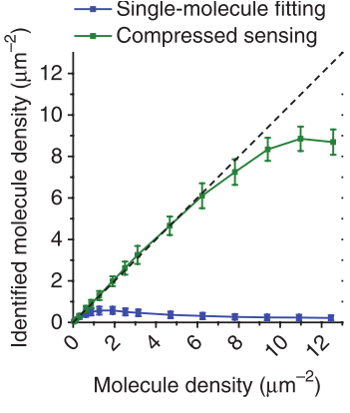
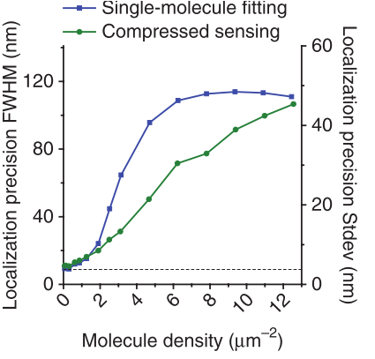
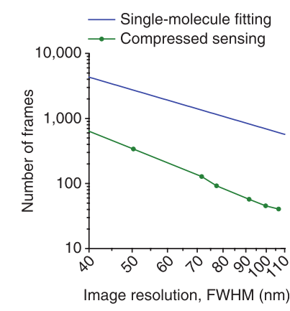
Results

Slide 20
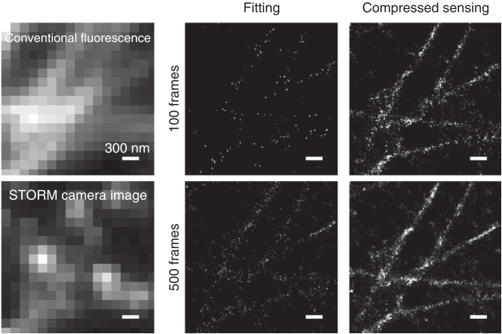
Results

Slide 21
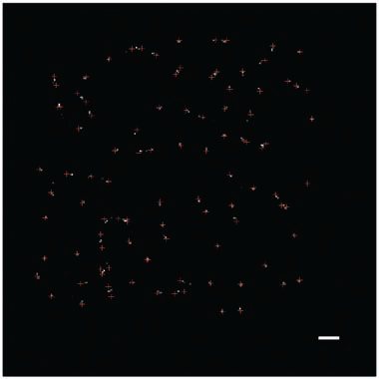
Data Analysis and Discussions
The red-cross is the reconstructed image using compressed sensing
The white one is fluorescence position (original image).
The maximum difference between two positions is 60nm.
Scale bar is 300nm.

Slide 22
Conclusions
Conclusion
This journal has potential benefit. It was first step of compressed sensing with super resolution microscope.
It had not been impossible to taking a living cell image without compressed sensing.
Now, it could be done with compressed sensing.
The author spent 3sec for taking living cell photo. And they get a same result when they spent over 30sec. They decrease experiment time 10times more.
According to this, now we can get a living cell image.

Slide 23
Improvement
Algorithm
If we make measurement matrix A using difference method, we can decrease error and also increase spatial resolution.
The other reconstruction method, instead of SOCP, can decrease error.
Hard ware
The author used EM-CCD camera, it is very expensive detect device.
But if we can make same result using cheap detect device like a sCMOS or
CMOS, the system cost is more cheaper than before.

Slide 24
Thank you

